Slide 1
Statistical anxiety: will qualification focussed student support help?
Rachel Hilliam, Carol Calvert, Emma Steele and Di Haigney
Thursday 12th May 10am
eSTEeM Annual Conference 2022: Scholarship Success Stories – Innovation Through Community

Slide 2
What problem are we trying to solve?
 |  | Year in which study of M248 commenced (Oct)
Qualification-based group | Qualification studied | 2017 | 2018 | 2019 | 2020 | 2021
M&S | BSc (Hons) Mathematics | 61 | 111 | 108 | 137 | 113
 | BSc (Hons) Mathematics & Statistics | 107 | 94 | 119 | 108 | 112
Economics | BSc (Hons) Economics & mathematical sciences | 71 | 59 | 53 | 53 | 66
 | BSc (Hons) Economics | 1 | 3 | 11 | 26 | 75
Data Science | BSc (Hons) Computing & IT with statistics | 17 | 32 | 32 | 33 | 33
 | BSc (Hons) Data Science | 5 | 4 | 18 | 67 | 200
Open | Standalone module study | 23 | 31 | 29 | 36 | 30
 | BSc (Hons) Open | 61 | 49 | 38 | 43 | 40
 | BSc (Hons) Combined STEM | 12 | 28 | 33 | 36 | 45
 | Other qualifications | 14 | 23 | 16 | 22 | 45
Total |  | 372 | 434 | 457 | 561 | 759

Slide 3
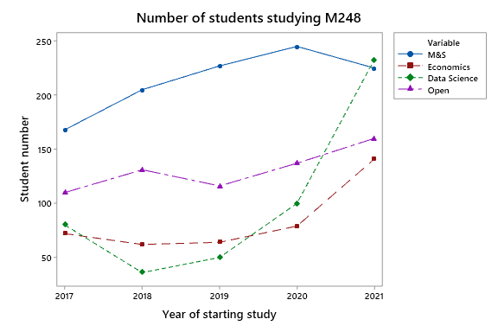
What problem are we trying to solve?

Slide 4

Timeline of project
Review meeting with ALs
Meetings with ALs to explore how qualification-based support could be implemented
Meetings with ALs to review qualification-based support and embed this into business as usual
Student surveys, Feb 2020 and May 2020, to identify units in the module where more support would be needed
Student survey, Dec 2020, to identify impact of qualification-based tutorials
Regular analysis pointing to increase in Economic student numbers and lower pass rate for these students
Summer 2019:
Writing of economics specialist pre module start tutorial materials
Summer 2020:
Writing of limited number of qualification-based tutorial materials
Summer 2021:
Writing of more tutorial qualification-based tutorial material
Oct 2017
Oct 2018
Oct 2019
Oct 2020
Oct 2021
Rewrite of M248 module for Oct 2017
Launch of BSc (Hons) Economics and BSc (Hons) Data Science

Slide 5
Pre-project changes for Economics students
Pre-module start and exam
Material written by an M248 AL who was an economist to offer pre-module support
Handbook of techniques and examples to be used in two pre-module tutorials
First two units available on M&S Study Site, plus conditional access to Minitab and Unit 3
Multiple choice element removed from the exam

Slide 6
Timeline of project
Review meeting with ALs
Meetings with ALs to explore how qualification-based support could be implemented
Meetings with ALs to review qualification-based support and embed this into business as usual
Student surveys, Feb 2020 and May 2020, to identify units in the module where more support would be needed
Student survey, Dec 2020, to identify impact of qualification-based tutorials
Regular analysis pointing to increase in Economic student numbers and lower pass rate for these students
Summer 2019:
Writing of economics specialist pre module start tutorial materials
Summer 2020:
Writing of limited number of qualification-based tutorial materials
Summer 2021:
Writing of more tutorial qualification-based tutorial material
Oct 2017
Oct 2018
Oct 2019
Oct 2020
Oct 2021
Rewrite of M248 module for Oct 2017
Launch of BSc (Hons) Economics and BSc (Hons) Data Science

Slide 7
Changes in Tutorial support
Pilot for 20J
Students assigned to an AL based on their qualification rather than on geography
Introduced core and qualification-based tutorials
ALs with non-M&S tutor groups provide few tutorials in order to spend more time supporting their tutor group

Slide 8
Evaluation of changes in tutorial support
Surveyed students – asked to provide more day time tutorials and more qualification-based tutorials (addressed for 21J)
Used data on access to recordings of tutorials to gauge areas students keep reviewing (more tutorials on these areas for 21J)

Slide 9
Tutorial unit views

Slide 10
Tutorial attendance and viewing
Tutorial type | Synchronous attendance per 100 students | Viewing per 100 students | Divisor
Core | 4.2 | 697.0 | Number of students on M248
Qualification -based M&S | 6.1 | 54.5 | Number of students in the named qualification-based group
Qualification-based Economics | 9.4 | 16.9
Qualification-based Data Science | 11.4 | 224.0
Qualifcation-based Open | 8.2 | 331.0

Slide 11
Timeline of project
Review meeting with ALs
Meetings with ALs to explore how qualification-based support could be implemented
Meetings with ALs to review qualification-based support and embed this into business as usual
Student surveys, Feb 2020 and May 2020, to identify units in the module where more support would be needed
Student survey, Dec 2020, to identify impact of qualification-based tutorials
Regular analysis pointing to increase in Economic student numbers and lower pass rate for these students
Summer 2019:
Writing of economics specialist pre module start tutorial materials
Summer 2020:
Writing of limited number of qualification-based tutorial materials
Summer 2021:
Writing of more tutorial qualification-based tutorial material
Oct 2017
Oct 2018
Oct 2019
Oct 2020
Oct 2021
Rewrite of M248 module for Oct 2017
Launch of BSc (Hons) Economics and BSc (Hons) Data Science

Slide 12
Student feedback
“Compared to previous modules I had studied, M248 was definitely the best in terms of tutor approach, forum discussion structure, efforts to make every student to feel inclusive, being aware that students come from different backgrounds, and reflecting this in tutor groups arrangements as well as specifically orientated tutorials. Thank you.”

Slide 13
Conclusions and our current focus
Contributed to building a sense of community: some of the forums were very active
Associate lecturers really appreciated having time to spend with their tutor group
No need to “encourage” ALs to take non-M&S qualification-based groups in 21J
Possible that the qualification-based approach might help with statistics anxiety

Slide 14
Statistics anxiety
‘…anxiety which occurs as a result of encountering statistics in any form and at any level, involving a complex array of emotional reactions which hinder the learning process.’
(Vigil-Colet et al, 2008 p.175)

Slide 15
Statistics anxiety versus mathematics anxiety
Linguistic & data processing
Uncertainty & inconsistencies
‘Reasonable’ complex extrapolation

Slide 16

Project plan
Extend STARS etc using 6-8 students during summer 2022
Use adapted measure in 22J to identify types of anxiety
Create intervention workshops for use prior to 23J and evaluate effect on statistical anxiety

Slide 17
THANK YOU

