Slide 1


An evaluation of use and impact of zero grades in assessment
Are we being consistent, fair, and transparent?
Project leads:
Fi Moorman & Karen New
Notes:
Me

Slide 2

Assessments in the OU
Fixed deadline
No ‘personal’ aspect
iCMA
TMA
TMA
Potential for extn
Some AL/ST discretion
Notes:
Kjn

Slide 3
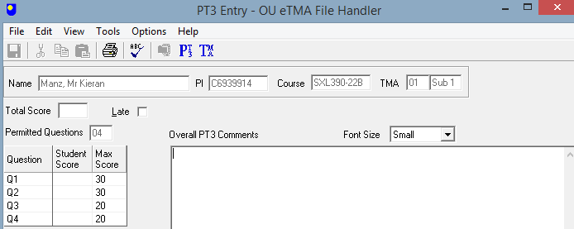
What is an L marker?
Set by the AL on completing the PT3
Notes:
Fi

Slide 4

Who are our students?
There is no typical OU student. People of all ages and backgrounds study with us, for all sorts of reasons – to update their skills, get a qualification, boost their career, change direction, prove themselves, or keep mentally active.
70% of directly-registered OU students work full or part-time during their studies
26% of OU UK undergraduates live in the 25% most deprived areas
34% of new OU undergraduates are under 25
77% of OU undergraduates had no previous HE qualifications on entry
We are the largest provider of higher education for people with disabilities:
36,400 students declaring a disability studied with us in 2020/21.
34% of students had one A level or a lower qualification at entry
https://www.open.ac.uk/about/main/strategy-and-policies/facts-and-figures (March 2022)
Notes:
Fi

Slide 5

What do students see?
2.4.4 Requesting an extension for a TMA If you find that you are unable to submit your TMA before the cut-off date, you can consider requesting an extension. You should contact your tutor in the first instance when requesting an extension of any length. Try to avoid asking for an extension close to the deadline as your tutor may not be available to authorise this at very short notice. You must submit your request for an extension before the cut-off date. If you are asking for an extension on the cut-off date and you cannot contact your tutor, please contact your Student Support Team. Your tutor will decide if the extension can be authorised. If your tutor authorises an extension they will set a new deadline for you for that assignment
2.4.5 Non-scored TMA marking and ongoing difficulties with submission. Occasionally, even when it’s too late to record a score that can contribute to your assessment, or if the extension request is not authorised, your tutor may still think it useful for your assignment to be marked so that you have the benefit of teaching comment
Assessment handbook
76 page document
Notes:
Kjn

Slide 6
Methodology
In partnership with ACQ/data analytics, we extracted all assignments which had L markers applied
Time period: 2018-2021
Only LHCS modules
SDK100 J & B; SXHL288, S295, S290, S215, S350, S248, S294, SK299, SDK228, SK298, S315, SD329, S317, SK320, SXLNM390, S826, S807, S827, S285
SXH810, SD816, SXM810
Considered key demographics
Gender, age, disability flag, ethnicity, WP flag, caring responsibilities
Notes:
kjn

Slide 7

Findings so far…..
18B – 21J presentations
92 L markers applied (& not overturned)
Notes:
kjn

Slide 8
How late is late?
10 SDK100

Slide 9
Total L markers in LHCS by module (as of April 2022)
Notes:
Kjn
Add date of analysis as this might show disproportionate number in 21J?

Slide 10
Characteristics of students receiving L markers
Notes:
Kjn

Slide 11
What happened next?
n = 33 for L1; 58 for L2/3
Notes:
fi

Slide 12
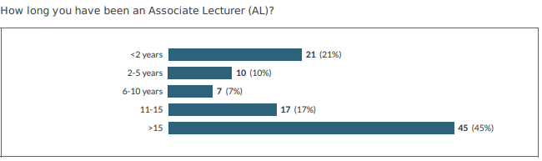
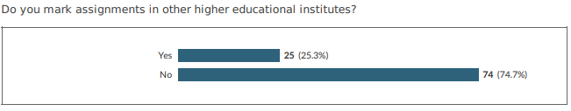
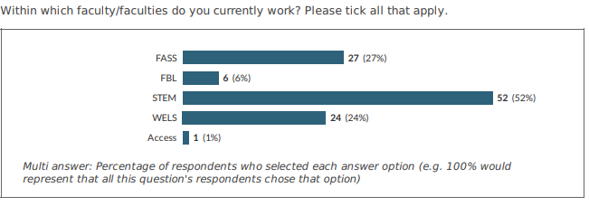
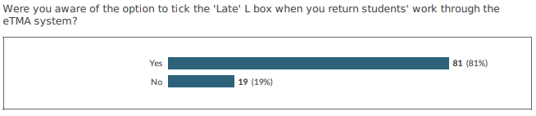
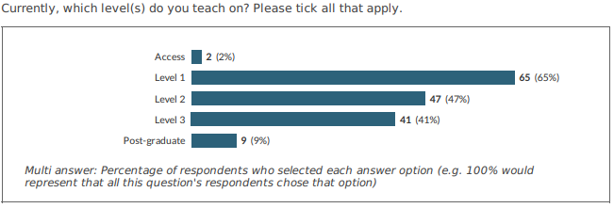
Surveyed a sample of ALs
across University
Notes:
fi

Slide 13
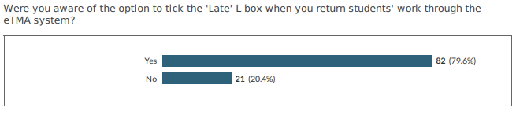
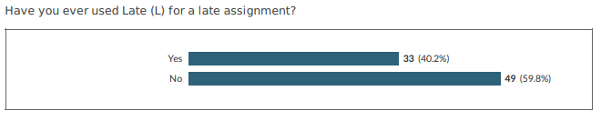
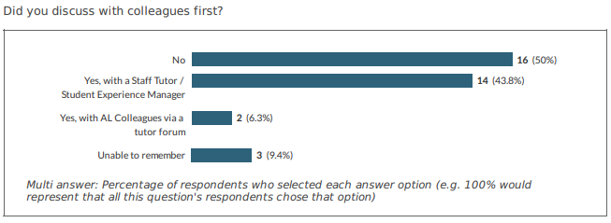
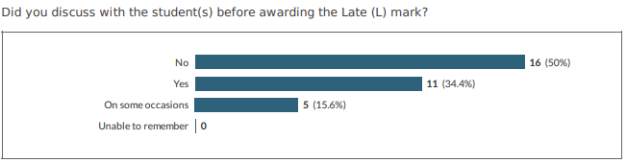
Using / discussing L markers
Notes:
fi

Slide 14

Looking ahead…
Introduction of Wiseflow
Time to take stock
Opportunity to change direction?
Notes:
fi

