Slide 1

Extensions - student use, impact, and implications
Cath Brown & Catherine Halliwell

Slide 2
Project Overview
Why do it?
Increasing numbers of extension requests
  Connection to high intensity study?
  But what is the impact on students?
Research questions
Do students studying at high intensity have more extensions?
How does use of extensions relate to success?
How are students using extensions?
What are the implications for assessment and course design
Implications for supporting non-traditional students
Methods
Statistical analysis and focus groups of students and of ALs
Modules
S294, S295, SDK228, SK299, SXHL288
Health Sciences & Natural Sciences

Slide 3
Who has extensions?
Proportionately twice as many for disabled students as non disabled
More for Health Sciences than Natural Sciences students
Not just low attainers
On a module by module basis, no clear relationship between study intensity and number of extensions
Interesting?
Only 31% of extensions were “official” – recorded on the system
37% of those not recorded (26% of ALL extensions) – were 1 day.
Many of these are likely to be late submissions

Slide 4
Any adverse impact?
Extension requests on TMA 01 can be a sign of struggle
Link with final outcome (drop-out/ fail/pass) shown for four of the modules
S294, SK299, SXHL288 (p < 0.01); SDK228 (p < 0.05)
S295 no link shown (p > 0.1)
Multiple extensions show link with final grade
Total number of extensions shows association with outcome for all five modules (p < 0.01)
But still plenty of students with all grades taking multiple extensions
Total length of extensions an issue for just one module
S294 shows negative correlation (p < 0.05) between total length of extension and OCAS and OES scores
This is the most content-heavy of the five modules

Slide 5
Data – Dropout & Grades S294
 | Drop out |  |  |  |  | Fail | Pass
 | After TMA 1 (53) | After TMA 2 (50) | After TMA 3 (24) | After TMA 4 (3) | Passive Withdrawal (27) | Fail (76) | 40-54 (57) | 55-69 (103) | 70-84 (75) | 85-100 (13)
0 ext | 35.8% | 10.0% | 0.0% | 0.0% | 22.2% | 10.5% | 10.5% | 17.5% | 22.7% | 38.5%
1 ext | 64.2% | 26.0% | 20.8% | 0.0% | 40.7% | 11.8% | 14.0% | 16.5% | 18.7% | 15.4%
2 ext |  | 64.0% | 29.2% | 0.0% | 14.8% | 11.8% | 14.0% | 12.6% | 16.0% | 15.4%
3 ext |  |  | 50.0% | 0.0% | 22.2% | 27.6% | 29.8% | 12.6% | 25.3% | 23.1%
4 ext |  |  |  | 100.0% | 0.0% | 38.2% | 31.6% | 40.8% | 17.3% | 7.7%

Slide 6
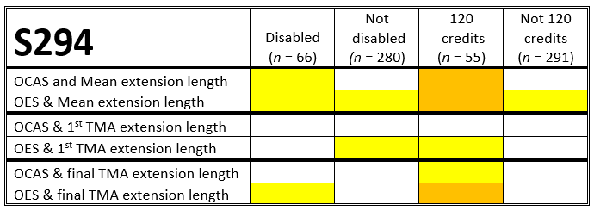
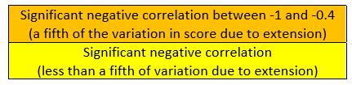
Data – S294 impacts

Slide 7
How are they used?
Not used tactically
No suggestion from either students or ALs that there’s significant tactical use of extension to balance workloads, or to gain other advantages
Disability
AL focus groups highlighted disability as a frequent factor
Less mentioned by students – but student focus is on own circumstances
Time management and workload
Mentioned by both groups
Nature, as well as timing, of specific assessments comes in
Life events
Highlighted as a very common reason by both groups

Slide 8
Recommendations
Students with significant extension on TMA 01
MILLs intervention to prompt discussion of workload and signposting to resources
Could feed into tutor-facing dashboards
Assessment design
Consider timings of assessment points
Look into the balance of report writing/ essays/ problem-solving to see what students find time-consuming
  We suggest gaining further insight from Curriculum Design Panel
Approach to granting extensions
We recommend ALs and STs continue to take a flexible and sympathetic approach when discussing extensions with students

Slide 9
Recommendations
Advice to students
Ensure students are made aware of the benefits of engaging with their tutors to discuss the best strategies
Disabled students
We suggest that scholarship centres, Assessment Policy Group and PVC-Students look at the impact of extensions for disabled students
Extensions policy
The current extensions policy enables students to continue who would otherwise drop out. We recommend the OU continues with a flexible policy on extensions and considers where else similar flexibility might be beneficial.
The data on numbers of “unofficial” extensions should inform this flexibility to avoid adversely impacting students.
OU systems should enable an equitable approach for students and ALs

Slide 10
Thanks for listening!
Any questions?
Cath.Brown@open.ac.uk
Catherine.Halliwell@open.ac.uk
Acknowledgements: eSTEeM, Data & Student Analytics, our project mentor, Rachel Hilliam,
Student Focus Group Facilitator Charlotte Hancox, and our student and AL participants

Slide 11
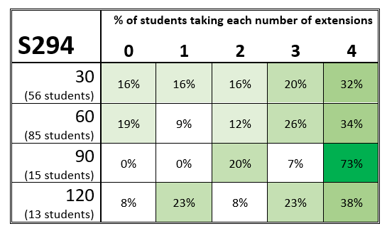
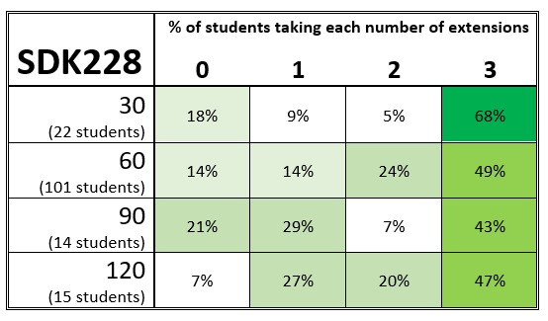
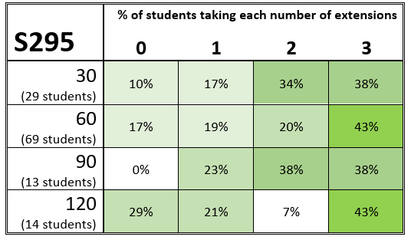
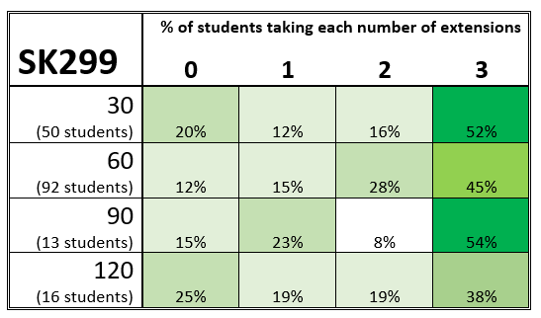
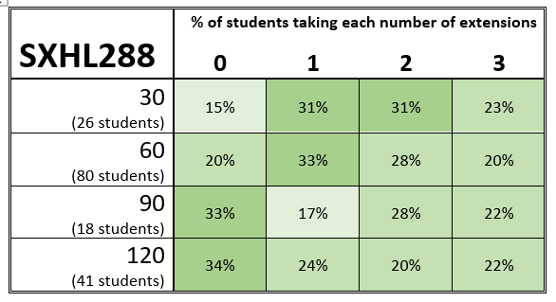
Data –Intensity by Module

Slide 12
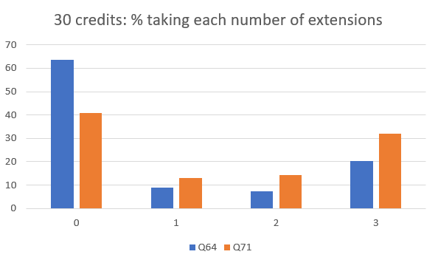
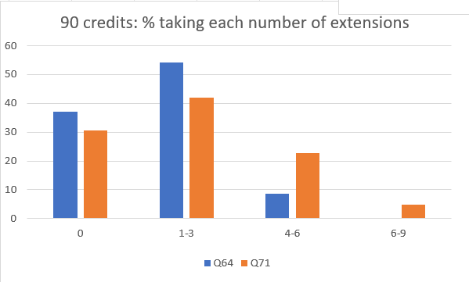
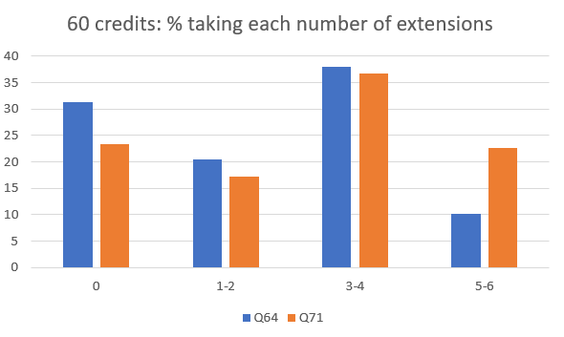
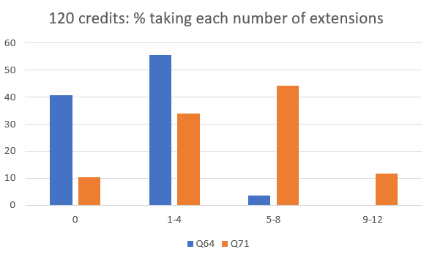
Data – Qualification & Intensity
Q64: n = 124; Q71: n = 225
Q64: n = 46; Q71: n = 62
Q64: n = 166; Q71: n = 291
Q64: n = 27; Q71: n = 68

