Slide 1


Slide 2
The importance of Community in developing the delivery of online labs during the COVID-19 Pandemic
Dr Cate Cropper
Lecturer – Chemistry (CTL)
ccropper@liverpool.ac.uk

Slide 3

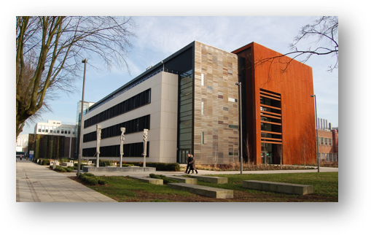
Overview
Who am I?
Why do I think collaboration and community is so important?
“Action stations!”
Mobilising the chemistry lab practitioners
“Oh, we should do that too!”
The birth of Physics LTHE
Output from the community…specifically post-Covid
Replicating the lab community for students online
Lessons learned
Notes:
– synchronous, sustainability, a time for change
Keep post covid for laboratory based teaching

Slide 4
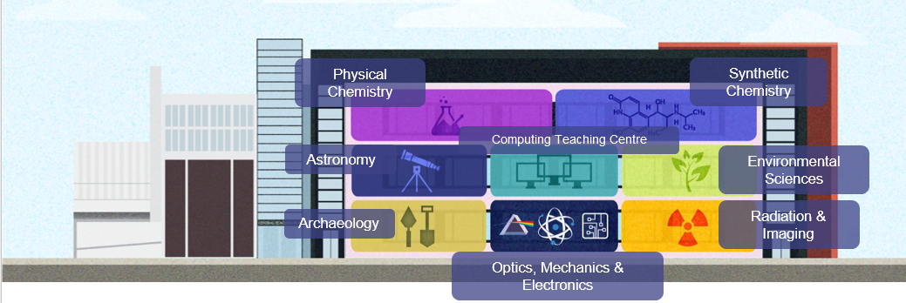
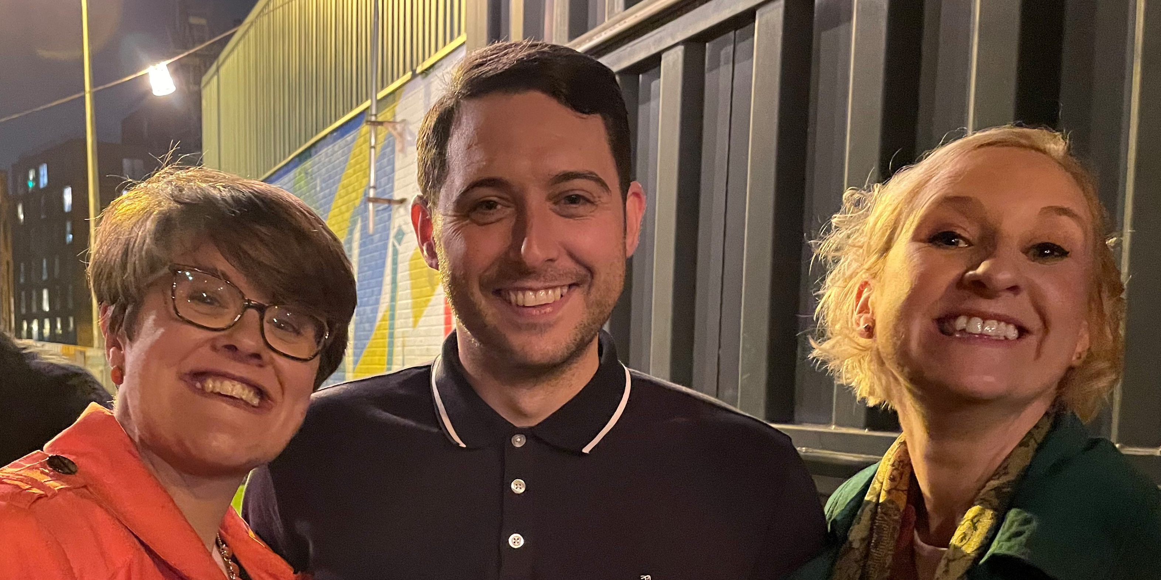
The Central Teaching Laboratories
Operational aims:​
More Space​
Higher occupancy​
New equipment​
Facilities for new teaching activities ​
Academic aims:​
Improved student skills opportunities​
Student project expansion​
Improved student employability​
Pedagogic developments in laboratory learning, teaching and assessment​
Collaboration between disciplines​
Facilitate by CTL academics​
Notes:
Collaboration and community is the backbone of this role –

Slide 5
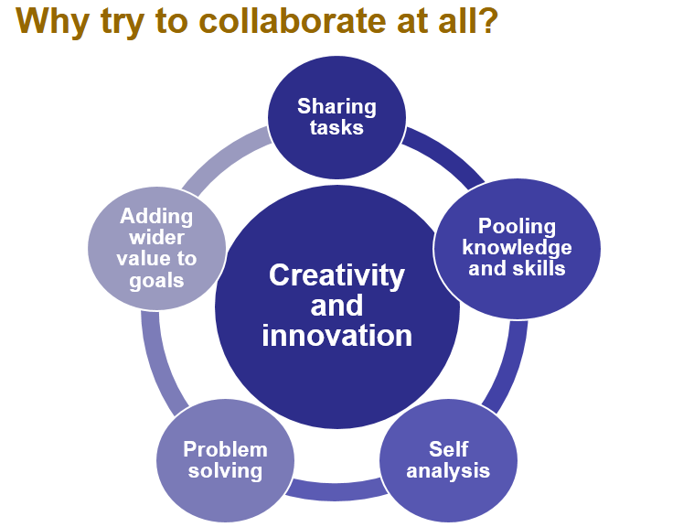

Slide 6
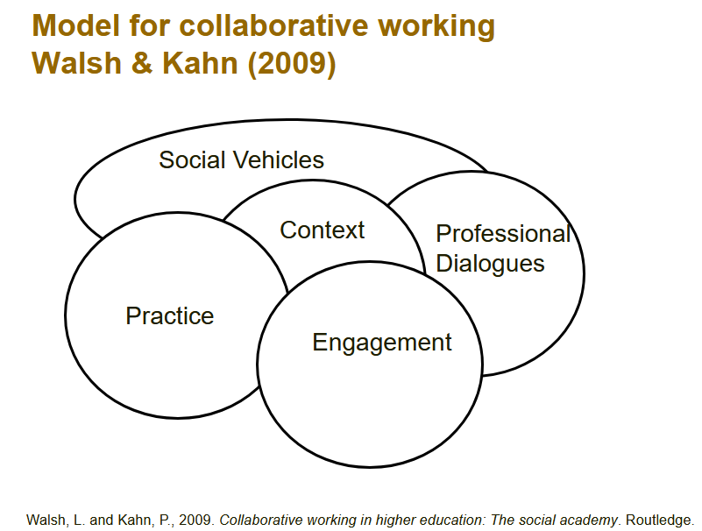

Slide 7
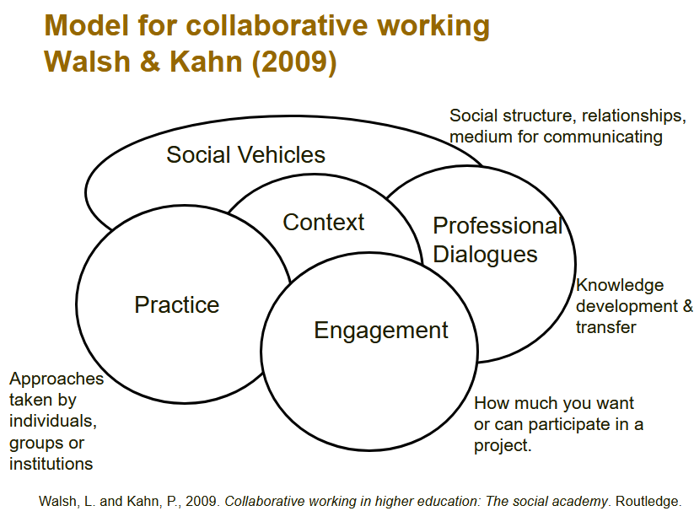

Slide 8
DryLabs, Physics LTHE et al.
Twitter, Zoom
New ways of working
Enthusiasm and a common goal
Taking lab classes online during COVID

Slide 9
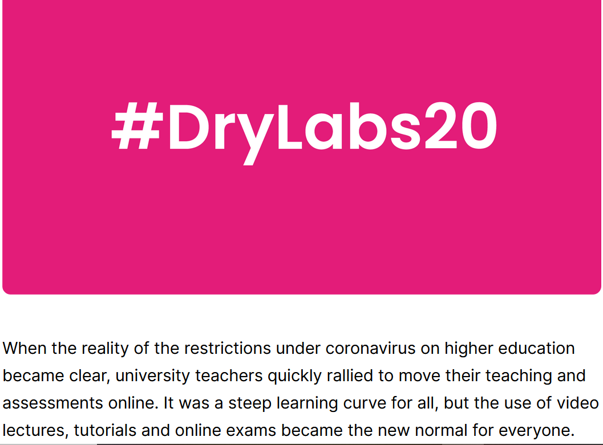
The birth of an online community of practitioners
Biosciences
  #DryLabsRealScience
  Nigel Francis (Swansea), David Smith (Sheffield Hallam) and Ian Turner (UoDerby)
Chemistry
  #DryLabs20
  Malcom Stewart, Craig Campbell and Ben Challen (Oxford)
  DryLabsDownUnder
  Dino Spagnoli (UoWestern Australia)
Chemical Engineering
  Chemical Engineering Hybrid Laboratories
  Tom Rogers (UoManchester)
Physics
  Physics LTHE
  Helen Vaughan (UoLiverpool)
Notes:
However, shifting laboratory-based course components online brought additional challenges, and collaboration across universities became part of the solution. In late April, a group of Chemistry teaching professionals led by Dr Craig Campbell and Dr Malcolm Stewart at the University of Oxford, set up an online meeting and invited interested parties to join them to discuss the challenges of teaching laboratories online.
So was born the #DryLabs20 movement. The first online meeting was attended by 200 people from across the world. Ideas and resources were shared and common challenges identified. It was so popular that new technology had to be employed to allow a bigger meeting second time round when everyone agreed they wanted to meet regularly.
Since then, further communities and websites have been set up to help higher education teaching professionals from various science disciplines that provide a professional space for collaboration and discussion:

Slide 10
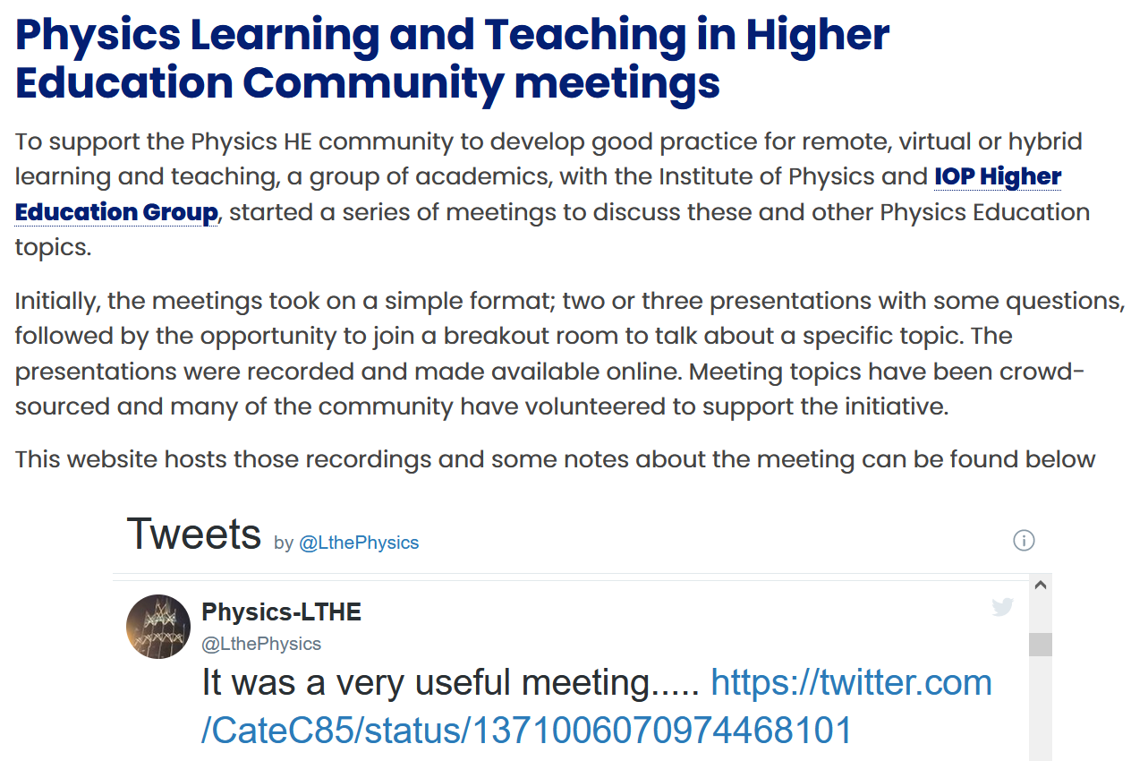
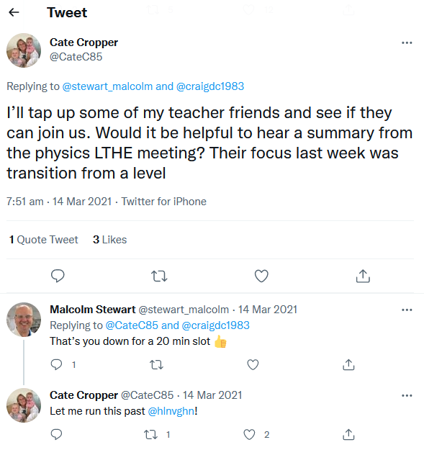
The power of Twitter
Notes:
Cross pollination of ideas and overlapping

Slide 11
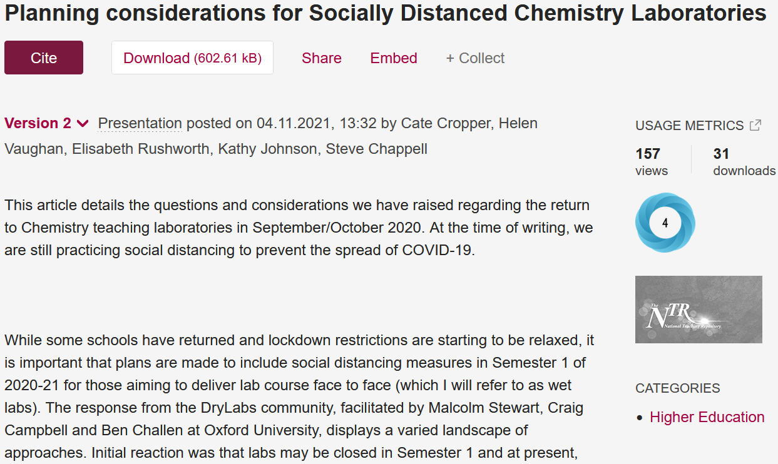
One size doesn’t fit all
Depending on subject, facilities, accreditation requirements etc. lab modules across the country were designed in different ways.
Publications detailing advice for virtual, remote and live labs during the pandemic was made available from various institutions
At the same time, evaluation of this approach was taking place and is now also present in the literature and in the resource links from the communities

Slide 12

Changing Tack

Slide 13
Taking Year 2 chemistry labs online
The aim of this module is to instruct students in
the practice of taking physical measurements,
the critical analysis and evaluation of experimental data,
the application of measurements to the study of chemical phenomena.
Pre-lab activities
Experiment in lab
Marking and feedback

Slide 14
Online Delivery Due to the Pandemic
Prelab activities were a vital resource!
Virtual experiments
  Daily drop-in sessions
  well attended
Canvas discussion board
  not anonymous was a barrier
Millions of emails!!!
Synchronous online marking
  Replicating face to face in the lab marking that gives instant oral feedback
  Dialogue between students and demonstrators
  Written feedback on feedback forms
  Detailed marking scheme and grade descriptors

Slide 15
The NMR Experiment
Delivered synchronously
Students worked in groups of 6 for support and to replicate the social side of labs
A week of online Zoom sessions with demonstrators
This worked much better than in previous years!

Slide 16
NMR experiment infrastructure
Schedule 4 weeks of Zoom sessions (cohort split into 4 groups)
  Seven 2-3h Zoom sessions per week with 2 demonstrators and academic
    Worked synchronously on experiment while in breakout rooms.
Asynchronous group work encouraged on MS Teams
Remote access to University computers was vital!
  Ensures everyone is using the same (version of) software, mitigates issues with licences etc.

Slide 17
What Did the Students Think?
“I have gained greater understanding doing it virtually than I would have if this was done on campus, the access to demonstrators was great. Bouncing ideas of my group members was good too.”
“The discussion with a demonstrator during synchronous online marking improved my ability to write a lab report drastically throughout the year. Going through the results and presenting them in real-time was an incredibly useful exercise.”
“I just wanted to say that I've really enjoyed the sessions put on this week and they have been really useful to help me better understand the software. Working in breakout rooms has also been great as I'm able to get help easily and speak to people I haven't really spoken to before. The demonstrators have also all been really lovely and patient so I was just dropping this email to say thank you to everyone who organised and helped with this experiment! “

Slide 18
What Did the Students Think?
“…9 out of 10 times I really do not enjoy using new software - truth be told I was really dreading this experiment. But having done it, it really was not that bad at all. I genuinely did really feel very supported the whole way, always felt like I had somewhere to turn to ask questions. All demonstrators were really helpful and really knew what they were talking about - and I felt very comfortable asking them questions. I also really like the idea of being in groups that was a really big help. even if I wasn't able to ask them any questions, just being in a group made the whole process more enjoyable. I can’t think of anything you could do to make the experience easier/ make me feel more supported. I also do feel MUCH more confident just using Topspin, this is all coming from someone who really isn't a fan of computer work.”

Slide 19
Hybrid Labs for the future
Reduced number of face-to-face experiments by online delivery of selected experiments - NMR!
  Demonstrator at the touch of a button
Online submission of lab reports
Synchronous online marking for instant formative feedback
Remote access to university computers solves a lot of problems
  Ensures everyone is using the same (version of) software, mitigates issues with licences etc.
  Can conduct live experiments by “remoting in” – used in physics.

Slide 20

There is no “one size fits all” solution
Quality assurance checking – are we aligned?
Social media is a powerful tool
Shared workload? Do we need to reinvent the wheel?
A bank of resources online, freely accessible
Synchronous activities are important to ensure there is time to engage with others
Friends are important
What did we learn from the communities?
“”
Notes:
’.

Slide 21
Thank you
Malcolm Stewart, Craig Campbell and Ben Challen @ Oxford University
Cropper, Cate; Vaughan, Helen; Rushworth, Elisabeth; Johnson, Kathy; Chappell, Steve (2021): Planning considerations for Socially Distanced Chemistry Laboratories. National Teaching Repository. Presentation. https://doi.org/10.25416/NTR.16930120.v2
Teaching practical Analytical Chemistry online: Improving delivery of a Year 2 NMR Spectroscopy Practical, Cropper and Sedghi, SEDA Special on Teaching and Assessing Online Practical Courses, in review.
Sedghi, G. and Cropper, C., Hybrid delivery of practical Chemistry courses using pre-lab tutoring system, in M. G. Jamil & D.A. Morley, Agile learning environments amid disruption: Evaluating academic innovations in higher education during COVID-19, Palgrave Macmillan, in press.

Slide 23
Resources
https://www.lecturemotely.com/copy-of-lab-courses
https://www.gla.ac.uk/schools/chemistry/research/drylabs/presentations/#d.en.738423
https://padlet.com/tomrodgers/HybridLabs
https://www.liverpool.ac.uk/central-teaching-hub/physicslthe/
https://ora.ox.ac.uk/objects/uuid:34490d01-6d7b-44b4-855e-f340086f24e6/download_file?safe_filename=Campbell_et_al_2020_drylabs20_a_new_global_collaborative_network_to.pdf&type_of_work=Journal+article

