Slide 1
Investigating how to enhance the idea generation process for academic projects by engineering students
Martin Braun, Ian Bates, Keith Carter, Joanne Holford and Katherine Kirk

Slide 2

01
Background
02
Creative process
Expertise
Creative skills
03
Ideation toolkit
04
What we found

Slide 3
Background
Section 1

Slide 4
Background
Final year projects
OU business model
  ALs
  No active research portfolio
  ➔ Students need to come up with project idea, method, plan etc
Student proposed
Continuum
Staff
proposed

Slide 5
Creative process
Section 2

Slide 6
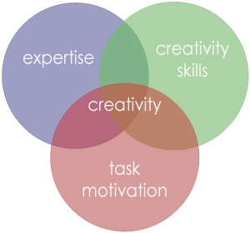
Creative process
Adapted from Amabile (1998)
Notes:
Motivation: Internal vs external (Want to finish my degree)
Schnittmenge: Intersection

Slide 7
Expertise
Most of the time students
study subject related material
Are final year students subject experts?
Litzinger et al (2011):
10,000 h to develop subject expertise
UG degree about 3,600 h
Knight & Botting (2016):
Lack deep subject knowledge to identify
research question
Notes:
A

Slide 8
Creative skills
Other modules teach subject specific
knowledge and skills
Project module needs to support
creative thinking skills
T452: Constructivist
Minimal guidance instruction (MGI)
Not much support in identifying projects
List of previous titles
Something that interests you
Short description of possible topic areas
Kirscher et al (2006): MGI does not work
Hmelo-Silver et al (2007): MGI needs sufficient scaffolding

Slide 9
Ideation toolkit
Section 3

Slide 10
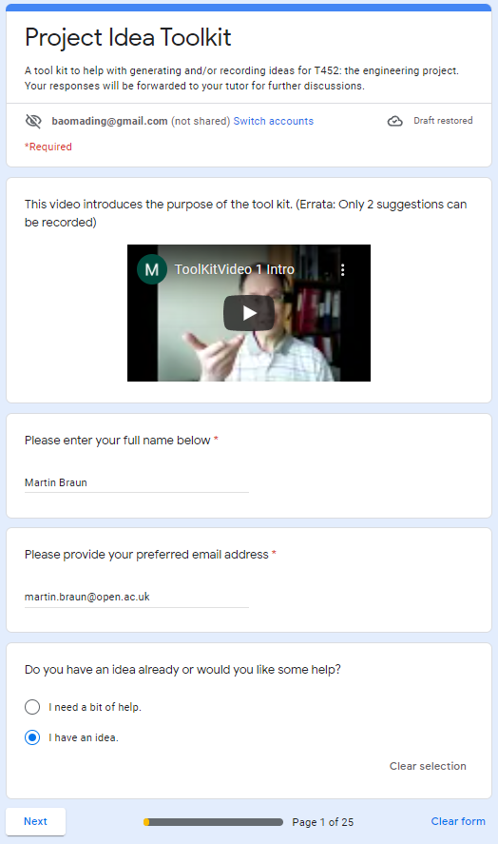
First section: Choose idea or not
Run workshop
to introduce toolkit

Slide 11
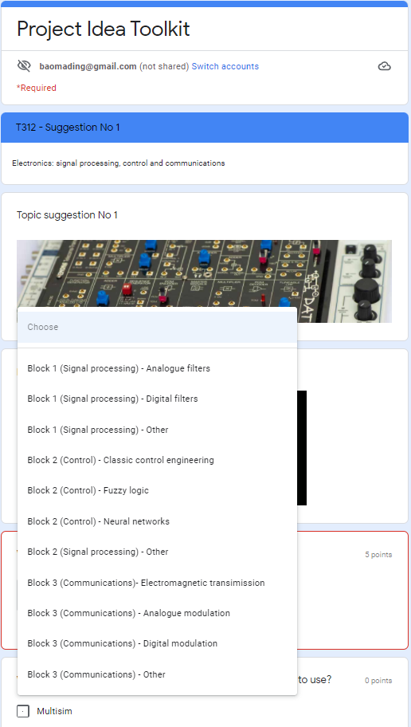
Have idea ➔ Suggestion form

Slide 12
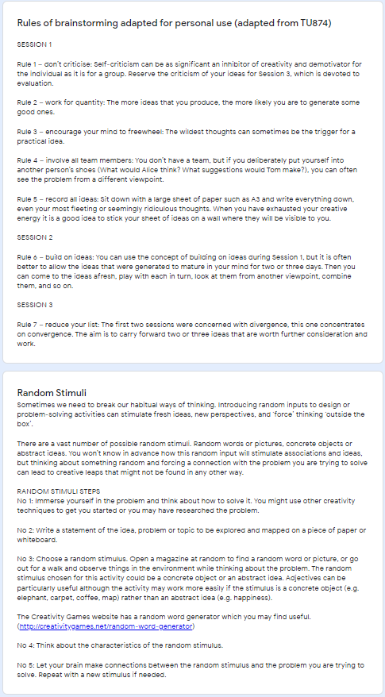
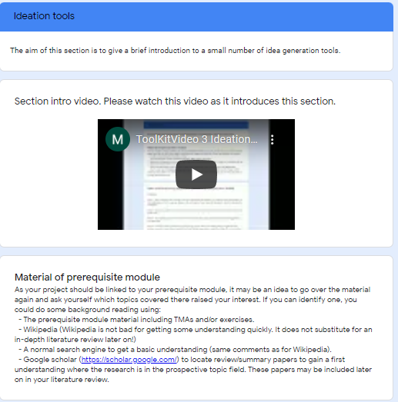
No idea ➔ Ideation section

Slide 13
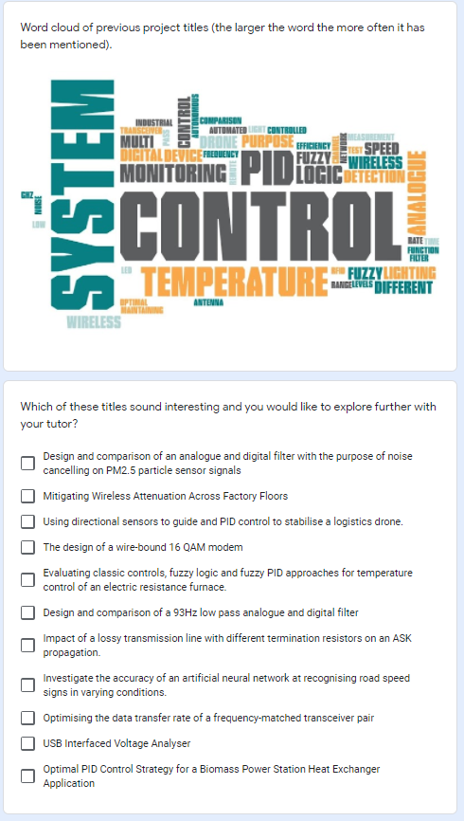
Sample of previous project titles

Slide 14
What we found
Section 4

Slide 15
Studying student ideation
Literature review
Other OU project modules
Impact of workshop (Entry/exit polls)
8 students and five T452 tutors
Questionnaire after workshop
8 students
Interviews with students after proposal feedback received
3 students (also discussion with tutors)

Slide 16
What we found
Workshop:
Only one student had a clear idea
Concerned about level of project idea
Discussion of ideation tools helped develop project ideas
Interviews:
Students benefited from facilitated workshop
Other in same boat, explanation of ideation tools
Students found most of the toolkit useful
Both parts useful, usability needs improving
➔ Project modules need to develop creative skills
➔ Clear guidance to appropriate level

Slide 17
THANK YOU

