Slide 1
Employability skills gained through engagement with practical investigations
Janet Haresnape, SFHEA
School of Life, Health and Chemical Sciences
Janet.Haresnape@open.ac.uk
11th eSTEeM annual conference, May 2022
Notes:
Based on an eSTEeM project
Focus on two main themes:
!. Skills progression through engagement with practical investigations in our Life Sciences curriculum
2. Employability skills – and whether students recognise them as such

Slide 2

Strengthening activities which relate to employability
Increased awareness in HE of importance of ensuring curriculum equips students with employability skills.
Experiential learning activities (Kolb, 2015) – including practical work – help students to develop crucial skills (e.g. reflection, evaluation, self-confidence, patience, perseverance, resilience)
Hence importance of including practical activities within curriculum – for improving student employability.
2
Notes:
Within the HE sector, there is increasing awareness of labour market detail, and student expectations.
Ensuring that curriculum equips students with appropriate employability skills is therefore of strategic value to HE institutions
Is also valuable and relevant to their students.
Hence HE institutions have striven to develop and strengthen activities which relate to employability.
Experiential learning activities – activities in which students learn through experience - include practical activities – and help students develop crucial skills
Engaging with practical activities can improve employability by helping students develop skills which are important for the workplace.

Slide 3
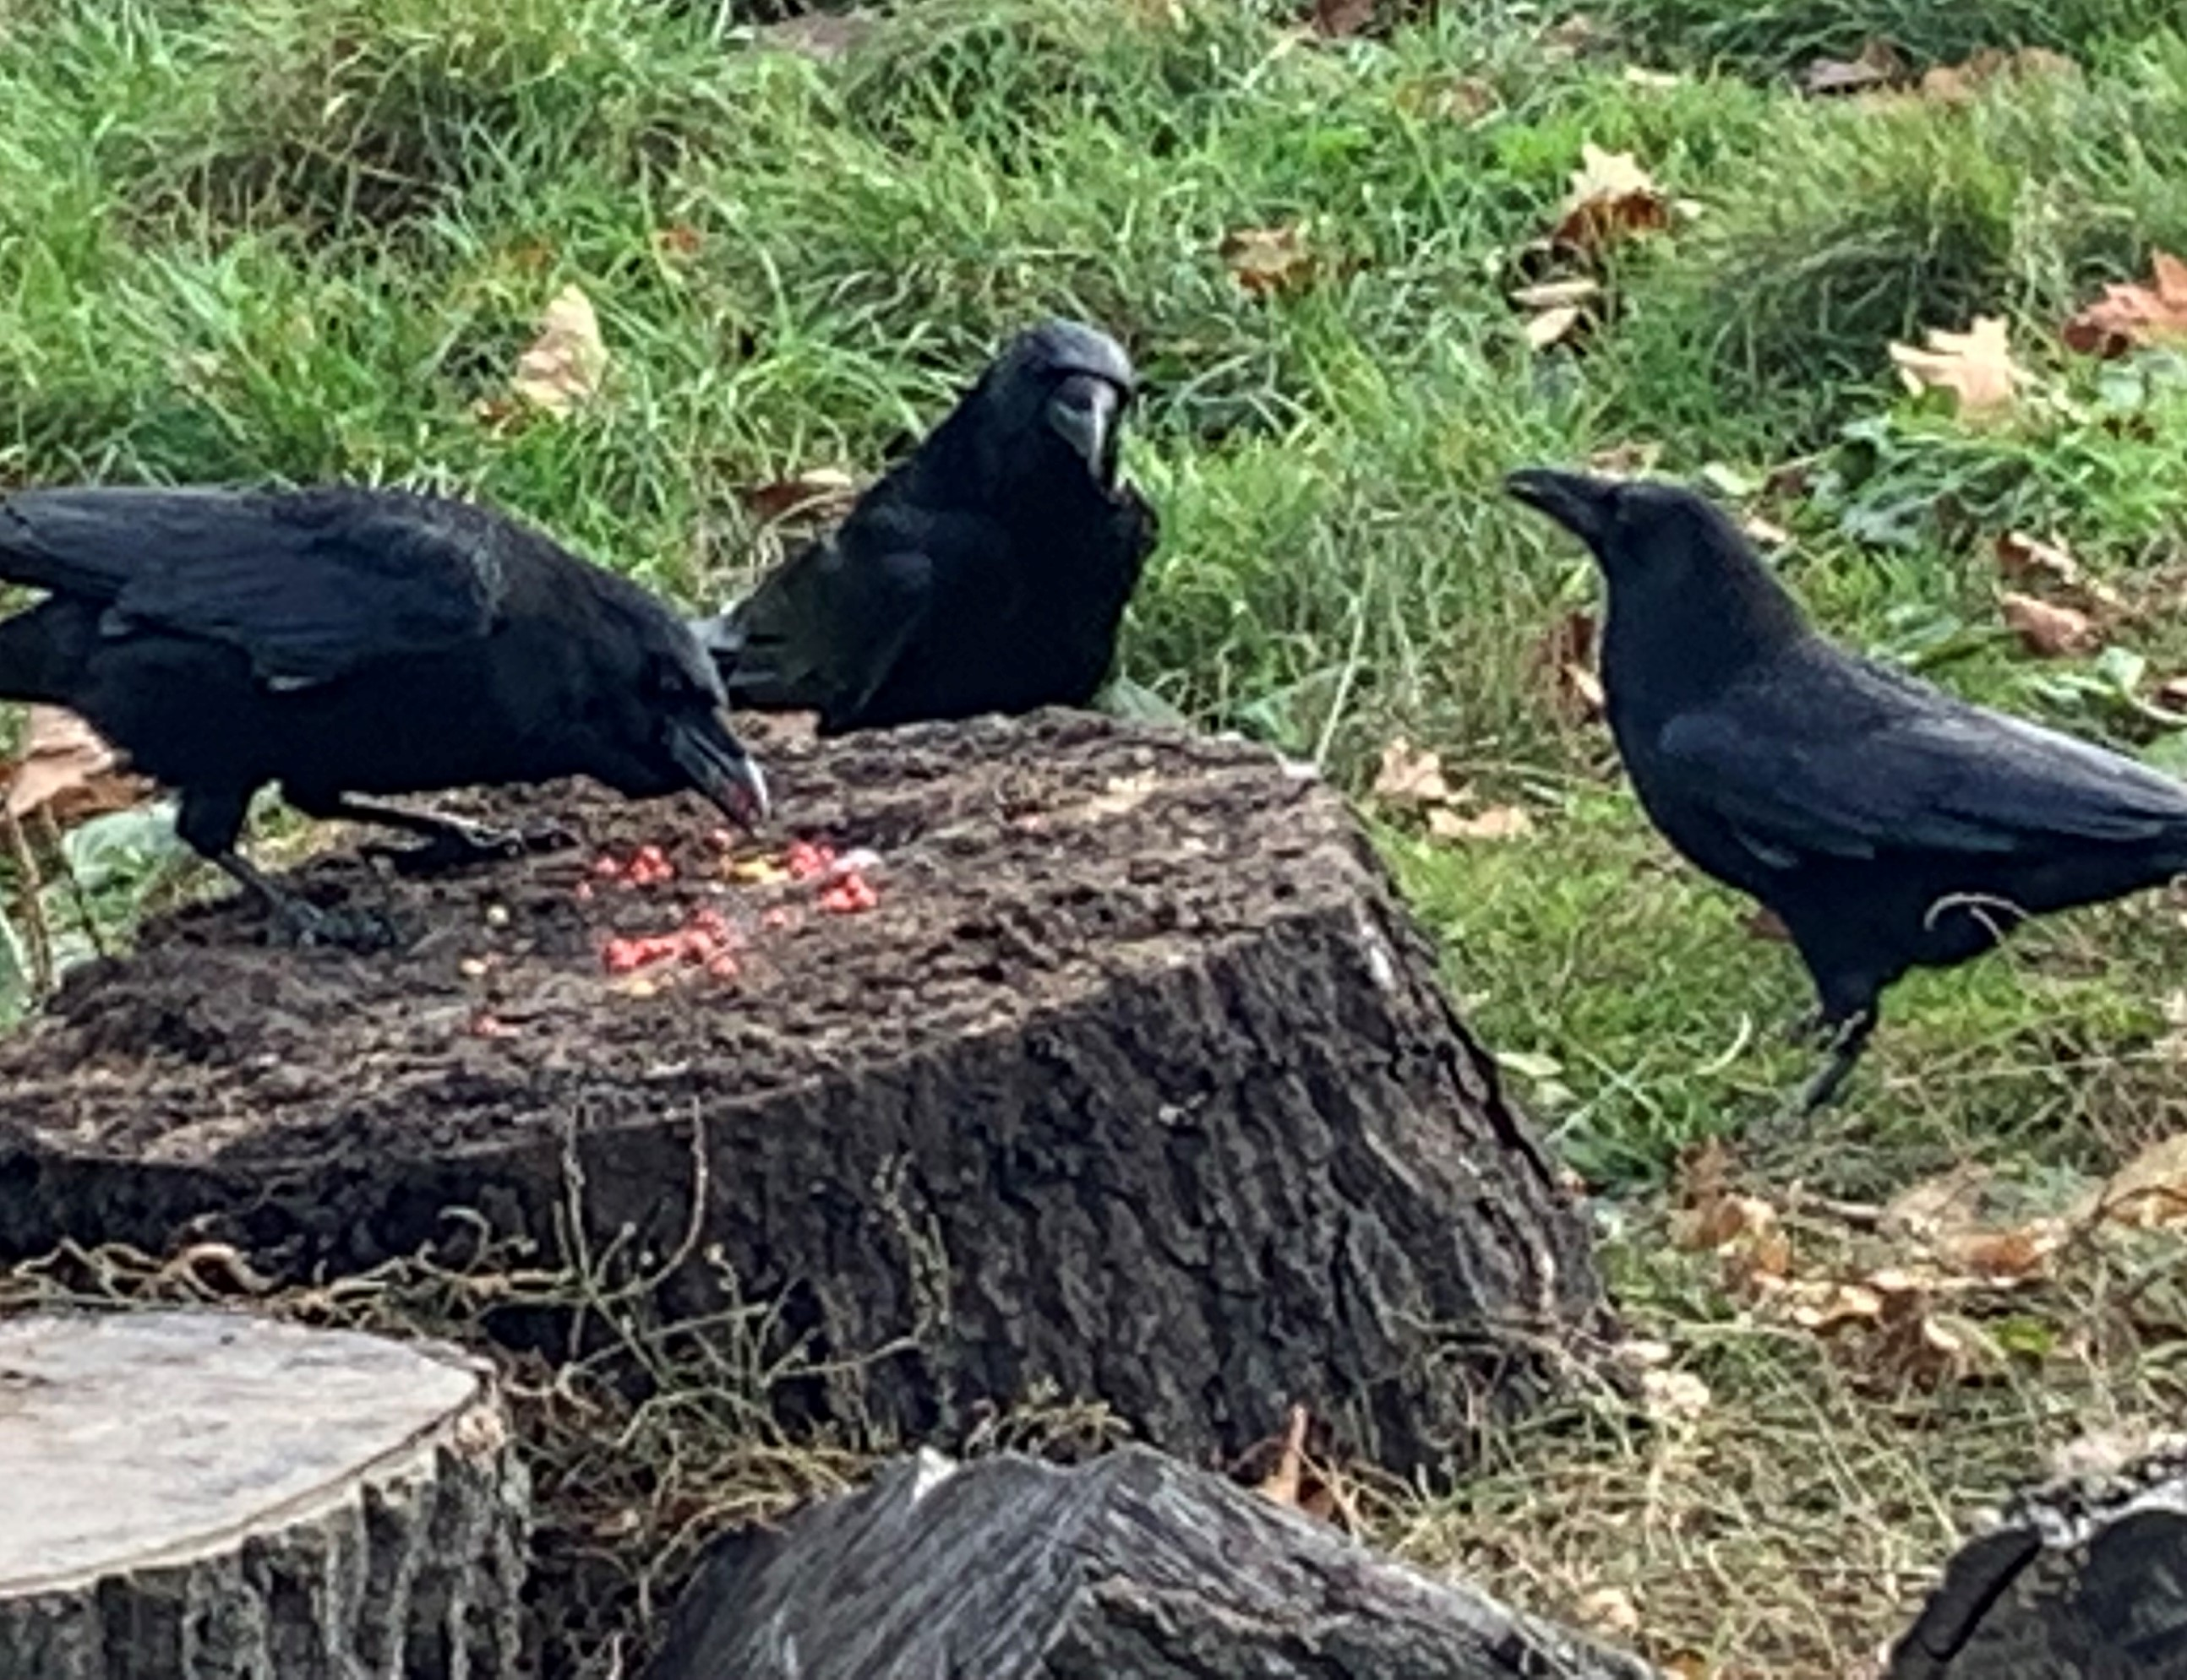
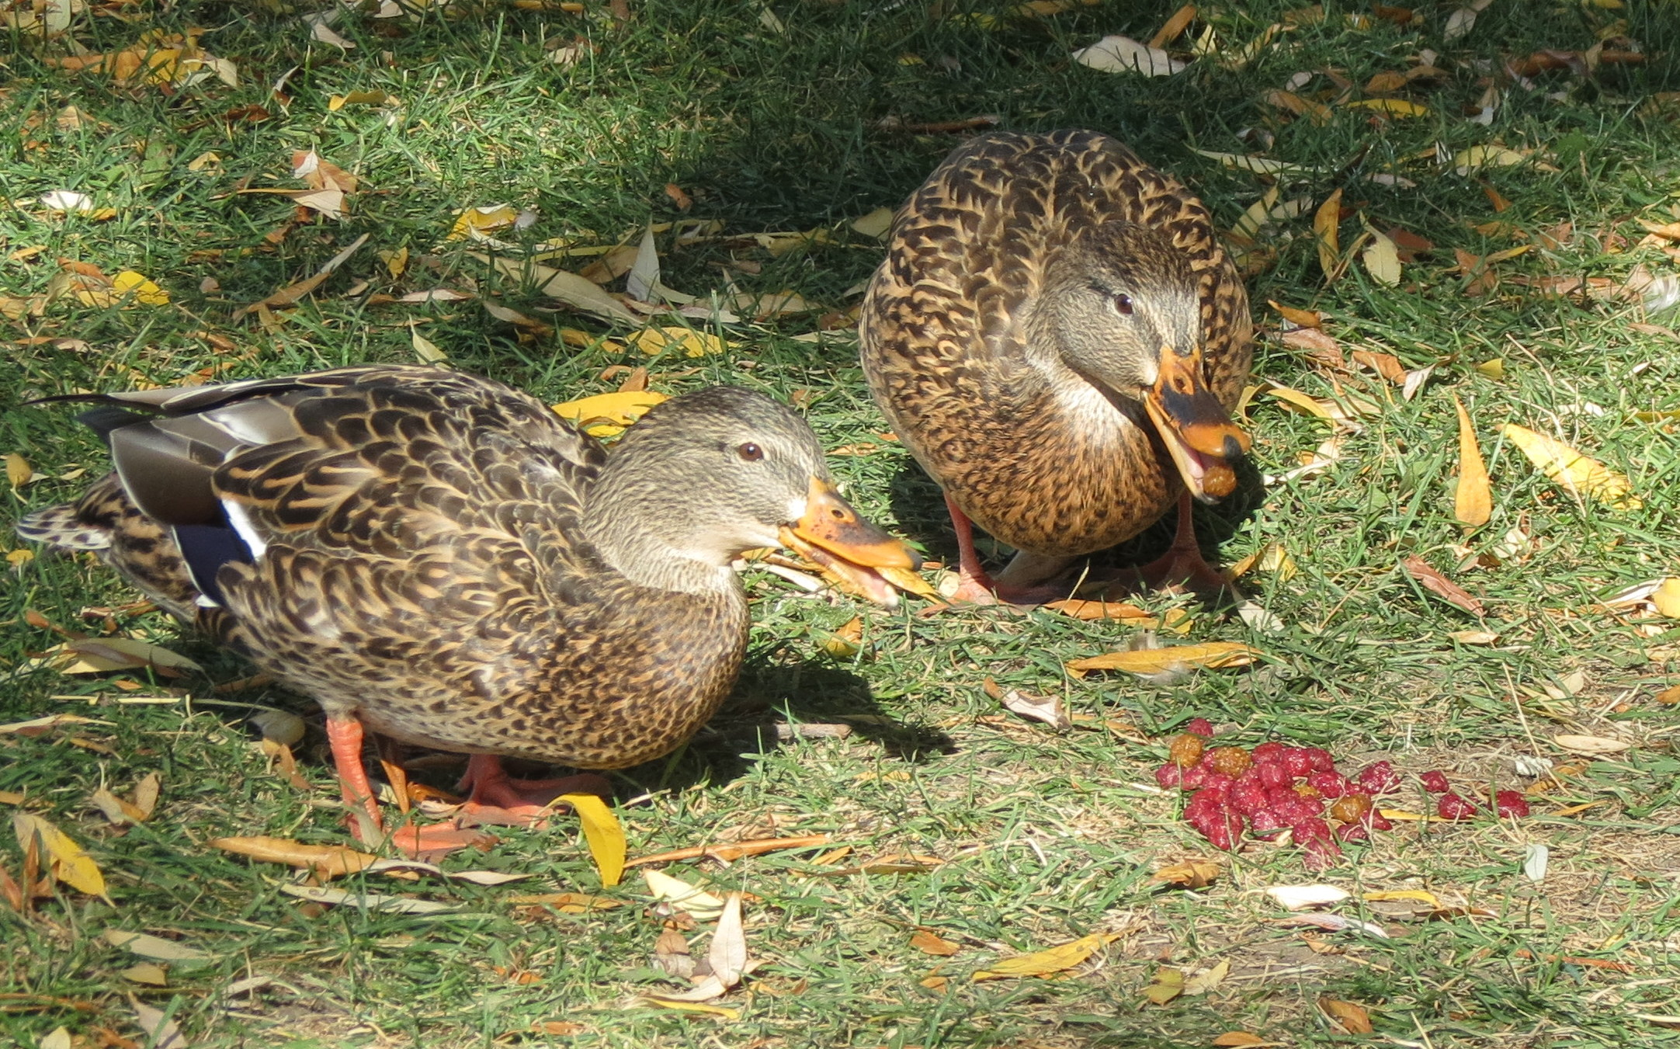
OU Life Sciences degree – practical skills progression
Previously practical skills were addressed at residential school. Now we have to incorporate them in other ways:
Open Science Lab (OSL)
Practical investigations undertaken at home
Focus here is on one particular practical investigation (bird visual discrimination) in the OU Life Sciences Degree
Introduced at Level 2 (S295)
Revisited at Level 3 (S317) – students design and carry out their own follow-up investigation
3
Notes:
Here the focus is on one particular practical investigation which Life Sciences degree students at the OU undertake - an investigation which is introduced in one module at Level 2 where students follow a set protocol, and revisited at Level 3 where students design and carry out their own follow-up investigation.
I’ve included some photos supplied by different students of the birds they used in their investigations, where they are supplied with red and yellow dough balls, in different proportions, to explore the extent to which the birds discriminate between them.

Slide 4
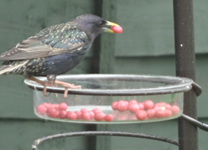
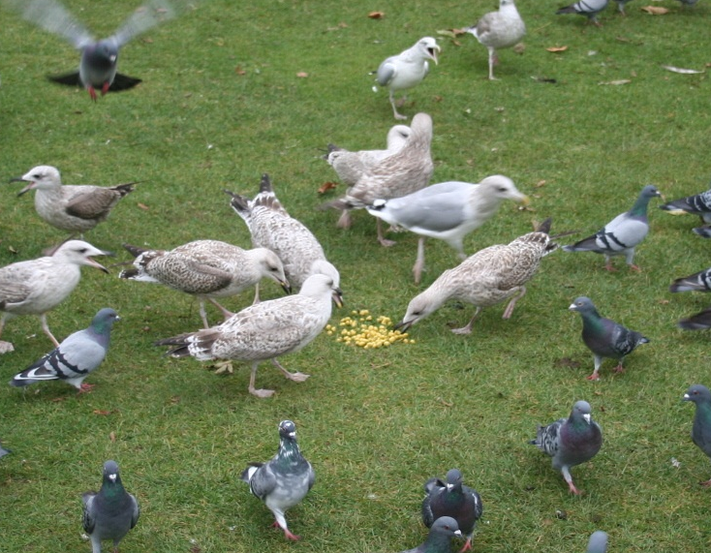
Survey of students who had completed both modules
Survey explored two aspects:
Development and progression of students’ practical and problem-solving skills
Students’ articulation/grasp of these as employability skills
4
Notes:
This presentation focuses on the results of a survey of students who had successfully completed both modules.
The survey explored to what extent they had (i) developed and progressed practical and problem-solving skills by undertaking these practical investigations and (ii) could articulate these as employability skills.
Details of how the survey was undertaken have been reported previously, so I’m not planning to go into much details here, but just to note:
Only students who had passed both modules were invited to take the survey – and the results reported here are based on the 22 out of 88 student who responded – 25% response rate – so based on a narrow demographic. But the responses covered a good range of views.

Slide 5
Survey results and conclusions
1. Development and progression of students’ practical and problem-solving skills
Main conclusions:
The initial and follow-up investigations had helped students to progress their practical and problem-solving skills
Many found the investigations satisfying/rewarding/thought-provoking, but some were frustrated with/disliked the repetition involved.
A few students viewed the investigations at face value and did not recognise their more far-reaching implications
Revisiting investigation (follow-up investigation) had helped many students with deeper understanding - spiral curriculum model (Bruner, 1960)
5
Notes:
The main themes to emerge from the analysis of the respondents’ comments (using NVivo) were that:
Students reported having progressed their practical and problem-solving skills.
Many found the practical investigations satisfying, rewarding and thought provoking, although some reported frustration with - and dislike of - repetitive work and a few viewed the investigations at face value and did not recognise the more far-reaching skills they were developing.
Revisiting an investigation had particularly helped students with deeper understanding – fits with the ‘spiral curriculum model’ of curriculum design where students revisit a theme and information is reinforced and solidified as they do so – allowing a logical progression from simplistic to complicated ideas.
Am now reviewing the grades obtained by participating students for both modules (still in progress) but it’s looking as if it’s the more high-achieving students who have reported finding the investigations rewarding and thought-provoking, and who recognised their more far-reaching implications, and those who achieved lower grades who reported finding the investigations frustrating and repetitive and viewed them at face value.

Slide 6
Survey results and conclusions
2. Students’ articulation/grasp of these as employability skills
Main conclusions:
Students had developed personal attributes – patience, perseverance, resilience.
A few students viewed the investigations at face value and did not recognise their more far-reaching implications, e.g. didn’t think this would impress an employer.
Half the respondents had equated skills developed with employability skills, but few had articulated these in a job situation
6
Notes:
Main themes continued – in the context of employability
Students had developed personal attributes such as patience and perseverance.
Although most students found the practical investigations rewarding and thought provoking, a few viewed the investigations at face value and did not recognise the more far-reaching skills they were developing. For example, one commented that they couldn’t see any employer being particularly impressed that they had managed to feed wild birds at a park.
Around half the respondents had appreciated the relevance of the skills developed to employability but few had had the opportunity to articulate these on a job application form or at a job interview.

Slide 7
Outcomes of this eSTEeM project
Practical investigations help develop employability skills – this has been made more explicit in the module materials
‘Developing creativity and innovation’ has been added to the module learning outcomes
Online workshops delivered to tutors to help them appreciate the skills students can develop through these investigations
Online sessions planned for students in June/July on ‘Skills for biology’ – covering skills needed for being a field biologist/lab biologist – emphasising how these skills can be developed through engagement with practical investigations in their modules.
7
Notes:
It has now been made clearer to students on the Life Sciences pathway that they are developing crucial employability skills through engaging in the practical investigations within their modules.
An additional learning outcome ‘Developing creativity and innovation’ has been added for the modules involved.
Online workshops have been delivered to Life Science tutors - more are planned for students - to help them appreciate the full set of skills which can be developed through engaging with practical investigations.
Plan to run a series of online sessions for Life Science UG students this summer, after end of J presentations, to include sessions on the skills needed for being a field biologist, being a lab biologist, working in bioinformatics. These will emphasise the importance of patience, perseverance, rigour, etc and the need for repetition in order to gain robust results, and aim to help students to recognise how they are developing these skills through engagement with the practical investigations in their modules.

Slide 8
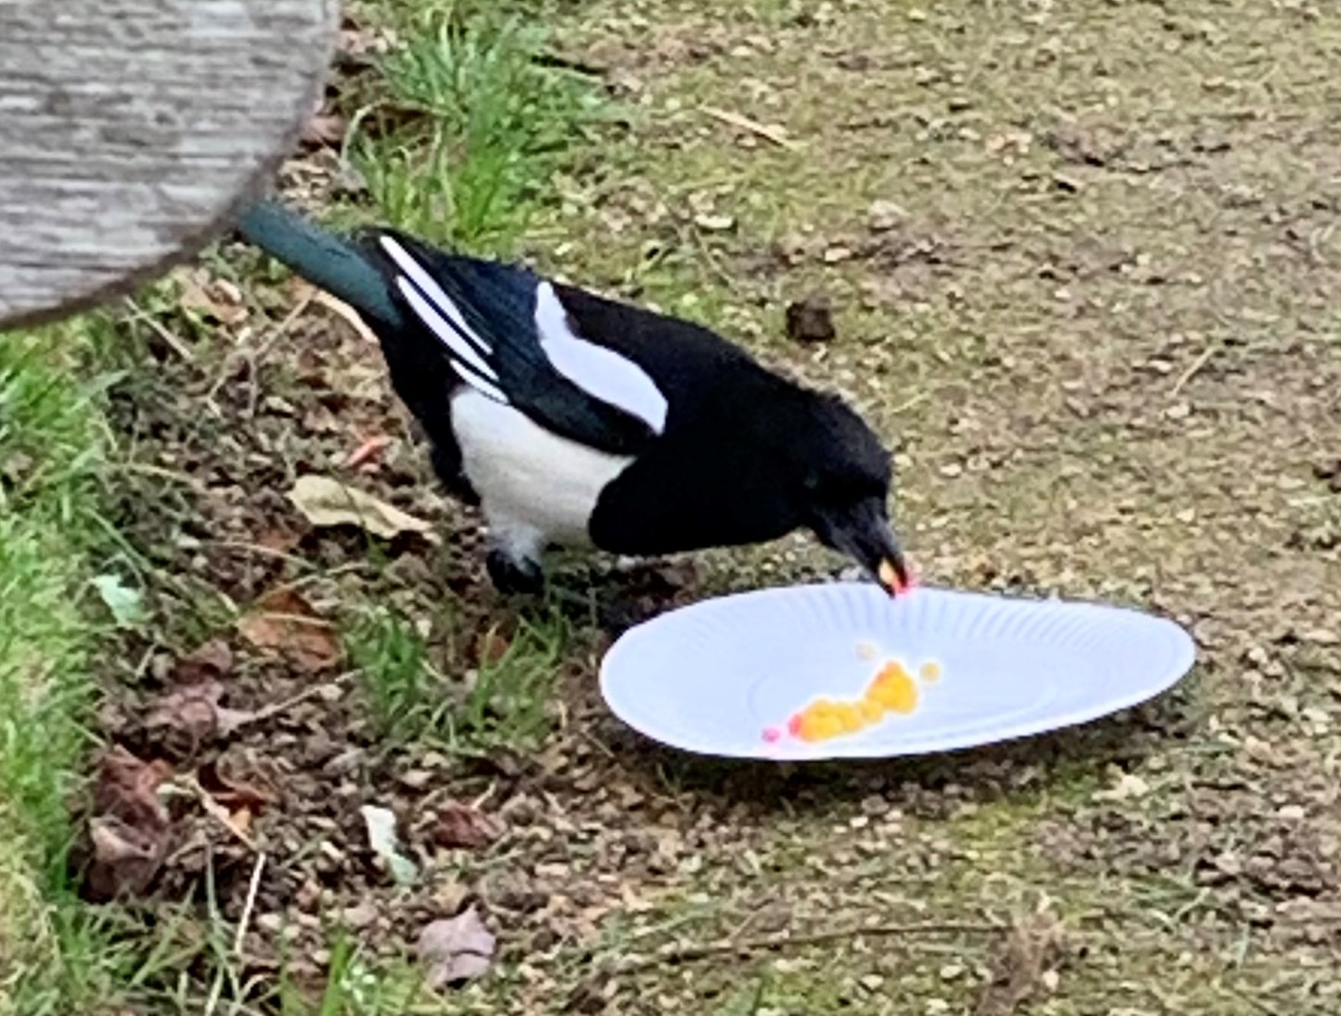
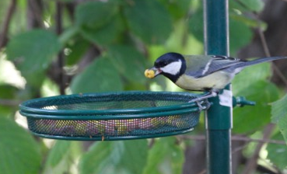
Other modules
Here I’d like to invite participants to consider their own modules, and whether more could be done to make the employability skills students develop more obvious.
In this survey, in answer to the question ‘What could we do to make it more obvious that these investigations are designed to help you to develop employability skills?’ One student simply responded ‘Actually tell us’.
8

Slide 9

Any questions?
Thanks to S295 students Rachel Dally, Kelly Helix, Jan Robertson, Audrone Koc and Agnieszka Kaczmar for photos
Image from Pixabay

