Slide 1
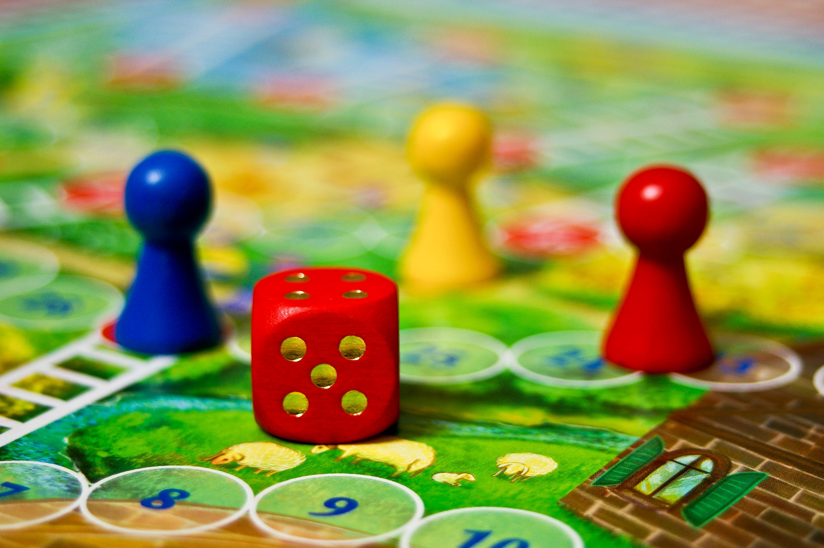

Creating a community of students through social activities
Sue Pawley and Cath Brown
School of Mathematics & Statistics

Slide 2
What are the problems?
Improving retention in Level 1 module that students often find demanding
Address students’ feelings of lack of community in Maths & Stats
Mathematics and statistics students’ feelings about a lack of community were shown in NSS data (2020 figures show 53.2% positive response on the “Academic Community” measure, compared with 58.5% for STEM as a whole and demonstrated in student behaviours on social media, some students do seek a community.
Notes:
Cath

Slide 3
What’s retention got to do with community?
Resilience and a growth mindset important for success¹
Community promotes these so could improve both retention & attainment^{2, 3}
Builds on work from Open Programme⁴, Design & Innovation⁵ and Life Sciences⁶
Notes:
Cath

Slide 4
About MST124
Students on this module are registered on the following degree pathways(red- non maths specific):
  more than 40 students for 21J: Q31, Q64, R38, Q62, R51, Q77, Q36, Q46, Standalone, R28, QD, Q67, Q15, R60
  Less than 40 students for 21J: T14, T13, T42, W77, T12, W43, M06, T11, W42, T09, W36, W82, R53, W34, W37, R30, R62, W13
For 38%(21J) of the cohort are new students, for most qualifications listed in red above it will be the first mathematics module.
Notes:
Sue

Slide 5
What are we doing?
Aiming to create a sense of community amongst MST124 students
Run an initial programme of events – quizzes, talks…
Develop/ enhance this by sourcing ideas from student focus groups
Notes:
Sue

Slide 6
Planned evaluation
Questionnaires
Attendance & in-event retention
Profile of attendees
Notes:
cath

Slide 7
How’s it going so far?
Two events for J and one for B so far; next is joint (this Sunday). Aim for 4 a presentation.
Around half the numbers attend who sign up; 20-50 students
Trying different days of the week and times of day
Different formats – Adobe Connect vs Zoom
Notes:
cath

Slide 8
Initial survey findings
How important do you feel it is to be part of the following communities?
 | disagree | neutral | agree
Studying MST124 | 25% | 14% | 61%
OU Studying the same degree | 27% | 19% | 54%
In same faculty | 35% | 35% | 31%
At the OU | 38% | 38% | 23%
Similar characteristics/interests | 42% | 23% | 35%
All students | 40% | 36% | 24%
How much do you feel part of the following communities?
 | disagree | neutral | agree
Studying MST124 | 39% | 29% | 32%
OU Studying the same degree | 54% | 23% | 23%
In same faculty | 54% | 31% | 15%
At the OU | 62% | 15% | 23%
Similar characteristics/interests | 65% | 27% | 8%
All students | 69% | 27% | 4%
Notes:
Sue

Slide 9
Free text responses
Give details of anything that has helped you feel part of a community on MST124:
  Tutorials/tutor, quizzes, forums and social media
Is there anything that could be done to help you feel more part of a community on MST124?
  I really struggle with anxiety and becoming overwhelmed. At the beginning of studying MST1240 enjoying the number of discord WhatsApp and Facebook groups for students studying at the same time as I was. I have to leave it group as the volume of communication was enormous. I found that students were often weeks ahead of where It difficult to cut through the noise
  possibly enable people to use forums on OU servers specificly for off topic chats
  Very difficult as it is remote, also it's not what I'm looking for from my studies
Notes:
Sue

Slide 10
Next Steps
Focus groups
Plans for next year - extension to other modules/qualifications
Any suggestions?
Notes:
Sue

Slide 11
References
Johnston-Wilder, S. and Lee, C. (2010), Mathematical Resilience, MathematicsTeaching 218.
Cançado, L., Reisel, J. and Walker, C (2018), Impact of first-year mathematics study groups on the retention and graduation of engineering students, International journal of mathematical education in science and technology 49.
Foster, E., Lawther, S., Keenan, C., Bates, N., Colley, B. & Lefever R. (2012) The HERE Project Toolkit: Higher Education: Retention & Engagement. London: Paul Hamlyn Foundation
Cooke, H (2020) What’s next? The series finale, Blog: Celebrating “Open” curriculum at the Open University. Available online:-http://www.open.ac.uk/blogs/openquals/?p=599#more-599
Lotz, N. and Holden, G (2020). Developing a sense of community through cross level engagement between staff and students in creative industries subjects (Scholarship Exchange)
New, K. and Moorman, F (2020) Online journal clubs in distance higher education: an opportunity to develop skills and community?. (Scholarship Exchange)

Slide 12
Questions?

