Slide 1

Tutor and student experiences of marking grids for assessment on a Level 3 interdisciplinary module
Jenny Duckworth & Harriet Kopinska

Slide 2

Inter-disciplinary module
Wide range of skills developed
Issues considered from multiple perspectives
Often ultimate/penultimate module studied

Slide 3
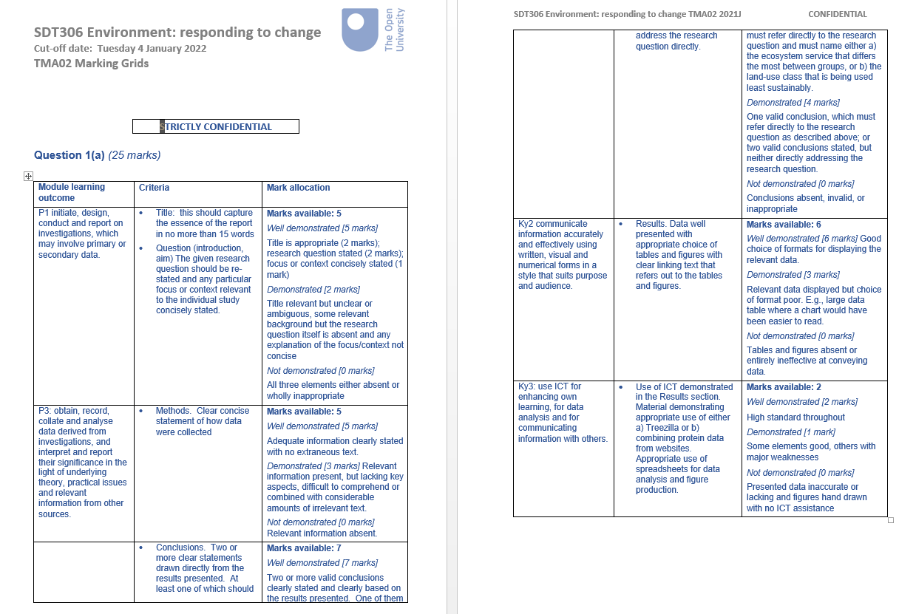
Marking grids

Slide 4
'What is the tutor and student experience of the marking grid approach used on SDT306?'
Aims:
Facilitate application of LO grading scales
Consistency of grading
Giving constructive feedback
Challenges for tutors:
Translation of criteria into scores
Time
Challenges for students:
?

Slide 5
Methods
Survey to tutors and students focusing on TMA02/03 using Likert scale, ordering, yes/no and free text. Student survey piloted by Student Buddies.
13 tutors (60%) and 30 students (17%) completed survey
Semi structured interviews of 6 tutors/students framed around experience of marking grids and learning outcomes.
Quantitative/qualitative analysis.

Slide 6
Results: Students - Time

Slide 7
Results: Students – Future work

Slide 8
Results: Students/Tutors – Learning outcomes
Students
Tutors

Slide 9
Results: Tutors - time

Slide 10
Results: Tutors – applying criteria

Slide 11
Results: Tutors – applying criteria

Slide 12
Tutor comments from survey
Mixed picture so far...
"The marking grids can speed up marking and make it easier to comment on work"
"I don't like it as it involves presenting a lot of unnecessary information in a time-consuming way"

Slide 13
Student comments from survey
Generally positive...
"It's a pretty straight forward way of seeing what I was meant to do, what i did well, and what needs improving"
"The grids give detailed summary of where I went wrong, which I can then relate to the work"
But room for improvement...
"It's often not very clear what I missed doing, and just comments on what I did right. That doesn't always help me understand where I went wrong"

Slide 14
Next steps
Further exploration of quantitative data
Thematic analysis of interview transcripts
Recommendations for SDT306 module team
Wider applicability beyond SDT306?

Slide 15
Any questions?
jenny.duckworth@open.ac.uk
harriet.kopinska@open.ac.uk

