Slide 1

STEM Inclusive Curriculum Project
eSTEeM conference, 11 May 2022
Diane Butler, Associate Dean (Academic Excellence)
Andrew Potter, Deputy Associate Dean (Academic Excellence)
Daphne Chang, Senior Lecturer and Staff Tutor in Engineering & Innovation
Clem Herman, Professor of Gender and Technology
Nicole Lotz, Senior Lecturer in Design
Peter Wood, Associate Lecturer

Slide 2
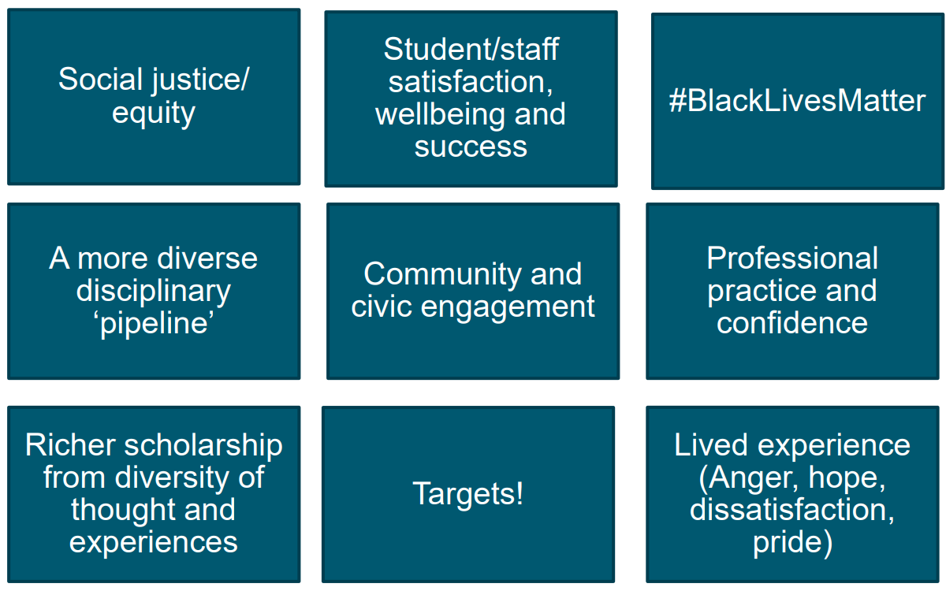
Why build a more inclusive STEM curriculum?

Slide 3



The Inclusive Curriculum Tool
Led by the Access, Participation and Success (APS) Team, developed in collaboration with stakeholders from across the University.
Principles
accessible to diverse groups of students not just in terms of accessibility for disabled students but the language, images, stories and structure used
all students see themselves reflected in the material
the material equips our students to participate in a global and diverse world

Slide 4
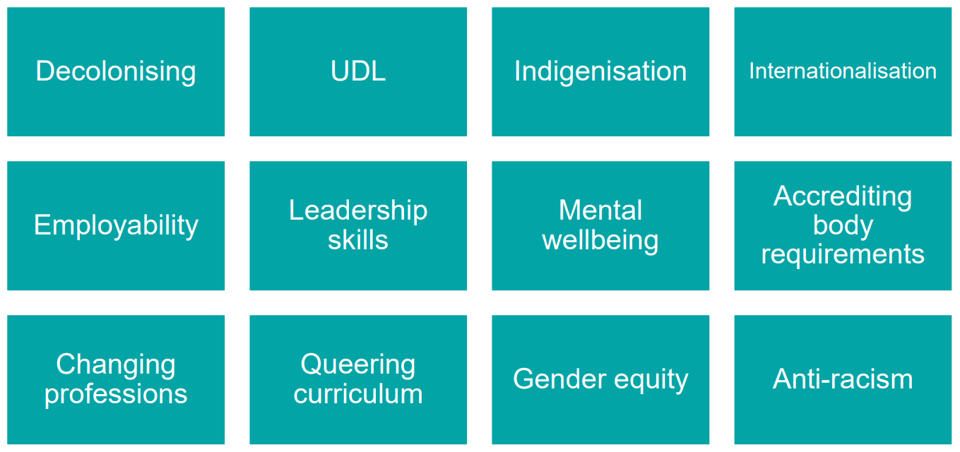
Influences on Inclusive Curriculum

Slide 5
STEM Inclusive Curriculum Project Phase 1
Activities
Outputs
Scholarship
Recruited 15 STEM Associate Lecturers
Reflective Journals
1-2-1 Interviews
Recorded discussions
Training & Workshops
Completed Inclusive Curriculum Tool spreadsheets
Thematic analysis
Audits of 14 STEM modules
Feedback to APS Inclusive Curriculum Team
Meetings with Module Teams
Report for STEM Exec, STEM Boards of Studies

Slide 6
Overview of Initial Findings
Images
Lack of diversity most easily recognised if indeed absent
What implicit/explicit narrative does an image present?
Language
Colloquialisms, cultural assumptions
“He or she” versus “they”
Laudatory adjectives applied to historical figures
Choice of data sets and case studies
Mostly from Western countries
Tendency to portray non-Western countries in “disaster narrative”
Diversity and balance of historical information
Historical development presented from largely Western perspective.
Consequential lack of gender balance and diversity presented without context
Missed opportunities
Small amendments to increase representation
‘Microexclusions’

Slide 7
Key focal points
Being ‘welcoming’
Module introductions are key for developing ‘sense of belonging’
Many modules were identified as excellent in this regard
Assessment
More inclusive content is not often formally assessed, as not considered ‘core’
Is inclusivity ‘core’ to our disciplines?
Inclusive peer interaction
Opportunities noted as limited
This could go beyond representing one’s own demographic to actively encouraging engagement to create sense of belonging

Slide 8
Big Questions
Is an inclusive STEM curriculum one which:
has a local (British) centre/viewpoint which aims to be as inclusive as possible?
has multiple (global) centres/viewpoints from different perspectives?
has no fixed centre/viewpoint (a “view from nowhere”)?
Is the goal of an inclusive STEM curriculum to:
eradicate potentially offensive content?
provide opportunities for each student to see themselves reflected in the materials?
provide opportunities for each student to have their experiences valued?
challenge injustices past and present in our disciplines?

Slide 9
THANK YOU
Questions? Comments?
Andrew.Potter@open.ac.uk

