Slide 1
You can't repeat the past: Community and placemaking in the distributed university.
David White, Head of Digital Education
@daveowhite

Slide 2
“You can't repeat the past.” “Can't repeat the past?” he cried incredulously. “Why of course you can!” He looked around him wildly, as if the past were lurking here in the shadow of his house, just out of reach of his hand.
The Great Gatsby, F. Scott Fitzgerald, Chapter 6.
Notes:
Replace ‘house’ with ‘university’.

Slide 3

http://daveowhite.com/desituated
Notes:
Similarities with STEM

Slide 4
What aspect of ‘post-pandemic’ working do you enjoy the most?
(Answer in text chat)

Slide 5
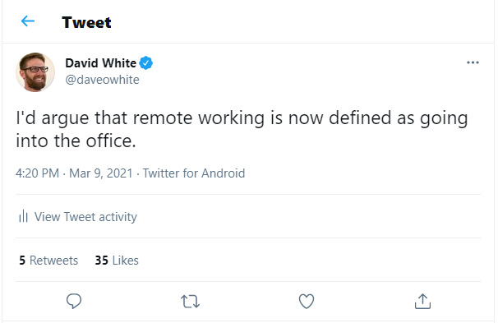
“What do you miss the most when teaching online?”
Notes:
Cultural flip

Slide 6
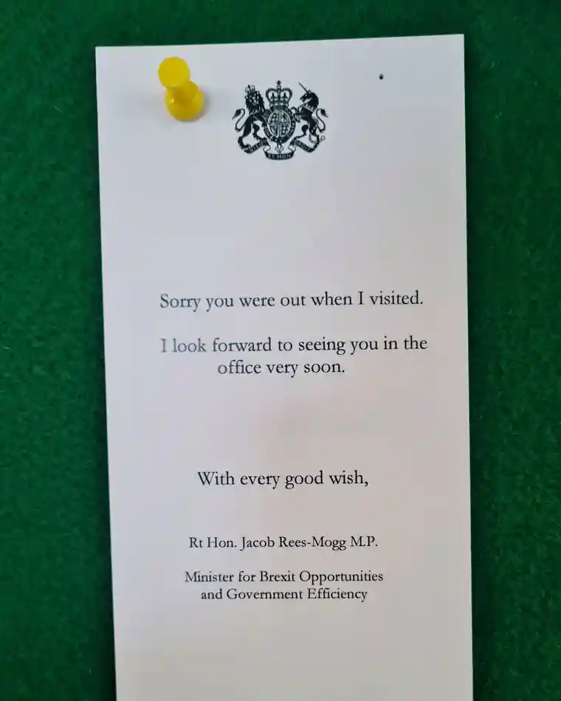
http://daveowhite.com/desituated
Notes:
Culture wars

Slide 7
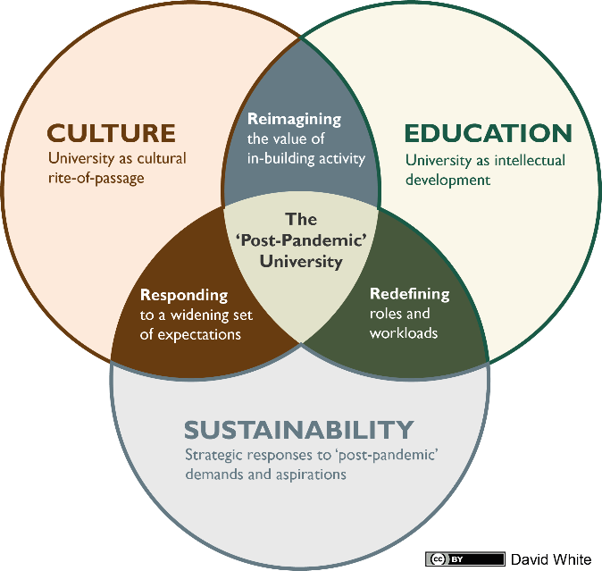
Notes:
Sustainability also means community (for us as acadmics)

Slide 8
RESEARCH
University as a community of scholars
University as development of knowledge
Notes:
Sustainability also means community (for us as acadmics)

Slide 9
If I say ‘University’, what do you think of first?
(Answer in Team’s poll)

Slide 10
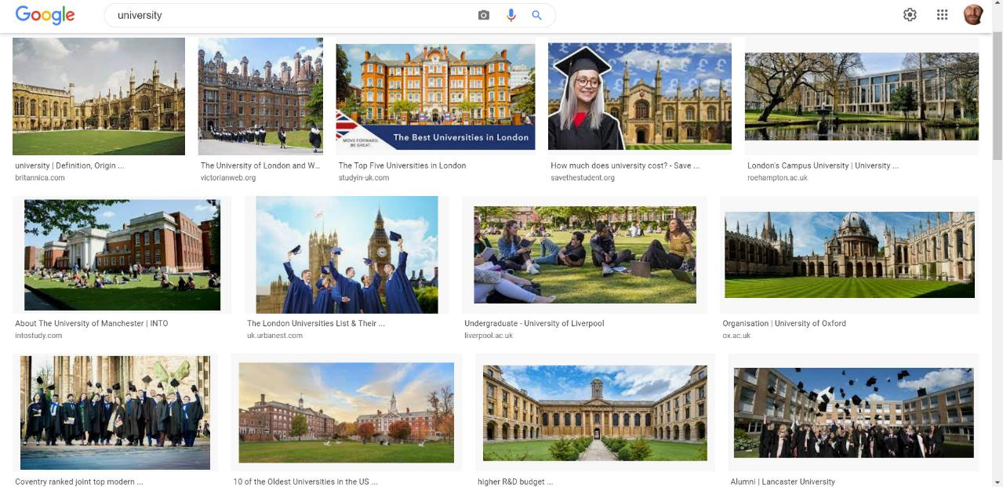
http://daveowhite.com/desituated
Notes:
Reconceptualise what the ‘place’ of the university is. Remake the ‘place’ or ‘places’ of the university.

Slide 11
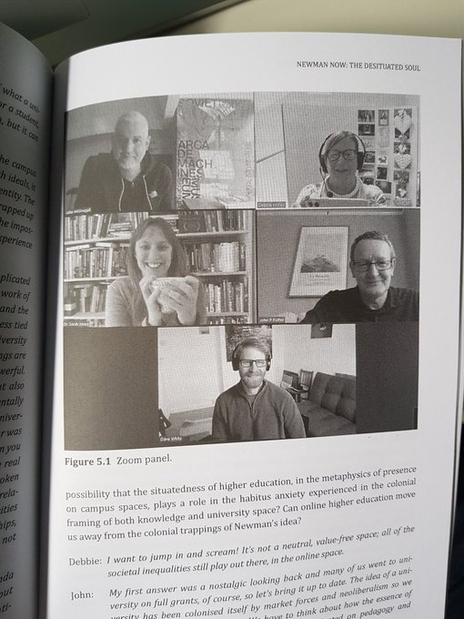
http://daveowhite.com/desituated
Notes:
From ‘The Idea of University ‘Now’

Slide 12
The university isn’t a set of buildings, it’s the work of the university, it’s the way we engage the students, it’s the research and the teaching. The place of the university still exists as a concept but it’s less tied to the buildings now, everyone involved in the place making of the university now might not be located in geographically at the university. …What does it mean to be, not place agnostic, but location agnostic? (David White 2021)
Th Idea of a University ‘Now’, Chapter 5, Newman Now: The Desituated Soul, Julian McDougall, in press.
Notes:
Responding to Newman

Slide 13
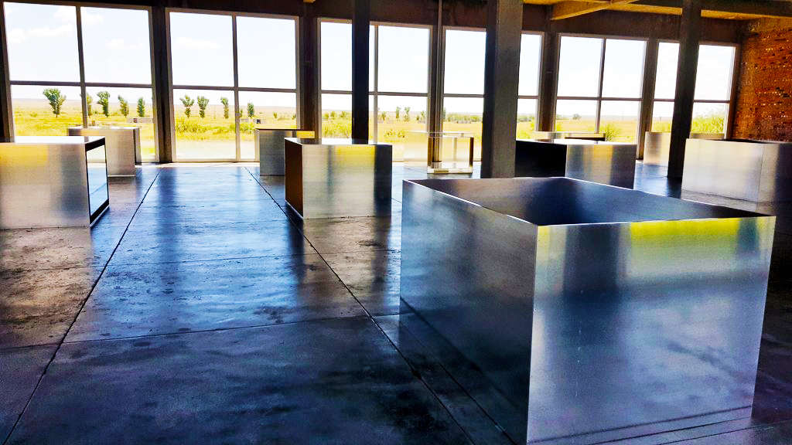
A loss
of place

Slide 14
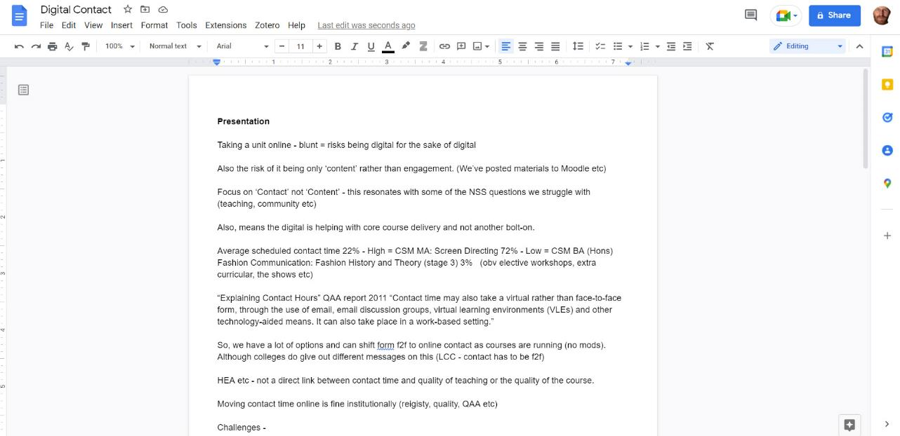
Tool
vs
Place

Slide 15
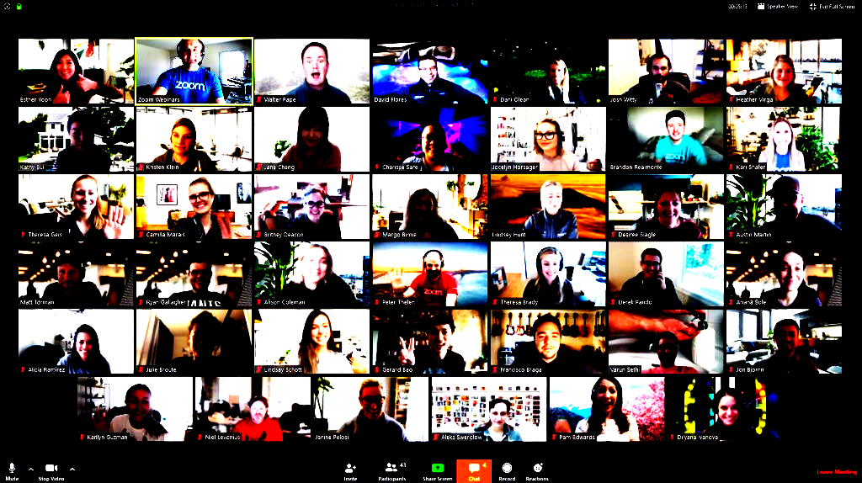
A
Non
Place

Slide 16
The concept of non-place is opposed, according to Augé, to the notion of "anthropological place". The place offers people a space that empowers their identity, where they can meet other people with whom they share social references. The non-places, on the contrary, are not meeting spaces and do not build common references to a group. Finally, a non-place is a place we do not live in, in which the individual remains anonymous and lonely.
https://en.wikipedia.org/wiki/Non-place
Marc Augé, Non-places: introduction to an anthropology of supermodernity, Le Seuil, 1992, Verso.

Slide 17
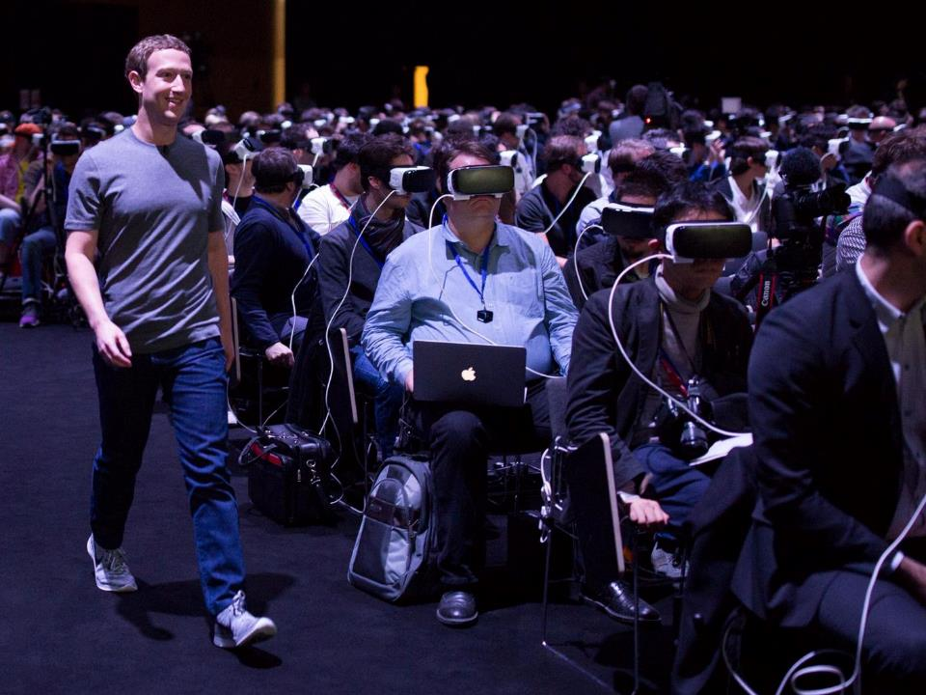

Slide 18
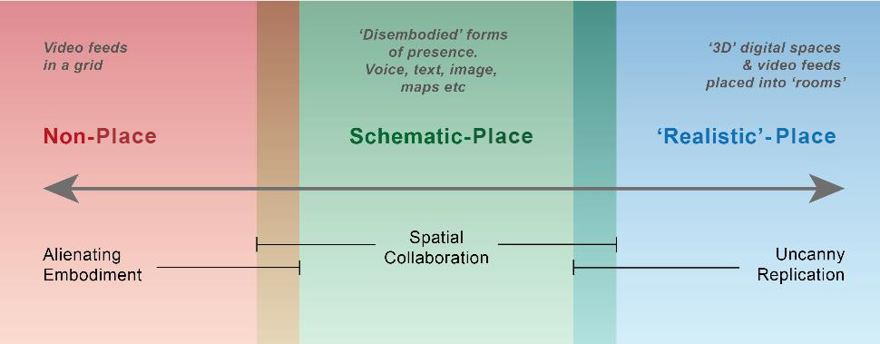

Slide 19
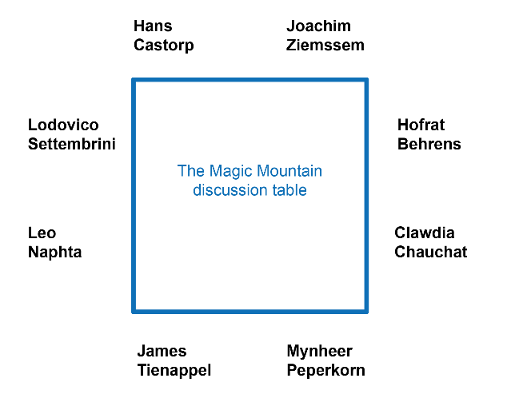

Slide 20
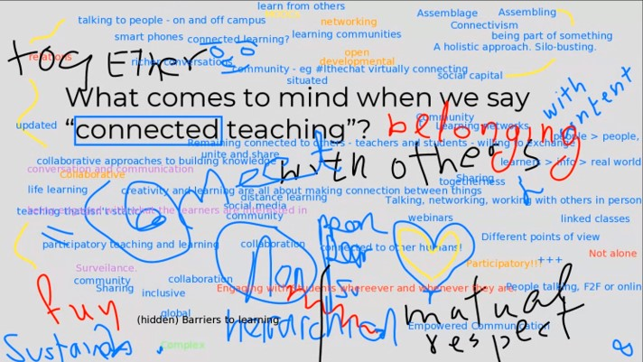

Slide 21
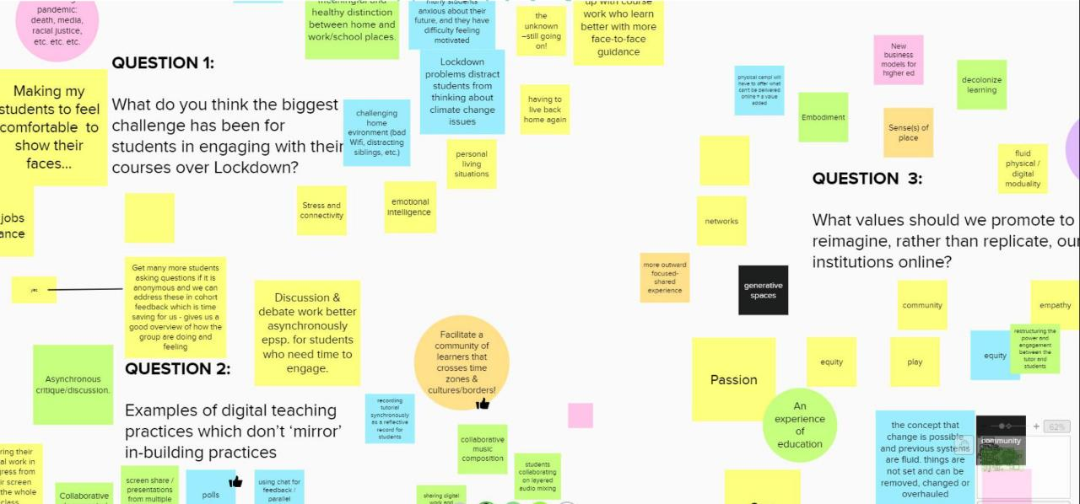

Slide 22
‘Shut up
and
write’
Notes:
Very Newman

Slide 23
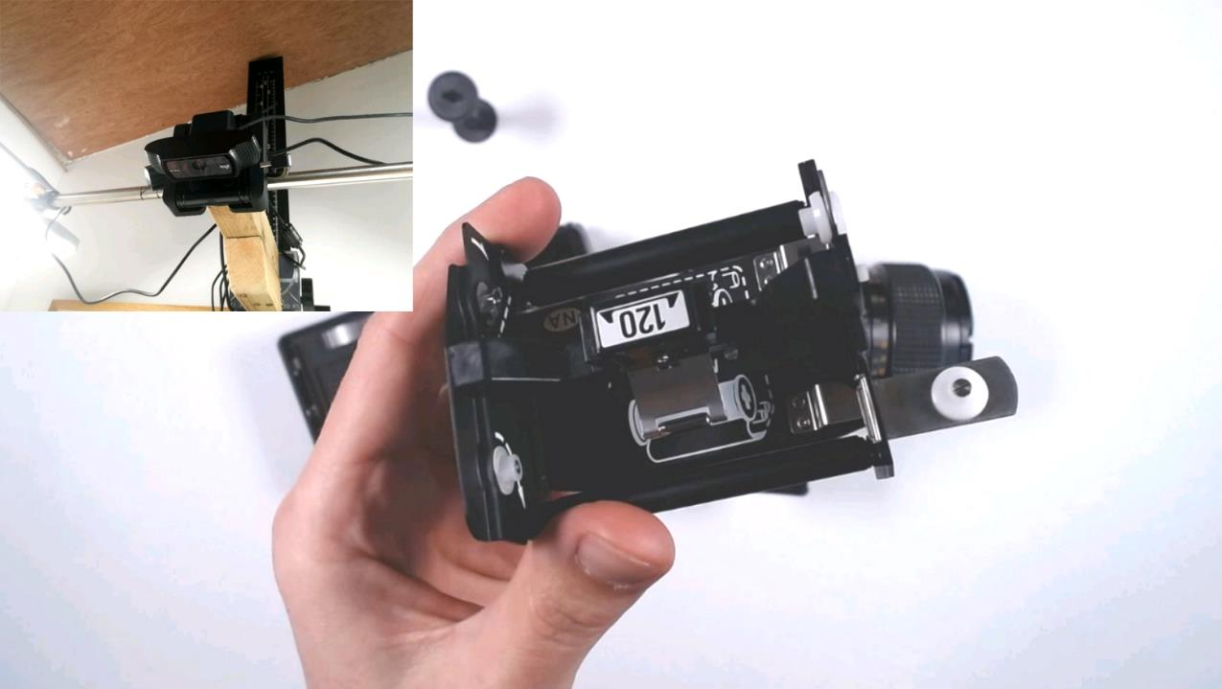
https://twitter.com/lewis__bush/status/1246051701582372867

Slide 24
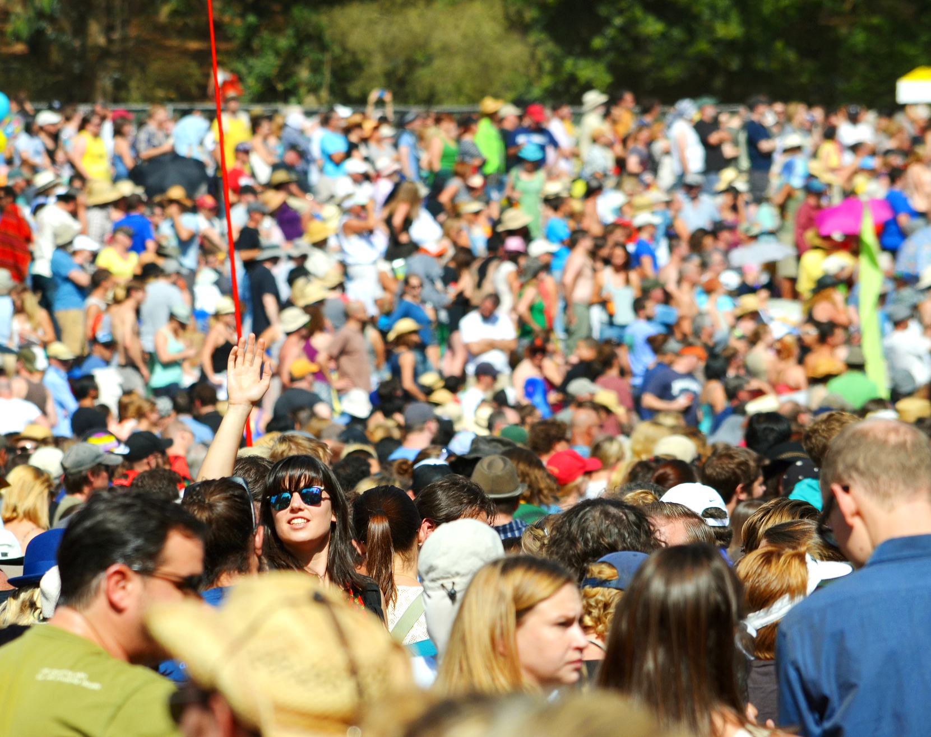
Placemaking
and
Community
Eric Sonstroem
Notes:
Very Newman

Slide 25
The university isn’t a set of buildings, it’s the work of the university, it’s the way we engage the students, it’s the research and the teaching. The place of the university still exists as a concept but it’s less tied to the buildings now, everyone involved in the place making of the university now might not be located in geographically at the university. …What does it mean to be, not place agnostic, but location agnostic? (David White 2021)
Th Idea of a University ‘Now’, Chapter 5, Newman Now: The Desituated Soul, Julian McDougall, in press.
Notes:
OU is digital but it’s not a tech company
University as digital

Slide 26
Thanks
@daveowhite
daveowhite.com
david.white@arts.ac.uk

