Slide 1

ARE VIRTUAL VISITS AN EFFECTIVE WAY OF ENGAGING LEARNERS?
DAVID CONWAY, CHRISTINE GARDNER, JANET HUGHES
Careers and Employability Services and School of Computing and Communications
Notes:
DAVID, CHRIS and JANET

Slide 2
Off site visits in education
Field trips, insight visits and museum visits are commonly used within education
Off site visits have wide ranging benefits for students including:
  Reinforcing and expanding upon existing learning (Chang, 2007; Manner, 2018)
  Improved ability to relate theory to professional practice (Higgins et al., 2012)
  The opportunity to practice academic and professional skills (Kali et al., 2014)
  Enhancement of motivation, interpersonal relationships, cultural value (Sachatello-Sawyer et al., 2002; Jakubowski, 2003)
Considering the benefits of well planned visits, it can be accepted that they can enhance:
  Teaching, learning and assessment
  Student experience
  Student employability
  Student outcomes
Notes:
DAVID

Slide 3
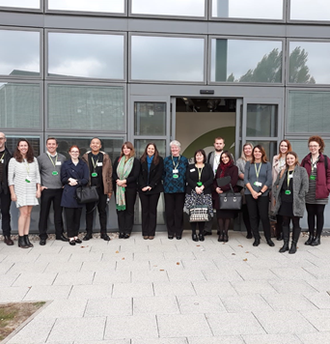
Distance learners and technology
Participating in off site visits is not possible for many distance learners
Distance learning providers may not be able to deliver off site visits at sufficient scale
Virtual visits are increasingly common:
  Guggenheim – Google Street view and paid tours using ZOOM
  NASA – Videos with comment section for questions to experts and chat rooms
Advances in technology make live interactive virtual visit ‘webcasts’ possible, but rarely used
  OU S206 ‘fieldcast’ good example of using webcasts to deliver interactive field trip
Notes:
DAVID

Slide 4
Aims and objectives
Aim
Investigate if a live interactive webcast (virtual visit) at Bletchley Park Museum using Stadium Live technology currently used at the OU is an effective way of enhancing the Level 1 Computing and Communication student experience
Objectives
• Explore and evaluate the design and delivery process (can it be improved?)
• Investigate the opportunities and limitations (do they provide value?)
• Evaluate impact of webcasts on student experience (is there enhancement?)
Notes:
DAVID

Slide 5
Method (1)
5309 Level 2 Computing and IT students were invited to participate through module site newsfeeds, social media and the Computing and Communication Subject Site.
Webcast involved two camera operators and editor
Webcast used OU’s Stadium Live platform
Two onscreen presenters – OU Staff Tutor and guest from Bletchley Park
Online audience interacted with presenters, chat box moderators and other audience members using interactive onscreen widgets and chat box
30 minute webcast in Block B of Bletchley Park
Covid compliant (e.g. Covid risk assessments, increase visit scrutiny)
x1 technology test and x1 rehearsal at Bletchley Park prior webcast
Notes:
CHRIS

Slide 6
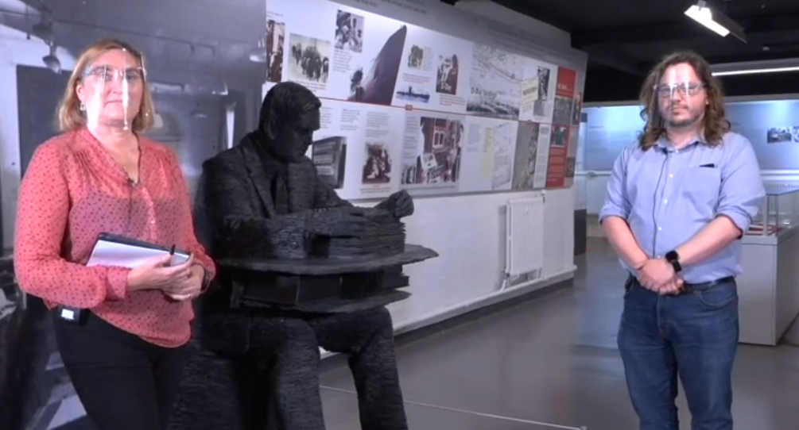
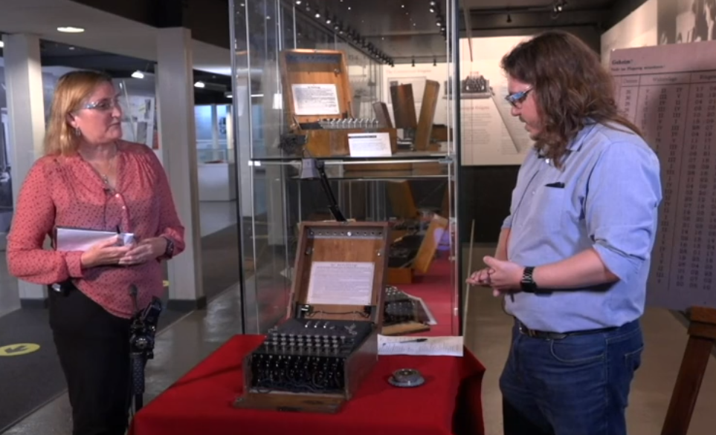
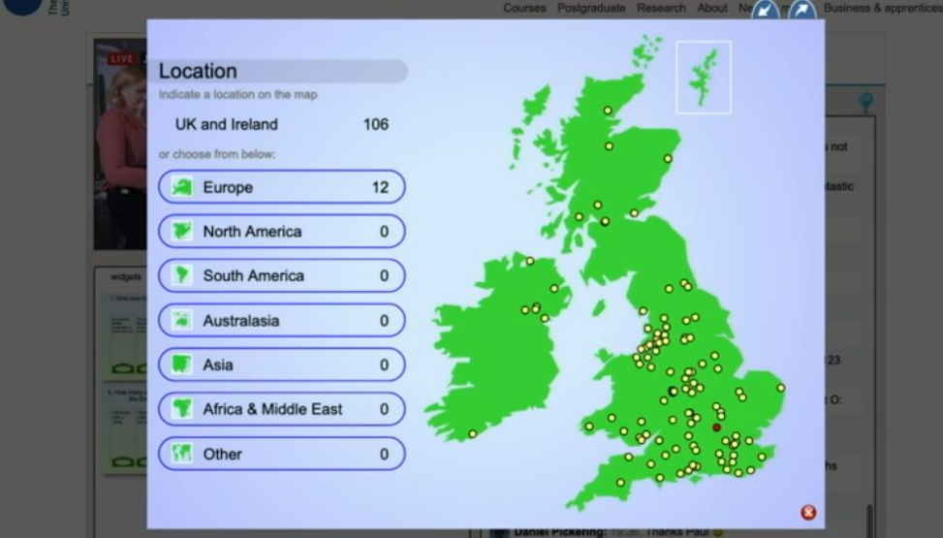
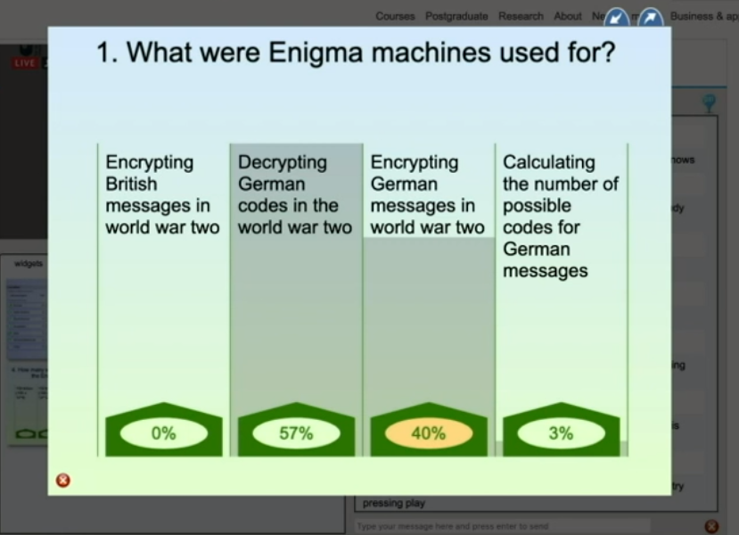
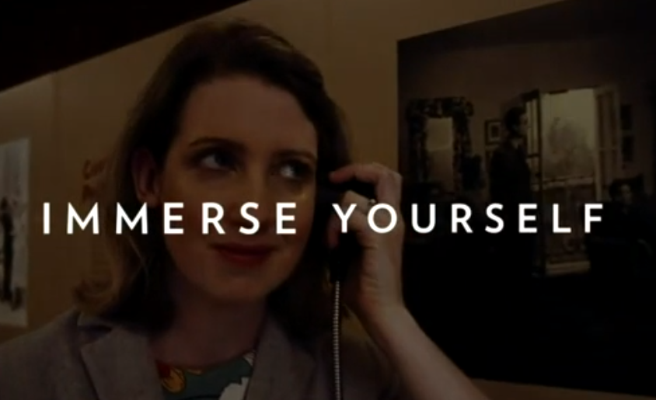
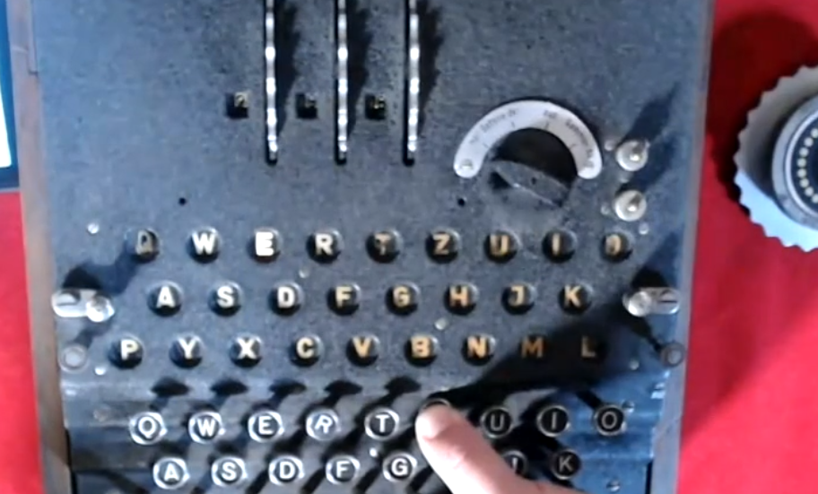
Screenshots from virtual visit to Bletchley Park Museum
Notes:
CHRIS

Slide 7
Method (2)
The project followed a mixed methods approach:
  Analysis of online audience demographics (age, gender, geographical location, index of multiple deprivation)
  Cost per online participant (total project cost ÷ number of student participants)
  Online participant survey (1-5 Likert scale and free text responses)
  Feedback from Bletchley Park Museum

Slide 8
Results (1)
101 students (164 people in total) participated during the live webcast
  Age: mean (SD) 38±14
  Gender: 75 male, 25 female, 1 unknown
  Ethnicity: 93 white, 1 Arab, 1 Asian, 1 Mixed , 2 Black African, 3 Unknown
  Disability: 80 none declared, 20 declared, 1 unknown
The webcast cost an equivalent of approximately £18 per student
**Broadcast would have cost between £2500 and £2800 if full visit was delivered as originally planned**
42% of student participants were identified as being in the lowest 50% of the Index of Multiple Deprivation.
64% of student participants resided over 2 hours in travel distance from Bletchley
  30% - Scotland, Wales, Northern Ireland and Europe
Notes:
DAVID

Slide 9
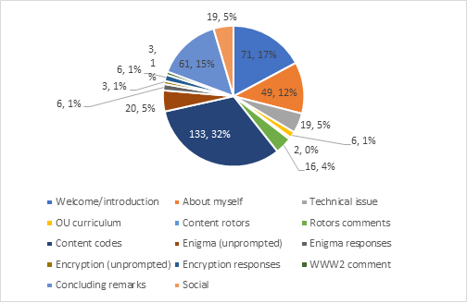
Chat box themes during the virtual visit

Slide 10
Results (2)
Student survey Likert results (13 from 68 surveyed, response rate 19%) reported that the webcast:
  supported previous teaching and learning: ‘somewhat’
  increased my motivation towards OU study: ‘quite a lot’
  prepared students for their next module: ‘somewhat’
  improved my overall experience as an OU student: ‘quite a lot’
  (median values)
The student survey also found:
  7 of the 13 respondents would find it difficult to visit Bletchley Park Museum in person, whereas 3 would have had no difficulty.
All the student survey respondents said they now want to visit Bletchley Park and would attend relevant virtual visits/webcasts in future
Notes:
DAVID

Slide 11
Student feedback
‘Helped put a physical view on the theory studied. Cryptography’
‘Fired my enthusiasm for the subject.’
‘Think this one could have been longer, or perhaps make a short series on the same subject?’
‘Reduce participation numbers but increase sessions. Most user comments were ignored by the hosts.’
‘I had technical issues and I wish I could watch it again because there were some parts I could not follow.’
‘I would even join if they were not relevant to my area of study but were relevant to the subject of computing and IT.’
Notes:
DAVID

Slide 12
Feedback from Bletchley Park
Bletchley Park Museum felt that the virtual visit went well and did not significantly impact them operationally
Feedback from Bletchley Park Learning Manager, Thomas Briggs stated:
  “I have done online demonstrations before, but nothing with this level of interactivity.”
  “I think it went really well as a trial, it was fantastic”
  “I would like to experience a virtual visit as a participant to learn more about them.”
  “Things could be improved with a smoother set up. This comes from experience.”

Slide 13
Discussion
Live interactive virtual visits/webcasts off campus are possible, even during a pandemic.
Virtual visits to locations such as museums can be cost effective
Benefits of interactive virtual visits include:
  Enhancement of student motivation and student experience
  Ability to offer engaging visits at scale across wide geographical areas
  Promotion of webcast location (encourage visitors to visit site, not replace)
Students may not necessarily understand the link between a webcast and curriculum unless associations are explicitly made
Limitations and future direction:
  would a more complex virtual visit have resulted in loss of financial viability?
  only 2% of invited students participated
  how much added value do live interactive visits provide in comparison with recorded visits?
Notes:
JANET

Slide 14
Conclusions and Recommendations
Results indicate that live interactive webcasts may be a effective way of engaging Computing and Communication students
Virtual and in person visits can produce many of the same benefits for students
If the purpose of a webcast is to augment previous or prepare for future teaching, learning and assessment, links to core curriculum must be explicit
Virtual visits may be an excellent ‘welcome’ or ‘bridging’ activity for distance learning provider which could:
  Enhance student satisfaction (positively impact SEaM and NSS?)
  Increase learner opportunity to engage with a range of ‘real world’ environments, thus enhancing employability
  Contribute towards maintaining student motivation which reduces risk of student withdrawal from university
Notes:
JANET

Slide 15
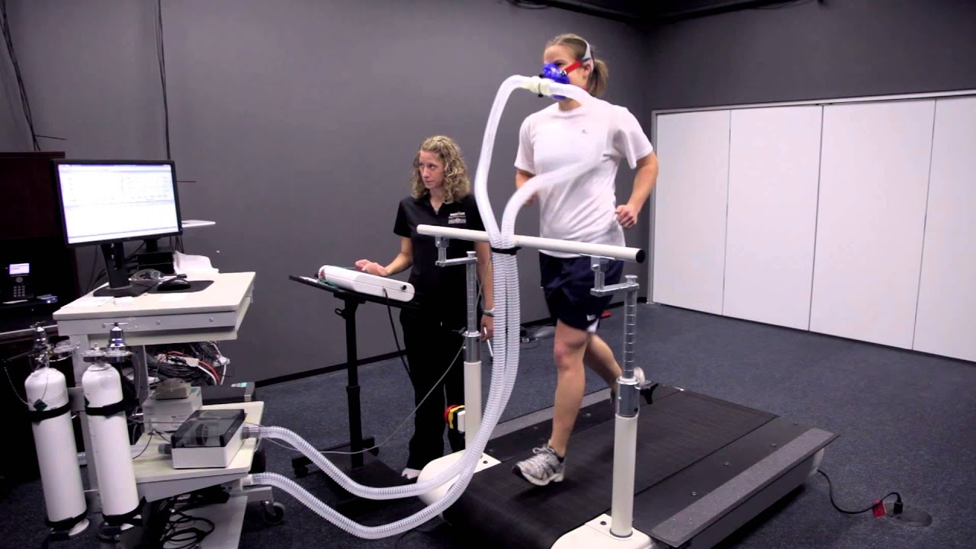
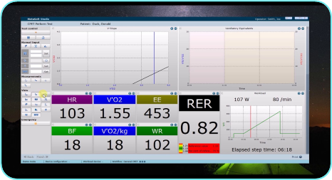
New project: Investigating remote access to live exercise physiology testing experiments through an interactive webcast
Much interest in virtual visit project around the OU and from external groups and individuals lead to webcast work being continued in different ways
Currently completing a pan university project with Life, Health, Chemical Sciences, Early Years, Childhood, Youth and Sport and OpenSTEM Labs
  Goal = inclusion of ‘live science’ at large scale in two qualifications
A pilot webcast is planned for May/June this year

Slide 16
Acknowledgements and references
Tom Briggs - https://tkbriggs.co.uk/contact/
Kate Travers (Head of Learning Bletchley Park)
Bletchley Park Trust
Trevor Collins and KMi
A recording of the webcast can be watched here -https://player.open.ac.uk/share/5da0d3d6eb
Chang, Eunjung (2007). Making Personal Meaning from a Museum Experience: Undergraduate Students’ Art Learning Experiences at the Indiana University Art Museum. PhD Thesis. Indiana University. Available at https://search.proquest.com/openview/79d332901f768cdc45f0b7950ec8cd6f/1?pq-origsite=gscholar&cbl=18750&diss=y (6/10/2020).
Higgins, Noelle, Dewhurst, Elaine and Watkins, Los. (2012). ‘Field trips and teaching tools in the Law curriculum’. Research in Education. 88, p102-106.
Jakubowski, Lisa Marie (2003) ‘Beyond book learning: Cultivating the pedagogy of experience through field trips’. Journal of Experiential Education. 26 (1), pp 24-33.
Y. Kali, O. Sagy, T. Kuflik, O. Mogilevsky and E. Maayan-Fanar. (2015) ‘Harnessing Technology for Promoting Undergraduate Art Education: A Novel Model that Streamlines Learning between Classroom, Museum, and Home’. in IEEE Transactions on Learning Technologies, vol. 8, no. 1, pp. 5-17, 1.
Manner, Barbara (1995). ‘Field Studies Benefit Students and Teachers’. Journal of Geological Education. 43 (2), p 128-131, DOI: 10.5408/0022-1368-43.2.128.
Sachatello-Sawyer, B., Fellenz, R. A., Burton, H., Gittings-Carlson, L., Lewis-Mahony, J., & Woolbaugh, W. (2002). Adult museum programs. Walnut Creek: Altamira

