Slide 1
How do we support students who study full time?
Findings from a Stage 1 interdisciplinary science module
Lynda Cook, Diane Butler, David Appleton, Anthony Short, Oliver Burney, Marcus Badger, Dan Berwick
Notes:
Diane

Slide 2
Full time Study Intensity: Setting the Scene
University level qualitative analysis undertaken of students choosing to study full time intensity
2018 VCE declared that scoping 3 year degrees/full time study intensity becomes a University strategic priority
University commissioned Marketing Insight team to look at outcomes for students on a variety of combinations of Level 1 modules
Notes:
Diane

Slide 3
University Level Findings (Insight Team)
Full time study-university wide
17/18 academic year 18,463 students studied 120 credits over 2,658 unique module combinations.
12,638 students, 68% in the full time population studied 120 credits concurrently (all modules studied starting in the same presentation month)
Majority of students studying full time take two modules (71.0%)
Notes:
Diane

Slide 4
When to discourage full time study
Analysis suggested
11 distinct Level 1 module combinations where full time study is not generally successful
The pass rates of both modules are below 60%, the success rate is lower than the best single version and both modules pass rates are lower than the single equivalent.
These modules combinations should be discouraged for full time study and/or alternative ways to deliver these modules should be investigated.
Module
Success
DE100J-SDK100J | 63.60%
S111J-S112J | 55.60%
S112J-U116J | 70.60%
DE100B-SDK100B | 41.90%
S112J-SDK100J | 38.80%
K101J-SDK100J | 48.70%
K101J-SDK100B | 59.30%
DD103J-U116J | 55.60%
T207J-T217J | 66.70%
AA100J-U101J | 64.30%
S112J-DD103B | 50.00%
Notes:
Diane
S111 and S112 are not a successful combination.
In fact 8 from 11 of these ‘’discouraged’ combinations include a science module
Is this a sign of something specific about the design of science modules, the hierarchical nature of the subject, the lack of a clear prerequisite pathway , the interdisciplinary service teaching nature of the modules –one module serving multiple purposes?

Slide 5
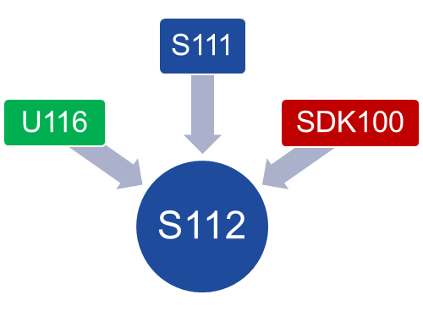
Considerations for Stage 1 science?
Marketing Insight data suggests we should discourage students from studying the S111/S112 combination of modules in the short term
Reality of situation is approx. 25% of students studying S112 are also studying S111 or another module.
Stage 2
Notes:
Lynda
S112 was designed as a stepping stone following on from initial Stage 1 modules in a variety of qualifications
Science is a hierarchical subject, requiring an understanding of key concepts to support learning of other concepts within the different discipline areas.

Slide 6
S111 and S112 as a combination– our reality
Potential outcomes
S111
S112
120 credits
S111
S112
60 credits
S111
S112
0 credits
Notes:
Lynda
3 outcomes for students
success in both both
success in only one module
no success in either module

Slide 7

How does study intensity affect module completion?
No study completed
Pass other module only
Cancel pre-start
Pass S112 only
Pass both modules (L1)
Notes:
Lynda
Students who take 120 credits at level 1
- 38% pass both modules
- 4% pass S112 & 21% pass the other module (25%) –a quarter gain 60 credits
- 38% do not gain any credit

Slide 8
Can we predict outcomes for our students?
17J Results
30% of students studying 120 credits passed both level 1 modules (38% of students who started)
48% of students studying S112 gained no credit (18% withdrew before module start and 30% before module end)
So some students can be successful studying this combination of modules full time, but how can we determine in advance which ones?
Notes:
Lynda
Some students are successful at full time study but some are not. How we ensure a student is on the right study intensity for them? Options include:
Student doing pre-module tasks or engaging with the SRSC for IAG.
Can we use any information about a student to inform us of how successful a student is likely to be at FT study intensity?

Slide 9
Can we predict the outcome of our students?
Which students succeed and which do not?
Activity
We have 6 case studies based on anonymized S112 17J students
Your task is to predict the study outcome of these students, given the information.
Report your thoughts on Mentimeter
https://www.menti.com/
Read the 6 cases and vote individually (code 45 27 22) deciding which students are likely to succeed in their studies.
2. Discuss the cases on your table, which student characteristics are likely to be indicators of success/failure?
Notes:
Oliver
15 mins

Slide 10
Can we predict the outcome of our students?
Which students succeed and which do not ?
A Women, 21, 3 A levels, considers education studies (primary), registered for psychology with OU then changed to Q64, works as a pharmacy assistant, reduced hours to take on study Q64 – biology full time, no disability. Not contacted about intensity.
D
Man, 19, declared mental health issues but no profile, GCSEs A*-C, not working due to long-term health problems, earth science pathway. Number of discussions with SST.
B Woman, 22, looking after two children under 3, GCSEs A*-C, worked in cafes previously, interested in chemical engineering, knows people who have succeeded with OU, had careers discussion pre-module start and identified concrete opportunities in the area, no disability.
E
Man, 35, technical apprenticeship, works full-time, senior automotive engineer, interested in marine biology, no disability.
C Man, 40, works full-time in IT, A levels, dyslexia but no profile, DSA in place, came off physics route pre-module start, passed S103 20 years ago. Did not respond to emails about intensity.
F
Woman, 30’s, self-employed sandwich shop owner, English as a second language, Slovakian, NVQ 2 equivalent, no disability, contacted many times pre-module start about intensity.
Notes:
Oliver
10 mins
Release the actual results at the end

Slide 11
Our project
Research questions
For science modules how do we ensure that only the students with a reasonable chance of success, study at full time intensity? How do we encourage or discourage appropriately?
What strategies are available to us to ensure we support fulltime level 1 science students appropriately?
Notes:
Lynda

Slide 12
Methods
Desk research
  gathering cohort level information for S112 deferrals, module results and credit gained
  gathering qualitative and quantitative information from individual student records
Surveying 17J and 18J students who studied 120 credits
Interviews and/or focus groups with students and associate lecturers
Notes:
Anthony
David Appleton and Anthony Short
Qualitative data as well as quantitative data – but limited to how accurate students records are recorded (VOICE)
- S112 17J & 18J student deferral information for students studying FT intensity

Slide 13
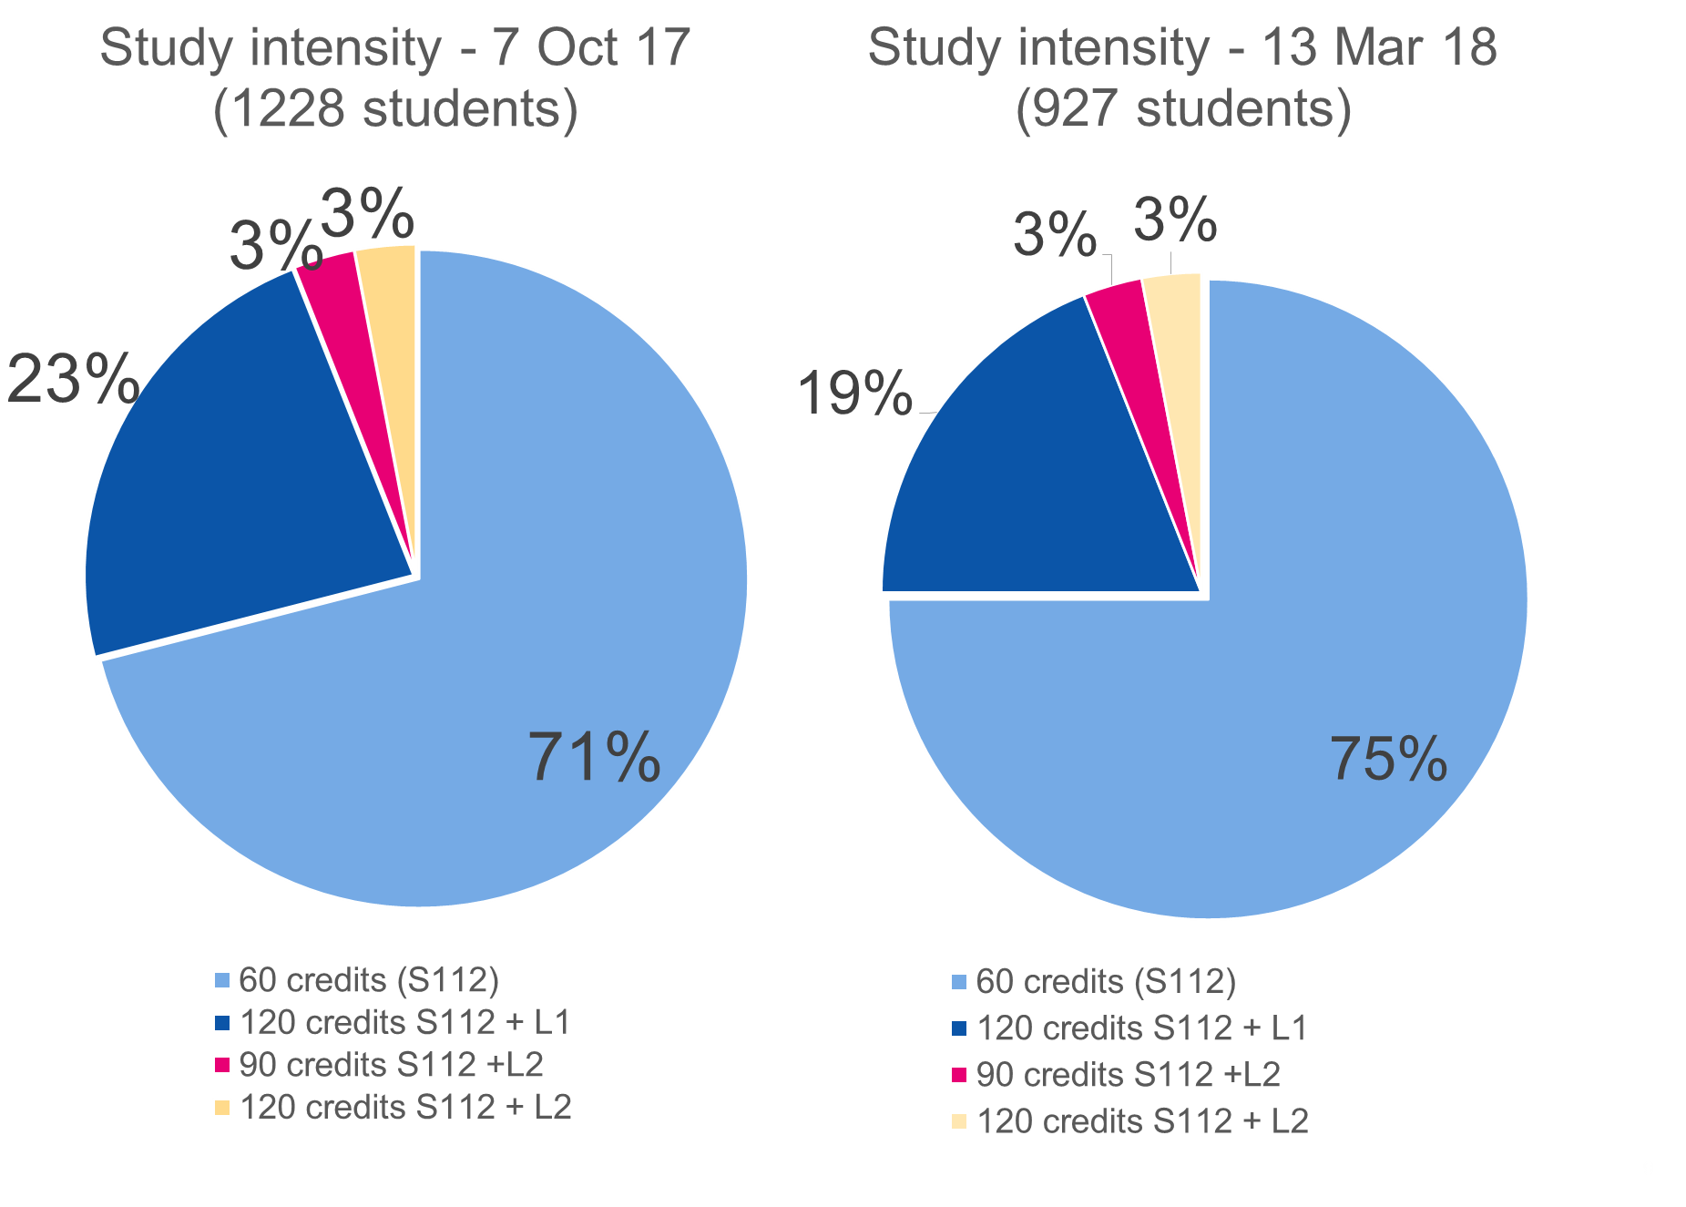
Results
Notes:
Anthony
Identifying students on FT study intensity

Slide 14
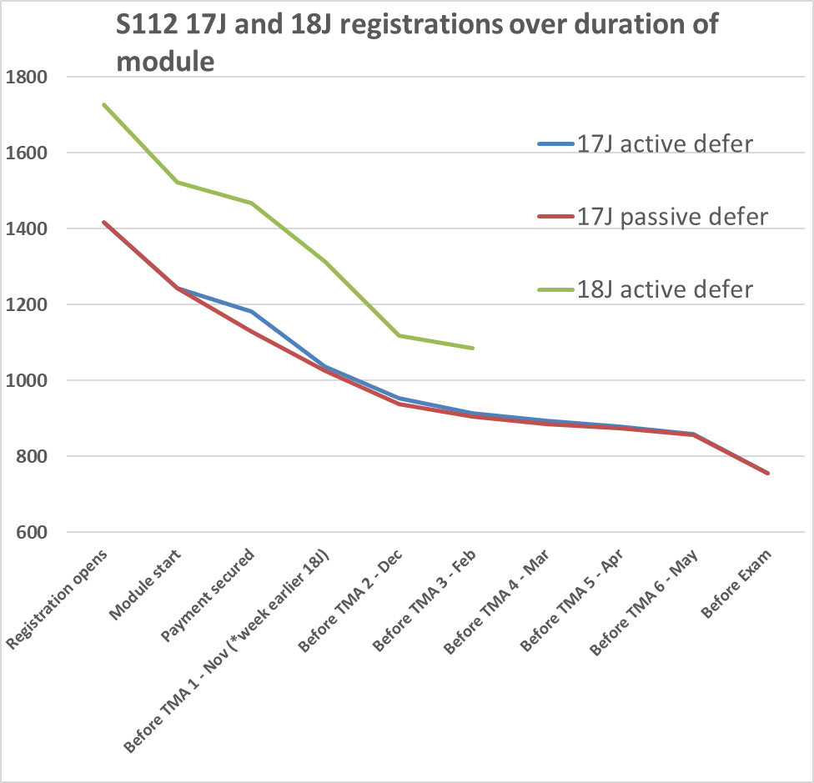
Results
SRF campaign
Notes:
Anthony
David Appleton and Anthony Short
Qualitative data as well as quantitative data – but limited to how accurate students records are recorded (VOICE)
- S112 17J & 18J student deferral information for students studying FT intensity

Slide 15
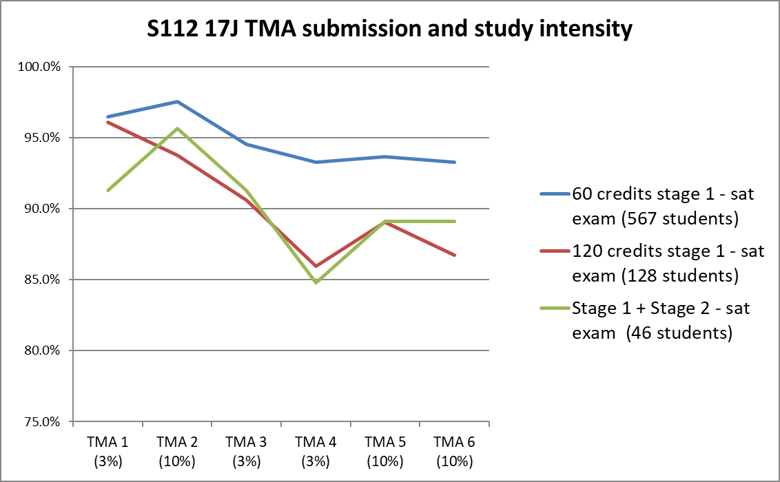
Do students studying > 60 credits study strategically ?
Notes:
Anthony
David Appleton and Anthony Short
Qualitative data as well as quantitative data – but limited to how accurate students records are recorded (VOICE)
- S112 17J & 18J student deferral information for students studying FT intensity

Slide 16
What are the reasons students withdraw from FT study intensity?
Activity
State reason(s) for students to defer from full time study intensity.
Enter your reasons in mentimeter:
https://www.menti.com/
(code 45 27 22)
Notes:
Oliver
5 mins

Slide 17
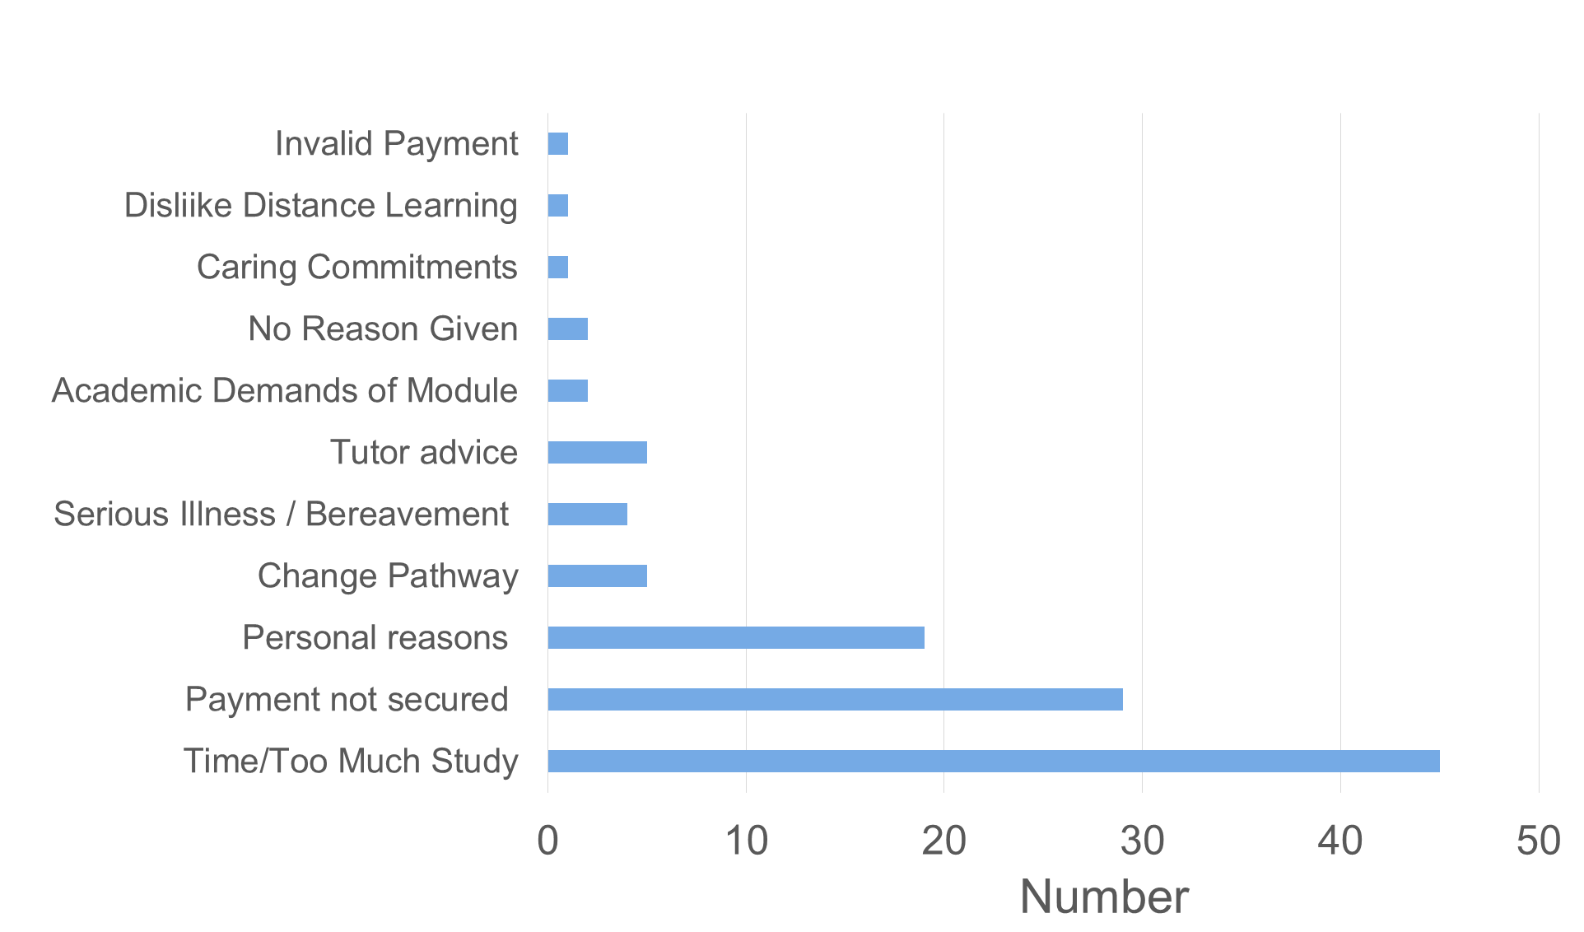
S112 17J 120 credit intensity –student deferral reasons (Oct-Dec)
Notes:
Oliver/Anthony
Taken from subset of 97 students – 120 credit intensity
This is a more detailed analysis taken from closer inspection of S112 + other module students withdrawn between Oct and Dec – caution in interpreting this for various reasons (how recorded, what and what student reports)
Could easily be multiple reasons and note that ‘difficulties with maths content’ may be greater than suggested here as students may not necessarily admit this.

Slide 18
What issues from the data did we decide to take further with our students ?
Survey questions focussed on
Prior Education
Career Motivation
Study Intensity plans – anticipation of
Research/ Advice before choosing OU study
Study preparation
Getting started
Study workload – experience of
Time availability
Academic issues and study challenges on these particular science modules
Reviewing choices to study full time with hindsight
Notes:
Oliver
Survey out now with 17J and 18J students
Anticipating two broad sets of issues in line with our RQ
Measures we can put in place pre start (IAG) and post start (Practical and academic support)
Divide into two groups –Oliver pre and Marcus post

Slide 19
Summary so far…
Return to 6 student case studies
Reveal outcomes
Not a simple situation – nuanced approach to student support
Final stage of our project is to find out by talking to students and ALs to establish which measures really would make a difference
Notes:
Oliver & Marcus/Dan
Survey out now with 17J and 18J students
Anticipating two broad sets of issues in line with our RQ
Measures we can put in place pre start (IAG) and post start (Practical and academic support)
Divide into two groups –Oliver pre and Marcus post

Slide 20
Can we predict the outcome of our students?
Which students succeed and which do not ?
A Women, 21, 3 A levels, considers education studies (primary), registered for psychology with OU then changed to Q64, works as a pharmacy assistant, reduced hours to take on study Q64 – biology full time, no disability. Not contacted about intensity.
A Case Study (120 credits -0 passed)
Outcome: withdrew from both modules within a month, finds distance learning much more challenging, and plans to go to brick university full-time
B Woman, 22, looking after two children under 3, GCSEs A*-C, worked in cafes previously, interested in chemical engineering, knows people who have succeeded with OU, had careers discussion pre-module start and identified concrete opportunities in the area, no disability.
B Case Study (120 credits – passed)
Outcome: found collaborative work difficult to organise with other commitments, passed both module, 60’s on S111, 70’s on S112.
C Man, 40, works full-time in IT, A levels, dyslexia but no profile, DSA in place, came off physics route pre-module start, passed S103 20 years ago. Did not respond to emails about intensity.
C Case Study (120 credits – 60 credits passed)
Outcome: Passed S111 60’s, not enough time for S112.
Notes:
Oliver
10 mins
Release the actual results at the end

Slide 21
Can we predict the outcome of our students?
Which students succeed and which do not ?
D Case Study (120 credits – 60 credits passed)
Outcome: Passed S111 50s, S112 withdraw due to stress of location move and other personal issues. Returned to Physics pathway but struggled with maths on that route.
D
Man, 19, declared mental health issues but no profile, GCSEs A*-C, not working due to long-term health problems, earth science pathway. Number of discussions with SST.
E Case Study (120 credits – 0 passed)
Outcome: poor marks on first TMAs, deferred due to illness, changed to engineering part-time on return. Interactions only by email.
E
Man, 35, technical apprenticeship, works full-time, senior automotive engineer, interested in marine biology, no disability.
F Case Study 1 (120 credits – passed)
.
Outcome: Passed both modules, 60’s. Higher on S112.
F
Woman, 30’s, self-employed sandwich shop owner, English as a second language, Slovakian, NVQ 2 equivalent, no disability, contacted many times pre-module start about intensity.
Notes:
Oliver
Results

Slide 22
Workshop input into what we can/should do to support FT study
Stagger TMAs
‘Flexible’ study of S112
Qualification view rather than a module view
Early start (of S112, like M140)
Design modules for FT study rather than PT and sequential
Support student deferral - Cath Brown…will follow up for more detail re how this would work re fees?
More ‘advertising’ of the SST (pre module start) so students can have good advice and guidance.
Notes:
Oliver
Results

Slide 23

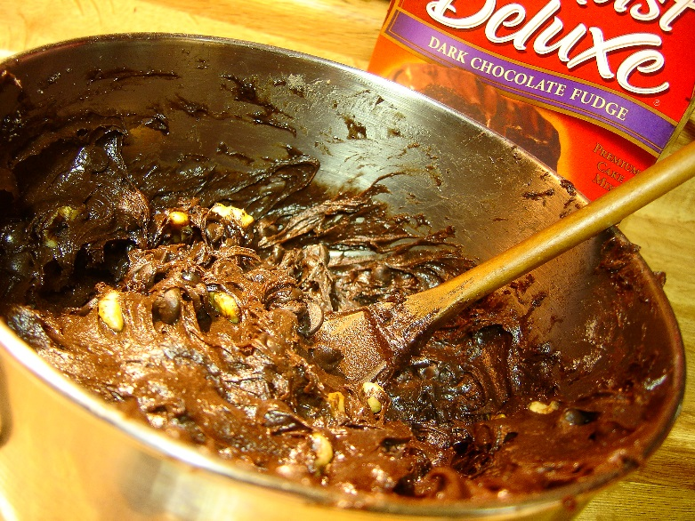

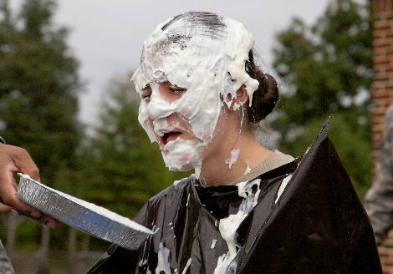
Summary so far…
Not a simple situation – nuanced approach to student support
Final stage of our project is to find out by talking to students and ALs to establish which measures really would make a difference
Notes:
Oliver & Marcus/Dan
Survey out now with 17J and 18J students
Anticipating two broad sets of issues in line with our RQ
Measures we can put in place pre start (IAG) and post start (Practical and academic support)
Divide into two groups –Oliver pre and Marcus post

Slide 24
Questions

