Slide 1

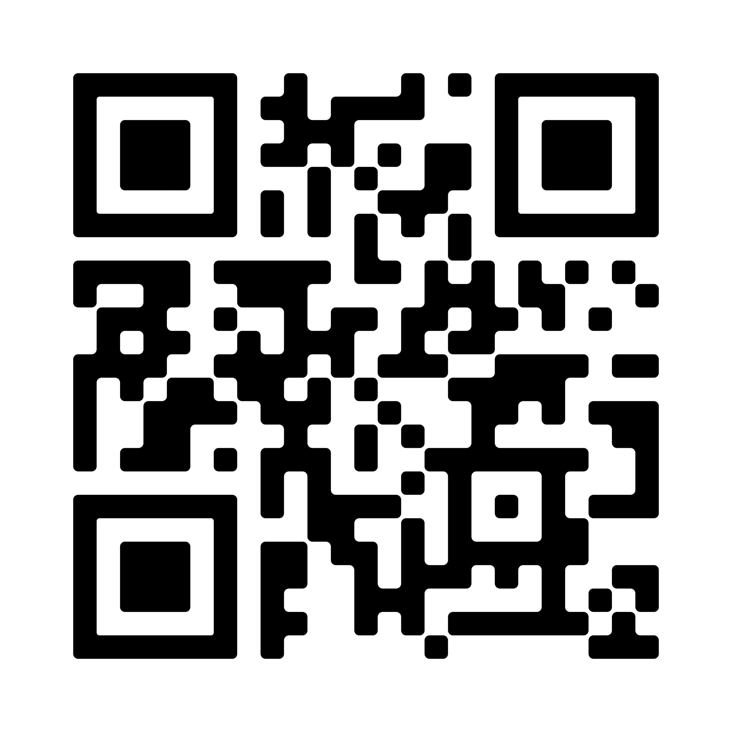


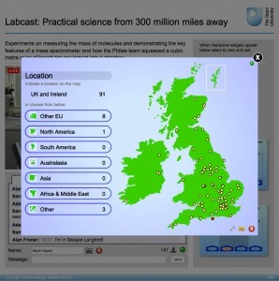

Are virtual insight visits an effective way of engaging learners?
Introduction
Insight visits can have wide-ranging benefits to students including:
Reinforcing and expanding upon taught learning
Improved ability to relate theory to practice
Encouragement of collaborative learning
Enhancement of motivation
David Conway, Christine Gardner, Janet Hughes
Scan barcode to learn more or contact David.conway1@open.ac.uk
Test & Learn
Virtual visit offered to Level 1 computing module students
Visit content relates to Level 1 module material and employability
Attendees interact with presenters and environment using Stadium Live widgets
Data: Authors’ reflective account, student feedback (online questionnaire), attendance and cost
Evaluation of approach: does it provide a cost and resource effective way of enhancing student experience?
Benefits may lead to enhanced student experience, outcomes and employability
Questions
Can a virtual insight visit to Bletchley Park Museum provide OU distance learners with effective interaction with a real world environment?
Can virtual insight visits provide OU distance learners with similar benefits to traditional insight visits?
Fieldcast (similar to used in S206)
HOW?
HOW?
Interactive Stadium Live Widgets

