Slide 1

Intro Slide Title 1
Barriers and Enablers to higher education: the experiences of disabled students from minority ethnic backgrounds.
Chris Corcoran
Staff Tutor
18th February 2025

Slide 2
Structure
Background and context
Aims and scope of the project
Intersectionality
Ethical approach
Changes to the project – the best laid plans . . . . . . .
Data collection
Findings
  Background
  Experience of the application process
  Experiences of learning and teaching
Summary

Slide 3
Background
In 2019 there were 10,543 students registered in STEM of which and 2,079 were registered disabled
Intersectional approach to the student experience combined perspectives of:
  social and cultural background and disability
Main focus:
  what were the barriers facing students entering HE and conversely,
  what were the enablers that helped them to complete their journey
Research can focus on the negatives (barriers) at the expense of the positive (enablers)
Often masks the positive support that students can have
Aim of this research was to identify areas that could be better but also to celebrate those areas of success.
Students as partners – the aim was to include a student as a partner.

Slide 4
Aims
Using an intersectional approach to the project the aim is to investigate that difference is not comprised of discrete areas.
Recruit a disabled student from STEM to help inform the project.
Identify barriers to STEM for disabled students.
Identify enablers to STEM for disabled students.
Feed results into various layers of the OU learning journey to enable good practice and promote greater inclusion.

Slide 5
Intersectionality
Intersectionality
  first created by black legal scholar and Professor Kimberlé Crenshaw in 1989
    to view order multiple oppressions experienced in identity;
    extended by Patricia Hill Collins later extended these intersections adding race, gender, class, sexuality, nationalism and age (Villia-Nicholas, 2018).
    drawing on this approach this would cover combined perspective of social/cultural background and disability.
    these intersections can combine, overlap or intersect especially in the experiences of marginalised individuals or groups (Theoharis and Causton, 2016).
Focus on challenges faced by students who fell into these intersectional areas within STEM.
Aim to go from registration to the end of the first year of study i.e. what are the barriers facing students entering HE and conversely, what are the enablers that help them to complete their journey.

Slide 6
Ethical approach to the study
Focused on a range of students:
  may have mental or physical health issues,
    it was important that the ethical approach taken was clear, supportive and transparent.
    for that reason, the approach was one of inclusion and equitability
    all individuals would be treated with respect and the OU codes of practice were strictly adhered to (The Open University 2021).
    lengthy process but it is crucial to good research practice.

Slide 7
Changes to the project – the best laid plans . . . . . . .
Students as partners:
  no volunteers ☹
Gap filled by asking for PhD student volunteers:
  they used their student perspectives of the topic to formulate appropriate questions.
Original plan to have questionnaire and focus groups:
  no volunteers for the focus groups
Lack of qualitative input was ameliorated by:
  adjusting the semi-structured survey to include the addition of more open-ended questions;
  students then had the opportunity to elaborate on their answers and give their own perspective (see Robson 4th edition (2017) Real World Research Wiley, UK – very helpful).

Slide 8
Data collection
Data collected through on-line semi-structured interview questionnaires
  100 students in total on T192 2022D and then U116 2022B
    different start dates - could not be done at the same time.
  e-mail sent to students with consent form and link to survey
  response rate low – two more e-mails sent
  12 students responded
  Small numbers are not considered to be generalisable:
    but low response rates should be considered on their merits
    as survey fatigue increases so thresholds might be seen as unrealistic (Meterko, 2015).
  question of ethics
    all results helpful and is it unethical not to use data?

Slide 9
Findings
Background:
  twelve students responded to the survey
  all male
  ages from in the 18-29 bracket and one in the 70-80 age range.
  only one participant ticked from an ethnic background
  geographically scattered – low numbers could not suggest a pattern of location
  four were studying U116 and seven T192 (one did not answer)
  63.6% had gone to further education but no higher
    similar to the OU figure of 76.% for the whole university (The Open University 2025)
Employment: 7 full time, 3 part-time, 1 unable to work
Disability – range of disabilities. The largest category was neurological/brain injury

Slide 10
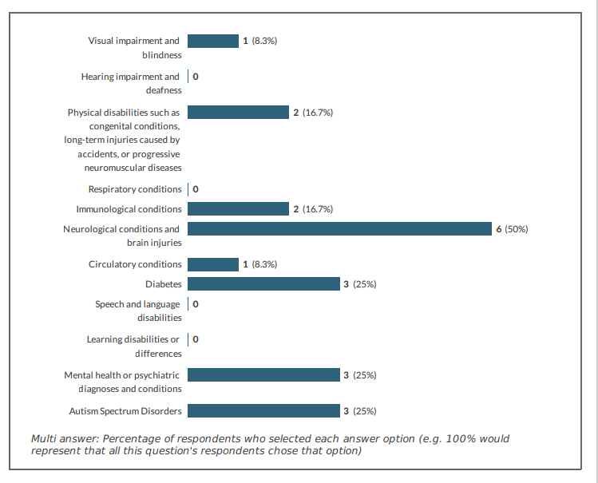
Disability

Slide 11
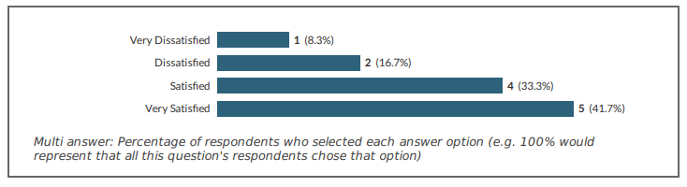
Student experience of the OU application process
83.3% (10) spoke to the student support team
74.4% were satisfied/very satisfied
Only one person was dissatisfied with the application form:
‘I could not easily access digital downloadable forms.’ (Participant M 6)

Slide 12
Student experience of the OU application process
Access to the Student Support Team and the Educational Advisory was universally positive although
  30% of respondents found it difficult to get information in relation to their disability support needs.
80% of participants were positive about their experience.
  two respondents were negative
  this may be the disadvantage of a small research population size it still represents 20% of the sample.
The majority of participants had a positive view of the registration itself, but
  the process of registration was viewed negatively with 51% of participants stating that this process was unclear. In other words, how you register could be clearer.

Slide 13
Student experience of the OU application process
When given the opportunity of making specific recommendations these included:
‘in this context It isn't clear what the definition of "Disability" is and if it applies to me if at all.’ (Participant M4)
‘an option to listen to a page and listen to the weekly activities.’ (Participant M3)
‘dedicated side page on the OU website for those that are unfamiliar with the structure of university education, many pages assumed familiarity and was a major cause of anxiety from a background of no exposure in family’. (Participant M7)

Slide 14
Student experience of the OU application process – specific barriers
The barriers to on-line study that people experienced:
  access to an appropriate computer device (40%),
  study space (60%) and
  poor internet access (40%).

Slide 15
Experiences of learning and teaching
The main reason students had elected to join the OU:
  offered the course they wanted (53%);
  access to learning material (50%), and
  ease of application (41.7% );
  the availability of courses being on-line or face to face;
    only one person registering their disappointment with both approaches to tuition.

Slide 16
Experiences of learning and teaching
The on-line material was accessible to 83.5% (n= 10) of students who had a number of positive comments, for example:
[‘course material is] accessible a few weeks before course beginning allowed extra study time before start, materials were easy to download, course structure in week format was easy to understand.’ (Participant M7)
Although a visually impaired participant pointed out:
‘there is no option to have the online course material read aloud, for people with visual impairment.’ (Participant M6)

Slide 17
Experiences of learning and teaching
Obstacles to tutorial delivery
Eight participants expressed that they had experienced obstacles accessing tutorials. The reasons why included:
‘the purpose of each tutorial feels somewhat unclear in the planner and booking them is an obtuse process spread across too many pages I have difficulty finding the link to the study room for sessions. Having a difficulty with verbal language, it is difficult to keep pace in tutorials due to monitoring the chat and tutor.’ (Participant M7)
‘on an evening I have little energy to engage in tutorials due to my health problems.’ (Participant M8)

Slide 18
Experiences of learning and teaching
Study support:
  majority of support from fellow students and their tutor (70%).
  40% of support was listed from the Student Support Team and Educational advisors
  60% of support coming from family and friends.
  four participants (33%) had helped from institutions outside the Open University which include support from an employer, using the health to work programme or drawing on on-line resources such as YouTube.
The majority of students (75%) had seen the accessibility and resources links on the OU website (n=8) had found them useful. When asked about the learning resources the responses were as follows:

Slide 19
Experiences of learning and teaching
The majority had found the on-line course material helpful (83.7%);
  slightly more found the quizzes useful (90%);
  all students found the printed material of use;
  videos were largely found to be helpful although one person found them unhelpful;
  podcasts were not considered helpful with 18.2% of people finding them very unhelpful, 54.5% unhelpful; although 27.3% (n=3 found them helpful.
  the use of forums was divided almost equally between being helpful and unhelpful.
  just over half of respondents, 54.6%, felt that the study planner was useful.
  the on-line tutorials were not found to be useful by 36.4% of the sample (n=4) although 7 participants found them helpful.

Slide 20
Experiences of learning and teaching
The qualitative answers gave a little more detail about resources that students also found helpful:
  ‘YouTube can sometimes explain a concept I may be struggling with.’ (Participant M9)
  ‘I struggled to get the daisy e-reader to work. Instead I use pdf to read it out to me. Being able to download course material was vital to me.’ (Participant M3)
  ‘The ability to download course material & have pdf read it to me.’ (Participant M6)

Slide 21
Summary and take away points (1/2)
Students feel well supported and our support teams are accessible.
We have plenty of resources to help students although finding them can be a challenge:
  website is not easy to negotiate;
  obstacles to finding tutorials.
The definition of disability could be clearer.
Do we do enough to explain the processes of HE to students?
    Assumptions?

Slide 22
Summary (2/2)
The challenge for this project was that very low student participants did not enable the findings to be generalised or to identify what were genuine outliers which could have been investigated more closely. That said, any participant who has expressed a view and contributed to a project has value and their views and experience have a moral and ethical right to be heard (see codes of practice The Open University 2021).

Slide 23
Questions?

