Slide 1


Supporting Apprentice Students by Evaluating their Study Needs - Pilot
School of Computing and Communications
Chris Thomson,
Marina Carter and
Dave McIntrye

Slide 2
At the Open University (OU) we are still learning about the best way to support our apprentice learners in their module study. Apprentices are provided with 20% of their paid working time for study which is often during the working day, however to accommodate their study intensity of 90 credits per year they often also need to study within their own time. The OU’s all inclusive flexible study approach ensures the learners can study whenever is appropriate, but we also provide synchronous tutorials.

Slide 3
In this research we investigated how apprentice learners engage with synchronous online tutorials and the barriers they face to participation. We used three activities to investigate their engagement. We surveyed and interviewed the learners and used action research to evaluate learner retention in a pilot study.
Survey: Completed November 2020. Mixture of closed and open questions. n=24
Interviews: Completed April 2021. Open questions. Quotes included. n=6
Pilot/Action research: Completed October-May 2021 Looking at how a cohort of apprentices made use of tutorials in depth. n=62

Slide 4
Apprentice tutorial survey and interviews
The survey and interviews highlighted that the apprentice learners valued the online tutorials over face to face due to issues including the ease of access and concerns related to coronavirus. Whilst many learners could attend tutorials on weekday daytimes, not all could. Most could attend in the evenings and one only at weekends. Work and life commitments both prevented engagement with most students joining from home during the pandemic. This diversity is not unlike that seen in our non-apprentice learner cohorts.

Slide 5
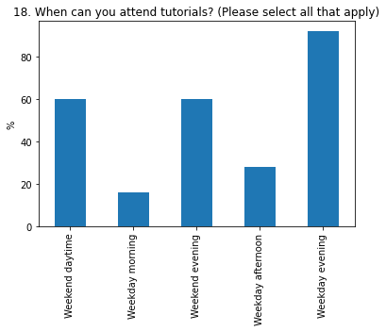
When
Around 25% of all the surveyed apprentices would attend day time tutorials.
But the majority can attend evening tutorials, particularly on weekdays.
Its unclear if apprentices felt this mean what they had attended or would attend ideally. As we will see on the next side.
n=24
Notes:
Around 25% of apprentices would attend day time tutorials.
We will see on the ne

Slide 6
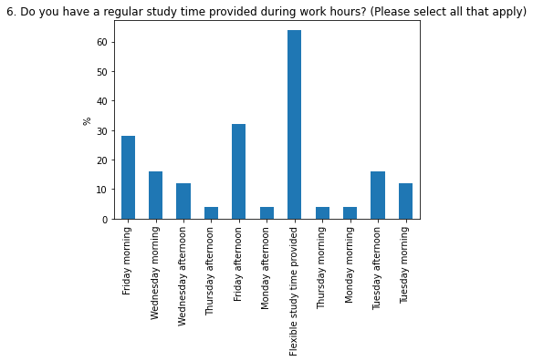
When
Most apprentices (>60%) do not have fixed study hours. They take advantage of the flexibility at the OU.
But there is around 30% of apprentices who have fixed time on Fridays, who could attend tutorials.
n=24
Notes:
The most common time availability is on Friday with 30% of apprentices available

Slide 7
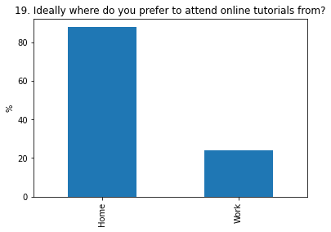
Where
That few apprentices can join from work may be a result of Covid-19, most were working from home at the time of the survey, and so would join from home.
Ideally we would want to look at this again once we are back to more normal working patterns.
In the free text responses it was clear that many of apprentices had been effected by the pandemic in various ways.
n=24
Notes:
This confirms that around 20% of student would access from work, however we note that the survey was completed in the pandemic so this may skew the results.

Slide 8
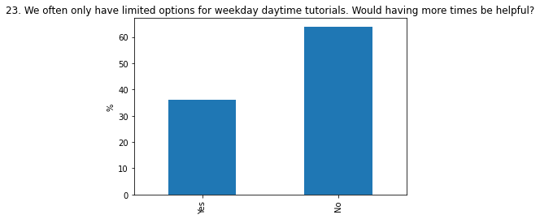
Options
The fact that around 35% of apprentices would find weekday day time tutorials useful supports the conclusion, that offered at the right time they would attend.
However evening tutorials remain a priority for many.
n=24
Notes:
Again the % of apprentices interested in weekday daytimes remains low, but more options may lead to more attendance. However this additional percentage is no more than 15%

Slide 9
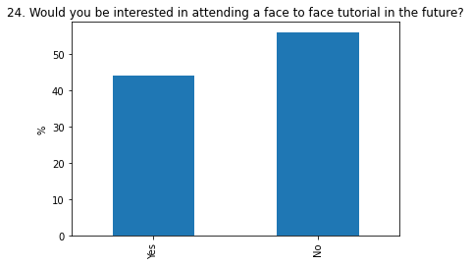
Venue
In the lead into the question we made clear that travel would be required to get to face to face tutorials, so it is surprising that so many apprentices would be happy to attend face to face tutorials.
In the free text comments apprentices did note however that worries about Covid-19 would mean that they would not travel, and equally the length of tutorial was important to ensure that the travel time was worthwhile.
n=24
Notes:
Apprentices are roughly split on attending f2f tutorials allowing for travel time. Its noticeable this survey was during the pandemic when they would be perhaps less likely to travel and several apprentices mentioned this in the comments.

Slide 10
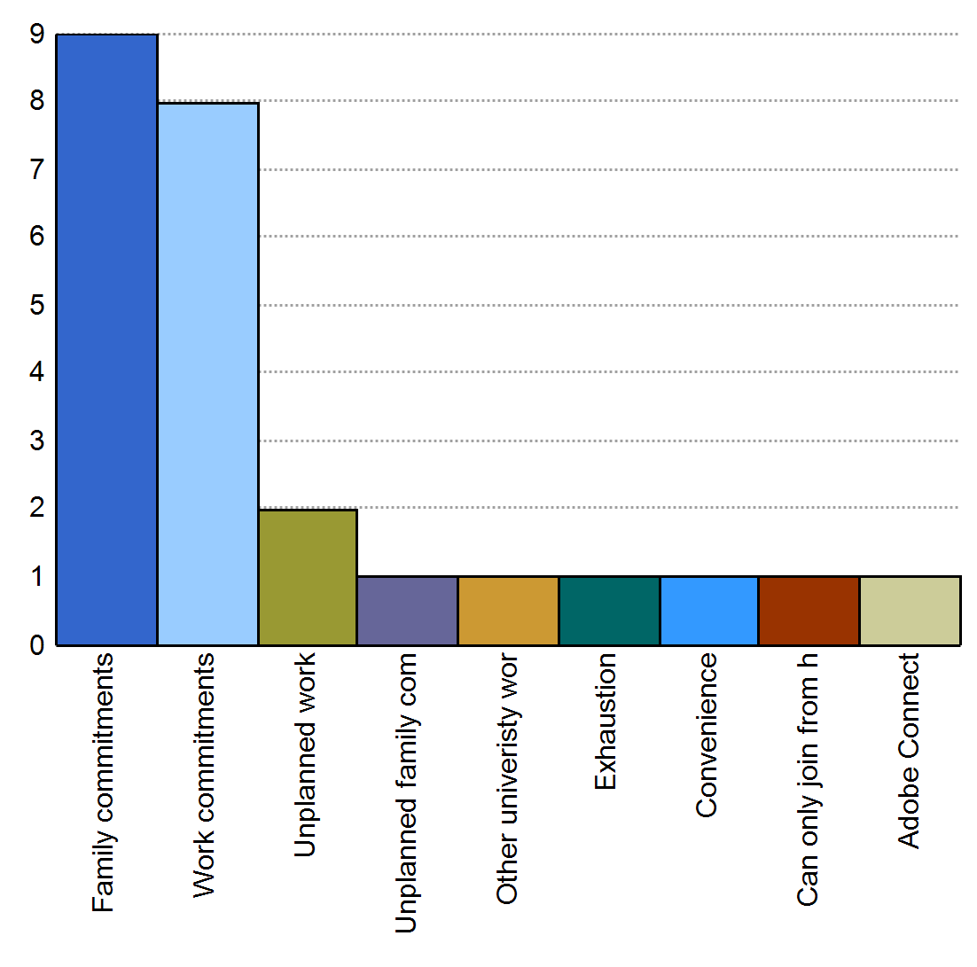
Reasons for not attending
The most common reasons for not attending tutorials are due to planned working or family commitments.
Unplanned work and family commitments were much less common reasons.
This suggests that tutorials that offer appropriate tutorials scheduled at the right time should attract apprentices.
Number of students who mentioned reason
Reasons for not attending
n=24
Notes:
Its notable that the reasons for not attending tutorials is mostly around planned work or family commitments. So apprentices should be able to book tutorials in advance.

Slide 11
What would influence your decision to attend a face to face tutorial?
Many students were concerned about Covid and travel restrictions
Another common comment was about travel time and distance
Other comments:
“It seems more dedicated, less issues with technology and can be interrupted less as you are in a room not being disturbed by work / home environments.”
“If I were finding the module difficult to comprehend on my own then I would engage in a face to face tutorial.”
“I have attended these before and find the ability to interact with my peers useful in gaining a better understanding of the topics.”
“Access to a tutor on subjects that really need further discussion which the student may not fully understand by means of brief explanation. Study can demand more questionable explanation for which a piece of study material will not provide. Questions are sometimes spontaneous and present when in a class environment rather than when self learning.”
“I have found that I can work well from the module materials, online tutorials and tutor-interaction (email), so do not feel that attending face-to-face is of additional benefit to my learning”
n=24

Slide 12
What did you take away from the tutorials that you have attended?
Almost every apprentice mentioned that what they took away from tutorials was how to do better on assignments, for example:
“Better understanding of what was needed in the TMA”
But also:
“There is a lot of inconsistencies between different tutors and no set style or template for presentations delivered.”
“A deeper insight and understanding both from the tutor and slides, as well as the participation from other students (typically on tutorials aligned to my chosen pathway)”
n=24

Slide 13
Next steps
Further analysis of the interview data is needed to support the indications in the survey
We need to improve messaging about tutorials to apprentices about what to expect.
Offer a broader range of tutorial start times (where possible).
In time we should review the effect of Covid-19 Pandemic, how has it changed ways of working?
We also need to look at more general trends within the non-apprenticeship cohort, the vast majority of online tutorials are on Monday – Thursday evenings at 7pm (Thomson, 2021).
Chris Thomson (2021), When do learners attend online tutorials?, Computing and Communication School Seminar, The Open University, 24th June

Slide 14
TT284 pilot
Currently apprentice learners are allocated to tutors in the same way as other learners. An initial pilot was undertaken for TT284 20J, to explore the benefits for apprentice learners in being allocated together in the same cluster and in apprentice tutor groups. As these learners are all on the same qualification pathway it was hoped that we can build on a sense of community and that the learners through the cluster forum can benefit from peer support.

Slide 15

Tutor Student Allocation
Normally Random
Tutors will normally have mainly
non-apprentice students and
a few apprentices
Concerns
  Guidance is often generic and may not apply to apprentices
  Apprentice goals can be different
  Little opportunity for peer bonding among Apprentice students
  Apprentices should have 20% work time available

Slide 16
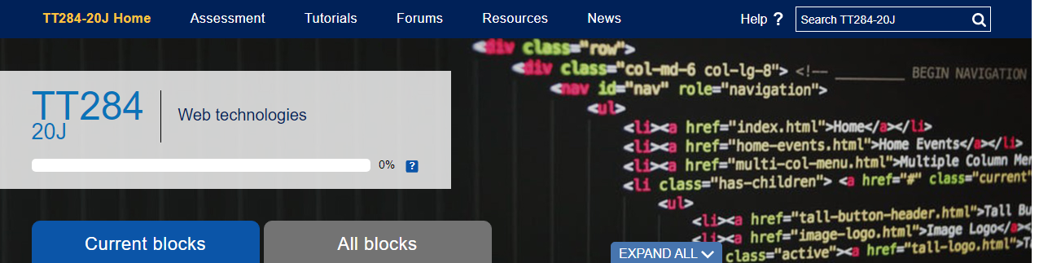
TT284 Pilot
Why TT284?
  National, not regional allocation
  All online (even before pandemic) so no physical constraints
  High population (over 1400)
  Reasonable number of apprentices (62)
  Tutors available with multiple groups so virtually all apprentices could be allocated to one tutor

Slide 17
TT284 Pilot
How does this address concerns
  Guidance is often generic and may not apply to apprentices
    Allocated tutor is working almost exclusively with apprentices
  Apprentice goals can be different
    So attuned to their needs and expectations.
  Apprentices should have 20% work time available
    Tutor is aware and able to schedule tutorials in the working day

Slide 18
TT284 What was done
The apprentice students were allocated to one tutor
That tutor was experienced in the needs of apprentices
  also a tutor on TMXY130 which is apprentice only
Students were still part of a larger cluster of approx. 300 students.
Cluster
Apprentices

Slide 19

TT284 How were the results assessed?
We analysed the tutorial attendance
We collected anecdotal comments from students via email and forums
We looked at retention statistics

Slide 20
TT284 How were the results assessed?
Tutorial attendance
  There were a large number of tutorials and I've chosen a few examples where an equivalent session was run both in a conventional weekday evening and also afternoon.
  As the group was approx. 20% apprentices and 80% non-apprentices the following charts are adjusted to use the proportions of students not actual numbers.

Slide 21
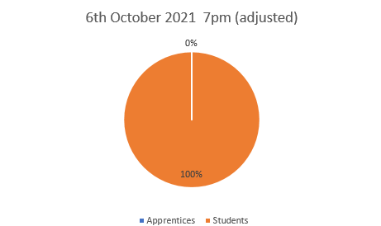
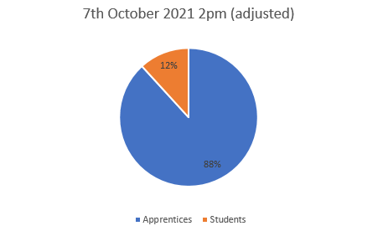
TT284 Tutorial attendance
Introductory Session

Slide 22
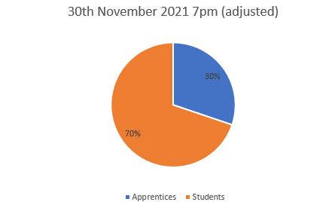
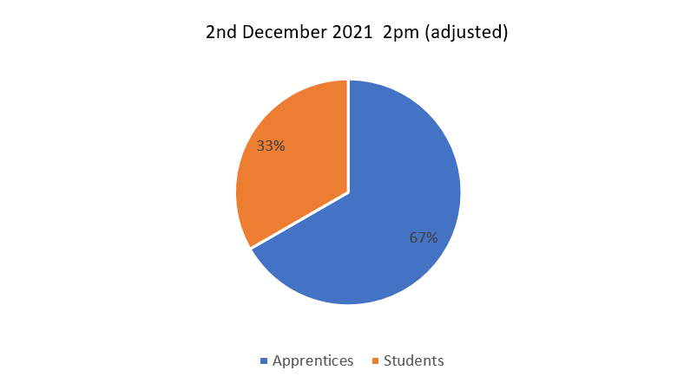
TT284 Tutorial attendance
JavaScript Part 2

Slide 23
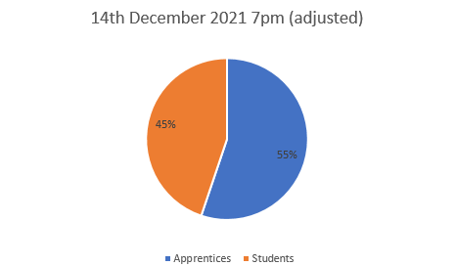
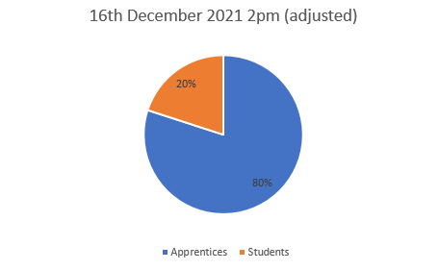
TT284 Tutorial attendance
PHP & SQL - Getting started

Slide 24
TT284 How were the results assessed?
anecdotal comments from students in email or forums (tutor name redacted)
Had a great tutorial yesterday afternoon with ****. It was a busy tutorial which was good. It seems like the afternoon tutorials work best for a lot of people. In most of my modules they are of an evening which I find hard to attend so it is good that we have the option with this module to have an afternoon tutorial.

Slide 25
TT284 How were the results assessed?
anecdotal comments from students in email or forums
I am an apprenticeship student, so the tutorials being set on weekday afternoons means this is within my employed time and can count towards my 20% off-the-job learning. In previous modules, I often had other commitments in the evening, so I have had to watch recordings of tutorials at another time. This meant less participation and I only had the opportunity to ask questions via email which would take longer than an instant reply in a tutorial.
Overall, afternoon tutorials are much better for me too 😄

Slide 26
TT284 Retention (submission)
The final assessment was based on retention.
This approach has been continued for 21J and 22J.

Slide 27
TT284 20J Retention (submission)
This is based on Marina Carter’s cluster where all 62 apprentices were allocated out of a total of approx. 300 students.
 | Results | Initial group | Percentage retention
Non-Apprentices | 176 | 238 | 74%
Apprentices | 56 | 62 | 90%

Slide 28
TT284 21J Retention (submission)
This approach was continued for 21J based on Marina Carter’s cluster where all 57 apprentices were allocated out of 317 students.
 | Results | Initial group | Percentage retention
Non-Apprentices | 190 | 260 | 73%
Apprentices | 51 | 57 | 89%

Slide 29
What happened next
Post Covid-19

Slide 30
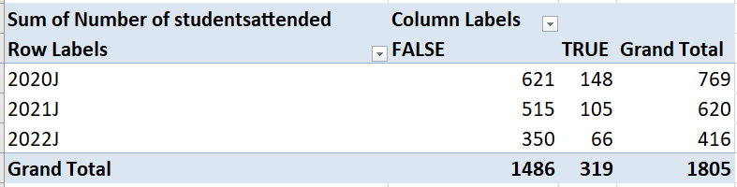
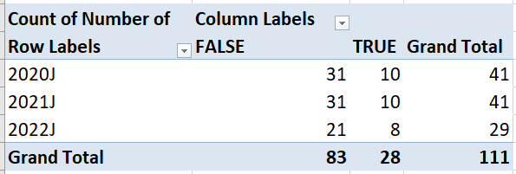
TT284 cluster learner attendance
True = day time tutorials
Number of tutorials

Slide 31
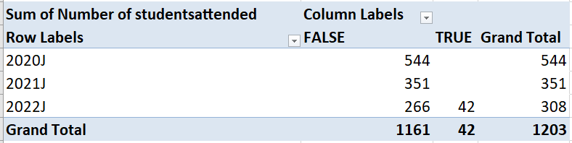
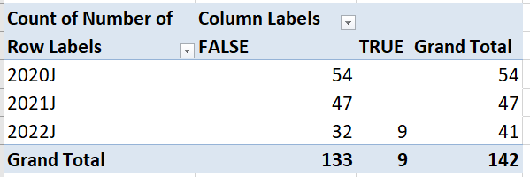
TM352 cluster learner attendance
True = day time tutorials
Number of tutorials

Slide 32
Conclusions

Slide 33
Conclusions
Weekday daytime tutorials are a positive bonus for apprentices
They are also (surprisingly) popular with non-apprentices
Grouping apprentices together but within a larger cluster gives them the benefit of more informed guidance yet allows engagement with there students and a more flexible tutorial timetable
Retention is very positive and TT284 22J apprentice retention is on a par with 20 and 21J.
As apprentice have returned to the office, day time tutorial attendance has dropped off slightly.

