Slide 1

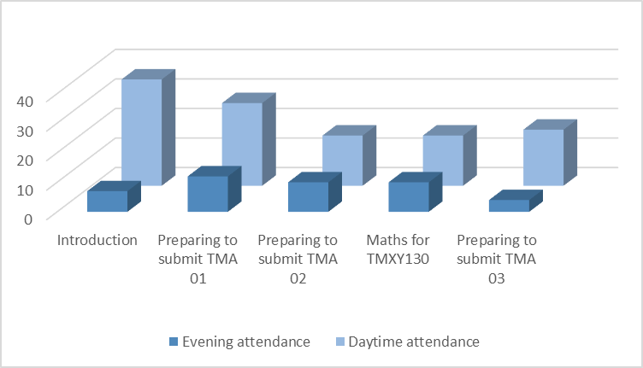












Day time tutorials for apprentices –
what is best practice in computing?
Chris Thomson, Marina Carter
Who are degree apprentices?
These students are in full time employment with study funded through the apprenticeship levy and other government sources. Apprentices study 90 credits a year in England and Wales and 120 credits a year in Scotland. They are provided with 20% of their paid time to study, about 1 working day a week. Many students use this time, during the working day as their main study time.
84% apprentices decided to attend during the day.
apprentices, but the take up has been much less than the apprentices. Earlier work by Crisp et.al. (2019) supports the view students have varied preferences. Neither project were able to predict why students made their choices, highlighting the range of student feedback received.
What are our concerns?
Whilst this time is clearly preferable to apprentices it is not clear if this is only because it is during the day, maybe the evening tutorials were too early. It is also unclear how effectively apprentices can participate, particularly if they are joining from a busy office. We also don’t know if this is a response to the particular module and tutor involved.
What makes apprentices different?
We would like to know why (these) apprentices seem to prefer daytime tutorials and begin to build a predictive model. This may be easier than for less cohesive cohorts. Predictive factors may also help us inform participation challenges the apprentices face and use this to inform advice for tutorial design.
Why look at tutorial times?
Evening and weekend attendance at tutorials is an issue for apprenticeship students. Daytime tutorials have been suggested as apprentices may be able to join during work hours. However, it is not only apprentices who study during weekday daytimes, other groups such as
shift workers and those who care for
others also have an interest in tutorials at this time. Thus, the results of this trial are also relevant to non-apprentice modules.
What has been found elsewhere?
Maths and stats (Thomas, 2019 & Pawley, 2020) have provided weekday tutorials for non-
How can we use previous work?
The analysis provided by Thomas (2019), Pawley
(2020) and Crisp et al. (2019)
point towards the factors which determine interest in tutorials, we can use these to develop survey questions.
What is happening?
An early stage pilot on TMXY130 (Introduction to Computing technologies) in 19J, one of the first modules apprentices’ study. 16% of tutorials (1 of every topic) were during work hours with the same tutor, with that tutor also providing a tutorial repeated identically in the evening of the same day. The initial findings were that workday tutorials were significantly better attended. We found that where this choice was given 63%-
Informing practice
We hope to use this to inform our provision of tutorials across the apprenticeship programme in computing. We will also share our results with other apprenticeship programmes in the University.
Crisp, L., Smith, D., Smith, K., Bailey, M., Robson, J., (2019) The pedagogical implications of diversity, FASSTEST, The Open University. Available online: https://openuniv.sharepoint.com/sites/units/lds/scholarship- exchange/Lists/projects/DispForm.aspx?ID=440
Pawley, S. (2020) Maximising online tutorial attendance of a high population level 1 module. The 9th eSTEeM Annual Conference: Informing Student Success – From Scholarship to Practice, The Open University, 29-30 April. Thomas, C.(2919) Maths & Stats Student Survey on the effective use of tuition time, The Open University, Available Online: https://openuniv.sharepoint.com/sites/units/lds/scholarship- exchange/documents/TuitionTimeSurveyFindings.pdf

