Slide 1
Perceptions and Plans of the Practice Tutor role in computing apprenticeships
Chris Thomson, Andy Hollyhead, Alexis Lansbury

Slide 2
Apprentices are a new addition to the OU family of learners. As part of their support we provide a dedicated practice tutor throughout their learning journey whose role includes pastoral and learning support. With our first apprentices in their final and 4th year of study in computing we have explored the perception of their role by the apprentices.
Data sources:
Survey: Completed November 2020. Mixture of closed and open questions. n=24
Interviews: Completed March 2021. Open questions. Quotes included. n=6

Slide 3
Practice tutors chair a regular progress review meeting with the apprentice and their employer. Apprentices recognised that this was to track and check on progress, but also raised that problem solving and planning next steps were important benefits. This resonates with their goals for study which focus on career benefits and the acquisition of knowledge that can be applied in work. The apprentices also highlighted some challenges in understanding the requirements of the university, settling into university study and managing their time effectively.

Slide 4
Who are our apprentices?

Slide 5
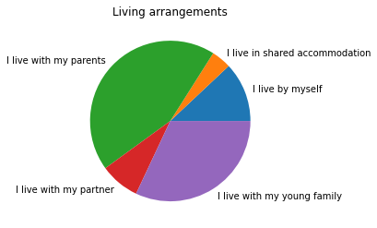
So we can better understand your commitments outside work please select the phrase that best describes your living arrangements?
Just under 50% were living with their parents, and the remainder were living with their own families or on their own with just under 30% having a young family themselves.
These do not fit with the typical stereo-type of apprentices, so we need to be clear about what kind of support they need.
n=24

Slide 6
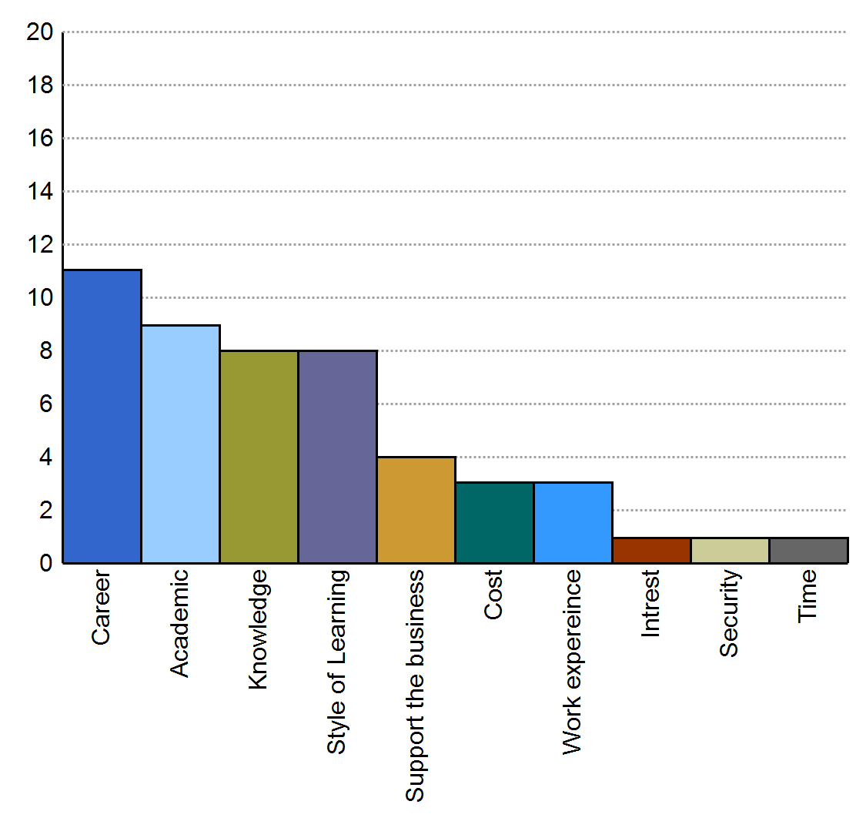
Reasons for studying an apprenticeship
Whilst a career was a common for choosing an apprenticeship, the an academic qualification, the knowledge to be gained were also important motivations.
Number of apprentices reporting reason
Reason
n=24

Slide 7
How has the PT helped raise the credibility of the role and hence the value of apprenticeships to the organisation?
"...her and my old manager did have a very good, I suppose, conversations each time we did our reviews and that was always commented on how he’d support where he can and she’s always mention that it’s good that I’m still going…" "...making sure they know about the progression and how that could … modules coming up that could help in the workplace..."
Interview quote
Notes:
Apprentice opinion is divided. When this works, it works well, and the value of apprentices for career development and change is seen. Where there is already substantial buy-in to apprenticeships in an organisation, apprentices do not perceive that PTs have an impact here. Where apprenticeships are relatively new, the perception is that PTs do not have impact in raising the credibility of the apprenticeship role..

Slide 8
How has PT helped develop work/life/study balance?
"...he works very hard to make sure that I get that…"…"You know, you should take some time out just to take a step back from everything”. So, it has been good in that regards cos I’ve been a lot of sort of less strict on myself so I can actually kind of take some time to relax and then produce better work..."
Interview quote
Notes:
Generally, apprentices value the contribution of PTs in this area.

Slide 9
What is their impression of the apprenticeship?

Slide 10
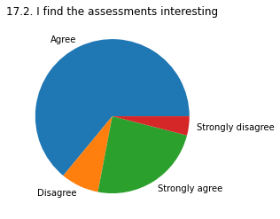
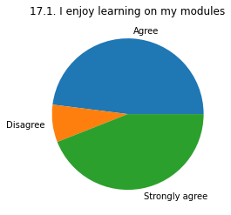
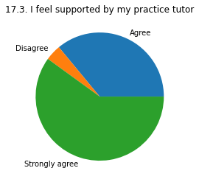
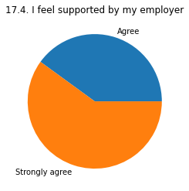
Do the apprentices enjoy and feel supported in their apprenticeship?
The majority of apprentices enjoy the academic aspects apprenticeship.
The majority of apprentices feel supported their apprenticeship.
n=24

Slide 11
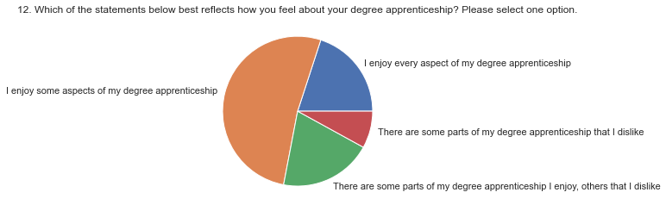
Do apprentices enjoy their apprenticeship overall?
This question allowed apprentices to look wider than the academic modules. The picture here is more mixed, whilst the vast majority of the apprentices enjoy the experience others have mixed feelings and dislike the overall experience.
n=24

Slide 12
What support do apprentices need and get?

Slide 13
Has PT helped stretch learning to make this more valuable to employer?
"...just something that needs to be done to kind of tick boxes. We don’t generally discuss the courses too much because I think cos I’ve been getting decent grades and stuff."
Interview quote
Notes:
Overall, apprentices perceive that PTs do not help to stretch their learning to make this more valuable to the employer.
This question failed to "land" based on the view that PTs are not stretching learning to increase its value to employers. Although, one apprentice acknowledged that the development of soft-skills would have been of value to their employer.

Slide 14
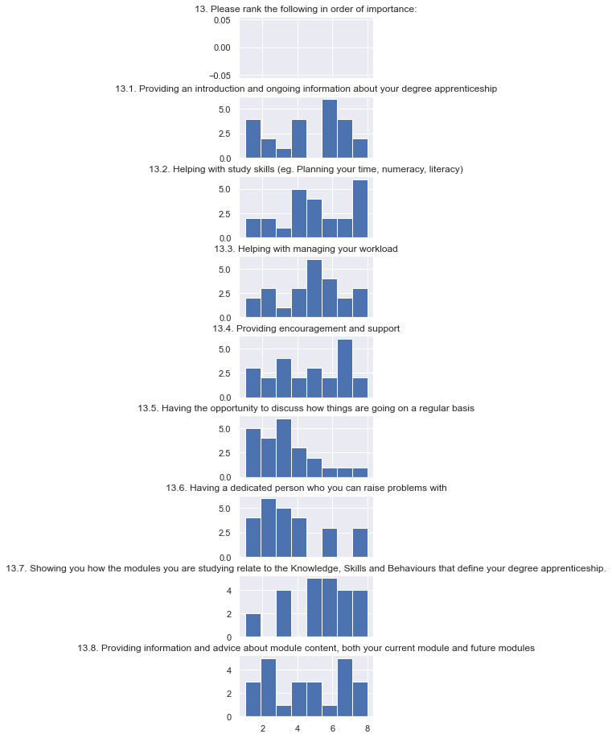
The important role of the practice tutor
None of these questions show a consistent view of the importance of these roles for the practice tutor. This suggests that these aspects of the role may vary depending on the apprentice and the support that they need.
1 = most important
8 = least important
1 2 3 4 5 6 7 8
n=24

Slide 15
Has PT helped develop any new skills?
"...am I applying the skills that I’ve learnt in my OU modules or am I just using the skills that I already have? So, in a lot of places my practice tutor has said “OK, you know, you can put in that you’re reinforcing your skills"…"
Notes:
Apprentice opinion is divided. One apprentice clearly identified problem solving skills that the PT helped with. Two apprentices felt that they were facilitating their own development rather than the PT. Three apprentices felt that the PT was not helping them to develop new skills, and further, did not perceive that they were developing new skills. This might be an area for development, both in terms of what the PTs do, and, in what the apprentices perceive that they do, in terms of their value in skills development.

Slide 16
How has your PT helped your employer to utilise your new skills?
"...in the forms that we have to fill in it’s very much me having to go through and just identify those areas where I’m using the skills from my various modules within the business and then obviously that goes through to my employer who will then see what skills I’m using from where..."
Interview quote
Notes:
Where there is a proactive employer, and where the employer is readily available to attend progress reviews, this can happen. When employers do become aware of new skills development, apprentices perceive that they take the lead on this. Apprentices tend not to perceive that this is something that PTs do.

Slide 17
The important role of the practice tutor
13.5 and 13.6 show a strong skew to the practice tutors role being to review progress and solve problems
13.7 shows a skew that practice tutors don’t communicate how module relate to the knowledge and skills of the apprenticeship.
13.8 suggests that the importance of module content information varies for apprentices
1 = most important
8 = least important
1 2 3 4 5 6 7 8
n=24

Slide 18
Other comments
"... I think practice tutor she was very supportive for everything that I went to her with and needed her for, so I had no problems on that side…"
Interview quote
Notes:
Apprentices value how the PT reacts when support, advice, guidance is requested.

Slide 19
How has your PT helped explain changes and what is important about apprenticeships?
"...I get regular communications from ... whenever there’s something to update me...what I’ve got coming up over the next couple of years and how I need to sort of focus on what I want to do for a project in the last year…"
Interview quote
Notes:
Generally, apprentices identify and recognise this PT activity, and value it.

Slide 20
Other types of support from the practice tutor
“Being clearer with the changing requirements and keeping me up to date with what is important and what it is not.”
“Industry related support (Work Environment/ Products and services Based) external to OU for which access could be arranged during the degree apprenticeship.”
Survey quote

Slide 21
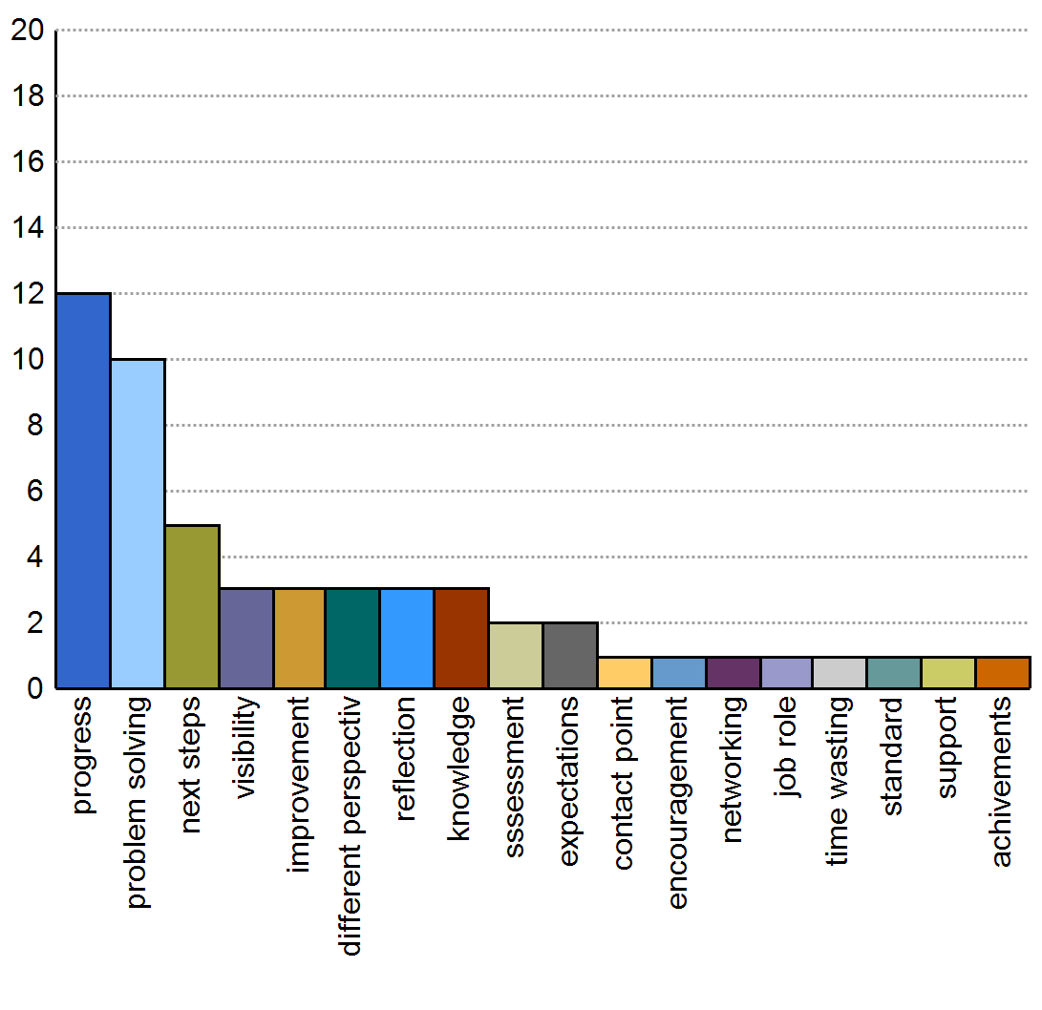
How do you feel that you benefit from your regular progress reviews?
Apprentices highlighted how important progress was alongside problem solving.
However considering next steps was also important.
Number of apprentices reporting benefit
Benefits
n=24

Slide 22
Summary

Slide 23
Summary
Apprentices have generally indicated that our practice tutors provide a high level of pastoral support that is well focused to their needs.
However the processes that we use to record and control this feel like box ticking exercises.
They also don’t perceive the role the practice tutor is playing in enabling their learning, even when this is happening.

Slide 24
Next steps
Themes:
  Explain the role and ability of practice tutors better to apprentices, emphasising how they can help link working to the skills and knowledge developed academically.
  Develop our systems so they feel less like form ticking exercises and more as opportunities to engage in meaningful discussion and action.
Explore these themes with employers and practice tutors to enable them to provide improved experiences to apprentices and ensure our guidance, systems and resources are appropriate.

Slide 25
Thank you

Slide 26
Balancing study
“I am thoroughly enjoying my degree apprenticeship and the knowledge gained within the past 2+ years has been immense. The structure of the programme, from module inception, the tutorials around them through to end of module assignments are incredibly well thought out and work well. Even amidst the pandemic, the show continued as usual without a hiccup - a clear demonstration of mighty efforts in the background. With multiple roles and responsibilities (employee, student, father and all rounder family man) studying is a bit of a juggling act to say the least. During the more intense study periods (3 modules on the go simultaneously) this has proven to be straight up stressful and in keeping up with deadlines, I find that I need to cut corners. This ultimately results in reduced quality from a study perspective, i.e. skipping activities where possible, focusing less on the lower scored TMAs etc. Where this may be an acceptable approach among others - I would argue that for higher achievers this is not a content position. A possible solution is to consider more time for assignments or less intense periods, thereby allowing maximum learning.”
Survey quote

Slide 27
How we could prepare apprentices better
“Introduction to practice tutor was interesting and I was not prepared for the first meeting, which could have been made more clear, as such I feel that this meeting could have be conducted and concluded better. Some of this being down to my anxiety as part of my preparation and ahead of the meeting, in light of this I would only ask for some empathy or sincere understanding toward the student in light of this being merely weeks into a degree. As a result the feeling from the meeting could have been more positive and supportive for which I felt was not there during the engagement. The personable approach was lacking sincerity in my experience. Tutorials could be made to delve deeper in certain subject matter as mentioned to better understand the content and provide tailored support for students.”
Survey quote

Slide 28
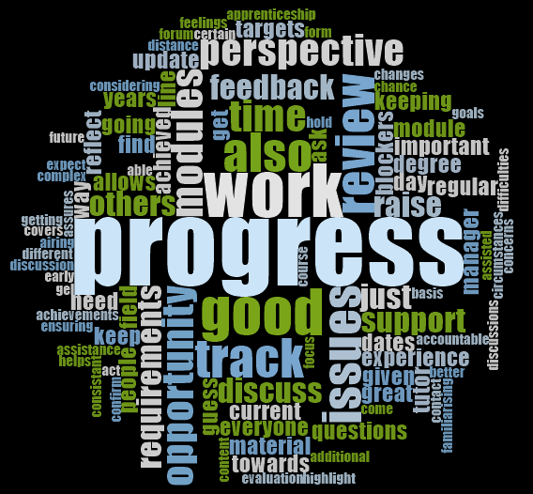
Benefits

