Slide 1

Analytics for tracking student engagement
Christine Gardner, Allan Jones, David Chapman (TM355)
Notes:
Give a short overview of who we are, and some TM355 detail.
This study will explore the use of specific computer aided learning (CAL) resources on module TM355, using a data analysis tool, A4A, developed by the Open University.

Slide 2
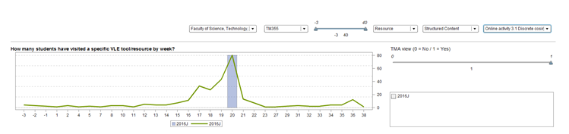
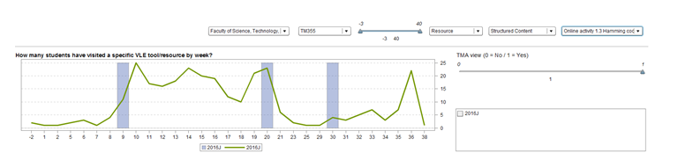
DCT – direct cosine transfer
Hamming codes
Notes:
Demonstrate the different kinds of patterns of CAL tools use that can be seen via A4A:
DCT - peak at TMA time
Hamming – use across Block 2
Neither have a big peak at revision time. Could mention student exam performance.
Need to know more detail about student use of the CAL tools e.g. do students use the tools more than once?

Slide 3
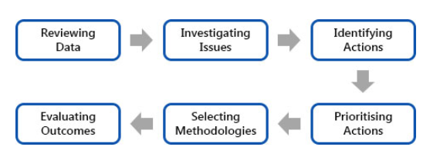
Analytics for Action, A4A , can provide detail of how students are engaging with specific online materials, with the aim to highlight the kind of interventions that module teams can make to support students.
A4A six phases:
However, it does not automatically identify activity at an individual student level.
For those not engaging with the CAL tools further research is required, for example via focus groups and/or interviews.
Notes:
Give an outline of A4A, what it can/can’t do.
At the moment we are reviewing data, need more detail on individual performance.
Then we can investigate issues etc.

