Slide 1
“To give a better understanding of who I am” the role of personal profiles in online learning
Karen Kear, Frances Chetwynd and Helen Jefferis
The Open University, UK

Slide 2
Research into personal profiles
Brief look at research into personal profiles in different types of online communities
Personal profile: An online space where a user can share information about him/herself
Notes:
…add photographs etc.
…such as LinkedIn and Facebook
…different meanings for ‘user profile’ vs ’member profile’, ‘personal profile’

Slide 3
Our research
Investigation into student use of profiles in Open University online forums
  Context was a first year Computing/IT module
  Project supported by the OU’s eSTEeM initiative for scholarship in STEM subjects

Slide 4
Social networking sites
Web based services that allow individuals to:
  Construct a public or semi-public profile within a bounded system
  Articulate a list of other users with whom they share a connection
  View and traverse their list of connections and those made by others within the system
  (Boyd & Ellison, 2007)

Slide 5
OU VLE Moodle forums
Web based services that allow individuals to:
  Construct a public or semi-public profile within a bounded system
  Cannot view or search a list of users
  Lurkers are invisible
  No system of ‘Friends’

Slide 6
Categorising online social networks
Networks centred on a common-bond community
  Members join to maintain or establish interpersonal relationships
Networks centred on a common-identity community
  Members join because they all share a common interest or aim
(Schwammlein & Wodzicki, 2012)

Slide 7
Common-bond versus
Common-identity
from Schwammlein & Wodzicki, 2012:
Social Network type: | Common-bond community | Common-identity community
Title | Cooking friends | e-Cooking
Purpose | Finding friends for cooking together online | Building the largest online recipe database by sharing cooking experiences

Slide 8
How do OU forums fit in?
Students have a common goal of studying the module
This fits with the common-identity community
Our research question:
  What role does a personal profile play in this type of educational online network?

Slide 9
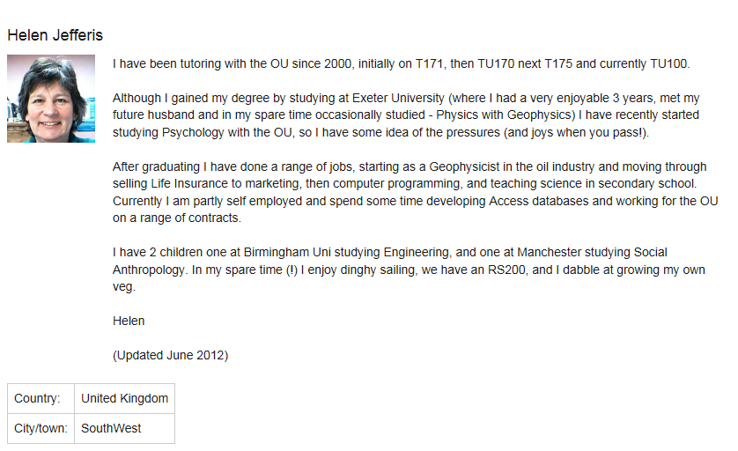
A profile in the OU VLE

Slide 10
Images in personal profiles
Common-bond SN sites:
91% members uploaded an image
Women use portrait photo
Men use full-body shot!
Gross, R., & Acquisti, A., (2005)
Haferkamp, N. et al (2012)

Slide 11
Data gathering
Observation of students’ profiles
Online survey of students
Two small online focus groups
Analysis of profile data across the OU VLE
Notes:
This presentation doesn’t discuss observations of profiles because of ethical/consent issues

Slide 12
The online survey
Questions on whether, and why, students:
  uploaded an image to their profile
  added information to their profile
  read other students’ profile information
24 respondents out of 28
Notes:
Next – details of the survey

Slide 13
Images in profiles: survey findings
Two thirds of respondents reported uploading an image
mostly ‘a photo of me on my own’
Seeing the anonymous image on forum posts against my profile didn't look right
Notes:
Next – details of the survey

Slide 14
Images in profiles: data from different subject areas

Slide 15
Images in profiles: data from different subject areas
Subject area | Percentage of profiles with an image
Law | 9.1%
Maths | 14.7%
Social Science | 16.7%
Health Sciences | 21.2%
Arts | 23.7%
Science | 27.4%
Business | 31.6%
Computing and IT | 32.7%

Slide 16
Adding information to profiles: findings from the survey
Half said they added information to their profile
Half said they didn’t
I felt it was sociable to tell people who were interested, who I am and what I do
To allow a small insight into my personality
I have no wish to share private information on these forums
Too busy
Notes:
Next – details of the survey

Slide 17
Common-bond profile fields
Top 3 fields of interest
Occupation;
Interests;
Expertise
A. Berlanga et al (2011)

Slide 18
Examining the profiles
18 students gave consent for their profile to be used in the research
Of these, only 6 had added information
  For 3 of these it was just a Skype/MSN ID
  The other 3 included personal information about career, disability, computing/IT interests
Some left their email address visible, but others hid it

Slide 19
Reading others’ profiles
60% of survey respondents said they looked at other students’ profiles
40% didn’t
Just being nosey or was interested in what they were saying and wanted to find out more about them
It does not seem like an important or relevant part of my course. more interested in their forum postings

Slide 20
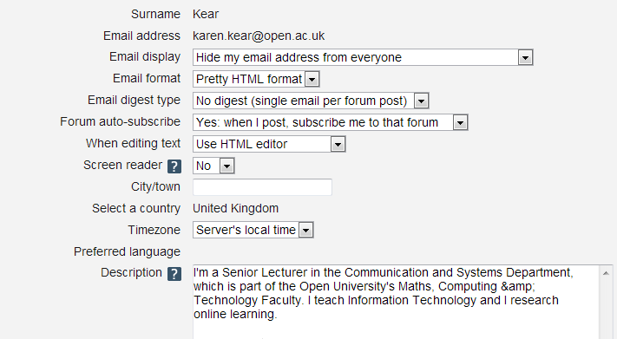
OU VLE Forum profile boxes

Slide 21
Summary of our findings
Most students added a photo to their profile
Not many added information
The VLE profile facility caused some confusion
Some students read others’ profiles
They valued the photos

Slide 22
Conclusion
Profiles can help personalise an online forum - but only for some students
  some feel no need to read or write profiles
  many have concerns about privacy online
  Is lack of profile use because OU forums are common-identity communities rather than common-bond communities?
  “more interested in their forum postings”
  “found out about people by the posts that they made”

Slide 23
References
Adriana J. Berlanga, Marlies Bitter-Rijpkema, Francis Brouns, Peter B. Sloep and Sibren Fetter (2011). Personal profiles: enhancing social interaction in learning networks International Journal of Web Based Communities, Vol. 7, No. 1, 2011
Boyd, D. M., & Ellison, N. B. (2007). Social network sites: Definition, history, and scholarship. Journal of Computer Mediated Communication, 13(1), 210–230. doi:10.1111/j.1083-6101.2007.00393.x
Gross, R., & Acquisti, A., (2005). Information revelation and privacy in online social networks. Proceedings of the 2005 ACM Workshop on Privacy in the Electronic Society (pp. 71–80). Alexandria, VA: ACM. doi:10.1145/1102199.1102214
Haferkamp (2012) Men Are from Mars, Women Are from Venus? Examining Gender Differences in Self-Presentation on Social Networking Sites. CYBERPSYCHOLOGY, BEHAVIOR, AND SOCIAL NETWORKING Volume 15, Number 2, 2012

