Slide 1
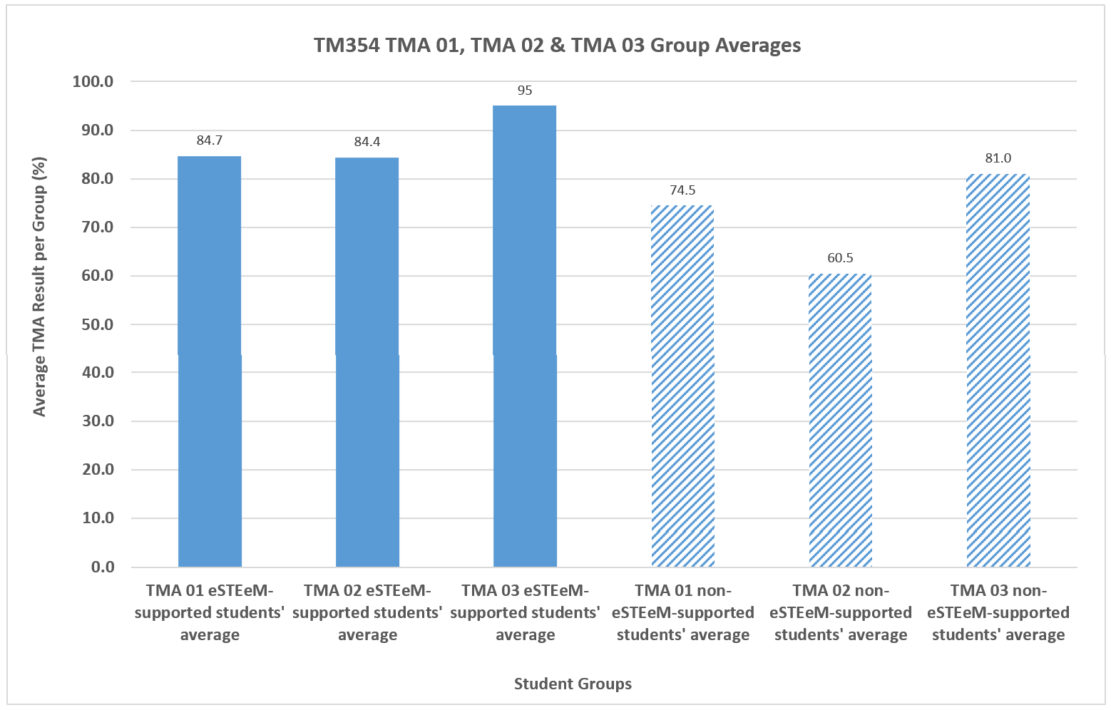
Support for Students. Teaching for Tutors. Ideas on Encouraging Students to Engage.
Dr Cathryn Peoples, Dr Richard Foley & Dr Leonor Barroca
An increased level of personalised support was made available to TM354 19J students. Support took the form of student diary entries, weekly group chats, ad hoc instant chat, and the creation of personalised development plans.
A minority of students in the group engaged with the program – 7 out of 38.
The students who engaged formed part of the stronger performing cohort, prior to beginning TM354 – the majority (5 out of 7) had achieved at least one distinction in their Level 2 study.
The aim of this programme is therefore to try to attract a greater majority of the cohort who don’t naturally engage with their tutor for a variety of reasons that more students benefit from higher results and improved module satisfaction.
One aim of achieving this is by responding sensitively to students who do not reply to initial contact attempts from their tutor with a more personalised approach to the introduction.
When asked in 19J reasons why the majority of students may not engage with the increased support programme, an engaged student told me:
“Perception of extra work. Individuals may not be confident to talk/discuss topics in a group. Slightly intimidated by the tutor – student 1 to 1 contact.”
Past investigation by the Project Lead has also revealed that students have variable expectations of their module tutor. Tying up the idea above of student intimidation with a perspective collected in 19J, a different student told me, in relation to his tutor expectations:
“[Students] don’t want a tutor who forever brags …”
“Students [want to] know they won’t be made to feel inadequate, dismissed, or humiliated.”
By way of contrast, however, another told student told me:
“It is also crucial that [the tutor] acts as an ambassador for the institution that they are working for.”
Students therefore have variable needs in that first introduction to a tutor, and that can influence the way in which they engage throughout the year.
Figure TM354 19J TMA Averages: Students Receiving Personalised Support vs those not Receiving Personalised Support
While there were also highly capable students who didn’t engage with the programme, there was nonetheless a higher overall average achieved by students who did participate (Figure).
This project therefore aims to contribute to research on personalised introductions, which are influenced by response (or not) to initial contact by the tutor. Once on board, this will be followed by personalised support.
Personalised support approaches are adapting from 19J to include, among others, paired peer learning, inclusion of past students of the module in the group chat, and personalised day-to-day life plans to support time

