Slide 1

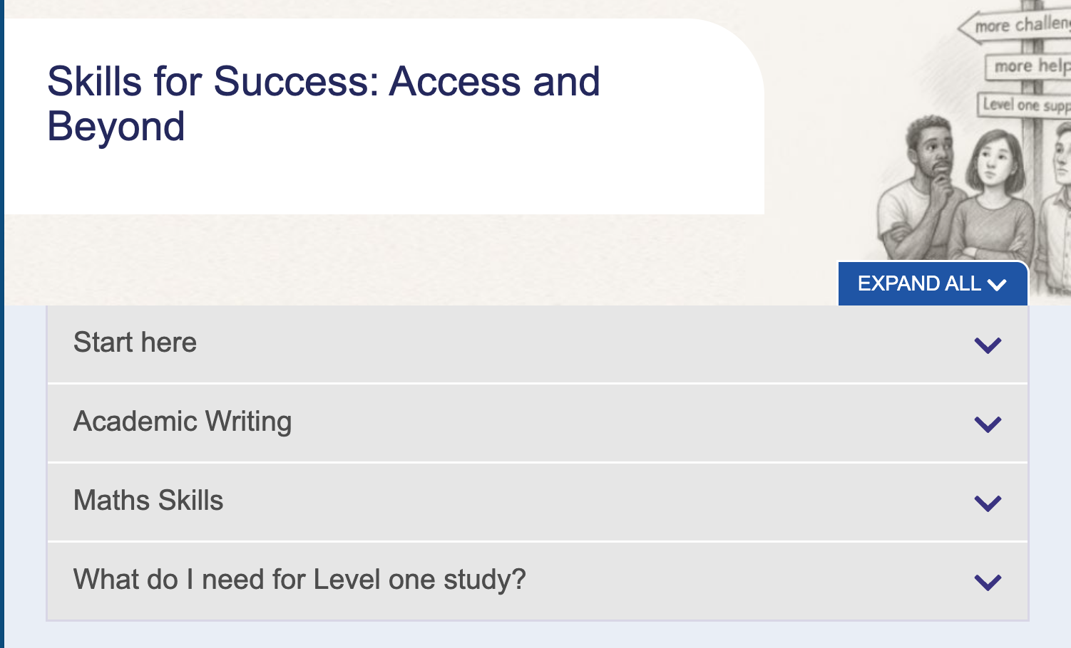
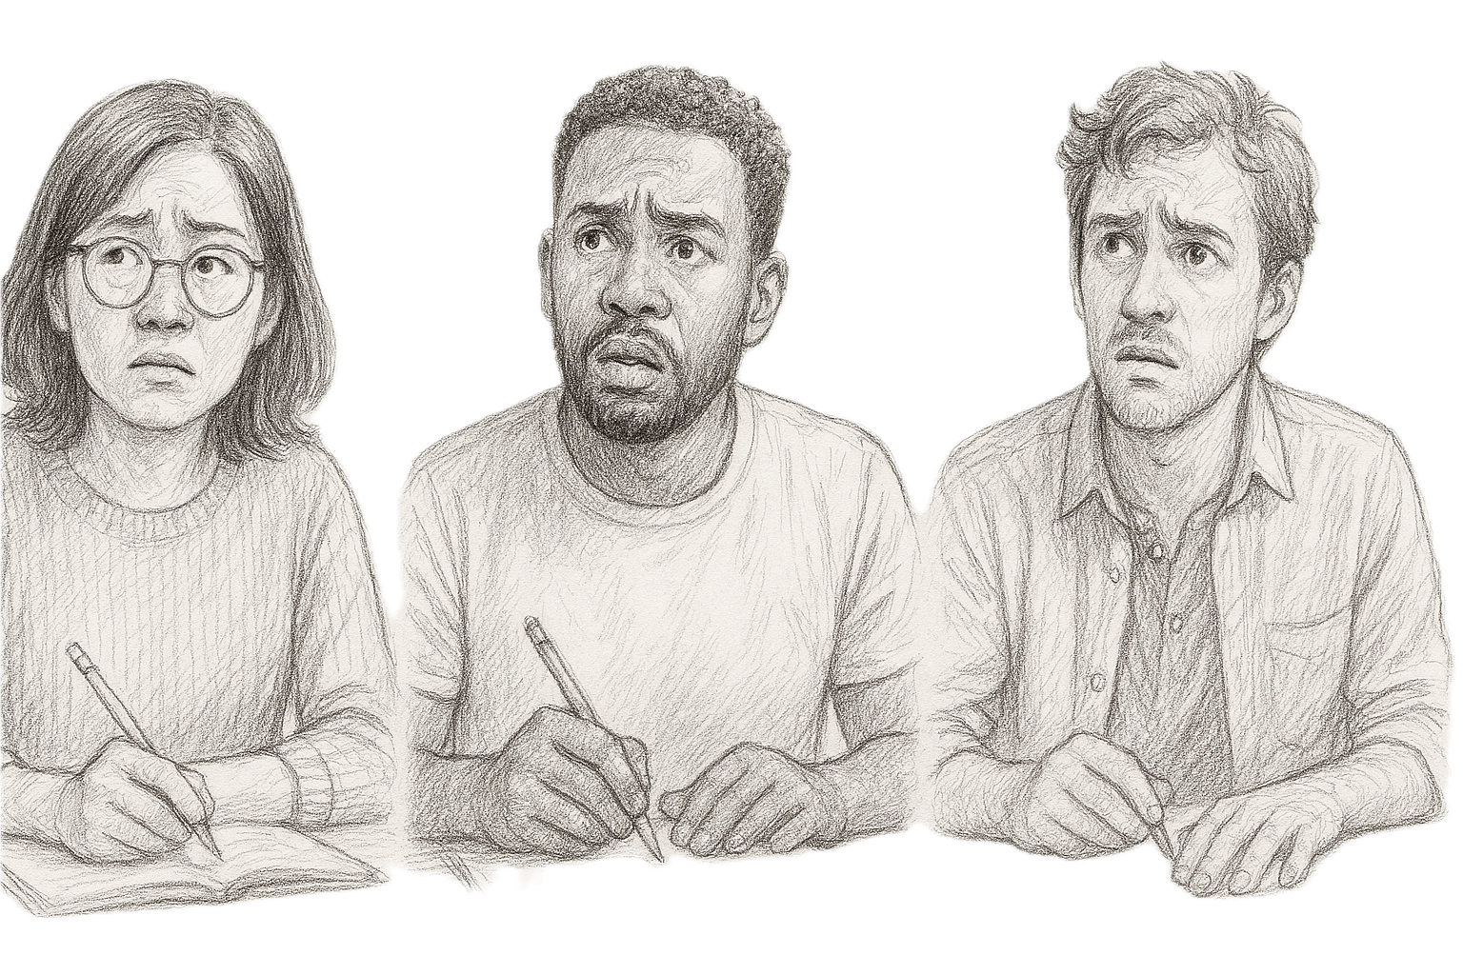
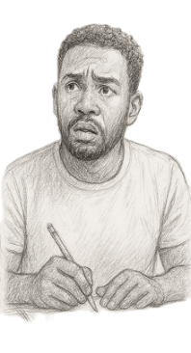
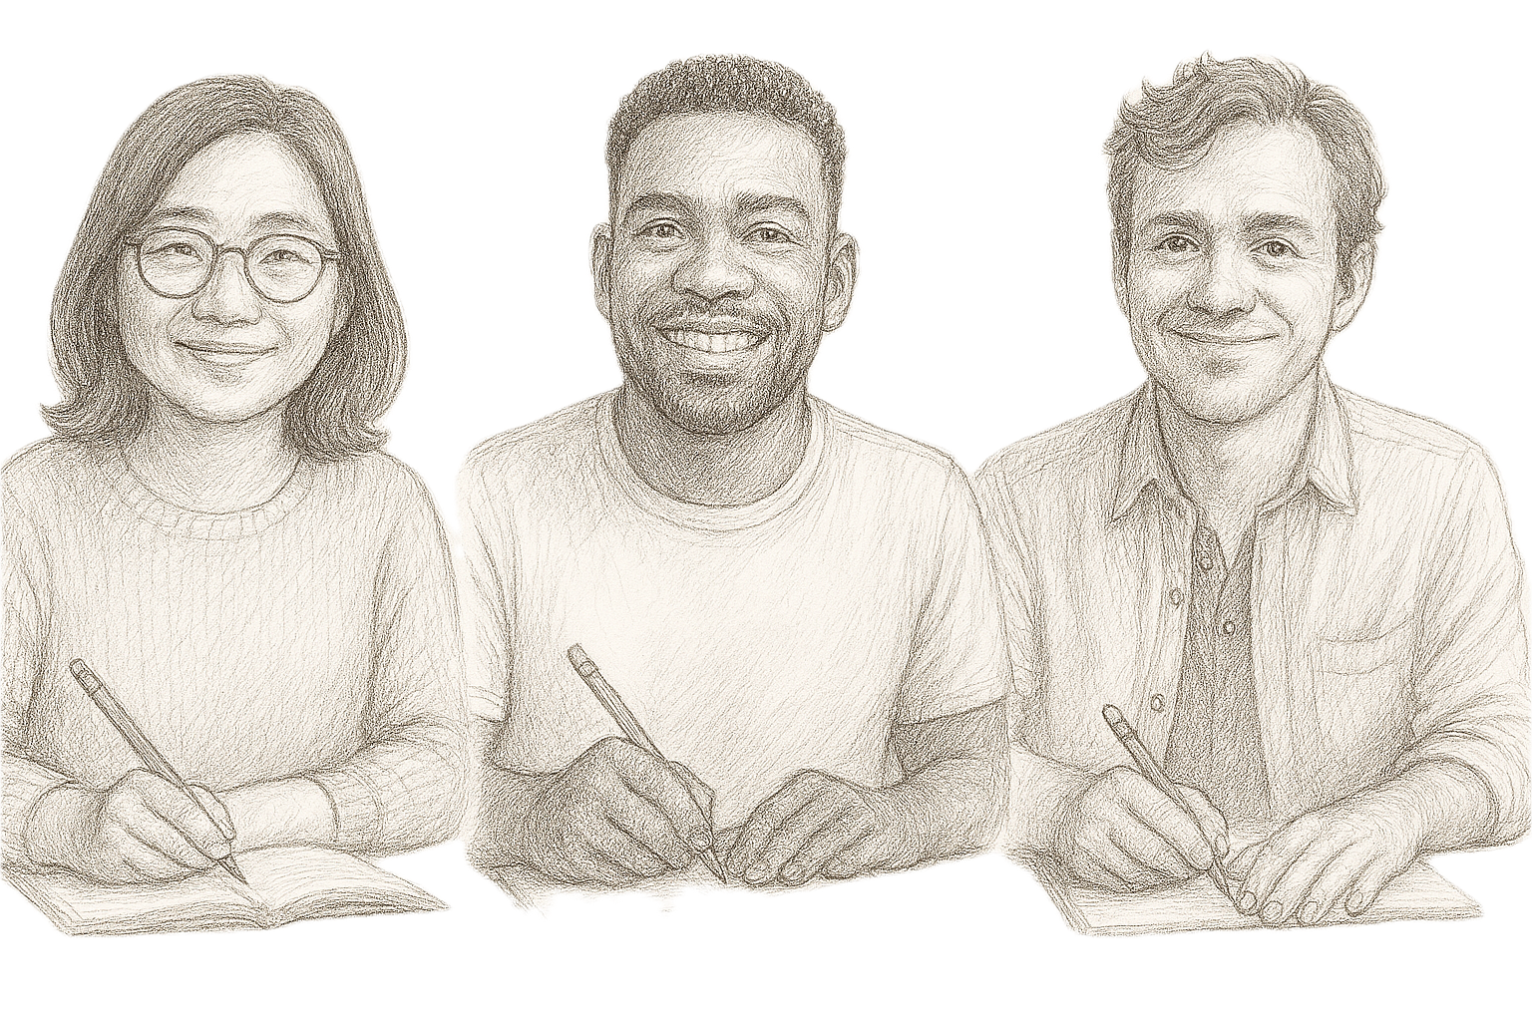

Access to Stage 1: Consolidated support for STEM pathways Catherine Scott, Eira Patterson, Fiona Aiken
Support me!
Challenge me!
Am I ready for L1?
YES ?
OU STEM Pathway
NO ?

