Slide 1



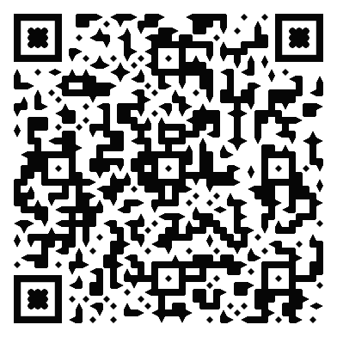

AIDED II – The AI Design Ed project
Practical application of AI tools in OU Design modules
Catherine Scott & AnnMarie McKenna
Copilot tooting its own horn
How we will do it (human us)
Hold a workshop with level 1 design students (U101) utilising Copilot to help generate ideas to design problems.
Compare and contrast outputs from students and GenAI, reflect and discuss quality of ideas with the group.
What we will do and why
Test Copilot as a tool for ideation in design to answer questions raised by AIDED #1 (QR link).
What Copilot could bring to a creative brainstorm:
“Copilot is surprisingly good at jump‑starting the creative process, especially when you’re staring at a blank page.”
(Copilot)
Expectations
Recommend best practice to incorporate GenAI as part of student design toolkit.
Confirm viable alternative for students with limited peer collaboration.
Build on clear, practical guidance on GenAI use in design education.
What we know
AIDED# I research

