Slide 1
How are students using extensions and what is the impact on their success?
Catherine Halliwell & Cath Brown

Slide 2

The Project
Why?
More students studying at high intensity and anecdotally more extension requests
Extensions potentially a mixed blessing
Our research questions
Do students studying at high intensity have more extensions?
How does use of extensions relate to success?
How are students using extensions?
What are the implications for assessment and course design?
Implications for supporting non-traditional students

Slide 3
Can we use extensions as an indicator of struggle?
For all five modules, there is evidence of a link (p < 0.01) between final grade and number of extensions
Whether or not a student takes an extension on the first TMA shows a link with final outcome (drop-out/ fail/pass) on S294, SK299, SXHL288 (p < 0.01) and SDK228 (0.01 < p < 0.05)
No such link on S295

Slide 4
An example – S294
 | Drop out |  |  |  |  | Fail | Pass
 | After TMA 1 (53) | After TMA 2 (50) | After TMA 3 (24) | After TMA 4 (3) | Passive Withdrawal (27) | Fail (76) | 40-54 (57) | 55-69 (103) | 70-84 (75) | 85-100 (13)
0 ext | 35.8% | 10.0% | 0.0% | 0.0% | 22.2% | 10.5% | 10.5% | 17.5% | 22.7% | 38.5%
1 ext | 64.2% | 26.0% | 20.8% | 0.0% | 40.7% | 11.8% | 14.0% | 16.5% | 18.7% | 15.4%
2 ext |  | 64.0% | 29.2% | 0.0% | 14.8% | 11.8% | 14.0% | 12.6% | 16.0% | 15.4%
3 ext |  |  | 50.0% | 0.0% | 22.2% | 27.6% | 29.8% | 12.6% | 25.3% | 23.1%
4 3xt |  |  |  | 100.0% | 0.0% | 38.2% | 31.6% | 40.8% | 17.3% | 7.7%

Slide 5
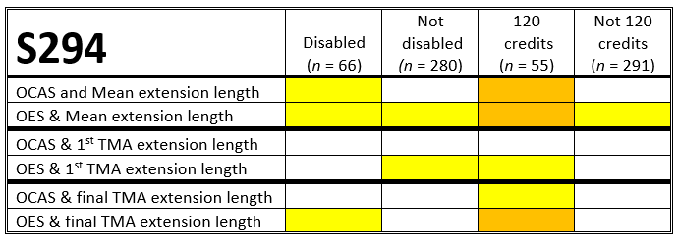
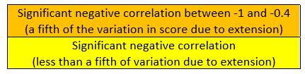
Length of extension can matter too

Slide 6
Some surprises
We thought students studying at high intensity would have more extensions
We thought Health Science students would have more extensions than Natural Science students

Slide 7
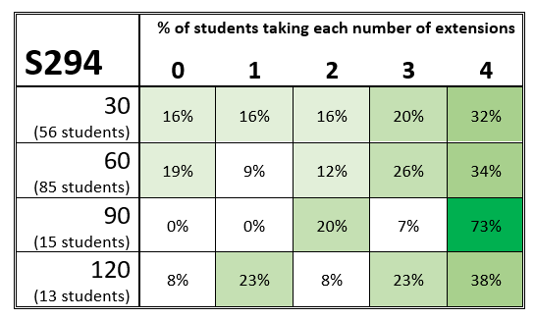
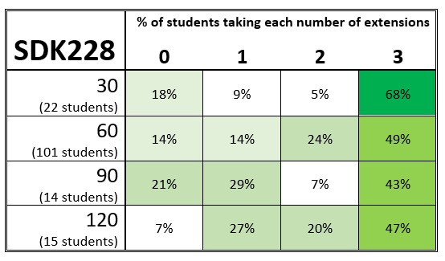
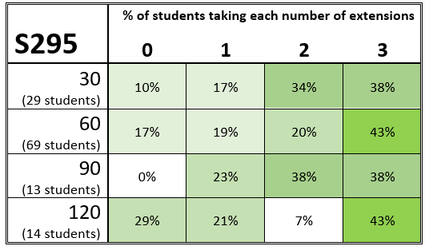
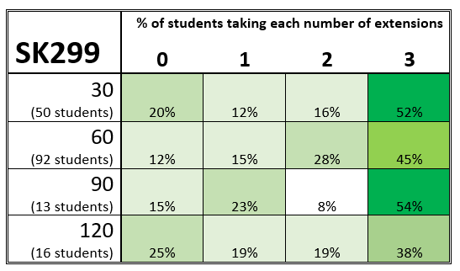
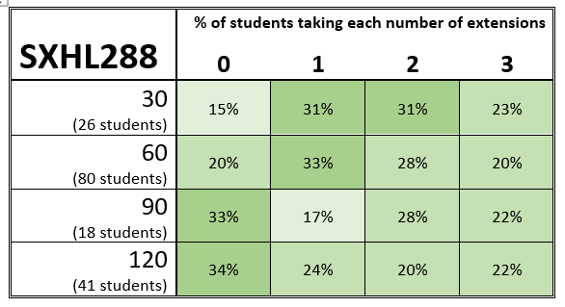
Extensions and Intensity

Slide 8
Does qualification make a difference?
Well, it depends how we look at it….
If we just compare on each module for the 4 relevant modules:
  NO statistically significant difference at all on any module
If we compare the two qualifications by study intensity across all modules (eg 60 credit Health Sci vs 60 credit Nat Sci):
  We get a very marked linkage at 30, 60, 120 credits
Possible confounding factor regarding some modules leading to more extensions, disproportionately taken by Health Sci students?

Slide 9
Comparing by intensity
30 Credits
 | Q64 (124) | Q71 (225)
0 | 63.7% | 40.9%
1 | 8.9% | 12.9%
2 | 7.3% | 14.2%
3 | 20.2% | 32.0%
60 Credits
 | Q64 (166) | Q71 (291)
0 | 31.3% | 23.4%
1 | 10.2% | 7.6%
2 | 10.2% | 9.6%
3 | 33.1% | 25.4%
4 | 4.8% | 11.3%
5 | 4.8% | 12.0%
6 | 5.4% | 10.7%
90 Credits
 | Q64 (46) | Q71 (62)
0 | 37.0% | 30.6%
1 | 13.0% | 6.5%
2 | 17.4% | 8.1%
3 | 23.9% | 27.4%
4 | 2.2% | 8.1%
5 | 2.2% | 6.5%
6 | 4.3% | 8.1%
7 | 0.0% | 0.0%
8 | 0.0% | 1.6%
9 | 0.0% | 3.2%
120 Credits
 | Q64 (27) | Q71 (68)
0 | 40.7% | 10.3%
1 | 7.4% | 5.9%
2 | 14.8% | 5.9%
3 | 25.9% | 19.1%
4 | 7.4% | 2.9%
5 | 0.0% | 10.3%
6 | 0.0% | 17.6%
7 | 0.0% | 7.4%
8 | 3.7% | 8.8%
9 | 0.0% | 2.9%
10 | 0.0% | 4.4%
11 | 0.0% | 0.0%
12 | 0.0% | 4.4%

Slide 10
TAKE AWAY POINTS
High intensity not always associated with multiple
extensions
Complicated picture with qualification
Other factors – eg employment status…
Early extensions can be a warning sign of struggle
Large numbers of extensions occur with all outcomes, but more often with lower grades
Some modules have a lot more multiple extensions, and a much stronger link between extensions and outcomes
CAMPAIGN ASSETS

Slide 11
Recommendations
Consider interventions to support students taking early
extensions
Assessment design – assignments requiring new skills or
or a great deal of detail need longer
Monitor level of extensions in modules as a measure
of real-time workload
Retain structured approach but with built-in flexibility –
students’ lives are complicated
CAMPAIGN ASSETS

Slide 12
ThANK YOU FOR LISTENING!
Questions?
Catherine.Halliwell@open.ac.uk Cath.Brown@open.ac.uk
Acknowledgements: eSTEeM, Data & Student Analytics, our project mentor, Rachel Hilliam

