Slide 1


A timed, marked mock exam to enhance student success
Cath Brown and Sue Pawley
School of Mathematics and Statistics
February 2025

Slide 2
Background: MST224
Large increase in numbers for 21/22 as module became part of the data science degree
Reduction in module pass rate in 20/21 and 21/22, despite similar exam format
Weaker Cohort
Notes:
Cath 19/20 examination taken under different circumstances due to Covid restrictions

Slide 3
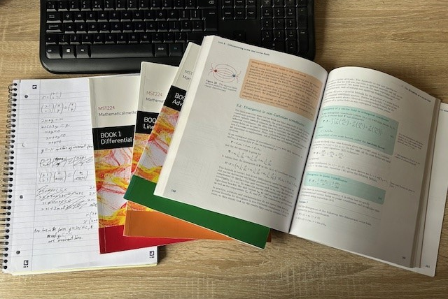
What are the issues with remote & open book exams
  Students seldom prioritise practising timing or working in test conditions
  They may not realise substantial revision is still necessary
  They may not appreciate a different style of question will be set to a closed book exam, eg they will not be asked for any standard definitions
  Remote exams can “feel like” a TMA:-
    Encourages typesetting
    Perfectionism is tempting
    No exam-hall adrenaline
  Opportunities for collusion/ GenAI use
Notes:
Cath

Slide 4
Introducing a timed, marked mock exam
Improving awareness of impact of time constraints
Encouraging earlier revision
Avoiding procrastination by introducing accountability
Giving a realistic picture of current position to help students focus their efforts
Notes:
Cath

Slide 5
How the marked mock works
Available early May; real exam a month later.
Available for a week, but same time limits as real exam once opened
Written by experienced AL using non-module FTE
Results back within 10 days
Marked by ALs using tutorial time
From second year, delivered using the iCMA system like the real thing
Notes:
Cath

Slide 6

Additional Support
  Full solutions available after cut off
    Typed up “perfect” solutions
    Handwritten “realistic” solutions
  Series of short (up to 15 mins) recordings going through questions
  Anonymous forum and drop-in session for students to raise issues
Notes:
Cath exam only open for one 24 hour period- standard exam time is 4.5 hours.

Slide 7
Impact of attempting the mock on student performance
88 students attempted the mock exam in 22J and then went on to take the real exam (a further 5 attempted the mock and then deferred the real exam)
166 took the mock in total in 23J
Students who attempted the mock were less likely to underperform in real exam
Notes:
Cath

Slide 8
Was this just high achievers wanting reassurance?
Percentages of students gaining marks in bands in mock
Notes:
Cath

Slide 9
But did we attract students across the range?
Students’ continuous assessment mark band
Notes:
Cath

Slide 10

Student experiences of the mock exam (22/23)
35 Students (48% response rate) responded to a 2023 survey which attempted to gauge the student experience of taking the mock examination and how it affected their preparation for the real exam.
All students that responded sat the real exam. The survey was opened after the real exam had taken place and did not close until after results had been released, giving students the option of whether to respond before or after they knew their results
The blue boxes in the slides are all quotes from students who have sat a mock exam

Slide 11
Why did you decide to take the mock exam?
“I hadn't done a marked mock for 20 years, I had really forgotten how much difference they make.”
“To familiarise myself with the process and to see how I coped with the time pressure and workrate.”
Notes:
Cath

Slide 12
Did the mock change the way you revised and prepared for the real exam?
“I had not revised much when I took the mock exam but it gave me a good sense of how much work I still had to put into it for the real exam.”
“I've managed to iron out so many wrinkles…..and also gave me a healthy dose of fear. I don't know as much as I thought. So I've been revising hard”
Notes:
Cath

Slide 13
How much did the mock exam help with the real exam?
“I think the mock exam is a really good thing…But most importantly the experience of doing a paper under exam conditions before the real thing is so helpful”
“I went to pieces in the mock and did very badly, I do not know my real exam grade yet but I performed much better in the real exam and did not go to pieces. ”
Notes:
Cath

Slide 14
How did the mock change your feelings about the real exam?
“Immediately after the exam, I felt stressed and worried as I knew I had not done enough to pass and found it very difficult, particularly with the timings. Though I changed my thought process around after a short time and used the process a positive -to help me focus on what I was doing wrong and how to improve. ”
“It felt much more authentic than just setting myself a past paper and a time limit. I can't explain why it feels different but it did, and I was able to use that to anchor myself in the real exam when I started to stress.”
Notes:
Cath

Slide 15

How helpful did you find having the mock exam marked and returned?
“Having university personnel grading the mock made me accountable to try my best. No doubt that the mock was one of the main reasons that made the difference between failing and passing the real exam.”
All students that responded to the survey found having the Mock exam marked helpful or very helpful.
“Doing a past paper and marking it yourself just isn't the same”

Slide 16
Problems still to solve
Downloading and distributing scripts to AL markers efficiently
Getting scripts and marks back to students efficiently
Conflicts in use of ALs’ time at a busy time of year
  Coincides with final TMA marking
  And often external pressures too
Work on “aftercare” for students who are disappointed with their score
Notes:
Cath

Slide 17

QUESTIONS?
Cath.Brown@open.ac.uk
Susan.Pawley@open.ac.uk
Notes:
Cath

