Slide 1
Improving student use of feedback on marked TMAs
Carol Calvert, Colette Christiansen and Clare Morris

Slide 2
Why this project?
Feedback on TMAs is a major element of the learning experience for distance students
More insight is needed into the type of feedback valued by students, and the way in which they use it
A significant proportion of students do not pick up their marked TMAs – around 10% for all 19J modules across the university
This represents about 40,000 uncollected scripts – and an enormous amount of work on the part of tutors

Slide 3
Not one project but three!
This project has three distinct phases over three years
Phase 1: Lead by Carol Calvert and Clare Morris
    Investigated feedback collection rates
    Surveyed of students on statistics modules about their views on TMA feedback
Phase II( eSTEeM funded): Carol Calvert, Clare Morris and Colette Christiansen
    eSTEeM funded project to extend questionnaire across economics and statistics
    Five Als involved in collection of qualitative information from their students
    Dissemination to Als and students
Phase III ( eSTEeM funded): Colette Christiansen and Carol Calvert
    Further statistical analysis of factors impacting feedback collection
    Further dissemination via publication

Slide 4
Aims of the project
To obtain a more in-depth understanding of how students use feedback on TMAs, and what they regard as ‘useful’
To provide this information to ALs in order to inform their marking practice
To educate ALs on systems tracking feedback collection
To provide advice to students on the use of feedback, based on the views of their peers
To obtain a more in-depth understanding of which factors affect whether or not a student collects their feedback

Slide 5
Design of study: Phase I and II
Anonymous questionnaire to students provided qualitative information on what students say they value in TMA feedback.
Analysis of central data provided information of which students were less likely to pick up their marked TMAs.
Qualitative information was provided by a small group of tutors through discussion with volunteers from amongst their own students. Findings were discussed with tutors at a series of events
Summary document of advice to students was compiled from the findings and placed on module websites

Slide 6
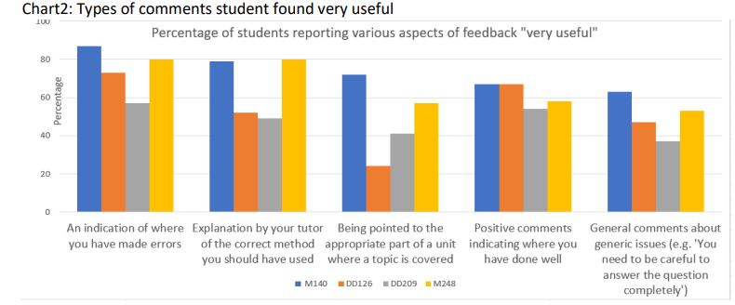
Usefulness of different aspects of feedback
Students find general comments eg “You need to be careful to answer the question completely”
Level 1- Blue M140
Orange DD126
Level 2 –Grey DD209
Yellow M248
M140 students find it very useful to be directed to the units compared to DD126 students
Positive comments matter to students

Slide 7
Dissemination to tutors
Discussions with tutors highlighted a range of areas including
  The extent to which tutors prompted students to collect feedback varied widely
  Many tutors were unaware that they could check whether students had collected feedback
  Tutors’ view was that anxiety was a barrier for students and good students were more likely to collect their feedback
  Use of the PT3 Assessment summary form varies widely between tutors and more guidance on what this summary should include would be very helpful
  Similarly more guidance on monitoring

Slide 8
Advice to students and from students
Some sample comments in answer to the question ‘What piece of advice about feedback would you give to someone starting their first module?’:
Read the feedback initially then go back the next day once emotions surrounding marks have subsided. Read, and review, then revisit the comments a few days later
Focus on applying the feedback given rather than focusing on your assessment score
Try not to get too upset if your mark isn't as high as you'd hoped or wanted
It's for your own good. If you don't know where you are going wrong, how do you expect to improve?
A4 sheet of advice distilled from the ‘advice’ comments
Quite a few course teams have placed this on their module websites

Slide 9
Design of study: Phase III
Data held on The Open University systems for students across all undergraduate modules was linked enabling both student characteristics and scores on assignments to be related to the propensity to pick up assignment feedback
The study included 88,000 students who were actively studying in October 2022
The data included 296,628 TMAs
The data included 9 factors in three key areas covering
  demographic factors (gender, ethnicity, Index of Multiple Deprivation (IMD)),
  assessment related factors (level, whether the assignment was the first, second or third in the course, performance of student on the assignment) and
  timeliness factors (whether the student had an extension, the return time from assignment cut-off date, whether the return was before or after the next assessment cut-off dates for any of modules studied).

Slide 10
Design of Study
64% of the students included in the study were female, 3% were Black and 18% were in the lowest quintile of postcodes in the Index of Multiple Deprivation
Separate χ2 tests were conducted to determine if each of the nine factors were individually significant in explaining the differences in collection rates
A stepwise logistic regression, including each of the 9 factors as potential predictors, was then undertaken to determine the order of importance of the 9 factors and which factors remained significant
Finally, first level interactions between the factors were also included in the model.

Slide 11
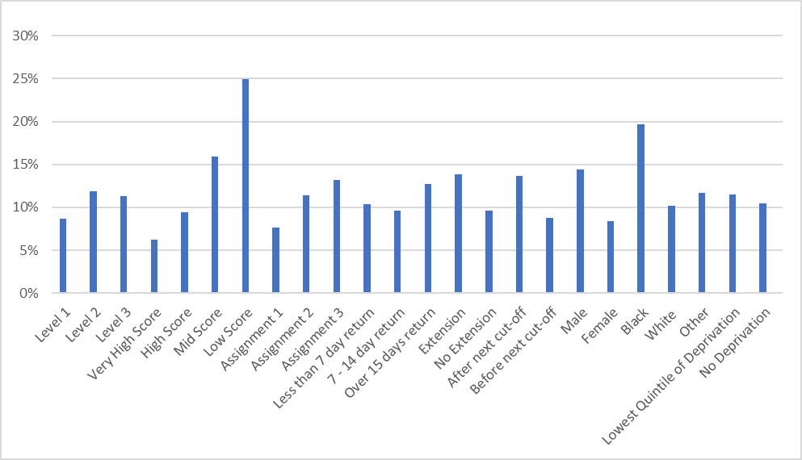
Results
All 9 factors were found to be individually significant (p < 0.001)
Variation by factor can be seen in the proportion of marked assessments not collected
The largest variation is seen for assignment score (6% non-collection in the highest category and 25% in the lowest)

Slide 12
Results
The analysis showed the order of importance of the factors to be
  Assignment score
  Gender
  Assignment number
  Whether feedback was returned before or after the cut-off date for any assessment on any course studied
  Course level
  Ethnicity
  Whether or not the student had an extension
  Time taken to return the assignment

Slide 13
Conclusions
The link between poor performance and feedback collection suggests interventions encouraging poorer performers to access feedback should be explored further
Clear trend that in general faster return times lead to a greater likelihood of the student collecting their feedback
Most significant of these factors was whether they received the feedback before the cut-off date of the next assignment they needed to submit, irrespective of whether it was for the same course or a different one
This shows that there is a risk that students mentally move on and do not allocate time to review feedback
Consideration should be given to having dedicated times for reviewing feedback, particularly for courses which have a modular design.

Slide 14
Publication
This work has now been published in Educational Researcher
https://doi.org/10.3102/0013189X241285416
And on the scholarship exchange are the two original reports
Student use of TMA feedback
Improving student use of feedback on marked Tutor Marked Assignments (TMAs). eSTEeM Final Report.

