Slide 1
Intro Slide Title 3
Perceptions, Expectations and Experience of Group Tuition: towards a shared understanding amongst stakeholders (part II: the student perspective)
Project team:
Anne Campbell (ALSPD), Anne-Marie Gallen (E&I), Mark Jones (SPS)
Thanks to Sylvie Serpell (interviewer)
Mark Jones
School of Physical Sciences
22 Feb 2023

Slide 2
Project aim
Our driver is the question
Do our students, teaching staff and other staff have common perceptions and expectations of what tutorials are for?

Slide 3
Background
Tutor perceptions of tuition in groups (Walshe & Gallen, 2017; Campbell et al. 2018)
Study (2016) with Stage 1 STEM tutors, about face-to-face and online tutorials.
Key findings were that tutors:
Appreciated the social aspects of tutorials.
Felt that students placed too much emphasis on assessment tasks.
Found it difficult to facilitate interaction online, and felt that students wanted presentations.
Difficulties in facilitating interaction in online tutorials reported by many others at the OU (e.g. Kear et al., 2012; Macdonald and Campbell, 2012; Lowe, Mestel and Williams, 2016; Butler, Cook and Hayley-Mirnar, 2019).
Approach of asking students what they expect in tutorials has been done before, e.g. Stevenson and Sander (1998) (face-to-face, psychology).

Slide 4
Part II: student perspective
We aimed to explore:
Student perceptions on the role of tutorials (“tutorials are important for…”)
Student expectations about teaching methods in tutorials
Student experiences of tuition in groups
Barriers to attendance or participation
Our study uses Stage 1 STEM modules. We considered face-to-face and online tutorials.
The project started in 2019 but then was delayed in 2020 because of the covid pandemic. On restarting the project we were also interested to find out if online interaction during the pandemic had altered student attitudes to online tutorials.

Slide 5
Part II: student perspective
Stage 1 STEM students
S111 (2019B) Questions in science
SM123 (2018J) Physics and space
T192 (2019D) Engineering: Origins, Methods, Contexts
T193 (2019D) Engineering: Frameworks, Analysis, Production
TM111 (2019D) Introduction to Computing and Information Technology 1
Surveys (closed and open questions)
Survey 1 (April 2019) Invited 3,147. Responses: 263
Survey 2 (April 2022) Invited 3,645. Responses: 197
Interviews
Eight volunteers (with demographic spread) Summer 2019.

Slide 6
Student initial perceptions (interview data)
Student interviews asked about perceptions before attending a tutorial,
“I don’t think I remember reading any article about OU tutorials in advance”.
“…my initial thoughts was I was a little bit worried (laughs) if I’m honest because I thought well I don't, I don't fully understand what this is about and I wasn't sure if I was completely prepared for University”
“…fear and dread that I was going to be on the spot and asked questions…”
And how these changed after attending,
“it turned out to be less formal which was actually quite nice”.

Slide 7
Role of tutorials
Surveys asked students to respond (5-point Likert scale)
“I think face-to-face tutorials or dayschools / online tutorials are important for… “
Assessment
Meeting tutors/students
Consolidation of knowledge
Skills development
Likert scale responses
strongly agree / agree/ neither/ disagree/ strongly disagree
have been mapped to numerical scale (-2, -1, 0, 1, 2).
We give mean score and standard error of this mean.

Slide 8
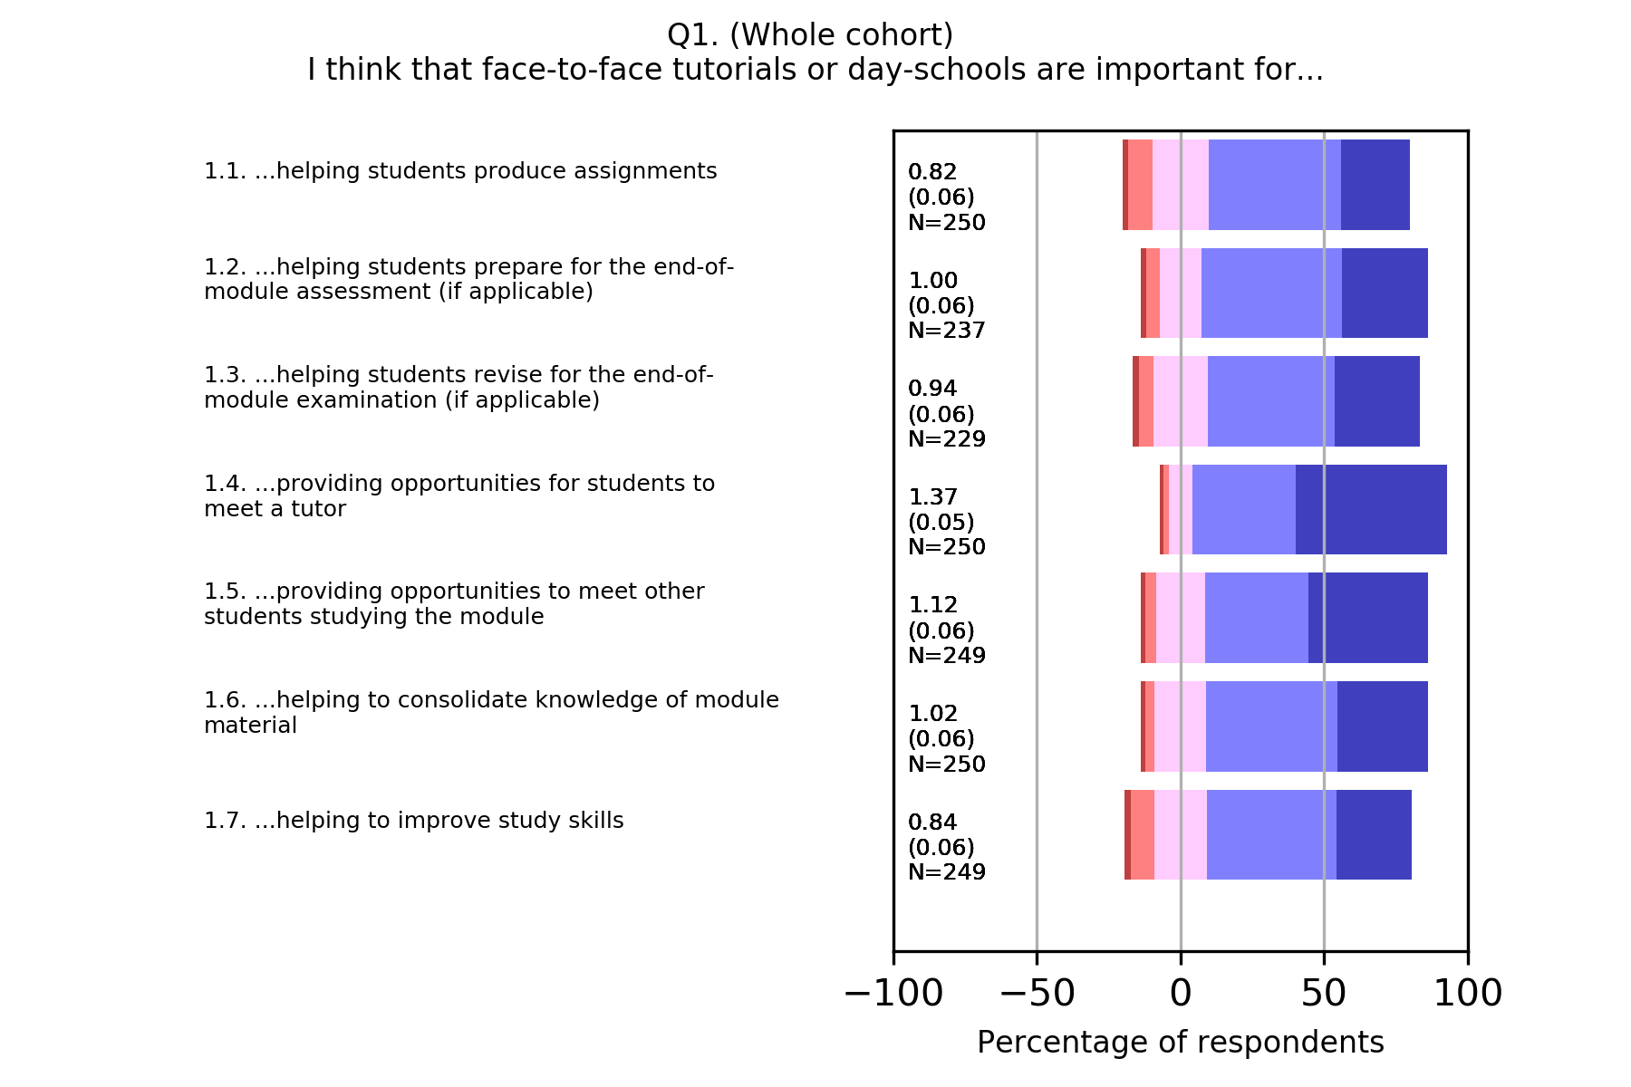
Face-to-face
Notes:
Scale 140% and recentre

Slide 9
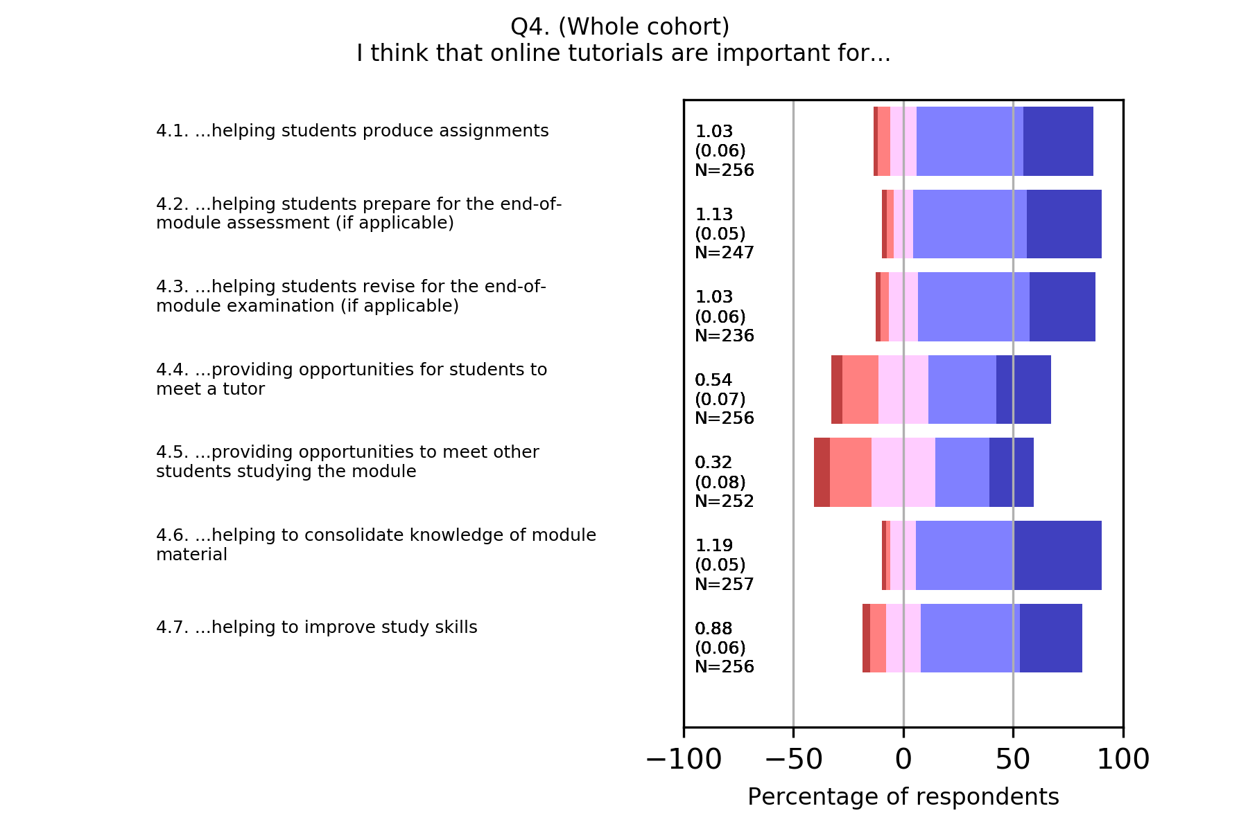
Online (2019)
Notes:
Scale 140% and recentre

Slide 10
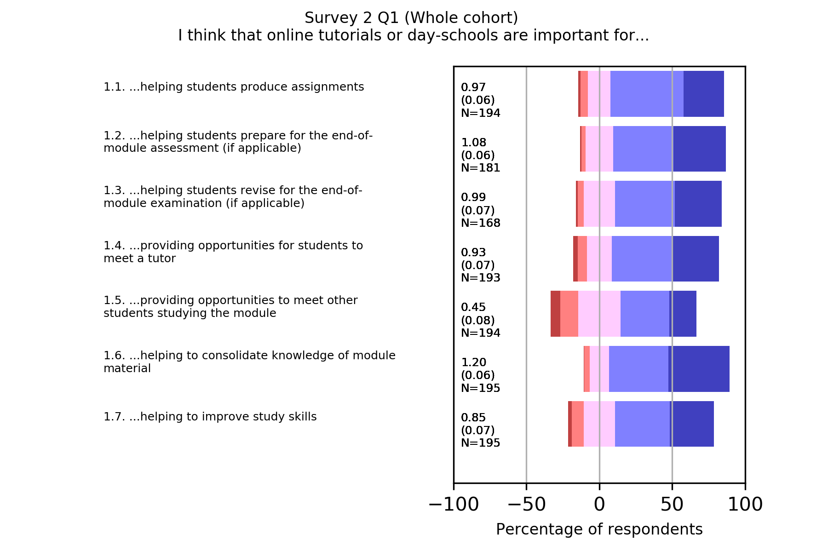
Online (2022)
Notes:
Scale 140% and recentre

Slide 11
Role of tutorials
In both face-to-face and online tutorials, students ascribe similar importance to their role in consolidating knowledge, developing skills, and preparing assessment tasks.
The major difference between face-to-face and online relates to the social purpose of tutorials (meeting tutors and other students).
While preparing for assessment is highly rated by students, consolidation of knowledge is consistently rated higher.
The tutor view that students are ‘too focussed’ on assessment may arise from student anxiety about assessment tasks.

Slide 12
Teaching methods expected in tutorials
Surveys asked students to respond (5-point Likert scale)
Tutorials should be mainly…
Presentation
Learning activities
Mixture of presentation and learning activity
Tutorials should include small group working.
Tutorials should include opportunities to ask questions.

Slide 13
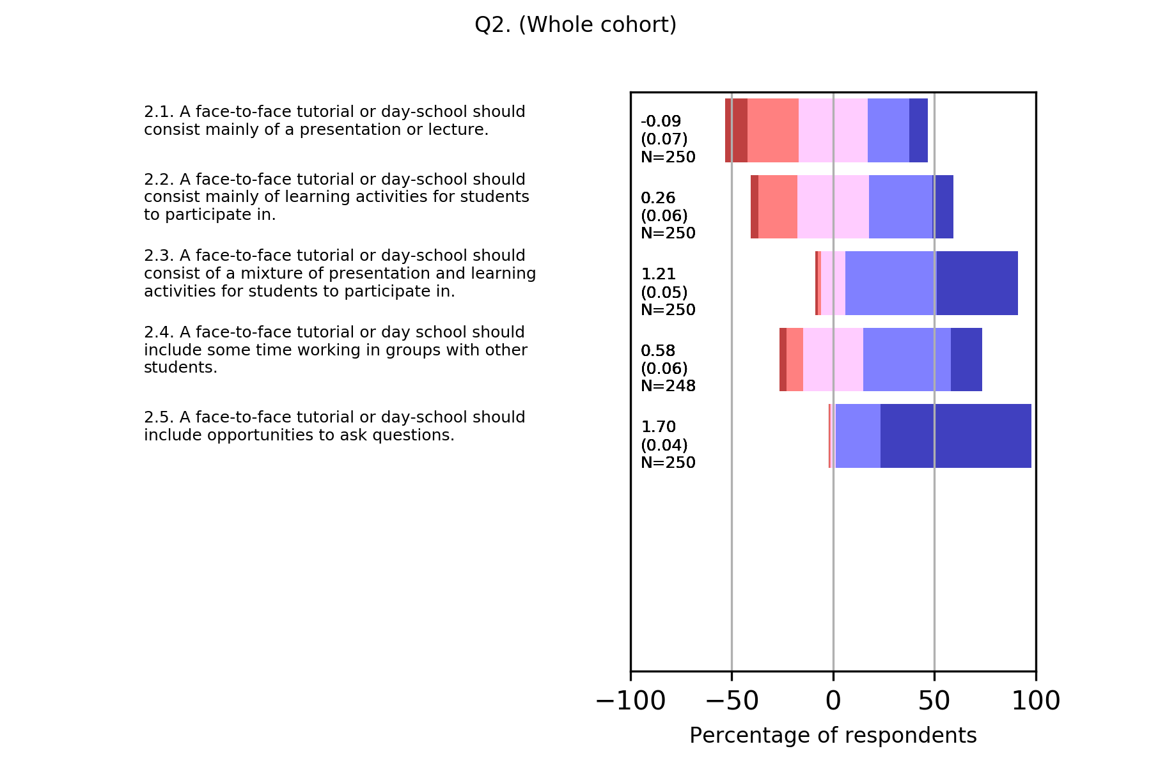
Face-to-face

Slide 14
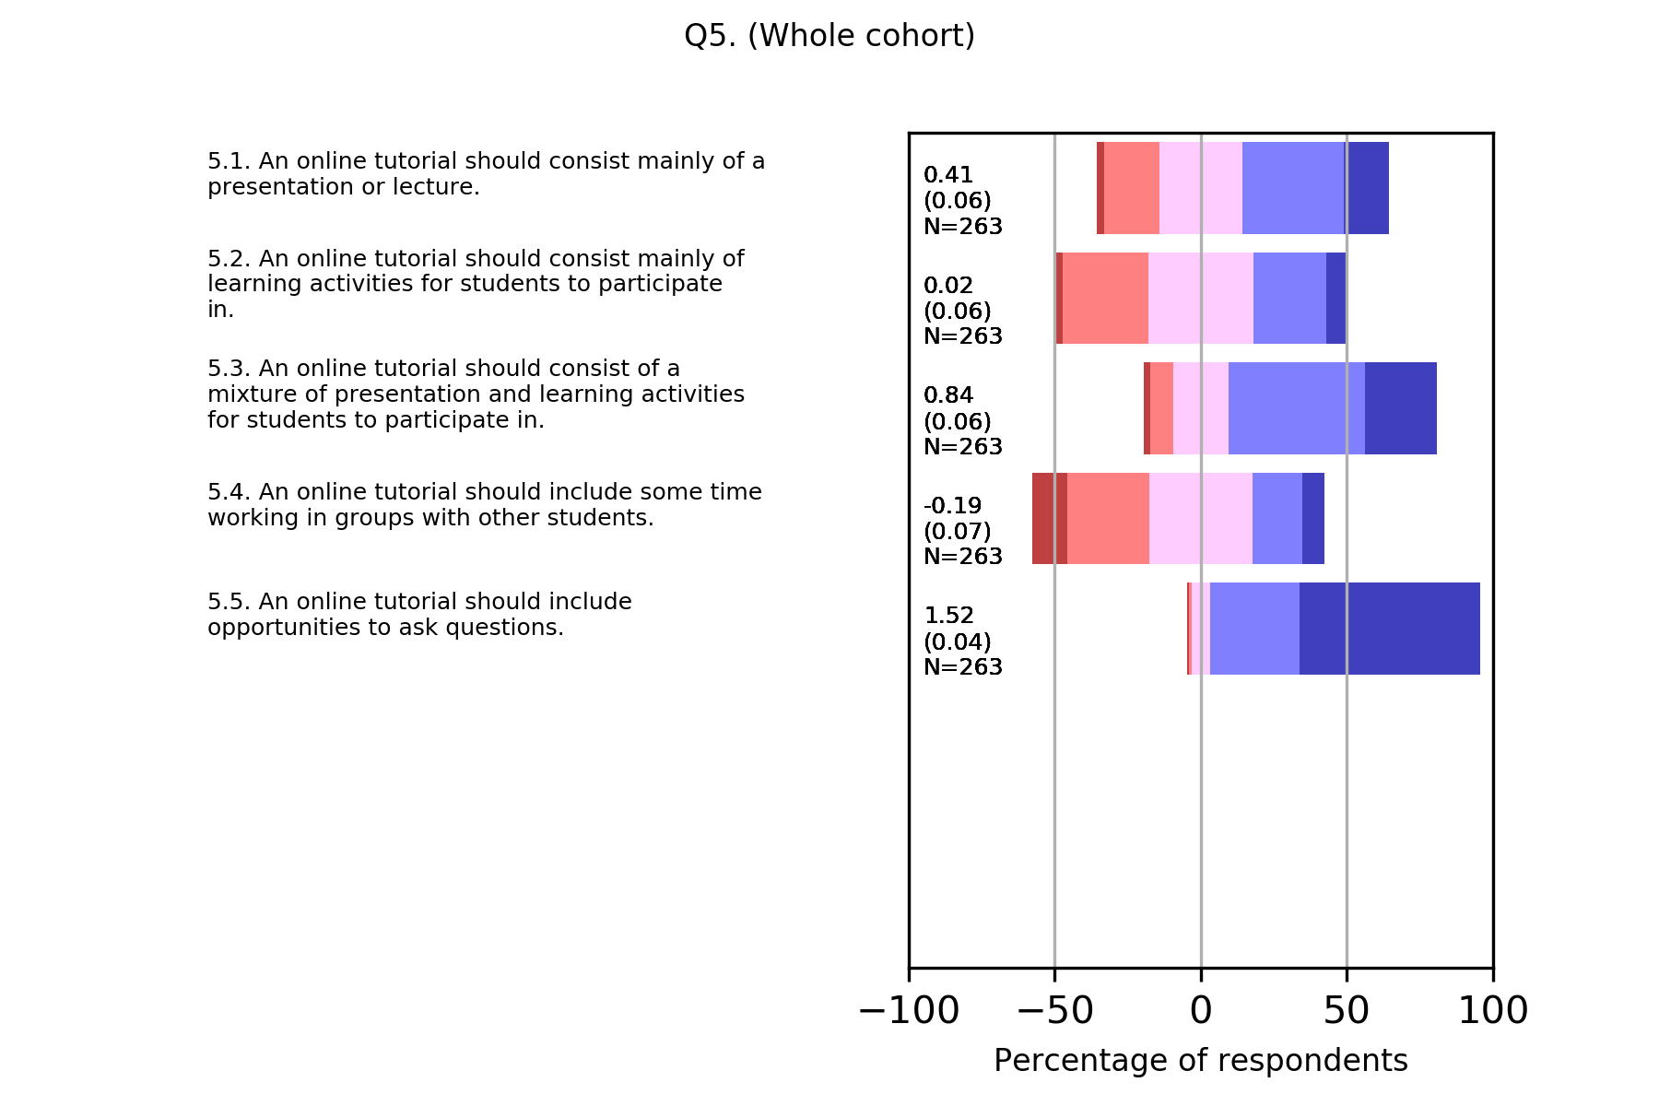
Online (2019)
Notes:
Survey 1 Q5

Slide 15
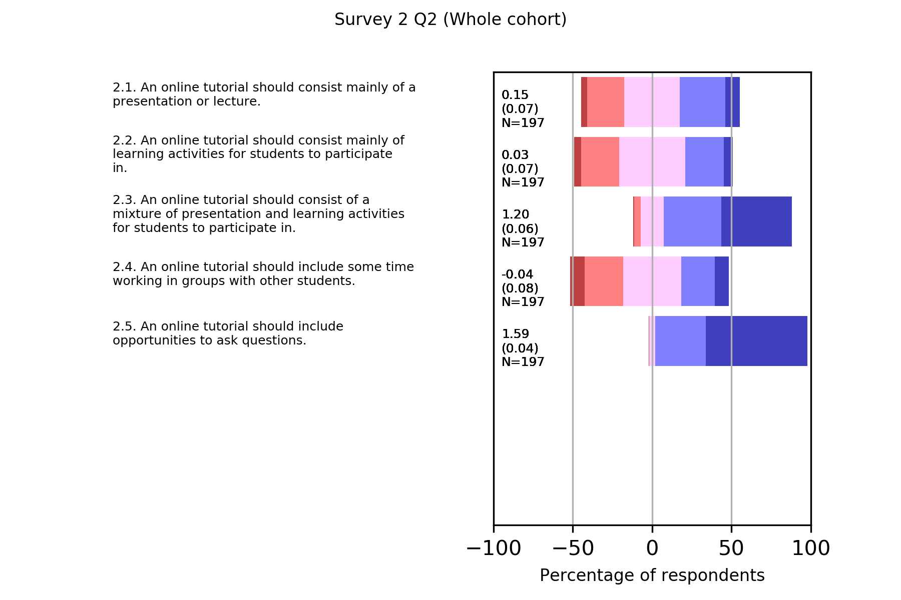
Online (2022)
Notes:
Survey 1 Q5

Slide 16
Teaching methods expected in tutorials
The most highly agreed with statement is that tutorials should provide an opportunity to ask questions.
In face-to-face and online tutorials, the preference is for a mixture of presentation and activities. A presentational format is more acceptable online than face-to-face, but students still prefer a mixed (active and passive) approach.
Group working is expected in face-to-face settings. Online, students slightly disagree with the statement that tutorials should involve group working.
Qualitative comments in surveys illustrate issues around online interaction
"Generally, they haven't been especially useful as they lack any kind of meaningful interaction and it is difficult to ask questions / really engage with the content". (Online)
"...some are useless because they are merely presentations and do not require student involvement, so might as well watch the recording". (Online)
"I have found some tutors do not understand questions when asked that deviate from the scripted presentation". (Online)

Slide 17
Teaching methods experienced
Face-to-face has a predominantly mixed (active and passive) approach (~70%). Less use of mixed approaches online, but increased from 47% to 52% (2019 to 2022).
Group working online is reported by 24% / 28% of students in 2019/2022.
An interviewee reported that
”...they're group activities in that, you know, … there would be an equation and, you know, we’d all write on the screen and some of us would provide one answer and someone else would write another answer and then, you know, there might be a little bit discussion around how we came to that” (online)
This raises the question of whether group activities in tutorials are focussing on discussing individual outputs rather than facilitating student joint working.

Slide 18
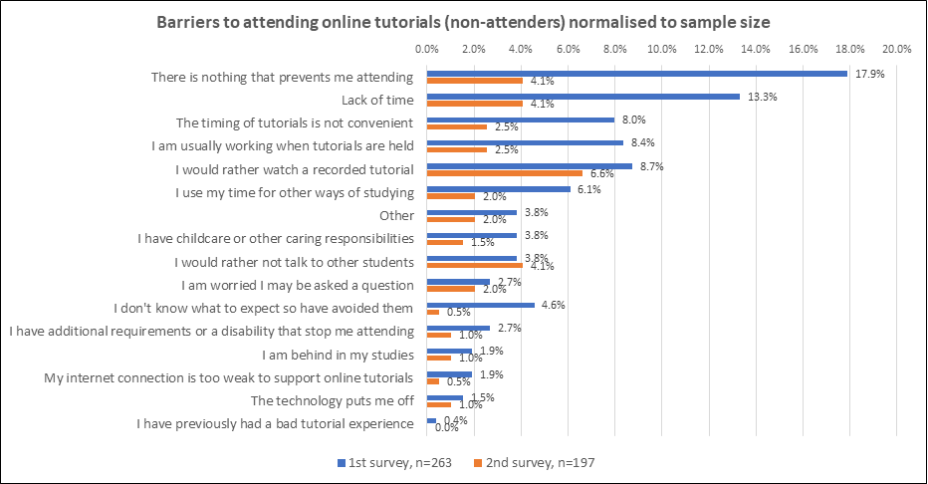
Barriers to online attendance (2019 & 2022)
Notes:
Non-attenders (online). Most barriers dropped between 2019 and 2022. However “rather watch a recording” and “rather not talk to other students” remained similar

Slide 19
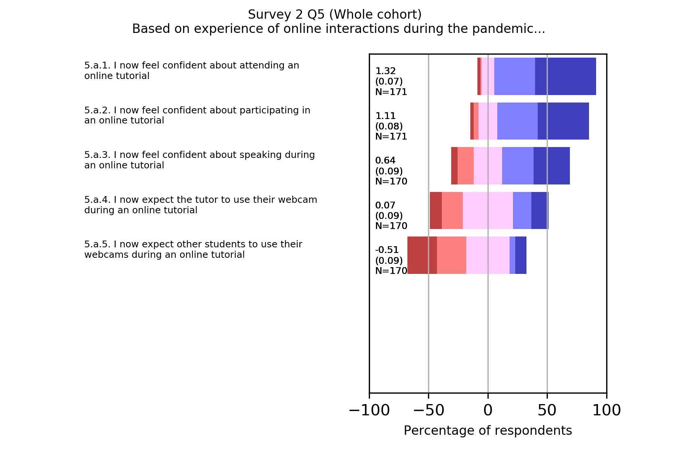
Online tutorials after pandemic experience

Slide 20
Summary of key findings
Lack of understanding of tutorials can cause anxiety.
Students have a strong preference for a mixture of presentational materials and learning activities.
The opportunity to ask questions is very highly valued. Ensuring that questions are answered to students’ satisfaction should be a high priority.
Working in small groups is expected in face-to-face tutorials but is thought not to be important in the online context.
Use of learning activities in online tutorials has seen some growth from 2019 to 2022.
Online group activities may be based on discussion of answers rather than fostering student collaboration on learning tasks.
Online, non-participation seems to be dominated by students who would rather watch recordings and those who prefer to avoid social interaction.
Post pandemic most students are more confident in using synchronous communications technologies. However, there was a wide variety of pandemic experience. Students strongly disagree with using webcams in online tutorials.

Slide 21
Slide Title 30
Thank you

Slide 22
Project aim
Our driver is the question
Do our students, teaching staff and other staff have common perceptions and expectations of what tutorials are for?
Why common perceptions matter:
Our tutorials are not mandatory. So student perception influences levels of attendance, as well as levels of participation during a tutorial.
Our module teams design tuition strategies, which may encourage or discourage students from attending/participating in learning activities during tutorials.
Our tutors design and run tutorials which influence student perceptions and how students learn from the experience.
Other stakeholders can influence university-wide policy (e.g. professional services staff), or can affect tutor perceptions (e.g. staff developers).

Slide 23
What students experienced
Notes:
Skip if not enough time

Slide 24
What students experienced
Notes:
Skip if not enough time

Slide 25
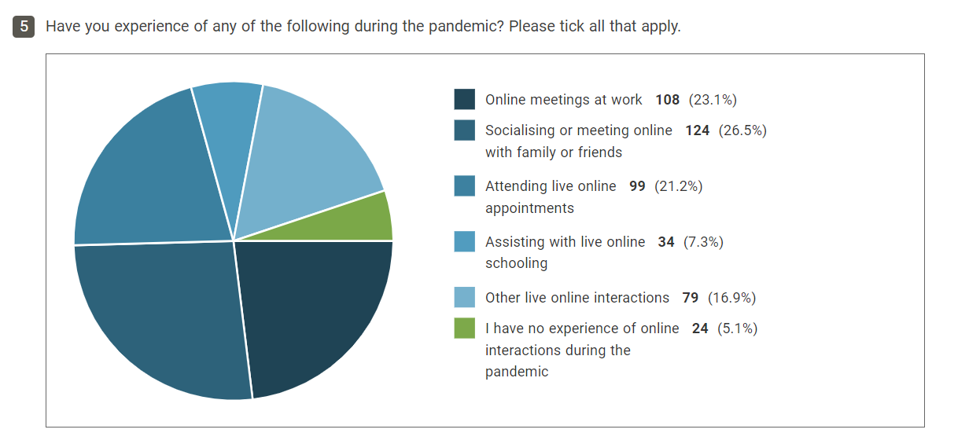
Pandemic: online experience
Notes:
Overlap – the fraction reporting no online interactions in the pandemic is 12.2%

Slide 26
Slide Title 31

