Slide 1
Improving student use of feedback on marked TMAs
Carol Calvert, Colette Christiansen and Clare Morris
Improving student use of feedback on marked Tutor Marked Assignments TMAs eSTEeM Final Report.pdf (sharepoint.com)

Slide 2
Outline
Why this project?
Intended outcomes
Process
Findings and outputs
Final points

Slide 3
Why this project?
Feedback on TMAs is a major element of the learning experience for distance students
More insight is needed into the type of feedback valued by students, and the way in which they use it
A significant proportion of students do not pick up their marked TMAs – around 10% for all 19J modules across the university
This represents about 40,000 uncollected scripts – and an enormous amount of work on the part of tutors

Slide 4
Aims of the project
To obtain a more in-depth understanding of how students use feedback on TMAs, and what they regard as ‘useful’
To provide this information to tutors in order to inform their marking practice
To provide advice to students on the use of feedback, based on the views of their peers

Slide 5
Design of study
Investigation limited to two statistics modules and two economics modules
Questionnaire, (design informed by preliminary work carried out in a previous project) was placed on the module websites with an invitation to complete anonymously
Questionnaire results were analysed, using both quantitative and qualitative methods
Findings were discussed with tutors at a series of events
Summary document of advice to students was compiled from the findings and placed on module websites

Slide 6
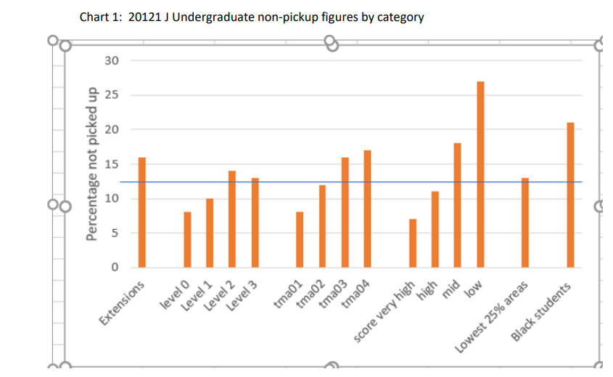
Brief summary of findings
Students with extensions are less likely to pick up
Level 2 students are least likely to pick up
Students are likely to pick up later TMAs
Students with low scores (less than 40%) are least likely to pick up
No evidence students from more disadvantaged areas are less likely to pick up
Some evidence Black students less likely to pick up

Slide 7
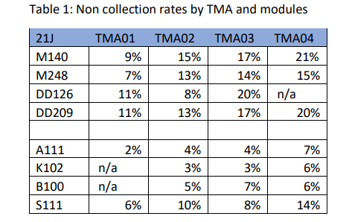
Massive variation by module
Our four modules where we used student questionnaires show the trend of later TMAs being less likely to be picked up
BUT contrary to overall patterns
The level 2 Stats module has lower non collection rates than level 1
Every module is different and needs looking at individually

Slide 8
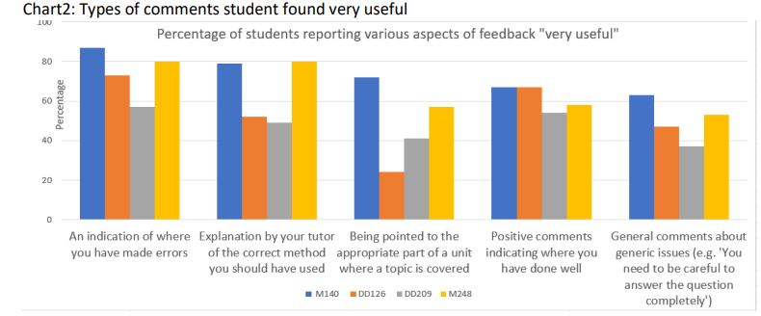
Usefulness of different aspects of feedback
Students find general comments eg “You need to be careful to answer the question completely”
Level 1- Blue M140
Orange DD126
Level 2 –Grey DD209
Yellow M248
M140 students find it very useful to be directed to the units compared to DD126 students
Positive comments matter to students

Slide 9
Dissemination to tutors
Discussions with tutors highlighted a range of areas including
  The extent to which tutors prompted students to collect feedback varied widely
  Many tutors were unaware that they could check whether students had collected feedback
  Tutors view was anxiety was a barrier for students and good students were more likely to collect their feedback
  Use of the PT3 Assessment summary form varies widely between tutors and more guidance on what this summary should include would be very helpful
  Similarly more guidance on monitoring

Slide 10
Advice to students
Some sample comments:
Read the feedback initially then go back the next day once emotions surrounding marks have subsided. Read, and review, then revisit the comments a few days later
Focus on applying the feedback given rather than focusing on your assessment score
Try not to get too upset if your mark isn't as high as you'd hoped or wanted
It's for your own good. If you don't know where you are going wrong, how do you expect to improve?
(a full copy of the paper for students was circulated with the invitation to this seminar)

Slide 11
Final thoughts
Students dislike the separation between PT3 and script comments – will this change with WiseFlow?
Accessibility via phone and tablet – for many students the preferred medium – must be considered.
Training both for new tutors and for monitors could take into account the findings of this study.
Paper will be submitted to ‘Open Learning’

