Slide 1
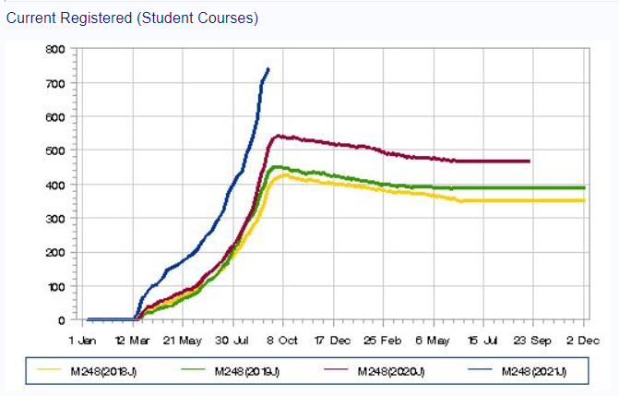
Embracing the difference-M248
 | Number students @20/09/2021
Data Science+related | 241
Maths & Stats+related | 224
Economics +related | 144
All others | 124
Scholarship talk 7th Oct

Slide 2
Just a reminder :Analysing data
The original course was designed and written by members of the school of Mathematics and Statistics as a part of Maths and Statistics qualification.
The course was re written for 2017 when there were 372 students registered. This year we expect just over double that number of students to be registered.
The vast majority of the 18 Associate lecturers in 2017 are still tutoring the module and they were used to working with students on Maths/Statistics qualifications . The majority of the students in 2021 are NOT on Maths and Statistics qualifications.
The course is now compulsory for students talking Economics and Data science as well as being increasingly popular with students on other degree pathways.
Exam pass rates results have consistently been higher for students on the Maths and Stats degree pathway

Slide 3
So why change? One view is pass rates

Slide 4
Changing “Analysing Data” to create more of a community for students
Major elements considered pre change
Theory
Learning theory re the students
Practical
Tutorial support
Assessment-exam
Pre Module start
Change theory re tutors and wider organisation
Statistics for non -specialists

Slide 5

Learning theory re the students
1. Students learn best what they practice and perform on their own.
2. Knowledge tends to be specific to the context in which it is learned.
3. Learning is more efficient when students receive realtime feedback on errors.
4. Learning involves integrating new knowledge with existing knowledge.
5. Learning becomes less efficient as the mental load students must carry increases.
Tishkovskaya, S., and G. A. Lancaster. 2012. “Statistical Education in the 21st Century: A Review of Challenges, Teaching Innovations and Strategies for Reform.” Journal of Statistics Education 20 (2): 1–56.

Slide 6
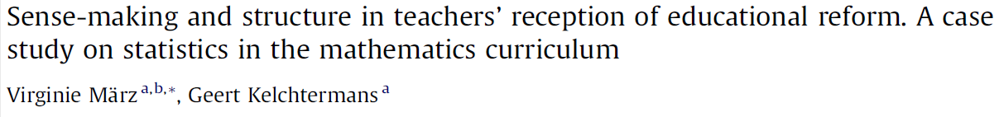

Change theory re the tutors and the organisation
-Acceptance of reasons for change- by tutors / school / Economics and Open degree
Micro politics- within tutors/school/ other schools
Concept of fair distribution of workload- within tutors
“Implementation mediated by personal beliefs about the content,normative ideas about good teaching and structural reality(i.e. subcultures,roles,positions)

Slide 7
Statistics for non specialists
Attitudes towards Statistics
Prior experience and Aptitude
Statistics Anxiety – Interpretational anxiety
-test and class anxiety
-fear of teacher
- fear of asking for help
- Computational self-concept
- worth of statistics
-

Slide 8
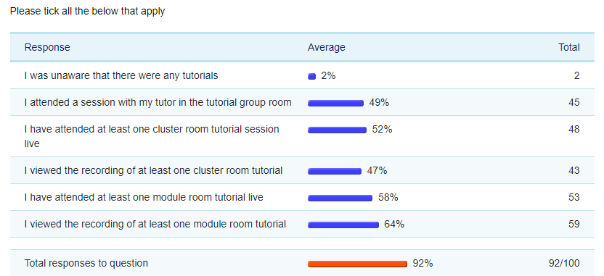
Asking students(1) 14th Dec 2020 to 14th Jan 2021 : 100 responses from 525 students. Three fixed and four open text questions
Background: Annonymous so we asked studying M248 as a part of which qualification and how many credits they were studying at 1st Jan 2021
Level of Awareness:

Slide 9
Asking students (2): Free text
One thing which would make M248 tutorials more useful to me is...
One thing that really irritates me about M248 tutorials is...
One piece of advice about M248 tutorials that I would give other students is...
Thank you very much for your time. If there is anything you would like to add please feel welcome to email me at carol.calvert@open.ac.uk or add in the text box below

Slide 10
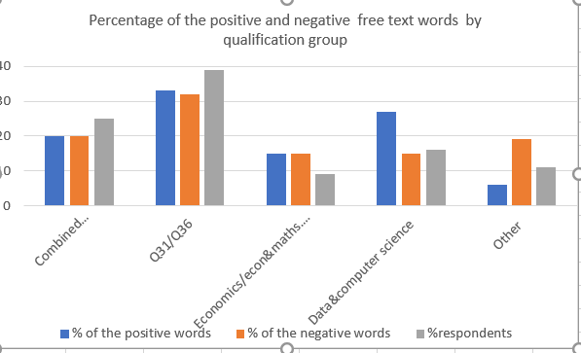
Variation between groups :20J

Slide 11
Practical:Changes in Tutorial support (1)
Grouped students into tutorial groups by qualification (instead of by geography) and with a tutor who had an interest in their area– shared interest, peer support,integrating knowledge into qualification route
Tutors given around half their tutorial time to spend on sessions just with their tutor group- greater personal contact so student more likely to ask for support and reduce ”fear of teacher /asking for help”
Introduced core and qualification route tutorials- qualification route tutorials have more relevance/ value to students’ the qualification routes, students attending sharing the same qualification route,
Surveyed students about what they wanted from tutorials- provided more day time tutorials and more qualification route tutorials

Slide 12
Practical:Changes in Tutorial support (2)
Used data on access to recordings of tutorials to gauge the areas students kept reviewing- more tutorials on areas students found more difficult
Tutor invited to air their concerns at a very early stage-allocation of hours biased towards non Maths and Stats qualification groups
Tutors encouraged to use more of tutorial time on supporting students to work through examples – increased active learning elements

Slide 13
Practical:Pre course start and exam
We adapted the ideas already in use elsewhere in the school
As Economics students were the biggest concern we got some materials written by an Economist who happened to tutor on the course. The materials were designed to introduce the students to the ideas in the course and supported by a series of three tutorials pre course start
The first two units of the course were made available to students during the summer . Satisfactory completion of a quiz then gave students access to further units and the course software if they wished
The multiple choice element was removed from the exam to enable greater credit for partially complete answers to be given

Slide 14
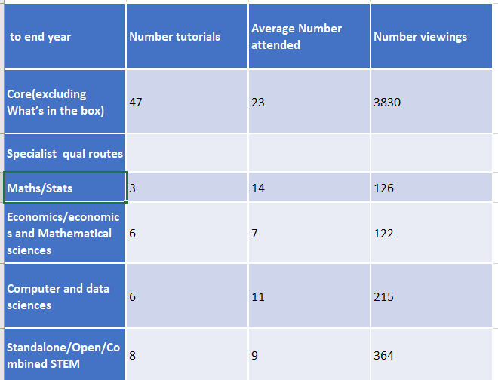
How did students react?
Table 5: Attendance and views to date
But the qualification routes have different numbers of students and tutorials and recorded tutorials on them
So………….

Slide 15
Another take is what elements do students find hard ? Ask them /look what they attend/look what recordings they keep revisiting

Slide 16

Viewed a slightly different way
So students attend their qualification route tutorials but watch the recordings of the core tutorials
This Photo by Unknown Author is licensed under CC BY

Slide 17
Conclusions
Contributed to building a sense of community - some of the forums were very active
Associate lecturers really appreciated having time to spend with their tutor group and enjoyed running tutor group only session and having non Q31/Q36 groups- the second year there was no need to “encourage” tutors to take non Maths and Stats tutor groups
Students seemed to welcome
“Compared to previous modules I had studied, M248 was definitely the best in terms of tutor approach, forum discussion structure, efforts to make every student to feel inclusive,
being aware that students come from different backgrounds,
and reflecting this in tutor groups arrangements as well as specifically orientated tutorials. Thank you.”

Slide 18
Thank you and questions?
Further details from Carol.Calvert@open.ac.uk or Rachel.Hilliam@open.ac.uk

