Slide 1


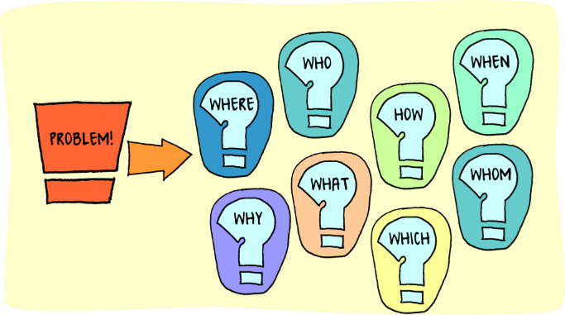

Improving student use of feedback on marked TMAs
Carol Calvert (staff tutor), Clare Morris (AL)
Problem: Inefficient use of correspondence teaching time
Symptom: up to 10% of marked etmas are not collected
(prior work undertaken outside eSTEeM on scholarship exchange https://openuniv.sharepoint.com/sites/units/lds/scholarship-exchange/documents/Student%20%20use%20of%20TMA%20feedback.pdf#search=calvert)
Solution (eSTEeM project):
- increase awareness of tutors of which students are and are not picking up and why
- build and disseminate materials for students to help them understand, use and value written feedback on TMAs
- build and disseminate materials for tutors to help them develop ways to get students to want to engage with feedback
This Photo by Unknown Author is licensed under CC BY

