Slide 1
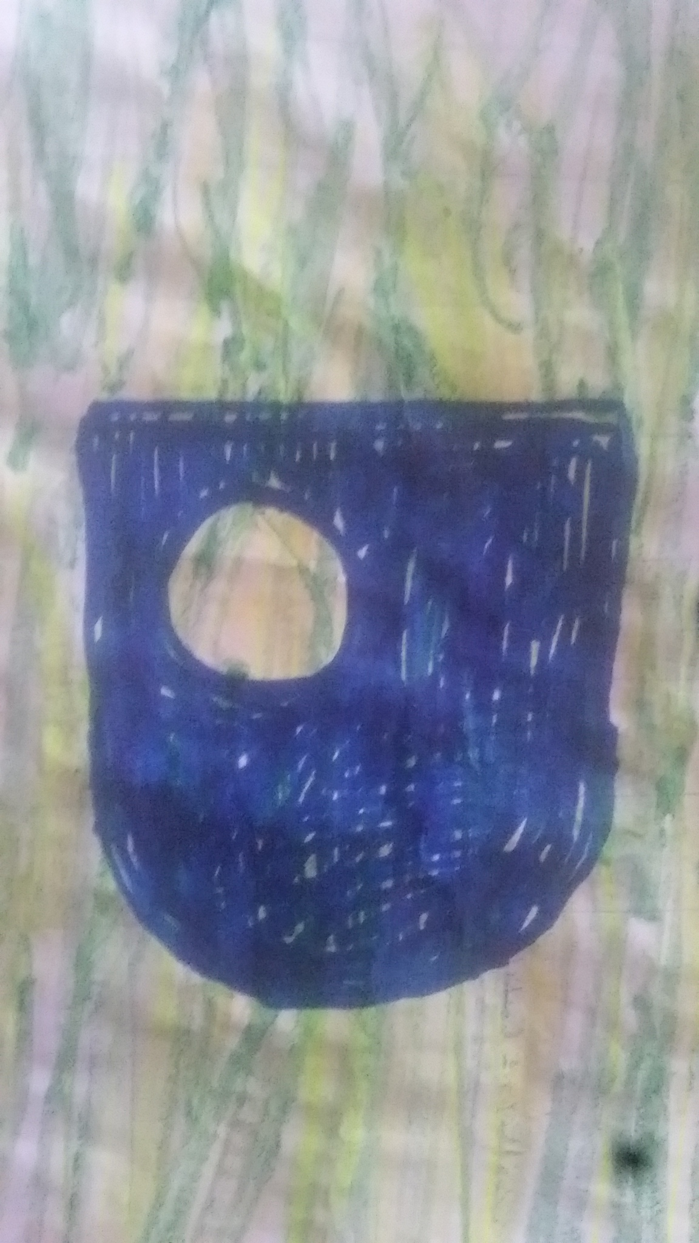

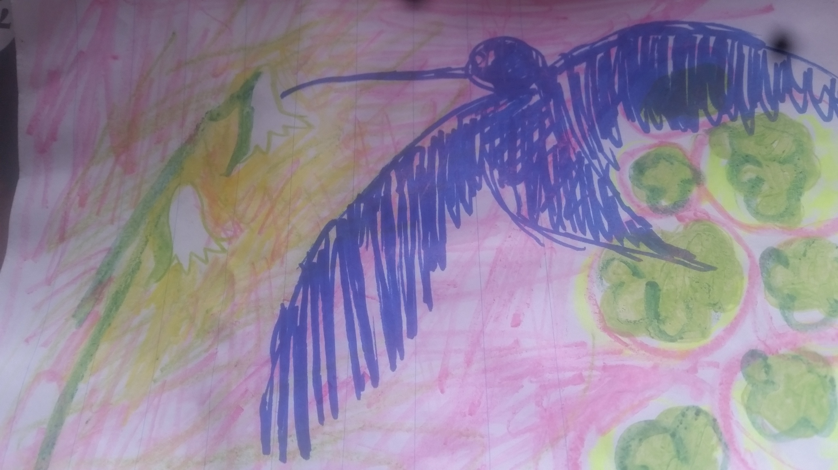
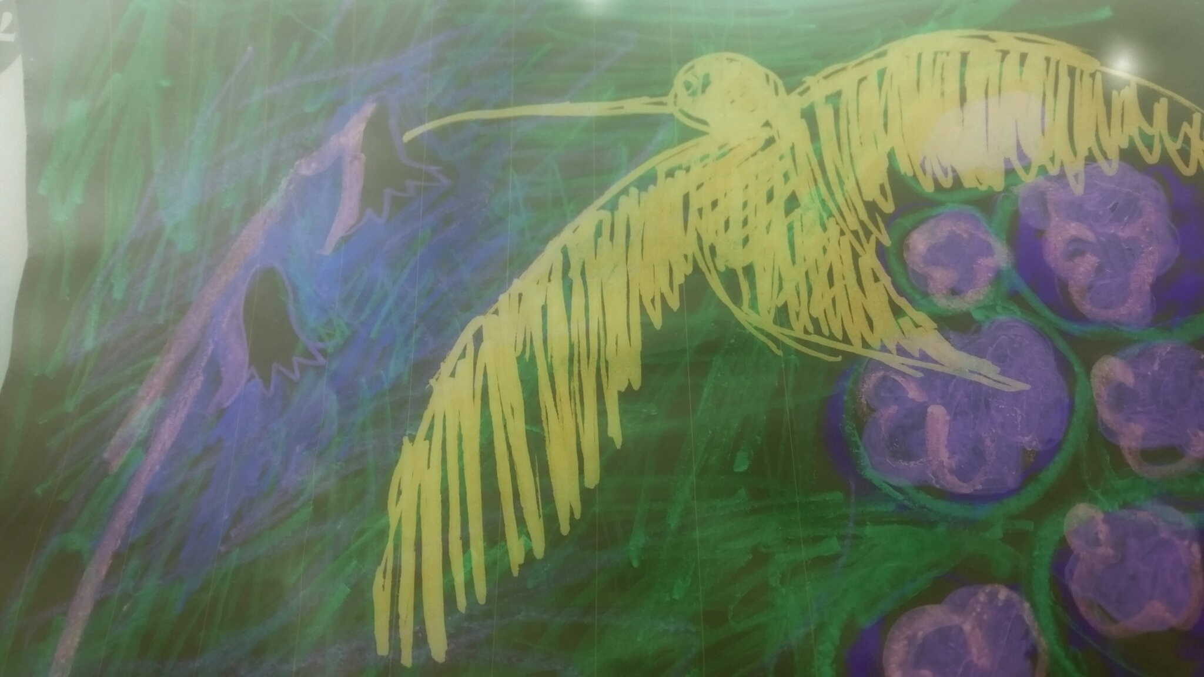
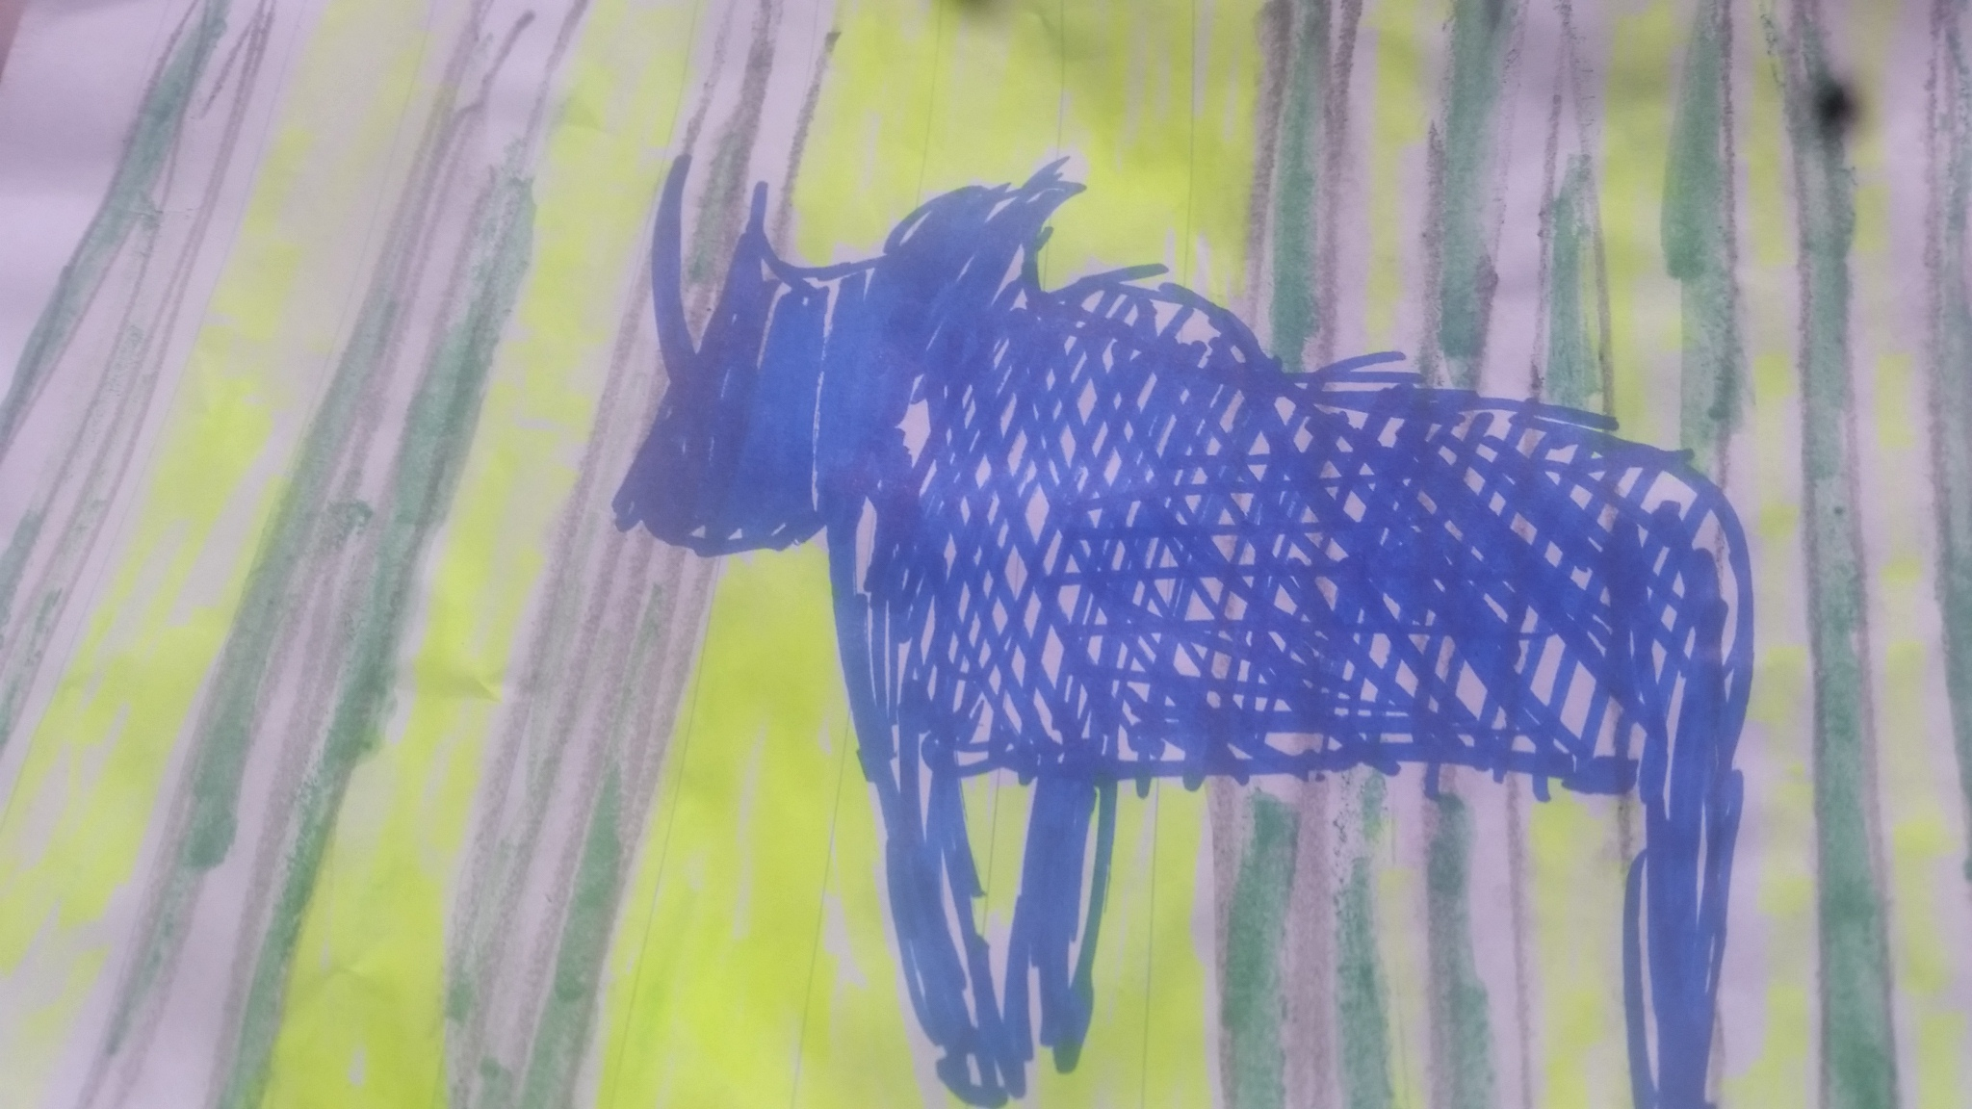
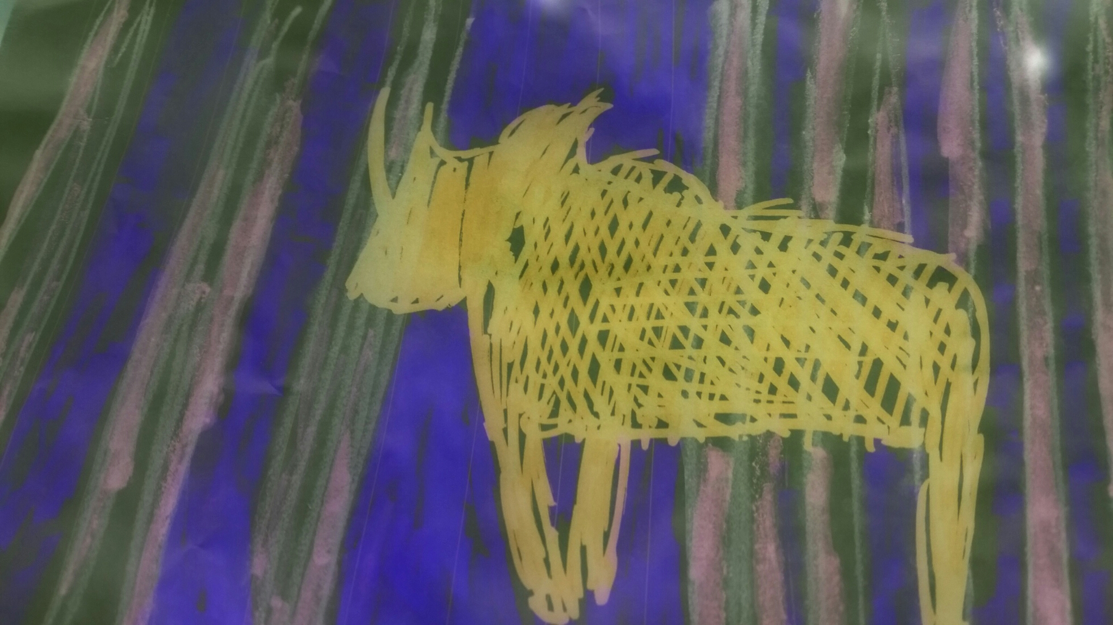
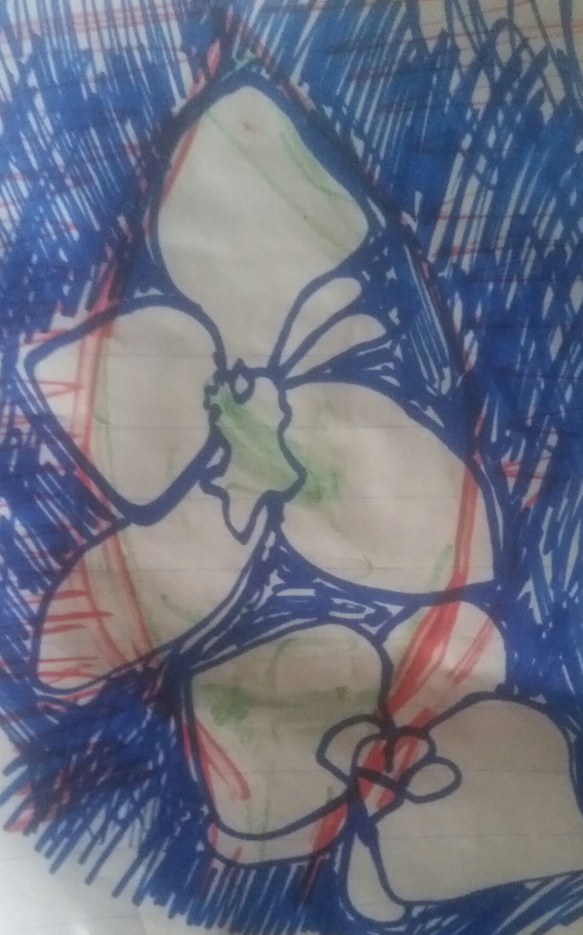

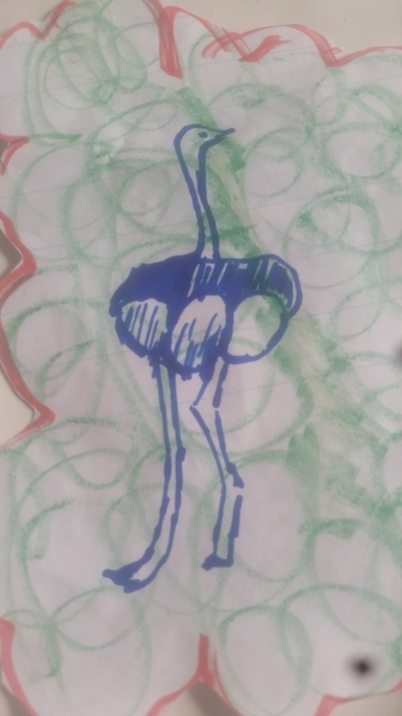
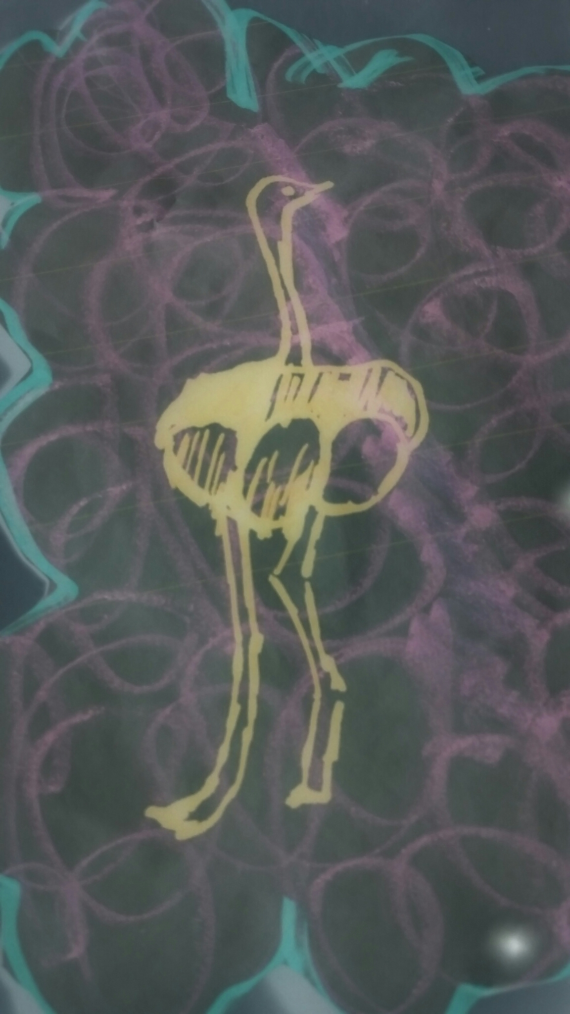
Supporting Environmental Management MSc students in Kenya - A work in progress
Stephen Burnley
Sinead O’Connor
Rich Campen

Slide 2
Background
The Commonwealth Scholarship Commission funds distance-learning MSc students in Commonwealth countries.
The OU has benefitted from this source of funding since 2006.
Funding includes the provision of in-country tutorials.
E&I has gained c£400,000 in the past five years and has around 25 students currently studying (or awaiting their final grades).
If we care about humankind, we need to be active in the global south.
All this money carries responsibilities on our part.

Slide 3
Commonwealth Scholars
Tend to be:
Young;
Family responsibilities;
Employed (but may be interns);
Graduates;
Unused to UK learning and assessment methods;
Highly committed.
Face all the issues that our “home” students do plus:
Travel;
Internet access and cost;

Slide 4
Project aims
To appreciate the academic and social cultures of our students.
To understand how we can best support our Commonwealth Scholars.
To produce internal guidance on supporting CSC students and other students in similar circumstances.
To disseminate our findings in the literature.

Slide 5
Mixed Methods
Quantitative
Official/ available Statistics
Pass/fail
Retention
Qualitative
a. Focus groups
Collective
Study logistics/ Online experience/Support
Qualitative
b. 1-1 personal narratives
Deep Hanging Out
Vignettes
Portraiture

Slide 6
Mixed Methods
Quantitative
Official/ available Statistics
Pass/fail
Retention
Qualitative
a. Focus groups
Collective
Study logistics/ Online experience/Support
Qualitative
b. 1-1 personal narratives
Deep Hanging Out
Vignettes
Portraiture
Subtle Cues
Felt experience
Deepen fuel
Gross Overview
Generic
Group Wisdom
Meaning

Slide 7
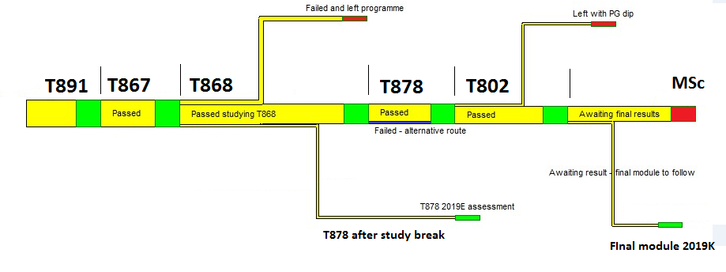
Quantitative assessment – our first cohort

Slide 8
Student performance – the statistics
Cohort 1 – started Nov 2015
 | Number | % | Max success rate
Started | 11 | 100
Failed – no qualification | 2 | 18
Left with Diploma | 1 | 9 | 81%
Still studying | 1 | 9
Awaiting final module results | 7 | 63

Slide 9
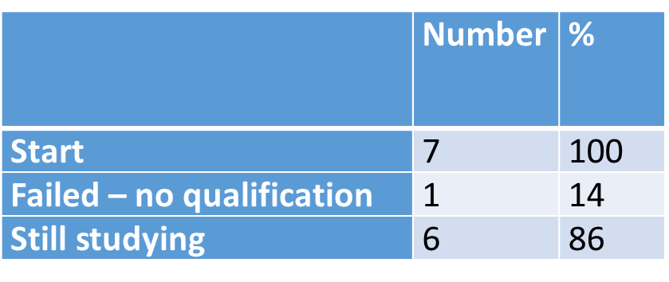
More statistics
Cohort 2 – started Nov 16
Cohort 3 – started Nov 17
 | Number | % | Max possible success rate (%)
Started | 13 | 100
Fail – no qualification | 1 | 8
Passed all modules first time | 9 | 69 | 92
Still studying via resits etc | 3 | 23

Slide 10
Q1 Travel arrangements to an OU face to face workshop.
Key issues
Get funds/ time to travel to Nairobi
Permission from work can be challenging
Child care help
Q2 Support from OU tutors - tutorials/ TMA feedback/ informal student groups
FORMAL - timely/regular feedback appreciated/ reflective practice a new thing/ how to write and not plagiarise
INFORMAL - Prefer whatsapp group to chat/ receive support/ socially engage - not OU forums (tone is unfriendly/ difficult to relate to)
Q3 UK and East African study comparison
Credibility of OU online studies is not taken seriously
Depth and tone of support by OU is more friendlier, nurturing as well as professional
No student card or graduation ceremony - makes study identity appear fake
Q4 Greatest study difficulties/ overcoming them and support from OU
“Phone in hand” - lighter material? Material in hand - wifi constraints
Cultural context - concepts + case studies? Graphic -Fatigue of reading online
Quiet space - physical space/ communal building
Engagement style - more social/ emotional/creative/positive? Cross-cultural?
Focus group - Key Findings
.

Slide 11
1-1 interviews - Key Findings

Slide 12
A day in the life + OU online identity....
The hummingbird
Job: Stay at home mum/lost job contract
Online: Limited/ unpredictable wifi access - whatsapp preference
Study space: Church – only quiet space
Family: Husband is sceptical
Support: God and omnipresence of OU
Agency: Empowerment- Women, mothers, community
Community: Domestic abuse and waste
Signature style: Smile and hug
Passive presence
OU as omnipresent - in heart, no wifi
Boost - hope for real change
Not reached full potential
Bare pass experience
Light touch communications – “Hello”
Feminine qualities

Slide 13
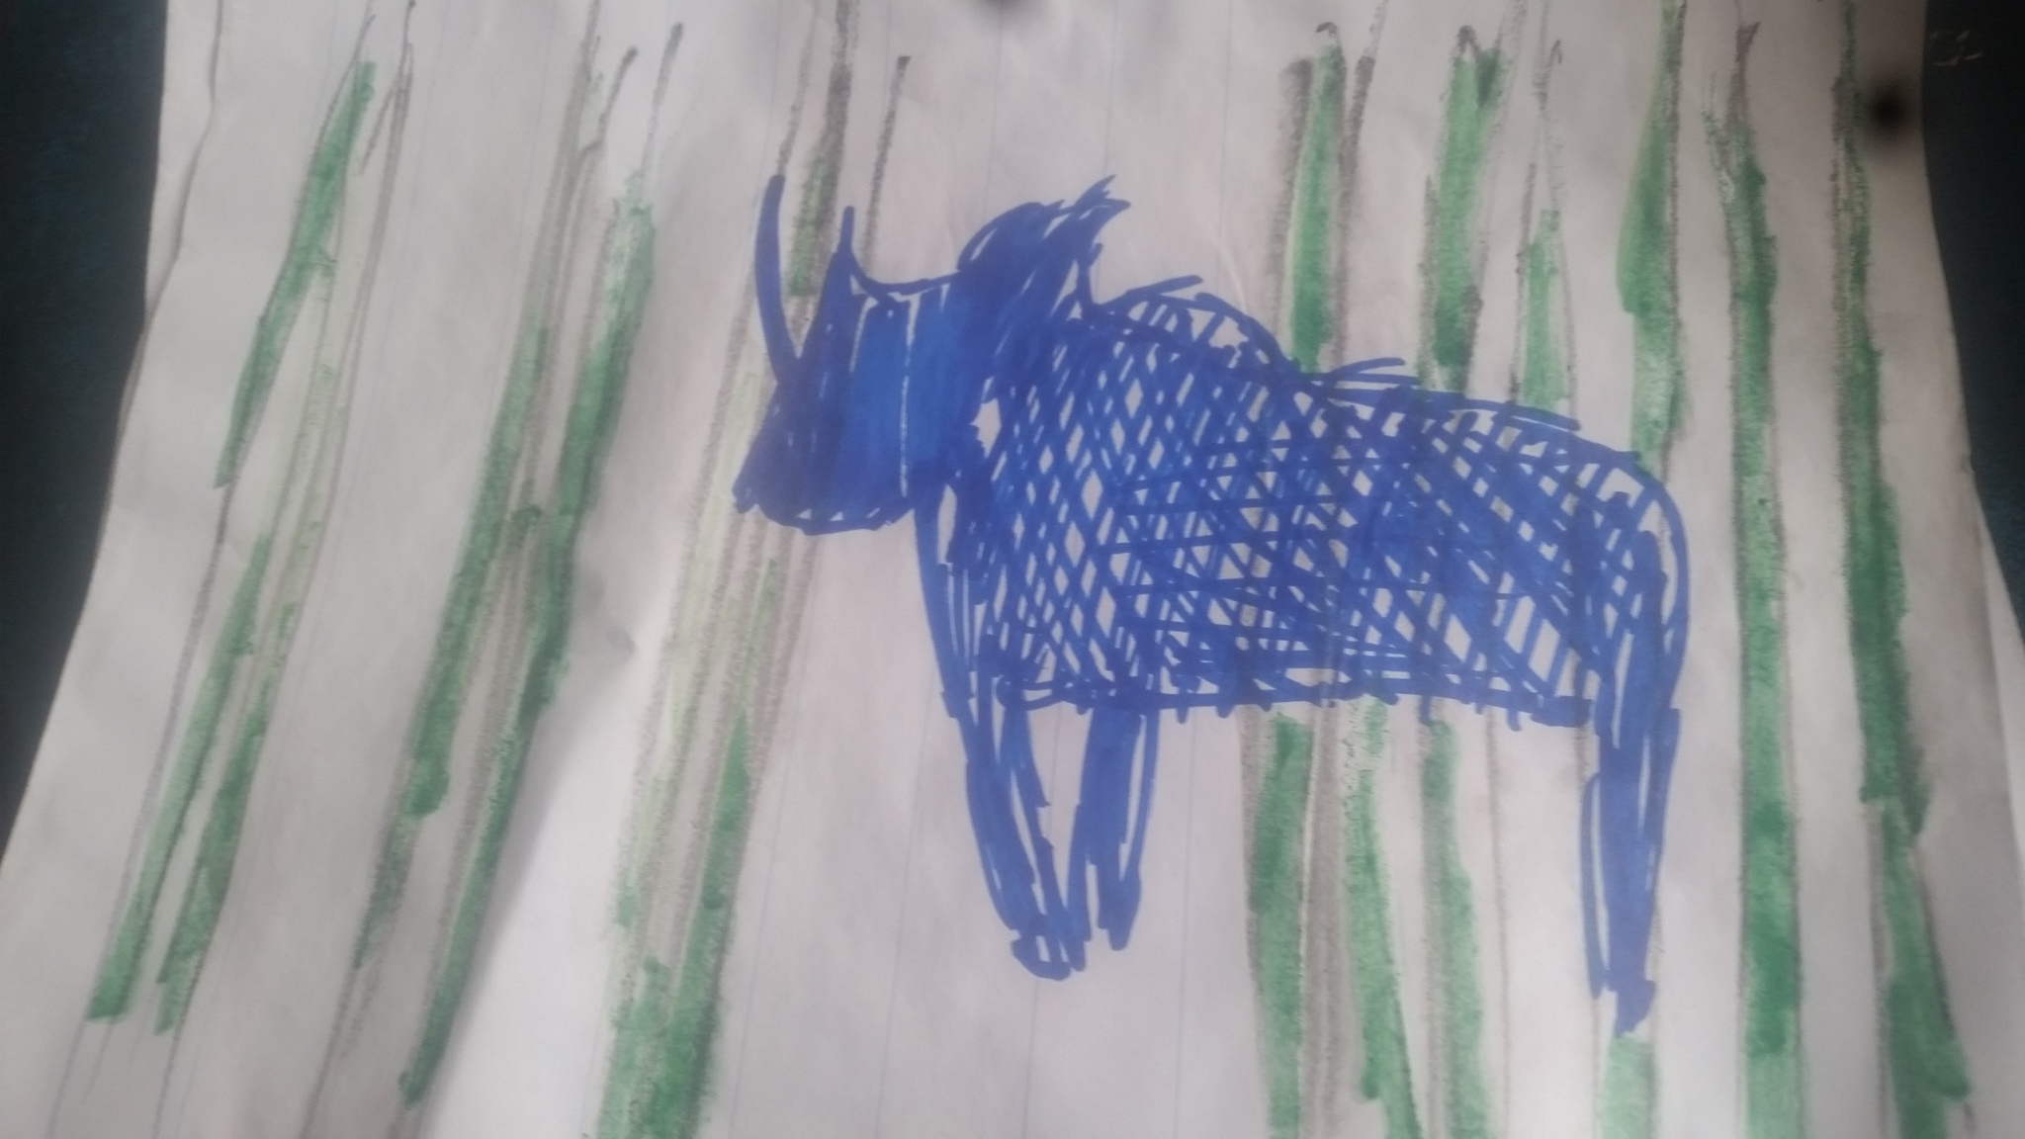
A day in the life + OU online identity....
Job: Climate change researcher/ in the field
Online: Spontaneous, access at work + phone in hand lifstyle
Study space: On the move
Family: Issues of credibility/ acceptance of online study
Support: Network: family/work/community
Agency: Co-create Kenya. Active facilitation, mobilization + social learning.
Community: Inequalities, social injustices
Signature Style: Patriotic beads
The Black Rhino
Shepherd - Active/ Nurturant with own cultural community
Social learning + Interdependence
Co-create with tutor + students
Whatsapp moderator - gives leg up + heads up to community (safe space to experiment)
Cheer leader
More Graphic + national content?
More networking between OU + Africa

Slide 14
A day in the life + OU online identity....
Job: Administrator at Environmental organisation
Online: Access at work/ controlled
Study space: work and home
Family: Supportive/ she cannot leave them
Support: Yoga/ secure job
Agency: Independent Self discovery
Community: Mix old and new traditions
Signature Style: Bright red braids + slogan t-shirts
The Orchid
Quiet self exploration
Independent space to think
Reflect and relaxation practice
Opportunities to influence Kenya - non-authoritative
Feminine Empowerment process
Videos/ tips on self care and managing emotions/ expanding awareness

Slide 15
A day in the life + OU online identity....
Job: Computer technician
Online: No pattern, day to day
Study space: Late evenings at home/ midnight hour
Family: No family/ no church
Support: “Outside of Kenya”, virtual life
Agency: Self Made. Radical/ New. Start Up – Waste business
Community: Look out of Kenya
Style: Clean white business shirt
The Ostrich
A Kenyan/ African OU hub?
Tutorials suit Kenyan time zone?
Head in sand - more hands + heart?
Applied - Start up projects whilst studying?
Culturally relevant exercises + exam Qs?
Extra research required to understand UK/ European centric case studies
Forge partnerships between OU +
local/ national agencies - to gain
access to data, resources, study space?

Slide 16

Conclusions
Commonwealth Scholars have high retention and progression rates
Supportive team communication + learning styles
the felt experience - relational + empathic
emotional supports rational tasks
informal is vital to formal outcomes
nurturing preparation for meetings + tasks

