Slide 1

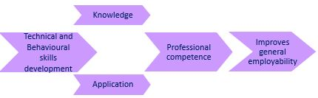
Postgraduate project management: interventions in module tuition and assessment to support employability skills development.
Kay Bromley, Joan Jackson, Jill Shaw, Mark Slaymaker
Computing and Communication
1st April 2026

Slide 2
eSTEeM project Postgraduate project management: evaluation of student employability skills development
Context: M815 Project management (30-credit postgraduate module). Optional module in STEM MSc qualifications including Computing, Technology management, Engineering, Environmental management, Space science.
Motivation and aims
Tutors’ anecdotal observations that there is a positive impact for some students’ professional development after study
Personal reflection of some students, embedded in assessment seems to show:
Examples of positive impacts on professional development
Examples of impacts in the students’ workplace
This research aims to:
Understand the extent to which M815 students benefit from professional development and their organisations benefit from student input
Make recommendations to improve the visibility of employability and professional development within the module.

Slide 3
Methods
The project used a mixed methods approach
Identification of 18 technical competences and 4 behavioural competences students can develop during study of the module using:
Professional project management competence frameworks from technology and engineering sectors
OU employability framework
Qualitative characteristics for postgraduate skills
Academic literature review
Student perception of development of employability skills and competences was examined through:
deductive and inductive thematic analysis of reflective question in TMA03 and the EMA (one cohort)
questionnaire about knowledge and ability to apply competences before and after module study (three cohorts).
To enhance understanding of student perspectives before and during the module presentation, the introductory tutorial recordings and module forum were analysed.

Slide 4
What is meant by professional competence?
Competence is a combination of knowledge and ability to apply that knowledge
Knowledge is acquired through study, past training and experience
Ability to apply is improved by applying the knowledge in assessment or in practice in the workplace.
Professional competence can be a combination of:
Technical competences – practices or skills needed to succeed in the discipline,
Behavioural competences – personal and interpersonal skills needed to succeed,
Contextual competences – relating to specific organisational factors to be aware of (not considered relevant to this research).
Behavioural competences are usually related to transferable employability skills.

Slide 5
Output 1 Six step method to identify competences
This method (Jackson, Bromley and Shaw, 2025) could be employed by other modules, programmes or disciplines, using appropriate sources for their context
The 18 technical and 4 behavioural competences (codes and short descriptors) identified for module M815 are given in the final slide. Long descriptors were also identified. The method recommends including students in the definition of descriptors.
Identify relevant competence frameworks;
Map to the specific module;
Compare framework to mapped competences;
Compare module assessment criteria to mapped competences;
Identify competences which can be developed through study;
Define competence descriptors.

Slide 6
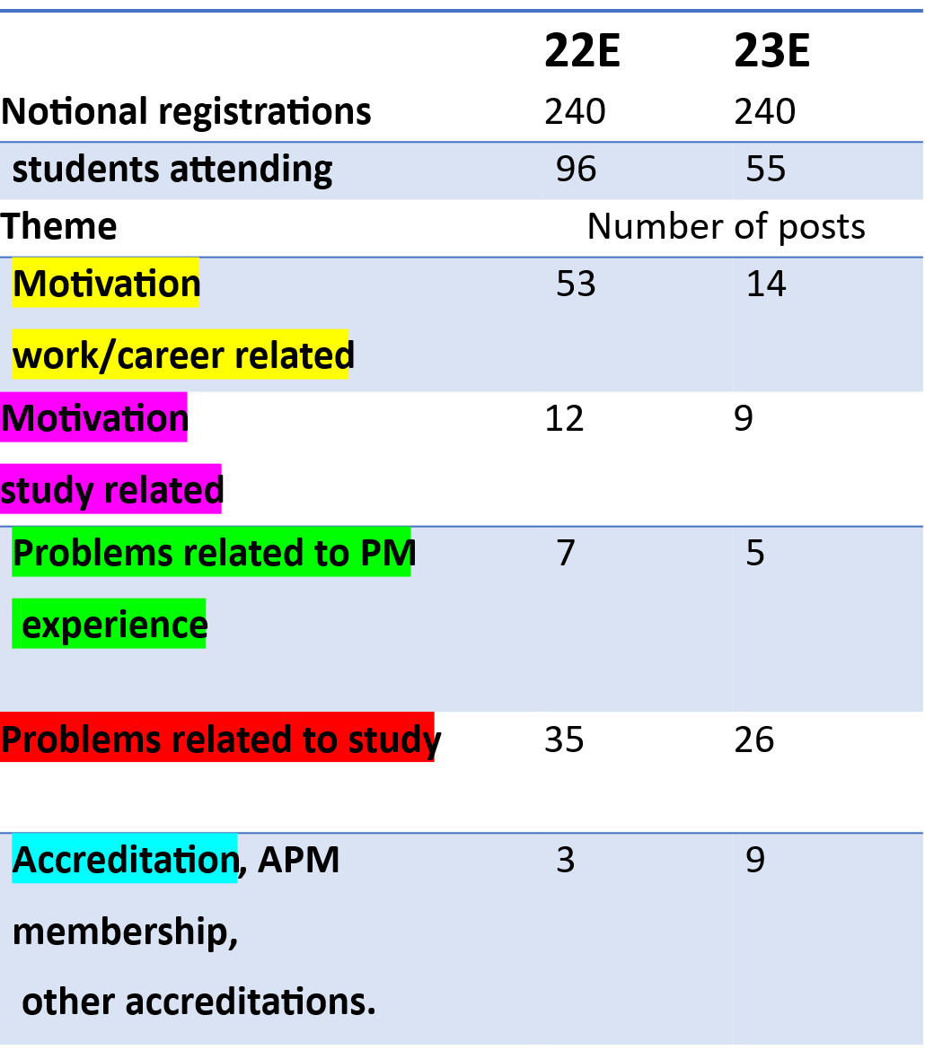
Output 2 Tutorial and forum analysis
Analysis of introductory tutorial chat
Analysis of responses to forum activities 21E prompted from module material
Competence | Type of competence | Demonstrated within how many posts
E Stakeholder engagement and communication | technical | 4
H Risk and issue management | technical | 4
J Team management | technical | 1
K Governance | technical | 2
Q Conflict resolution | technical | 3
S Problem solving | behavioural | 2
U Critical thinking | behavioural | 4
V Reflection | behavioural | 3

Slide 7
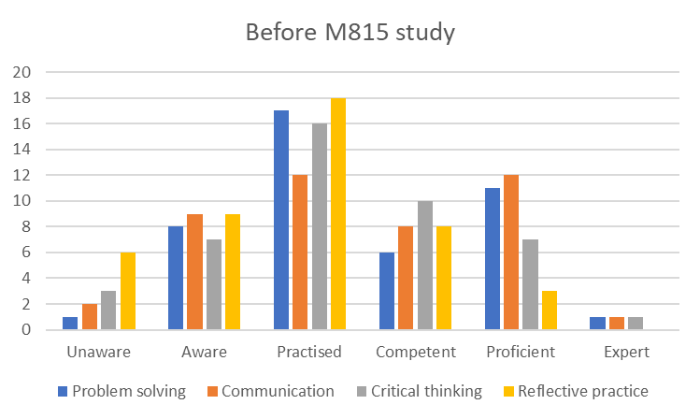
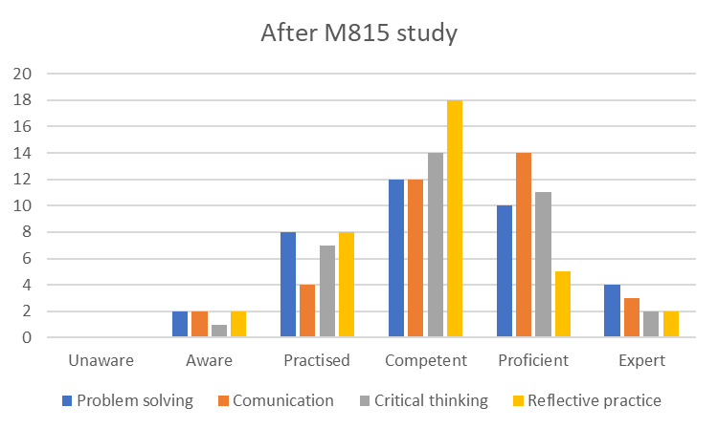
Output 3 Questionnaire: identifying behavioural competence development
Student assessment of development of ability to apply 4 behavioural competences using a 6-point scale (49 out of 374 13% response rate)
Notes:
Shift of bars to the right indicates development/improvement
The development of behavioural competences problem solving, communication, critical thinking, reflective practice is particularly relevant to improvement in transferable employability skills as a result of study.

Slide 8
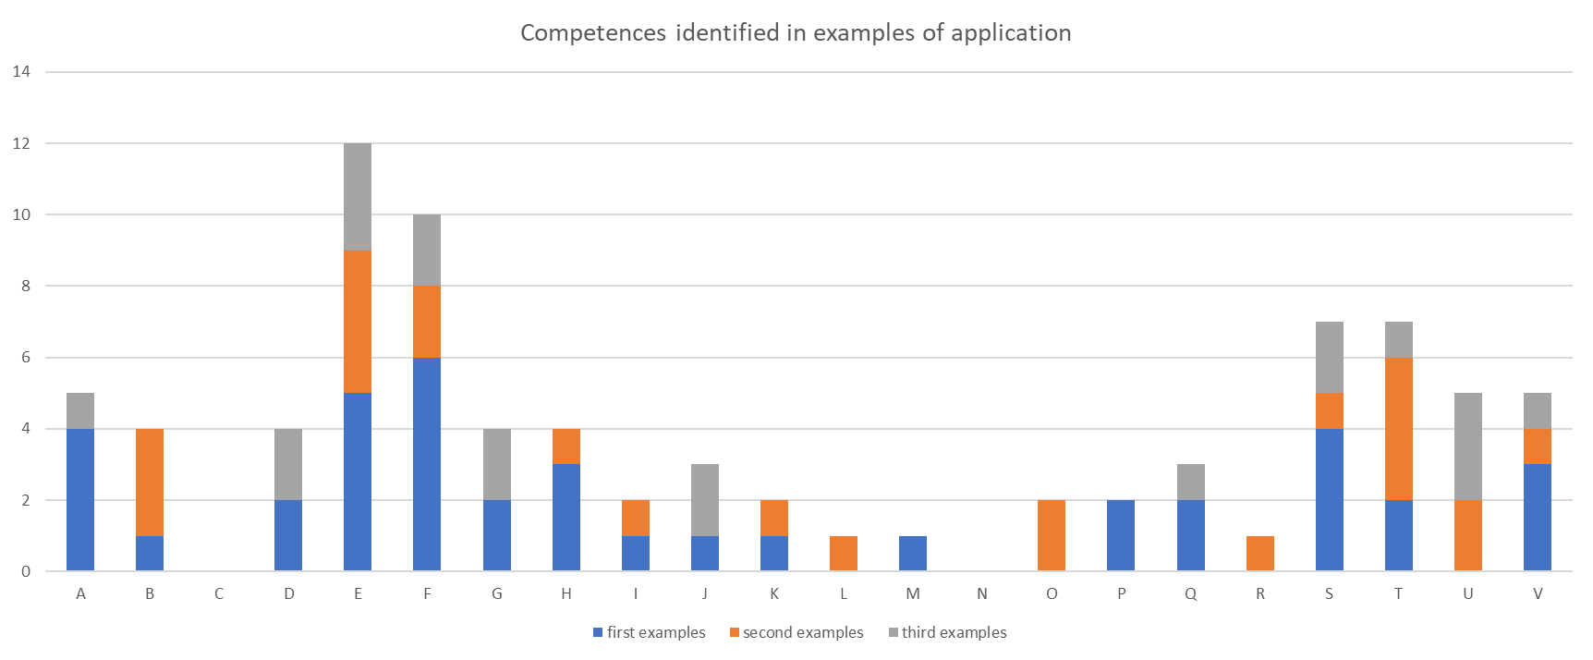
Questionnaire: Analysis of examples of ability to apply competences in the workplace
Students could provide up to 3 examples across all competences (28 students responded)

Slide 9
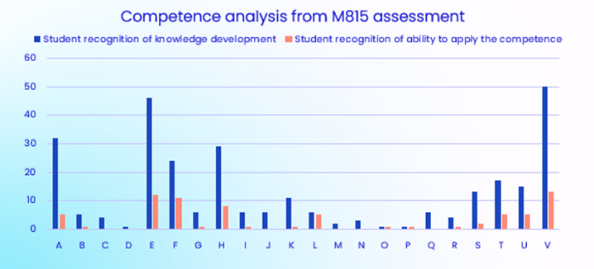
Output 4 Deductive thematic analysis based on M815 assessment
Instances of development recorded based on researcher analysis of personal reflection in 138 EMAs and 136 TMAs 22E
Development assessed in terms of knowledge acquired and improved ability to apply in the workplace as a result of study of M815 (competence coding explained in final slide)
Technical competences most recognised in terms of development:
A Life cycles
E Stakeholder engagement and communication
F Time-based planning
H Risk and issue management
K Governance structures and PMO
V Reflective practice most recognised behavioural competence.
Notes:
Competences A, E, F, H and K relate to aspects of module material, which are covered extensively in the module, usually in more than one Block. This has significance for module design.
All four behavioural competences (S, T, U and V) show some level of knowledge development and improved ability to apply the knowledge. Since the module teaches and emphasises reflective practice, discusses reflection in tutorials and encourages reflection as part of assessment, it would be expected that students demonstrate the highest level of competence development for Reflective practice (V) and thematic analysis of assessment supported this. Teaching reflection and embedding reflection in assessment encourages student recognition and articulation of this behavioural competence.

Slide 10
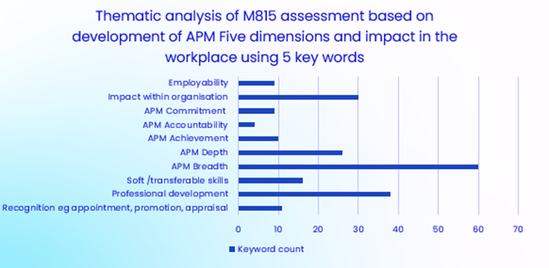
Five dimensions of professionalism and key word analysis based on M815 assessment
Instances of recognition of impact of study in terms of development of the APM Five dimensions of professionalism (APM, 2025) and impact on professional development, employability and impact in the workplace.
Good recognition of:
Impact within organisation
Professional development
Poor recognition of improving:
General employability
Soft/transferable skills
Professional recognition
APM dimensions of professionalism
Good recognition of increased breadth and depth of knowledge
Low recognition of impact on qualifications, CPD and codes of conduct.
Notes:
Thematic analysis of assessment also assessed student recognition of impact of study in terms of development of the APM Five dimensions of professionalism (APM, 2025) and impact on professional development, employability and impact in the workplace using five key words identified during a pilot by 3 researchers.
There is good identification of student recognition of impact of study within an organisation (30) and professional development (38), but the analysis shows poor student recognition of improving general employability (9), soft/transferable skills (16) and professional recognition (11). The data indicates that students do not link behavioural competence development with improved employability and increased soft/transferable skills. The module needs to link behavioural competence development with improved employability and transferable skills more explicitly.
In terms of development of the APM Five dimensions, as expected, students recognise increased breadth and depth of knowledge as a result of study, but low recognition of impact on qualifications, codes of conduct and CPD.
Development in terms of the dimensions is impacted by students’ level of project management experience at the start of the module. Additionally, student reflection suggests the module does not emphasise the link between qualifications and professional development with improvements in employability. This is one area for the module team to review, and this could apply to other modules.

Slide 11
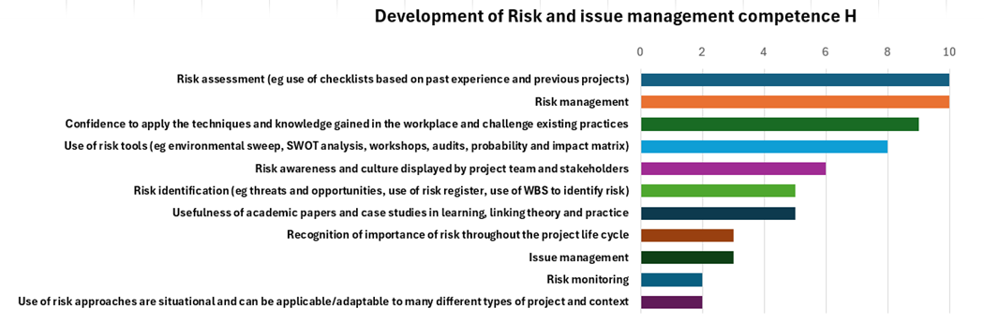
Inductive thematic analysis based on M815 assessment
Detailed analysis of the quotes recorded for some competences during deductive thematic analysis of reflection in assessment enables the module team to identify themes for future development of module material to enhance student recognition of development as a result of study.
Example: identification of themes for future development of module material relating to risk
Themes derived relating to competence H Risk and issue management
Key topics identified for module development:
Risk throughout the project life cycle
Issue management
Risk monitoring.
Notes:
The technique of recording quotes during thematic analysis of reflection in assessment in relation to competences, enables the module team to identify themes which may be useful in future development of module material.
This slide shows the themes uncovered for technical competence ‘risk and issue management’
Key topics identified for module development, that is, those themes mentioned by the least number of students are:
Risk throughout the project life cycle
Issue management
Risk monitoring.
This approach to module development could be applied to many modules or a qualification.

Slide 12

Relating to OU employability framework
OU employability framework core employability skills
Problem solving,
Communication,
Collaboration,
Numeracy Digital and information literacy.
Personal attributes and behaviours
Initiative,
Self-management and resilience and
Self-awareness.
Similarity between behavioural competences developed in M815 and generic employability skills.
Problem solving and Communication are explicitly identified as M815 behavioural competences.
In OU employability framework:
Reflection is only implicitly linked to self-management and self-awareness
Reflective practice is not included, could be considered within ‘others’ ‘improving practice’
Critical analysis is also omitted could be considered part of problem solving. However, this doesn’t fully cover the behaviour ‘thinking critically in decision-making in complex situations’.
Further consideration of personal attributes and behaviours might be considered if/when the OU employability framework is reviewed.
Notes:
The OU employability framework can be found by students through Help Centre (The Open University, 2024)
These employability skills are generic for all disciplines and levels within the University.
FutureYou shows some examples from the module which relate to the OU employability framework but this is not comprehensive.
There is some similarity between M815 behavioural competences and the OU framework: problem solving and communication.
But behavioural competences Reflection and critical analysis are not explicitly included in the framework.
Further consideration of personal attributes and behaviours could be considered when the OU employability framework is reviewed.

Slide 13
Module interventions
24E
25E
Chairs module-wide introductory tutorial includes more about employability skills
APM agreed to give an additional webinar about career development as a project manager
Module-wide Reflection tutorial with links to competence development and employability.
Embedded technical and behavioural competences in module assessment
Encourage student recognition and articulation of competence development and reflection on employability skills development in reflective tasks in assessment.
Notes:
This slide shows some of the interventions in the module initiated as a result of this research.

Slide 14
Evaluation of interventions
Another project would be needed for robust evaluation of the interventions in the last 2 presentations.
EMA co-ordination discussion indicated that some competences are being recognised more and reflective writing shows some improvement
Some indication from marking EMAs that student articulation of competences relates to tutor specialisms, possibly through EMA tutorials (module-wide reflection tutorial should address this issue).
Changes in module team involving change of role and employment situations for all members of the module team have limited continuity of support for interventions. However, we are talking to the new chair of M815.
Other successes are:
The analysis of competence development has supported the new module team as they prepare for APM accreditation review
Project report also supports setting priorities as module team consider updates required for accreditation against APM BoK 8
The development of the six-step method for identification of technical and behavioural competences developed as a result of study of a module/qualification – another project to test this method on another module is needed.
Notes:
Another project would be needed for robust evaluation of the interventions, but there is some anecdotal evidence from EMA co-ordination and EMA marking.
Changes in the module team have resulted in limited support for interventions, however, we are talking to the new module chair.
Other successes are:
Findings can support the new module team during APM accreditation and update of material for 8th edition of APM BoK.
The development of the six-step method for identification of technical and behavioural competences for a module or qualification. Another project is needed to test the method on another module – volunteers?

Slide 15
Questions?

Slide 16
References
Association for Project Management (APM) (2025) Five dimensions of professionalism. Available at: https://www.apm.org.uk/ about-us/ apm-5-dimensions-of-professionalism/ (Accessed: 12 June 2025).
Jackson, J., Bromley, K. and Shaw, J. (2025) Identifying competences to support evaluating and enhancing student recognition of employability skills development: Examples from postgraduate project management. In: The 13th eSTEeM Annual Conference Proceedings: Sharing Best Practice - Implementing What Works (Pawley, S. and Chang, D. eds.), 10-11 Apr 2024, The Open University, UK. DOI: https://doi.org/10.21954/ou.ro.00102263
The Open University (2024) Reflect on the development of your employability from OU Study – Computing (Postgraduate). Available at: https://learn2.open.ac.uk/mod/oucontent/view.php?id=1696832 (Accessed: 2 April 2024).
Title slide image: ©iStock/Rawpixel

Slide 17
Appendix – explanation of competence codes
code | Technical competence | code | Behavioural competence
A | Life cycles | S | Problem solving
B | Financial management | T | Communication
C | Transition management | U | Critical analysis
D | Benefits realisation | V | Reflective practice
E | Stakeholder engagement and communication
F | Time-based planning
G | Resource management
H | Risk and issue management
I | Change control
J | Team management
K | Governance
L | Quality management
M | Ethics, requirements and professionalism
N | Requirements management
O | Solutions development
P | Integrated planning
Q | Conflict resolution
R | Leadership
Notes:
Keep – referred to in the slides.

