Slide 1


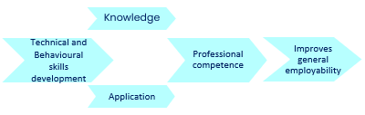
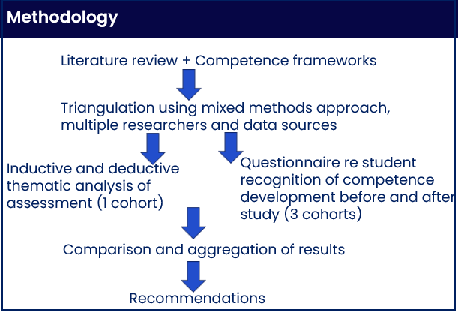
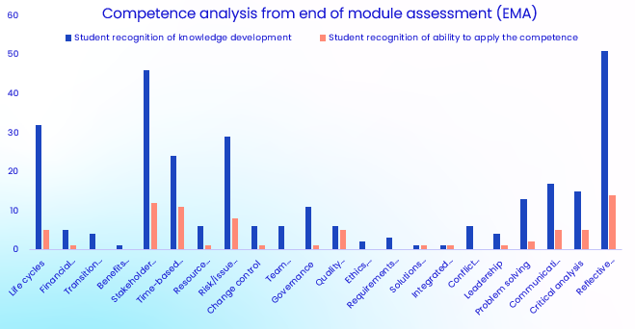
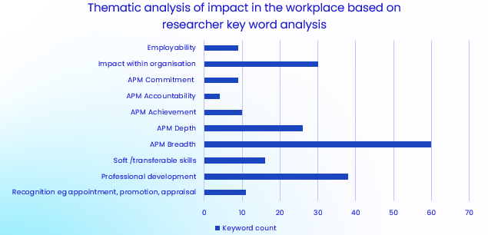
Employability skills development in STEM an example using postgraduate study of project management
Kay Bromley, Joan Jackson, Jill Shaw, Mark Slaymaker kay.bromley@open.ac.uk joan.jackson@open.ac.uk
Introduction: context, motivation, reflective practice; methodology.
The context for the research is an Open University, distance learning, 30 credit STEM optional postgraduate Project Management (PM) module, accredited by The Association for Project Management (APM). The student population is typically working in the STEM sector and studying a range of MScs, some have experience of working in project teams or project management.
The research was motivated by anecdotal evidence of weak student recognition that study of the module results in behavioural competence development and improvement in employability/transferable skills.
Competence frameworks.
Professional competence is based on both knowledge and ability to apply. Development of competence improves general employability.
Based on APM [1], IPMA [3], other project management competence frameworks [6, 7], MSc academic requirements and OU employability frameworks [5], 18 technical and 4 behavioural competences developed by study of the module were identified and long descriptors developed and reviewed by students.
Behavioural competences are closely related to transferable skills.
Students study the module to gain experience of project management or for the 30 credits. The module teaches reflective practice and embeds reflection in assessment based on knowledge development and application of PM theory within the workplace.
The research adopted a mixed methods methodology [4].
Analysis of competence development based on thematic analysis of end of module assessment (EMA).
Thematic analysis of 138 EMAs showed 85% of students recognised competence development of knowledge acquired. Reflective practice is a key competence developed. Whilst there is recognition of ability to apply knowledge in the workplace, the opportunity for recognition is limited within the timeframe for study.
Based on key word analysis researchers could identify additional impacts within organisations and professional development, but student recognition of employability and soft/transferable skills development as a result of study is low. Students did recognise development in terms of the APM Five Dimensions of Professionalism [2], breadth and depth of knowledge were extended. Additional keywords emerged: impact on future studies; confidence to apply; improved time management.
Students’ perceptions of behavioural competence development and application in workplace based on questionnaire (13% response rate).
Measuring improvement on 6-point scale: before study some students are Unaware, but none are Unaware after study; more are Expert after study than before. The peaks of student perception have moved from Practised to Competent and Proficient.
Some students reflect on positive impacts in organisations and benefit of behavioural skills development in future academic study. Other students’ perception of skills and competence development is weak.
Confirmed the findings of the thematic analysis. Reflective practice is a key behavioural competence developed.
Outcomes and recommendations.
Additional reflection on competence development embedded in assessment, introduced by module chair’s tutorial.
Personal reflection more explicitly linked to:
Identification of technical and behavioural competences
Professional competence defined in terms of knowledge and ability to apply technical and behavioural skills
Impact in workplace, future studies, increased confidence to apply and improved employability.
Additional APM webinar to link competence development with enhanced employability in project management. More publicity for student membership of professional bodies.
Further recommendations will be shared across MSc Qualifications.
References
[1] Association for Project Management (APM) (2024) APM Competence Framework - Overview. Available at: https://www.apm.org.uk/resources/find-a-resource/competence-framework/overview/ (Accessed: 2 April 2024).
[2] Association for Project Management (APM) (2024) Five Dimensions of Professionalism. Available at: https://www.apm.org.uk/about-us/apm-5-dimensions-of-professionalism/ (Accessed: 2 April 2024).
[3] IPMA International Project Management Association (IPMA) (2015) Individual Competence Baseline for Project Management. Version 4. Available at: https://www.ipma.world/individuals/standard/ (Accessed: 2 April 2024).
[4] Braun, V. and Clarke, V. (2006) ‘Using thematic analysis in psychology’, Qualitative research in psychology, 3(2), pp. 77–101. Available at: https://doi.org/10.1191/1478088706qp063oa (Accessed: 4 June 2024).
[5] The Open University (2024) Reflect on the development of your employability from OU Study – Computing (Postgraduate). Available at: https://learn2.open.ac.uk/mod/oucontent/view.php?id=1696832 (Accessed: 2 April 2024).
[6] Rezende, L. B. D. and Blackwell, P. (2019). Project management competency framework. Iberoamerican Journal of Project Management, 10(1), 34-59.
[7] Udo, N. and Koppensteiner, S. (2004). What are the core competencies of a successful project manager? Paper presented at PMI® Global Congress 2004—EMEA, Prague, Czech Republic. Newtown Square, PA: Project Management Institute.

