Slide 1

The search for collaborative improvements: using learning networks and learning analytics to drive module improvements in STEM at the Open University
Lesley Boyd, PhD Researcher, Institute of Educational Technology
Christine Leach, Module Associate Lecturer
Rob Janes, Module Chair
Tom Olney, Senior Manger Teaching & Learning, STEM faculty
Horizons in STEM Conference
3 - 4 July 2019

Slide 2

Using learning networks and learning analytics to drive module improvements in STEM at the UK OU
A story of combining theory and practice - insider action research and Grounded Theory Method (GTM) – in a Higher Education distance learning context
What’s a learning network?
Methodology
Brief history of the project
Progress so far
  Phase 1 (2017) & Phase 2 (2018)
Signposting trial
Completing the research
References

Slide 3
What’s a learning network?
  Working definition: a task-driven technology-mediated intervention, connecting together individuals of disparate backgrounds to learn how to address a specified outcome or goal; the learning may be formal, informal, social, organisational or creative.
Task driven (what shall we do next?), but no known right answer
Technology-enabled (in contrast to technology-enhanced)
Collaborative and equitable
Structured
Connecting together disparate practitioners across different contexts and boundaries, eg remote tutors, module teams, staff tutors, Learning Design
Aiming for a particular practical improvement outcome
Using affordances of collaborative learning technology

Slide 4
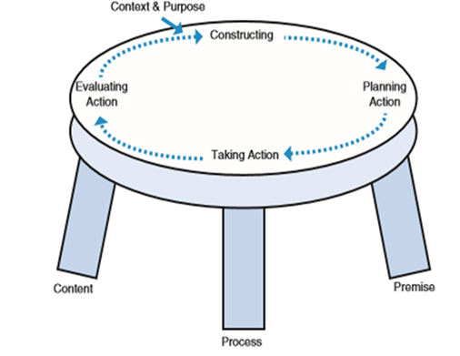
Methodology
Technology-enabled participatory action research
  Point of departure is that insider action research is one way to develop new organisational capabilities
  Answer a perennial organisational need to close a feedback loop between remote module tutors and campus based teams, to develop a joint understanding of teaching and learning design challenges, and to put tutors as close as possible to the development of solutions. Can learning networks help to achieve this?
Learn together in an unfolding and emergent process
Joint ownership: discussion, action planning, implementation & evaluation
Underpinned by Grounded Theory Method (GTM)
  Exploring a new conceptual framework regarding the unfolding process, and driving round the progressive action research cycles in a structured and rigorous manner.

Slide 5
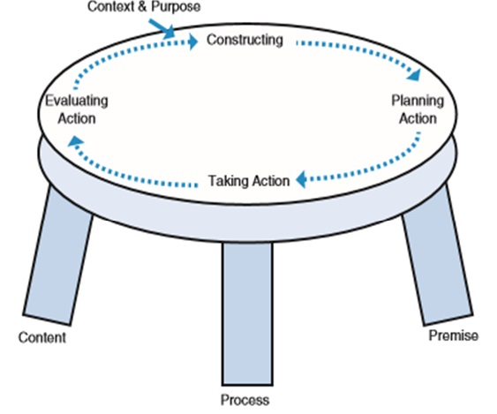
Action research table top model
Source:
Coghlan, D. and Brannick, T. (2014) Doing Action Research in Your Own Organisation, London, Sage.

Slide 6

A collaborative conversation
Image: Getty Images/iStockphoto

Slide 7
Methodology – why GTM?
A theory-building, not theory-testing or theory-verification methodology. Systematic data collection and analysis.
‘Far better to allow the data to tell its own story in the first instance, build a theory, then, subsequently, engage your theory with the theory that you thought you might impose initially. You can see if your emergent theory confirms or challenges existing theories. So, potentially GTM has a huge role to play in theory building, in all disciplines’.
Urquhart, C. (2013) Grounded Theory for Qualitative Research: A Practical Guide, London, Sage.
Sannino and Engeström (2017) describe ‘looking in vain’ for recent discussions of ‘theoretically and methodologically ambitious approaches’ of intervention research in major journals.
  Sannino, A. and Engeström, Y. (2017) Co-generation of societally impactful knowledge in Change Laboratories. Management Learning, vol.48, no.1, pp.80-96.

Slide 8
Brief history of the project
Phase 1 (Oct 2017 modules):
learning networks hosted in dedicated VLE sites for three pilot modules on conceptually challenging ‘Tricky Topics’ being experienced by students.
discussion forums and online workshops used to seek feedback from tutors, in order to collaboratively identify Tricky Topics and suggest improvements or produce learning interventions. One particular module team very successfully identified a list of conceptual Tricky Topics, plus a list of additional issues including pace and volume of material.
tutors designed and implemented four innovative Tricky Topics intervention videos, which have been in use on the 2017 and 2018 module website, shared with other modules and emulated elsewhere.
Phase 2 (Oct 2018 module):
second cycle of collaborative work building on the analysis from the first cycle. Since tutors had identified concerns about pace and volume of material, an online workshop and discussion forum shared and interpreted specialised learning design analytics visualisations with tutors with the aim of identifying areas for further interventions.

Slide 9
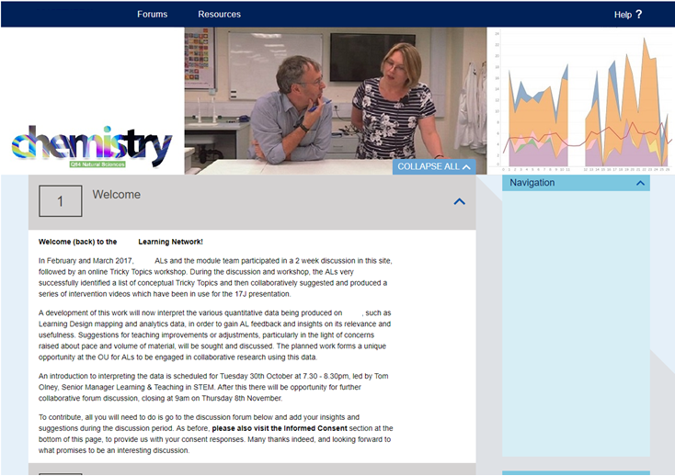
Learning Network site

Slide 10
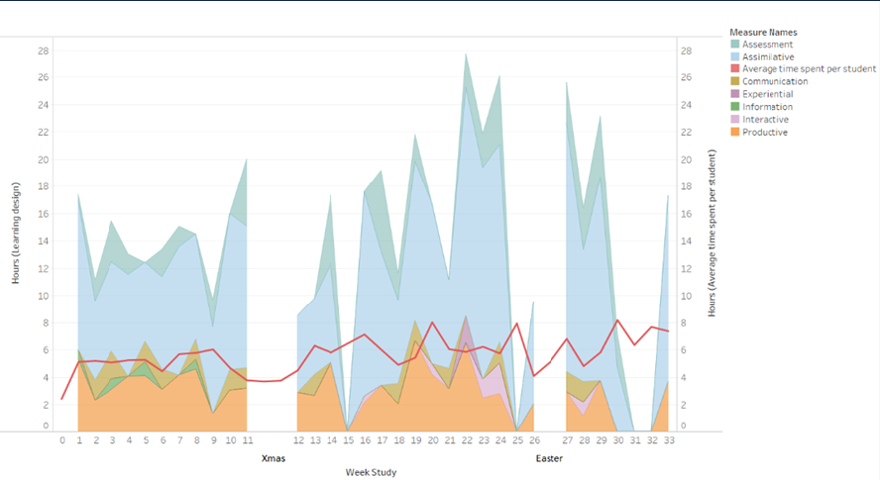
Using learning design analytics
The three visualisations discussed with tutors were:
expected student workload by activity type
comparison of expected student workload and MT advised workload per week
comparison of expected student workload by activity type and average VLE engagement

Slide 11
Results so far: unfolding process
Phase 2
The learning network discussions have highlighted a number of issues, represented in an interactive spreadsheet, which organises the supporting qualitative evidence. These issues include pace and volume of material, prerequisite knowledge and online / offline study behaviour. All these issues have contributed towards the planning of four actions:
production and trialling of ‘signposting’ material
finding out more re student preparedness
finding out more re online / offline study behaviour, and which resources students download
clarifying issues re the use of ‘OU Analyse’
The trial signposting materials have been produced by a tutor, reviewed by the module team, and implemented in the current module presentation.
An end of module questionnaire and follow up session for students was run based on the identified issues.

Slide 12
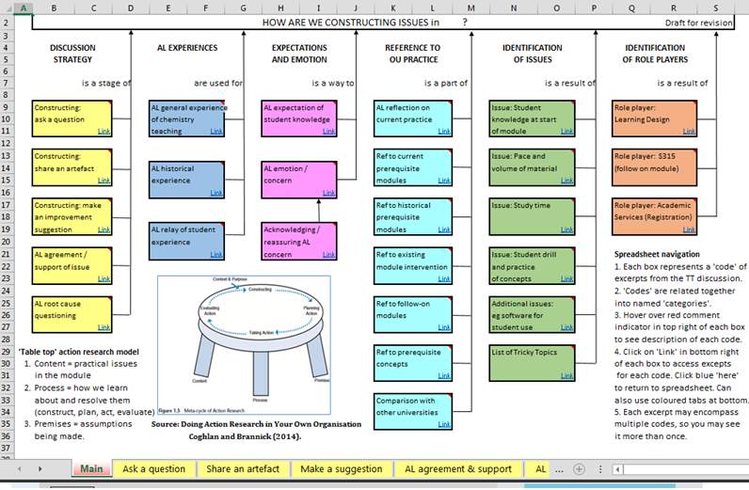
Process – interactive spreadsheet
Two years of qualitative feedback from the 2017 and 2018 learning network discussion forums, which is now represented for both years in a new navigable interactive spreadsheet.

Slide 13
Results so far: signposting trial
Level 2 Chemistry is divided into 14 Blocks providing students with a broad foundation in physical, inorganic and organic chemistry. It is the first full chemistry module studied by our students and makes up one sixth of a degree.
The Blocks chosen for this pilot were:
Molecular characterisation and spectroscopic analysis
Introduction to the first-row transition metals
The signposting material aims to cover:
prerequisite knowledge/conceptual understanding required to study the Block
key points regularly examined
material that is crucial to learning but not directly tested
material written for interest only.

Slide 14
Block Signposts
Developed to include:
Overview
Knowledge and understanding; Learning Outcomes
Objectives tested directly in assignments and the exam
Background and key terms from earlier in course
Summary of topics
  a brief summary of each section and then a list of sections which are not crucial but with the caveat that they are likely to help your overall understanding
  whether topics were crucial, essential reading, or not essential
  an indication of whether the topic is examined and which parts do not need memorising.
Considerations:
We do not want to give students more work – this is to save time for those who are finding it hard to keep up or have already dropped behind.
Materials must be brief and easy to use.

Slide 15
Examples
Section 1 introduces different oxidation states of transition metal ions and their colours in solution. Section 1.5 is crucial as it introduces the structure of transition metal complexes.
Section 7 covers tetrahedral complexes. The concepts introduced in section 5 and are applied to tetrahedral complexes so this section provides useful consolidation and practice of what you have learnt. The exam can ask about octahedral and tetrahedral complexes, so this section is crucial for the exam, except for section 7.4 on spinels.

Slide 16
Feedback
fantastic and helped reduce the workload
both ‘loved and hated’ them
didn’t find them
instead of signposting, could there just be less content please?
a link to the extra content for those who want to go on to more chemistry
improve presentation based on student feedback
write signposts for more Blocks
not all students found them – so embed them in our online materials
What next for signposts?

Slide 17
Completing the research
Evaluate interventions and perceptions of new improvement mechanisms
Continue grounded theory analysis to consolidate and strengthen the emerging conceptual framework of technology-enabled organisational learning
Evaluate use of GTM to explore a new conceptual framework and drive round progressive AR cycles in a structured and rigorous manner. Does it yield actionable knowledge, which is usable by practitioners whilst being sufficiently theoretically robust? (Coghlan and Brannick, 2014).
Challenges / enabling or constraining factors:
  time!!
  facilitation and engagement
  insider action research
  rigorous analysis methods / GTM
  combining the two methodologies
  relationship between theory and practice,
  or between research and scholarship

Slide 18

Some key references
Carvalho, L. & Goodyear, P. (2014) (eds) The Architecture of Productive Learning Networks, New York, Routledge.
Coghlan, D. & Brannick, T. (2014) Doing Action Research in Your Own Organisation, London, Sage.
Conole, G. 2012. Designing for Learning in an Open World. Dordrecht: Springer
Meyer, J. and Land, R. 2006. Overcoming barriers to student understanding: Threshold Concepts and Troublesome Knowledge. In: Meyer, J. and Land, R. (eds.) Overcoming Barriers to Student Understanding: Threshold Concepts and Troublesome Knowledge, London and New York: Routledge. pp.19–32.
Open University. 2018. Teaching and Learning Tricky Topics. Available at https://www.open.edu/openlearn/education-development/learning/teaching-and-learning-tricky-topics/content-section-0?active-tab=description-tab [Last accessed 1 July 2019].
Sannino, A. & Engeström, Y. (2017) Co-generation of societally impactful knowledge in Change Laboratories. Management Learning, 48(1), pp.80-96.
Urquhart, C. (2013) Grounded Theory for Qualitative Research: A Practical Guide, London, Sage.
Wenger-Trayner, E., Fenton-O'Creevy,M., Kubiak,C., Hutchinson,S., & Wenger-Trayner, B. (2015) (eds) Learning in Landscapes of Practice: Boundaries, identity, and knowledgeability in practice-based learning, Abingdon, Routledge.
lesley.boyd@open.ac.uk @lesleyboyd

