Slide 1

Using technology-enabled learning networks to drive module improvements in STEM
Lesley Boyd, PhD Researcher, IET
Rob Janes, Module Chair S215
Tom Olney, Senior Manger Teaching & Learning, STEM
8th eSTEeM Annual Conference
8 - 9 May 2019

Slide 2

Using technology-enabled learning networks to drive module improvements in STEM
An action research story of collaborative participation in problem solving and improvement, and putting ALs ‘close to the solution’.
What’s a learning network?
Methodology
A brief history of the project Phase 1 (17J) & Phase 2 (18J)
Results so far
What are the next steps?

Slide 3

What’s a learning network?
Task driven
Technology-enabled
Collaborative
Structured
Connecting together disparate practitioners across our different contexts and boundaries, eg ALs, module teams, staff tutors, Learning Design
Aiming for a particular practical improvement outcome
No known right answer

Slide 4
Methodology
Technology-enabled participatory action research
Learn together in an unfolding and emergent process
Equitable
Collaborative
Joint ownership: discussion, action planning, implementation & evaluation
Underpinned by Grounded Theory Method (GTM)
Exploring a new conceptual framework regarding the unfolding process, and driving round the progressive action research cycles in a structured and rigorous manner.

Slide 5
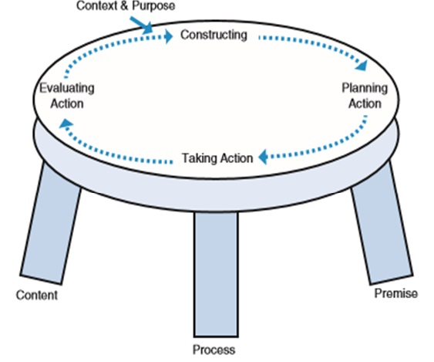
Action research table top model
Source:
Coghlan, D. and Brannick, T. (2014) Doing Action Research in Your Own Organisation, London, Sage.

Slide 6

A collaborative conversation
Image: Getty Images/iStockphoto

Slide 7
Methodology – why GTM?
A theory-building, not theory-testing or theory-verification methodology. Systematic data collection and analysis.
‘Far better to allow the data to tell its own story in the first instance, build a theory, then, subsequently, engage your theory with the theory that you thought you might impose initially. You can see if your emergent theory confirms or challenges existing theories. So, potentially GTM has a huge role to play in theory building, in all disciplines’.
Urquhart, C. (2013) Grounded Theory for Qualitative Research: A Practical Guide, London, Sage.
Sannino and Engeström (2017) describe ‘looking in vain’ for recent discussions of ‘theoretically and methodologically ambitious approaches’ of intervention research in major journals.
  Sannino, A. and Engeström, Y. (2017) Co-generation of societally impactful knowledge in Change Laboratories. Management Learning, vol.48, no.1, pp.80-96.

Slide 8
Brief history of the project
Phase 1:
learning networks hosted in dedicated VLE sites for each of three pilot modules on Tricky Topics.
discussion forums and online workshops used to seek feedback from tutors, in order to collaboratively identify Tricky Topics and suggest improvements or produce learning interventions. S215 ALs and the module team very successfully identified a list of conceptual Tricky Topics, plus a list of additional issues including pace and volume of material.
ALs designed and implemented four innovative Tricky Topics intervention videos, which have been in use on the 17J and 18J module website, shared with other modules and emulated elsewhere.
Phase 2:
second cycle of collaborative work building on the analysis from the first cycle in S215. Since tutors had identified concerns about pace and volume of material, an online workshop and discussion forum shared and interpreted specialised learning design analytics visualisations with tutors with the aim of identifying areas for further new interventions.

Slide 9
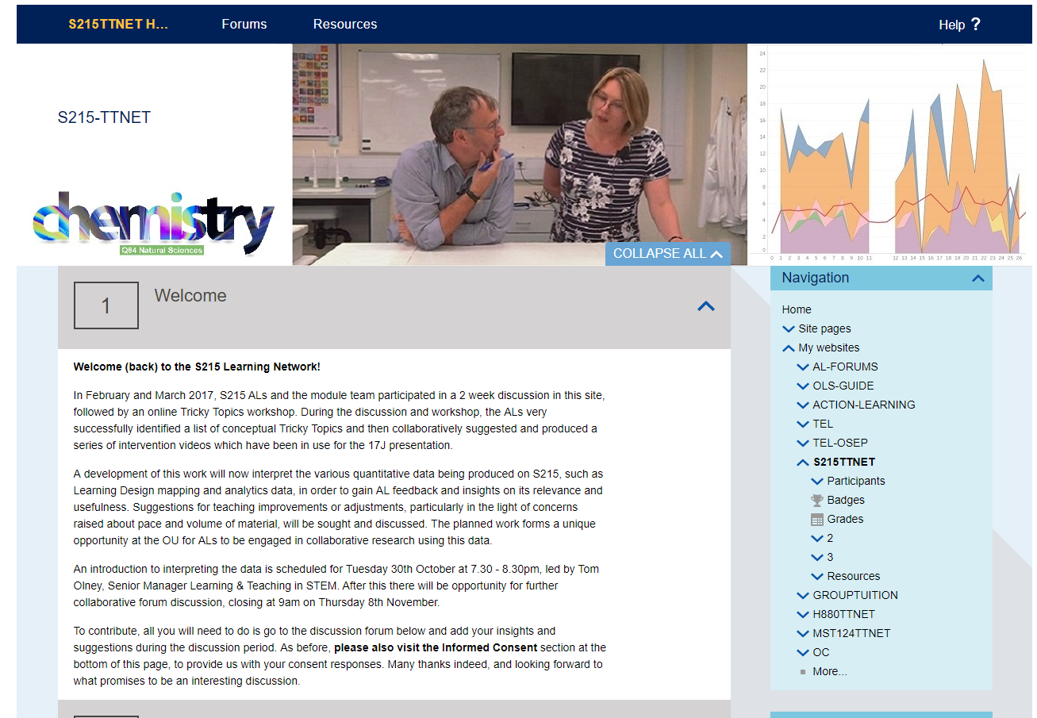
Learning Network site

Slide 10
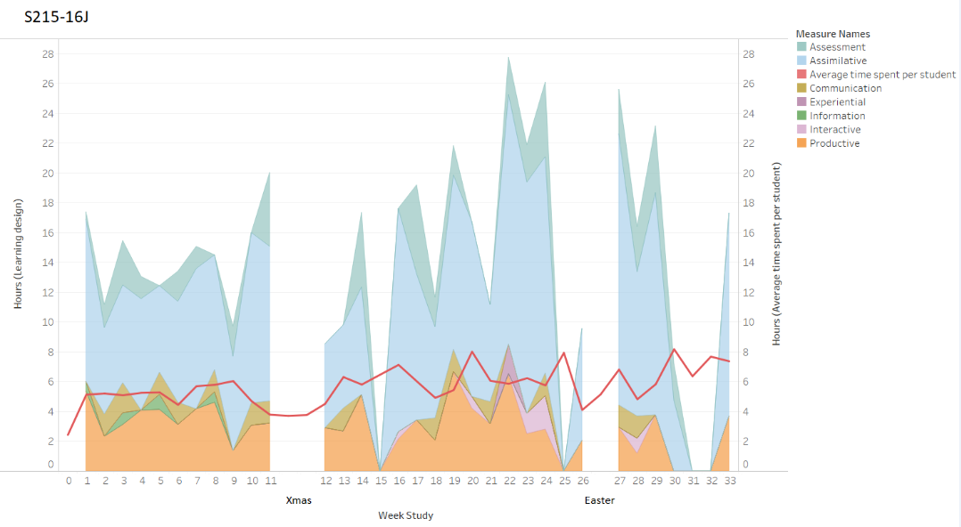
Using learning design analytics
The three visualisations discussed with S215 ALs were:
expected student workload by activity type
comparison of expected student workload and MT advised workload per week
comparison of expected student workload by activity type and average VLE engagement

Slide 11
Results so far
Phase 2
The learning network discussions have highlighted a number of issues, represented in an interactive spreadsheet, which organises the supporting qualitative evidence. These issues include pace and volume of material, prerequisite knowledge and online / offline study behaviour. All these issues have contributed towards the planning of four actions:
production and trialling of ‘signposting’ material for Blocks 9 and 10
finding out more re student preparedness and study choices before S215
finding out more re online / offline study behaviour, and which resources students download
clarifying issues re the use of OU Analyse
The trial signposting materials have been produced by an AL, reviewed by the module team, and implemented in the current presentation.

Slide 12
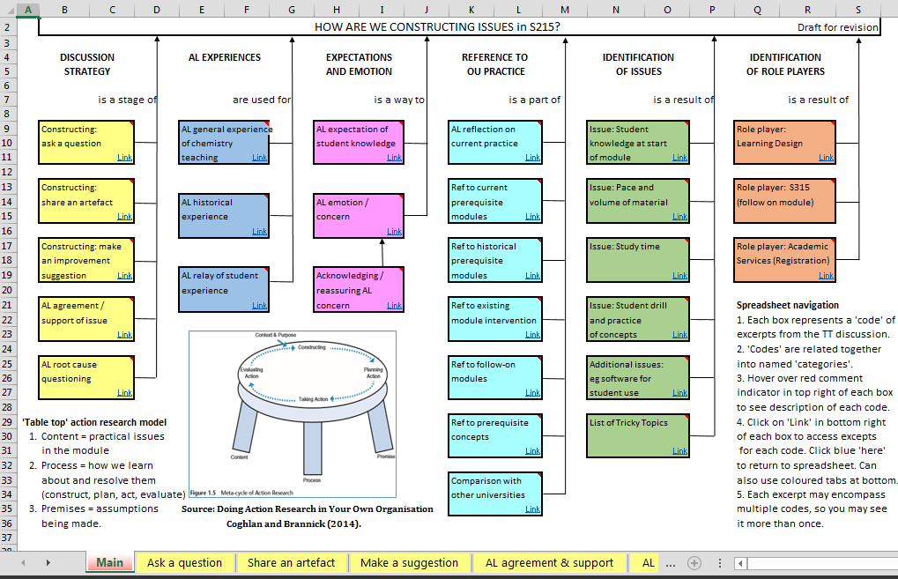
Analysis – interactive spreadsheet
Two years of qualitative feedback from the 17J and 18J learning network discussion forums, which is now represented for both years in a new navigable interactive spreadsheet.

Slide 13
Results so far
Phase 2
Two Study Pathway Analysis reports for 17J and 18J, have been produced for the project by a STEM Data Wrangler. These reports illustrate the module combinations and presentations taken by 17J and 18J students before S215.
The Study Pathway Analysis reports illustrate an extremely scattered picture of previous study pathways, taken over many years. In 18J, out of 160 students in total, there were 71 different pathways; all but the first 7 were unique to one student. 32%, or 51/160 students followed the recommended route of S111+S112.
The Module Chair has collected some informal feedback from a selection of students at the recent Residential Schools, with initial positive feedback for the trial signposting documents and underscoring the concerns over pace and volume of material.

Slide 14
Next steps
The next stage is currently being undertaken: to consider all the data and possible actions, and plan for some questions direct to students, using the Real Time Student Feedback Tool (RTSF), before the students sit their exam in early June.
The project now has organised qualitative longitudinal evidence from the ALs, staff tutors and module team in 17J and 18J, and looking to underscore this with direct feedback from students.
Students will be asked during the RTSF whether they would like to provide further individual or discussion group feedback post exam.
Evaluations:
  effectiveness of each action research cycle
  collaboration and joint ownership
  integration of evaluations at intervention level, module level, qualification level, and organisational learning or systemisation level
Finally we will evaluate to assess whether this approach can be extended to other modules (one is already under consideration).

Slide 15
Next steps
The acquired data and qualitative feedback may help inform future module wide improvement actions, adjustments to the learning design, provide support to inform AL teaching practice, and answer the questions and issues raised by their participation in the learning network thus far.
All the data, learning analytics visualisations, discussion forums and analysis of the issues with supporting evidence are held in a dedicated VLE site for S215, which is accessible by all participants and stakeholders.
The grounded theory analysis will be extended to consolidate and strengthen the emerging conceptual framework of technology-enabled organisational learning, and compared back to other existing and emerging conceptual frameworks in the literature.
Evaluation of use of GTM to explore a new conceptual framework and drive round progressive AR cycles in a structured and rigorous manner. Does it yield actionable knowledge, which is usable by practitioners whilst being sufficiently theoretically robust? (Coghlan and Brannick, 2014).

Slide 16
Thank you
Any questions?
lesley.boyd@open.ac.uk
rob.janes@open.ac.uk
tom.olney@open.ac.uk

