Slide 1

Presentation to eSTEeM Conference
John Butcher, Director (Access & Open)
Wendy Fowle, Assistant Director (APS)
Darren Gray, Manager (APS)
29th April 2020

Slide 2
Access Participation and Success
The need for greater understanding:
Why do our BAME students not achieve the same results as our white students?
Welcome and high-level context setting
John Butcher, Director (Access & Open)
Access Participation and Success Strategy & Access and Participation Plan
Wendy Fowle, Assistant Director (APS)
.
The data, the work-to-date, the task-at-hand
Darren Gray, Manager (APS)
Devising scholarship proposals – facilitated table work
Feeding back and next steps – scholarship launch
Diane Butler, Associate Dean Academic Excellence / Director, eSTEeM

Slide 3
Access Participation and Success
Why do we need an Access, Participation and Success Strategy?
Provides a strategic direction to enable equality of access and outcomes for students from underrepresented and disadvantaged backgrounds
Creates a joined-up approach which recognises nation-specific priorities
Institution-wide commitment

Slide 4
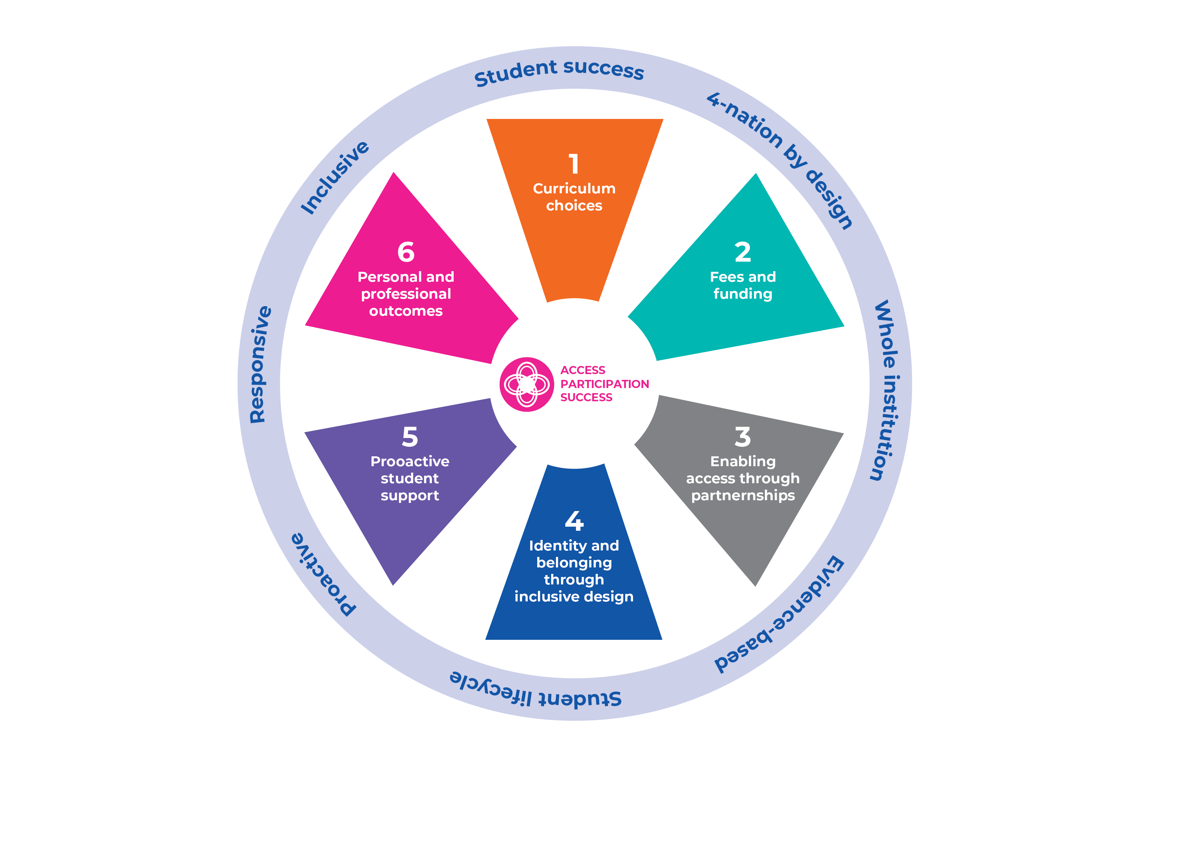
Access Participation and Success
Ambition: To remove inequalities in access, participation and success in HE
Strategically coordinated
Recognition of institutional and faculty responsibilities
Embedding
Theory of change methodology
Equality analysis
Sharing of good practice
Embedding learning into BAU across the University
BAME | LSES | Disabled | Gender | Carers | Care experienced | SiSE | Low PEQs
Access Success Retention Progression | Access Success | Success Progression | Access (discipline specific) Retention | Access | Access | Access Success | Success Retention
Access, Participation and Success Strategy 2020 – 2025
Access, Participation and Success website (includes links to nation funding body agreements)

Slide 5
Access and Participation Plan
2020/21 to 2024/25
Access and Participation Plans are a condition of registration with the Office for Students
Failure to have an approved plan means:
  students (in England) not eligible to apply for financial support through the Student Loans Company
  the University is ineligible to apply for other grants and funding opportunities
  Non-compliance could mean:
    financial penalties
    conditions imposed
    enhanced monitoring
    registration refusal

Slide 6
Access and Participation Plan
2020/21 – 2024/25
OfS mandatory areas of focus
    Drawn from analysis of OFS and internal data, universities MUST set ambitious targets to reduce inequitable outcomes for students, with a particular focus on:
    Low socio-economic status
    Black, Asian and minority ethnic (BAME) disaggregated
    Disabled students (disaggregated by physical, mental and specific learning difficulties)
    Mature learners
    Care leavers
BUT…
There is a persistent sector-wide gap in higher degrees awarded for Black students
This is an Equality and Diversity priority as well as the OFS

Slide 7
Access and Participation Plan
2020/21 – 2024/25
Priorities focus on the student lifecycle:
Reduce the gap in the award of module passes between
Black and White students
Physically disabled students and those with no disability
Students within IMD Q1 and IMD Q5
Students with mental health conditions and those with no disability
Reduce the gap in the award of good module passes between
Black and White students
Asian and White students
Students within IMD Q1 and IMD Q5
Eliminate gap in declaration of mental health conditions between Black and White students
Reduce the gap in progression to higher skilled employment or further study between
Black and White students
Mental health conditions and those with no disability
Students with sensory, medical or physical impairments compared to those with no disability

Slide 8
Access and Participation Plan
2020/21 – 2024/25
APP commitments
£5m annually over the five years of the plan focused on:
  Access activity (recruitment)
  Financial support
  Research and evaluation (£320K)
  PhD studentships
    Research and evaluation specialists (PVC-S)
    Data insight manager and analyst (Data and Student Analytics)
  Initiatives to deliver student success also required to be reported in annual returns against APP spend
  personal learning advisors
  peer mentoring
  developing inclusive curriculum
  research and scholarship
  bespoke training and resources

Slide 9
Access Participation and Success
Key Data / Comparisons: Entrants
UK- domiciled students – sector-wide
The largest broad ethnic group amongst UK-domiciled undergraduate entrants in 2018-19 was white (71.2 per cent), although the proportion from minority ethnic groups has increased 7.5 percentage points since 2010-11.
During the last eight years, black students had the biggest increase in postgraduate entrance, rising from 5.8 per cent of postgraduate entrants in 2010-11 to 8.1 per cent in 2018-19.
Source: Office for Students
Equality and diversity data release April 2020
Part time and full time

Slide 10
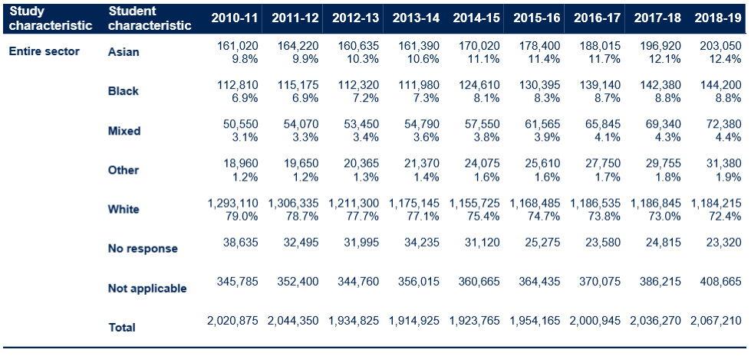
Access Participation and Success
Key Data / Comparisons: All Students
Part time and full time
UK-domiciled students – sector-wide
Source: Office for Students - Equality and diversity data release April 2020

Slide 11
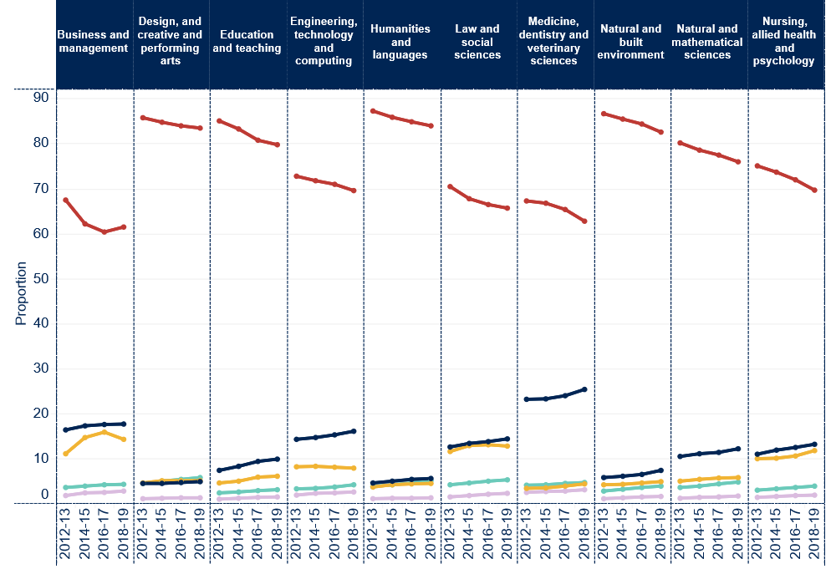

Access Participation and Success
Key Data / Comparisons: All UK-domiciled students by study area

Slide 12
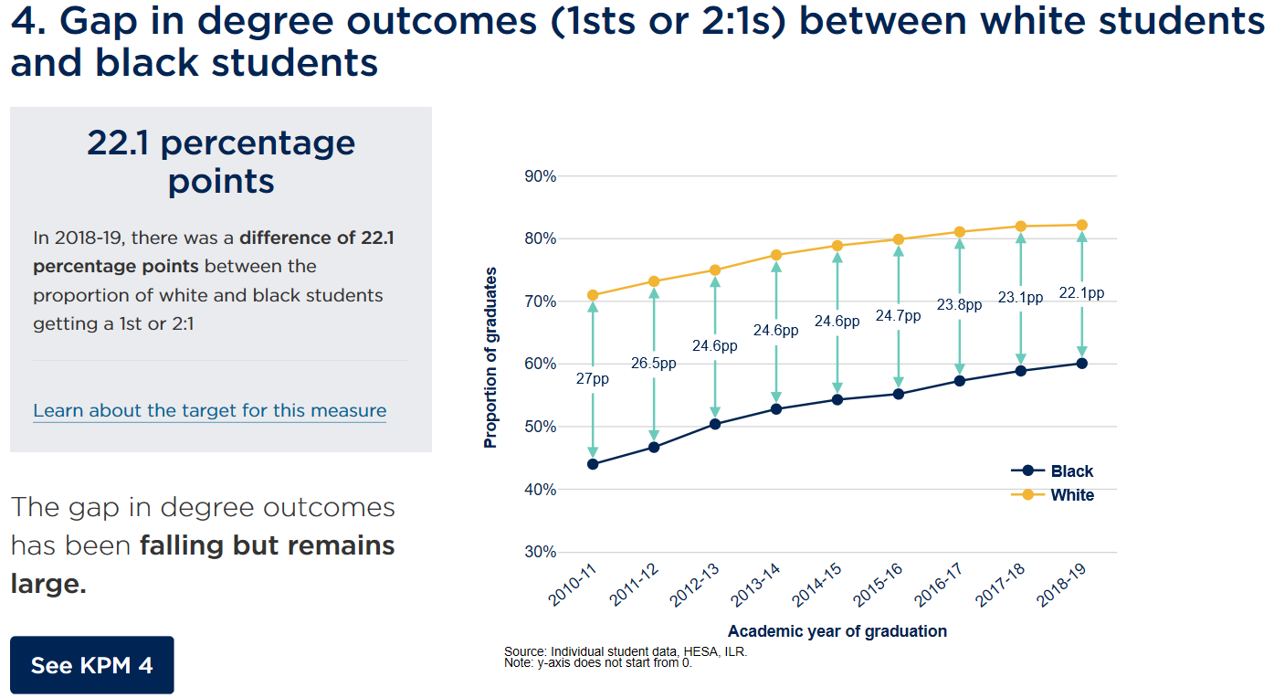
Access Participation and Success
Key Data / Comparisons: All UK-domiciled students / degree awarding gap
Source: Office for Students - Equality and diversity data release April 2020
Part time and full time
Source: Office for Students - Equality and diversity data release April 2020

Slide 13
Access Participation and Success
Your view
APS Online Poll
To what extent do Societal and University factors affect the Black attainment gap?
What do you think the University should prioritise as the top three things to reducing the Black attainment gap?
In five years time what level of a Black attainment gap do you think would be achievable?
Tell us your answers: https://bit.ly/esteem-2020-workshop-poll
Summary of results: https://bit.ly/esteem-2020-workshop-poll-results
Notes:
Slide 13 – Online Poll

Slide 14
Access Participation and Success
Pass gap:
BAME students module pass rate compared to white students
 | OU | STEM | C&C | E&I | EE&ES | LH&CS | M&S | PS
2015/16 | 7611 | 2150 | 525 | 354 | 78 | 473 | 768 | 181
2016/17 | 7497 | 2107 | 511 | 387 | 64 | 414 | 736 | 197
2017/18 | 7433 | 2136 | 586 | 412 | 95 | 418 | 683 | 139
2018/19 | 7377 | 2157 | 655 | 435 | 76 | 393 | 668 | 129

Slide 15
Access Participation and Success
Good pass gap:
BAME students module pass rate compared to white students
 | OU | STEM | C&C | E&I | EE&ES | LH&CS | M&S | PS
2015/16 | 1181 | 394 | 111 | 56 | 10 | 84 | 124 | 28
2016/17 | 1194 | 402 | 100 | 60 | 13 | 83 | 123 | 41
2017/18 | 1376 | 407 | 106 | 64 | 9 | 101 | 114 | 32
2018/19 | 1583 | 411 | 110 | 64 | 14 | 104 | 103 | 30

Slide 16
Access Participation and Success
Why do our BAME students not achieve the same results as our white students? : a scholarship approach
What might our specific research questions be?
How might we address these questions?
When and over what timescales?
So what – what would we do with our findings?
Why, how, when, so what....

Slide 17
Access Participation and Success
Potential themes for scholarship
Inclusive Curriculum
Inclusive curriculum tool
Co-creation with students
BAME or beyond –intersectionality
Unique nature of STEM – is STEM universal or are there cultural variations
Assessment
Students schooled overseas
Flexibility
Feedback
Type of assessment
Teaching
Relationships
Resources
Group work
Support

Slide 18
Access Participation and Success
Potential areas for scholarship
Support for Students
Peer mentoring / buddying
Role models
Forums
Advisors
Belonging
Diversity in the workforce
Seeing self reflected in the module
Building community
Contribution
Pan University
Culture
Discipline differences
Sector comparisons
Intersectionality

Slide 19
Access Participation and Success
Activity
35 minutes for discussion in Schools and then 15 minutes plenary
For this exercise:
Appoint a rapporteur and a time keeper
Through discussion identify two or three (or more) priority research questions for your school and any thoughts about how you would address this question in a scholarly way
Use the Padlet (Password Daffodil) to record your thoughts in detail
After 35 mins return to the main meeting room, ready for your rapporteur to feedback your highest priority research question

Slide 20
Please click on the link below to go to your group:
Group | Link
Computing & Communications and the Knowledge Media Institute | https://bit.ly/aps-breakout-room-one
Engineering and Innovation | https://bit.ly/aps-breakout-room-two
Environment, Earth and Ecosystem Sciences | https://bit.ly/aps-breakout-room-three
Life, Health and Chemical Sciences | https://bit.ly/aps-breakout-room-four
Mathematics and Statistics | https://bit.ly/aps-breakout-room-five
Physical Sciences | https://bit.ly/aps-breakout-room-six
Everyone else (e.g. visitors, colleagues from other faculties, non STEM school affiliated delegates) | Remain in this meeting room

Slide 21
Access Participation and Success
Plenary
Review the Padlet content.
From each school , feedback verbally on your highest priority research question.
What next for the STEM faculty?

Slide 22

Thank you
widening-participation@open.ac.uk

