Slide 1
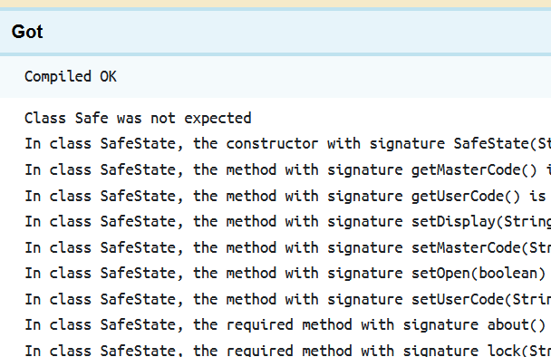
Intro Slide Title 1
M250’s unlimited feedback
What we’ve learned
Anton Dil and Sharon Dawes
Computing and communications
20th June 2024
Notes:
We are a 2nd year object-oriented Java programming module with a starting cohort of about 1400. Dropout rate is about 25%. We offer formative and summative activities with automated feedback.
There are historical (and continuing) differences in pass rates for certain demographic groups: lower for female, black, disabled students. Analysing use of feedback gives some insight into why these differences might arise.
Automated feedback is via the Moodle VLE, and we are focussing on interactive feedback for coding activities, which is delivered via the Coderunner plugin for Moodle.

Slide 2
Example of unit-test incompatibility with student code
Unit test | Student’s code | Typical compiler error message for first issue
Book b = new Book(); System.out.println(b.getId()); | class book { String id = "a1234"; public String GetId() { return id; } } | Test.java:11: error: cannot find symbol Book b = new Book(); ^ symbol: class Book location: class Test Test.java:11: error: cannot find symbol Book b = new Book(); ^ symbol: class Book location: class Test 2 errors
Notes:
We’d like to be able to provide automated tests for our students’ code. But test code and student code may not be compatible with each other.
A compilation error message like this can be hard for students to understand.
In Coderunner, students would not even see the test code that led to the error, because Coderunner won’t show the test case when compilation fails.

Slide 3
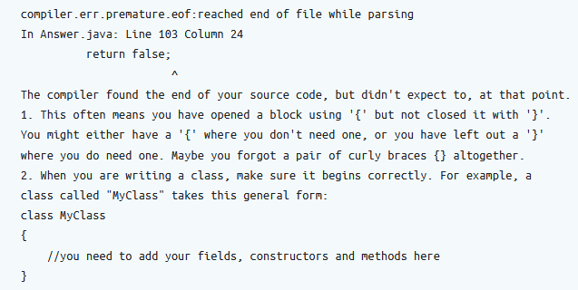
Three kinds of feedback
1. Compilation errors - hand-tuned, a bit of guesswork.
Notes:
We added separate compilation and structural tests.
Because the compiler call here is dynamic, we can compile the student’s code in isolation from test code.
We try to provide a more friendly error message, but sometimes it is not so clear what causes a problem.

Slide 4
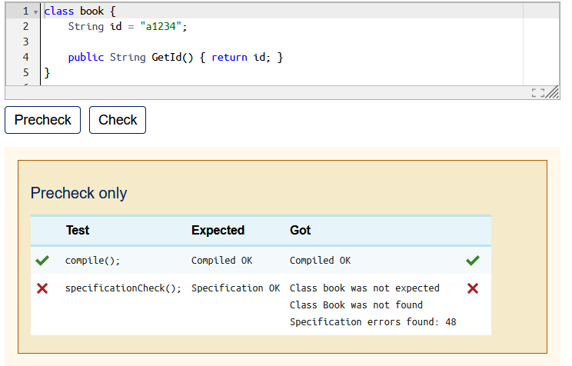
Structural feedback example (1)
2. Structural – comprehensive structural feedback, leading to unit testing.
Compilation and structural feedback were produced in a previous eSTEeM project and refined over several years.
Producing this feedback relies on close specification of what the student should produce.
This extra help is deployed via the Precheck button.
Notes:
Even if code doesn’t compile, structural feedback can often be provided. This involves parsing the students code and comparing against a known specification.
In general, you can’t unit test unless your code compiles and passes structural tests, although there are a few exceptions for structural failures.
Structural and compilation error feedback are to help students get to the point where they can test their code.

Slide 5
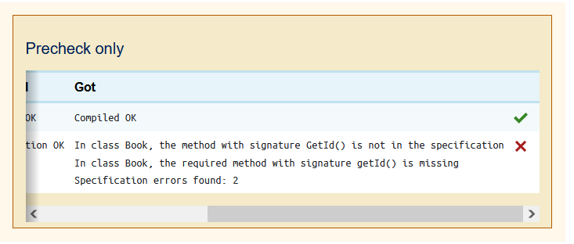
Structural feedback example (2)
2. Structural – comprehensive structural feedback, leading to unit testing.
After fixing the class name error, further structural errors can be revealed
Notes:
Now we can also show errors relating to the contents of the Book class.
We do this by specifying closely what students are expected to produce. We say that ‘The solution is the specification’.

Slide 6
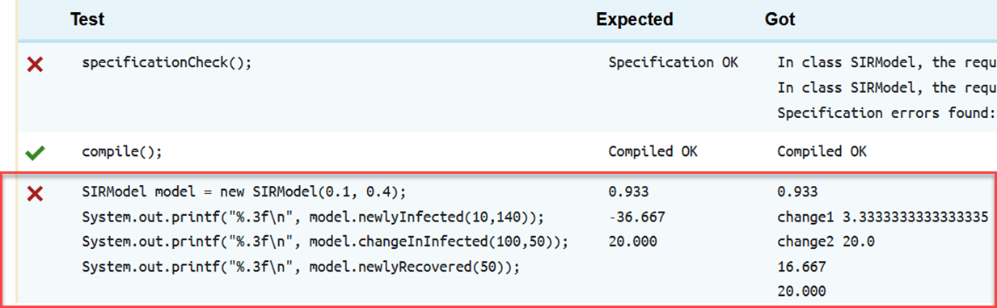
Three kinds of feedback
3. Functional, testing the student’s code
Notes:
Here all three kinds of feedback can be seen. The student should really have fixed their specification (structural errors) first.
Structural testing can be made fairly complete easily. Question author can write a single test for each assignment in effect. Some extra work needed in Coderunner to make this happen.
The third test here is functional.
Students don’t always understand the difference between these three layers of testing.

Slide 7
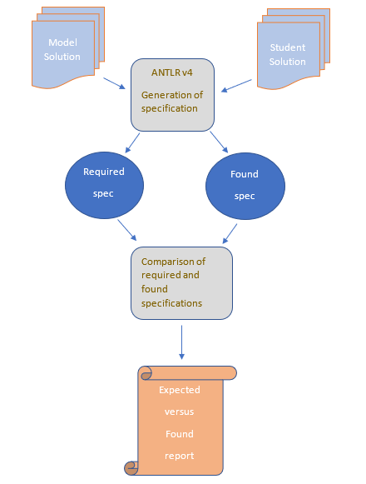
Structural checking process - JavaSpecCheck
Tutors could also use this to help mark code, but now it’s in the VLE anyway
Notes:
This involves parsing the students code and comparing against a known specification.
The tool is run in two modes: generate and check. The generate mode uses a model solution. We say ‘the solution is the specification’ , at least for structural part.
A serialised java object is added to the Coderunner support files, together with the JavaSpecCheck jar (the structural checking tool) and with some adjustment of the Coderunner template, a single test can be used in all assignments to report on structure. This is preferable to hand-writing unit tests for structures, which some authors have done. Also, we can report when code doesn’t compile, most of the time, where many rely on bytecode (compiled code) for reporting purposes. There are other advantages to using a parser.

Slide 8
Slide Title 2
Student survey
102 students responded

Slide 9
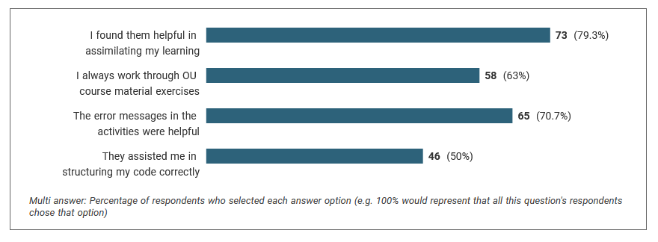
Student Survey
Student view of CodeRunner
92% of students surveyed used CodeRunner for their practical exercises. They said:
97% always or sometimes used CodeRunner to check the structure of code for their TMAs.

Slide 10
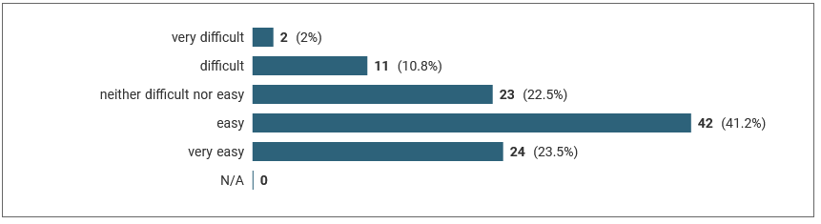
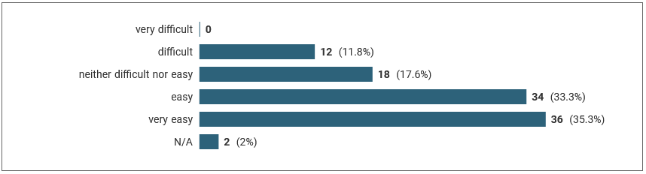
Student Survey
Student view of CodeRunner
We asked how easy it was to check compilation errors in CodeRunner:
and in BlueJ:

Slide 11
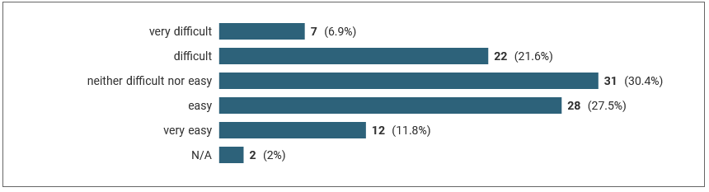
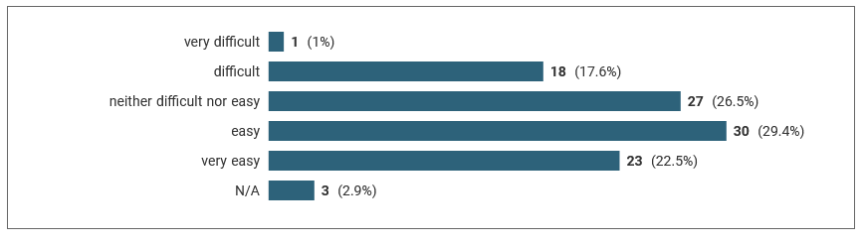
Student Survey
Student view of CodeRunner
We asked how easy it was to check code logic in CodeRunner:
and in BlueJ:

Slide 12
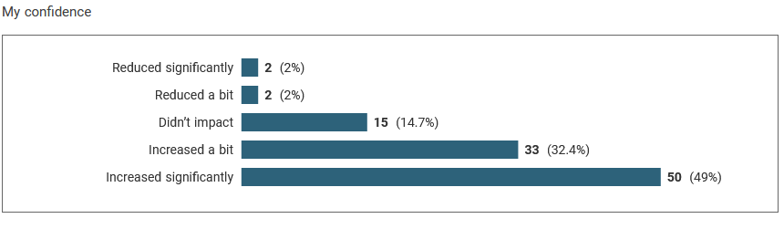
Student Survey
Student confidence
81% of students reported that their confidence was increased a bit or significantly when using the TestBed to check their TMA answers.

Slide 13
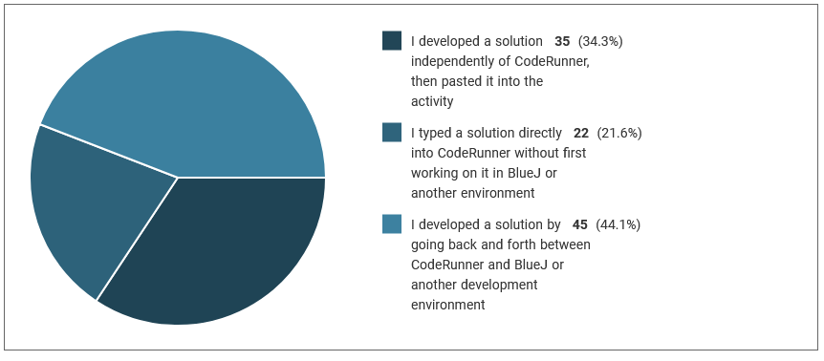
Student Survey
Insight into how students were using the software

Slide 14
Slide Title 2
Student use
Varies a lot

Slide 15
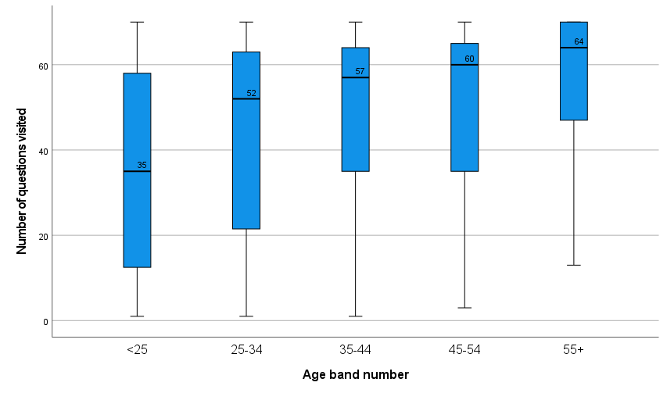
M250 2021J Formative Engagement
70 embedded activities online, with automated feedback
Age
Mean and median engagement increases with age
Here 65+ (N=3 group) is merged with 55-64.
Gender
Females more engaged (median +7) p = .024
Female lower IQR (interquartile range)
Notes:
Graph edited to merge 65+ with 55-64.
The same pattern is seen with summative testbed use to a lesser extent, see next slide.
Other differences in engagement by demographic can be seen in our Esteem report on scholarship home.
SPSS Analyze -> Explore -> Dependent variable ‘number of questions visited’, Factor: Age band.

Slide 16
M250 2021J Summative testbed requests
TMA01
Age band | Median | Max
< 25 | 23 | 434
25 – 34 | 29.5 | 590
35 – 44 | 34 | 2160
45 – 54 | 35 | 922
55+ | 48.5 | 244
Similar age pattern with summative feedback.
However, the median TMA scores across age groups are not significantly different by an independent samples median test or by Kruskall-Wallis. So the implications of testbed use by age are not clear cut.
It appears that older students are benefitting more from automated feedback, since we know that testbed use is associated with higher scores
Notes:
SPSS Analyze -> Explore -> Dependent variable ‘number of questions visited’, Factor: Age band. Graph edited to merge 65+, using minimum group size.
The same pattern is seen with summative testbed use to a lesser extent, see table

Slide 17
Slide Title 17
Structural checking requests by assignment
Assignment | 1 | 2 | 3
Total requests | 63725 | 45627 | 58678
Functional feedback (unit testing) | 33719 (53%) | 31090 (68%) | 31090 (72%)
Structural / compilation feedback | 30006 (47%) | 14537 (32%) | 16328 (28%)
Compilation Error ratio | 0.386 | 0.262 | 0.200
% of starting cohort | 95.6% | 85.4% | 79.9%
Notes:
Some students use thousands of steps (Check and Precheck requests).
Error ratio also varies by demographic – females’ code is less likely to compile successfully than males’.
On the first assignment, 47% of the requests were for structural and compilation feedback, and this decreased as the module progressed, as did the error ratio (proportion of time students code doesn’t compile). However, some of this is due to weaker students dropping out. Nevertheless, it is clear that some students are leaning quite heavily on structural feedback early on in the module and even stronger students continue to use it later on.

Slide 18
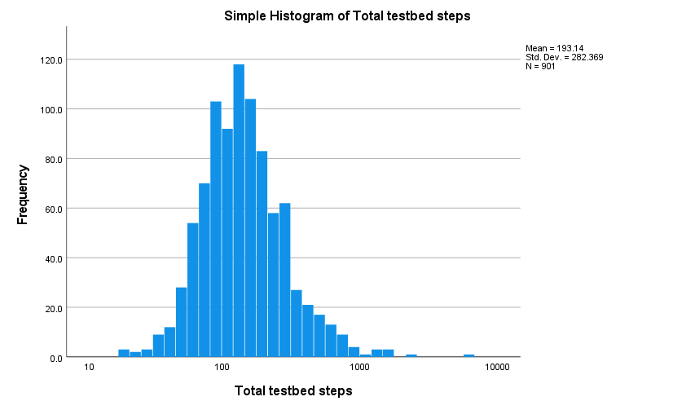
M250 2021J Summative TMA Interactions
Older, female students have a higher median steps on testbeds
Log-scale interactions over all TMAs per student
Similar pattern across all TMAs.
Here only including students who did all three TMAs.
Mean total steps 193, median 136
but > 1000 interactions for some students.
T-tests for different mean total number of steps
Age 35+ > younger p = .005
M250 Level ‘high’ > M250 level ‘OK’ p = .030
female > male p = .081
Unclear from this whether fewer interactions means more confident or more stuck.
Some bring nearly complete work to testbed, others work in testbed.
Notes:
This is not lognormal, just more bell-shaped after applying log, indicating high skew (+).
M250 Comfort Level isn’t significant for median number of steps, while means are sig. different, which is because there is a larger IQR for the ‘level too high’ group for numbers of steps, and a longer tail of students who are thrashing around on the testbed – so the means are significantly different.
Number of steps is not related to Qualification significantly.

Slide 19
M250 2021J TMA01 structural errors
Proportions due to different code structures
33.5% of submissions contained a structural error, with a total of 2381 structural errors detected (N=1240 students)
44.7% of submissions previously contained errors (previous assignment without automated feedback, N=250)
Many introduced extra structures and some other object-oriented design errors
Several patterns in type errors we can identify
Some patterns in naming errors, e.g.
  Camel-case errors
  Contractions / expansions of names, or adding words (elaborating)
  Prefix (get / is / has) variations, including dropping the prefix

Slide 20
Slide Title 17
Structural checking process – transition matrices
Assignment 1 |  |  | Assignment 2 |  |  | Assignment 3
 | S | F |  | S | F |  | S | F
S | 0.32 | 0.68 | S | 0.23 | 0.77 | S | 0.21 | 0.79
F | 0.67 | 0.33 | F | 0.69 | 0.31 | F | 0.44 | 0.56
S = Structural and compilation error feedback (Precheck)
F = Functionality feedback (unit testing)
Showing transitions S-S, S-F, F-S, F-F
Notes:
Transition matrices give an impression of the amount of switching students did between different forms of feedback. In assignment 1 students spent 2/3 of the time switching back and forth between structural and functional feedback. By TMA03 they mainly required functional feedback.
Even within the stronger cohort left at the end of the module, there is still considerable use of structural / compilation error feedback.

Slide 21
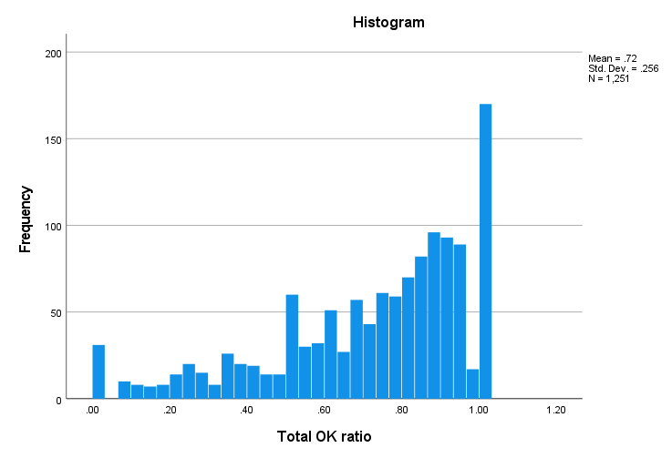
M250 2021J TMA01 Interactions
Ratio of OK compilations by demographic
Ratio of OK compilations / number of steps
TMA01 comparison
T-test for different means of OK compilation ratio
Mean = .72, std dev. = .256 (N = 1251)
Female < Male t = -4.881 p < .001
.65 vs .74
Low SES < Higher t = 2.399 p = .017
.68, vs .73
Disabled < Not t = 2.313 p = .021
.69, vs .73
Notes:
C:\Users\ad2472\OneDrive - The Open University\M250\Esteem2022\2023\TMARelated\errors\TMA01ErrorOKCounts-Sum-Demog.sav
Most authors talk about ‘Error ratio’. OK ratio = 1 – Error Ratio.
No significance for qualification (Q62 versus other) or older age (35+ vs younger).
No significance for ethnicity or white versus ethnic minorities
Strongest difference in means for female. 10% higher compilation error ratio for females

Slide 22
Slide Title 2
Impact on results
Useful...

Slide 23
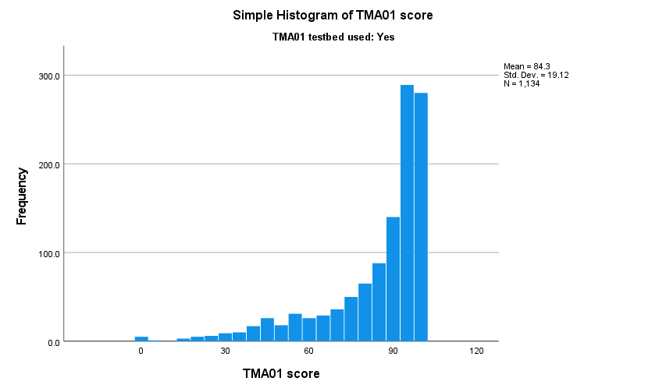
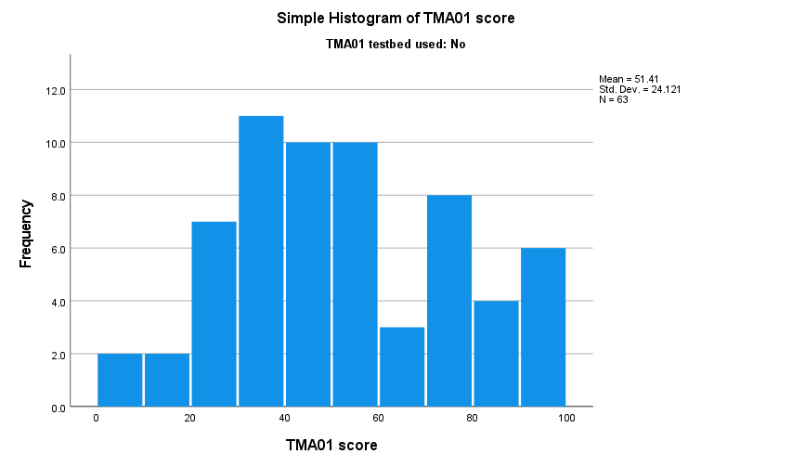
Grade distributions – testbed / non-testbed users (2021)
Notes:
Note negatively skewed distribution of scores for TMA01 for testbed users.
More normal distribution of scores for non-testbed users.
No sig difference in submission rate between these groups.
Explanations for why students may not have used the testbed include:
assessment banking from a previous presentation, including resits,
not finding it (though it is linked to from the TMA, so this seems unlikely),
fear of penalisation for using it (there is none),
having already dropped out, or deferred,
running out of time to test their code,
confidence that their solution fulfilled requirements, without testing.

Slide 24
Results
Mean TMA01 score testbed users: 87.3%, s.d. 16.1 (N=1268)
versus non-testbed users: 56.7%, s.d. 24.2 (N=72)
Students in the below median (< 136 over all TMAs) interactions group have significantly lower mean, but not median TMA scores, due to a different distribution of scores
  i.e. some make few requests because they’re done, others not...
Has an impact on Pass 1 % rate, although there are other factors in M250.
High numbers of interactions are strongly positively correlated with higher final scores, indicating that our automated feedback is helping some students to improve their work.
Grades awarded versus testbed interactions.
Grade | Median steps | Max steps
5 | 8.5 | 2160
4 | 10 | 541
3 | 19.5 | 870
2 | 34 | 466
1 | 34 | 203
The Spearman’s rho correlation coefficient between human scores and automated testbed scores is 0.746. (Pearson’s r = 0.774.)
Notes:
The effect size by Cohen’s d is -1.694, which approaches two standard deviations between the two groups, based on the pooled standard deviation.
Human scores are also quite similar to testbed scores. Humans are better at marking when the assignment is poor.

Slide 25
Slide Title 2
Future work

Slide 26
Future work
Interpretation of automated feedback use is difficult:
  Scores increase as students try more
  Large number of requests could indicate being stuck
  Should we applaud someone who takes 2160 attempts? (It happened)
  Student intent is unclear – when writing a method, did they mean to?
  Some bring nearly complete work to the testbed, others code in it
Need to explore what students are doing while interacting, e.g. edit size, time between edits, transitions between kinds of checks, signs of being stuck.
The best balance of tutor and automated marking is an open question.
  One student nearly finished assignment via testbed without the assignment one year
  We have seen our structural error messages on CourseHero and Chegg (unlimited, penalty-free feedback doesn’t stop cheating)
  The more closely we specify, the easier it is for GAI to produce a near-perfect solution.
Notes:
Unlimited feedback, while supposedly removing jeopardy or the need to cheat, doesn’t.

Slide 27
Slide Title 30
eSTEeM report on Scholarship Home
“An evaluation of the impact of changes to assessment practice in a second-year object-oriented Java programming module”
Thank you
Anton Dil
anton.dil@open.ac.uk
Notes:
For more detail, including other demographic analyses, please see our Esteem report.

Slide 28
Slide Title 31

