Slide 1
Java specification checking
Evaluation of a tool for use on M250 “Object-oriented Java Programming”
Anton Dil and Sue Truby

Slide 2
Part of an M250 TMA01 question, specifying Java code in English
In the public class M250Account:
Declare a private instance variable of type String called accountNum.
Edit the constructor for M250Account so that it initialises the accountNum instance variable to the account number "X00000".
Write a getter method for the accountNum instance variable.
A valid account number must have a length of 6 characters. Write a public method isValidLength(String s) that returns true if s is the correct length, and otherwise returns false.
A valid account number must begin with a capital letter. Write a public method isValidStart(String s) that returns true if s begins with a capital letter, and otherwise returns false.
In a valid account number, all the characters after the first (capital) letter must be digits. Write a public method hasValidDigits(String s) that tests whether s meets this condition and returns true or false accordingly.
Write a public method isValidAccountNum(String s) that performs the three checks above, and returns true if the account number represented by s is valid, and otherwise returns false.
Notes:
English specification is wordy and detailed, at least for some questions

Slide 3
How many errors are there in this solution?
public class M250Account
{
String accountNo;
private String s = "X00000";
public M250Account()
{
accountNo = "X00000";
}
public M250Account(String s)
{
accountNo = s;
}
public String getAccountNo()
{
return accountNo;
}
public boolean isValidLength(String s)
{
return s.length() == 5;
}
public boolean isValidStart(String s)
{
return s.charAt(0) >= 'A' && s.charAt(0) <= 'Z'; }
public boolean isValidAccount()
{
return isValidLength(s) && isValidStart(s);}
}
The instance variable accountNo not in the specification
The instance variable accountNo is missing the access modifier private
The instance variable s is not in the specification
The method isValidAccount is not in the specification – it should be called isValidAccountNum
The method isValidAccountNum should have an argument s of type String
The method hasValidDigits() is missing
Methods isValidLength() and IsValidAccount() perform incorrect tests
Curly brace formatting is inconsistent
There are no comments – poor style
Notes:
In this case, it’s consistently incorrect, so it will work, but it’s not what we asked for
It will work anyway, though it’s not what we asked for and it’s poor practice.
The code will compile and run, but not as we intended
If misspelled consistently, it will run anyway
The student has an instance variable s, so the code compiles
An attempt to use it will fail, but the student hasn’t used it
The code will behave incorrectly if tested appropriately
It’s ugly, but it doesn’t affect functionality
There are no comments – that’s poor style
What automated tests could help?
Does it compile? The compiler could be used – if tutors used it! Some don’t.
Does it pass a style check? We could provide a style sheet for this.
Does it pass unit tests? We could provide a test harness for this
Does it meet the English specification? This was the focus of my investigation.
Two options for specification checking
We have Java interfaces, but they only cover part of the specification requirements.
We could write Junit tests to check specifications, but they’d need rewriting for each specification.
So I wrote my own more generic specification checking software

Slide 4
What’s available to us to perform automated tests?
What automated tests could help?
Does it compile?
Does it pass a style check?
Does it pass unit tests?
Does it meet the English specification?
What tools could we use?
The compiler, if tutors use it – but they may not.
Static style checkers are available – a style sheet is needed.
A unit testing framework (JUnit) is available – a test harness is needed.
CheckM250 prototype
Notes:
Specification Checking:
We have Java interfaces, but they only cover part of the specification requirements.
We could write Junit tests to check specifications, but they’d need rewriting for each specification.

Slide 5
“CheckM250” specification checking tool – Research questions
1) Find out how tutors feel about this, and about use of similar tools – particularly style checking and unit testing.
With respect to marking
With respect to student use
Does it make marking faster?
Does it change the focus of marking?
Does it find errors tutors would have missed?
2) Explore use in Moodle for students, under CodeRunner
Requires code adaptations for the VLE
3) Later I decided to add compilation error help.

Slide 6
Design of the tool
How the tool works

Slide 7
Question authoring using “CheckM250” tool
1. The question author writes a more formal specification according to a simple specification language, based on the English specification and a provided solution class from the module team
class:public/M250Account/java.lang.Object/
field:private/java.lang.String/M250Account.accountNum
method:public/java.lang.String/M250Account.getAccountNum/void
method:public/boolean/M250Account.isValidLength/java.lang.String
method:public/boolean/M250Account.isValidStart/java.lang.String
method:public/boolean/M250Account.hasValidDigits/java.lang.String
method:public/boolean/M250Account.isValidAccountNum/java.lang.String
method:public/void/M250Account.setAccountNum/java.lang.String
constructor:public/M250Account/void
The Specification Checker compares this specification with the student’s solution
  – what’s missing; what’s excess in the solution?
  – Reports on the results
  – student’s code needs to compile
Unintended benefit: Cross-checking what the question asked for – did it ask for everything we wanted?
Notes:
About 2500 lines of code to implement this, plus some more to create a bluej plugin. Some extra also for compilation help in Coderunner.
400 lines of code for compilation helper
300 lines of code for the Bluej Extension, plus a GUI.
But in retrospect, there was might have been an easier way of achieving this, which also covers generic type parameters.

Slide 8
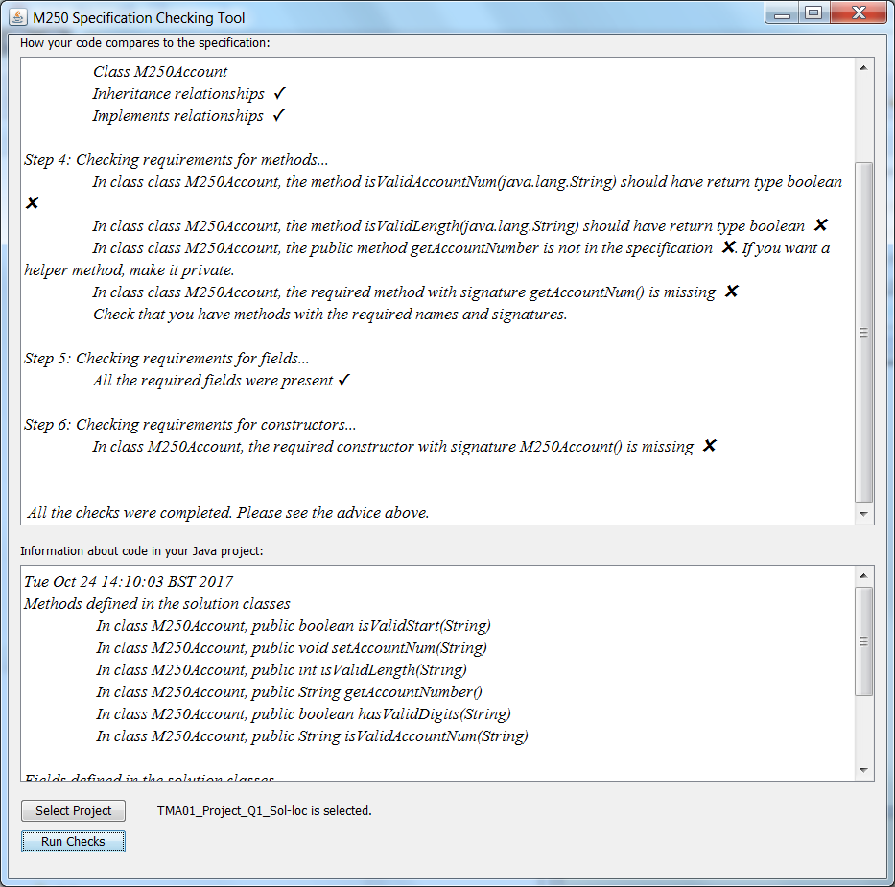
Running the tool: Found some errors!
Notes:
In this case, there were errors. The tutor is shown where they occurred

Slide 9
Student facing tool

Slide 10
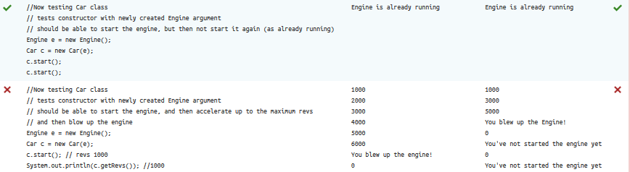
Typical CodeRunner output for a partially correct solution
Green ticks and red crosses are motivating!
Notes:
Typical coderunner output involves running unit tests and seeing ticks and crosses.
It is quite motivating to achieve all green ticks.

Slide 11
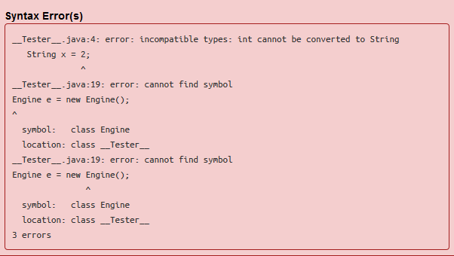
Typical compilation error
Just what javac said…
Notes:
When it doesn’t work…
All errors are reported by javac
Some errors relate to unit testing code that cannot run because the answer is incomplete.
The class __Tester__ is mentioned, which is unexpected, as it is a class used behind the scenes by Coderunner and not one that the student can see.
No explanation for the observed errors is offered

Slide 12
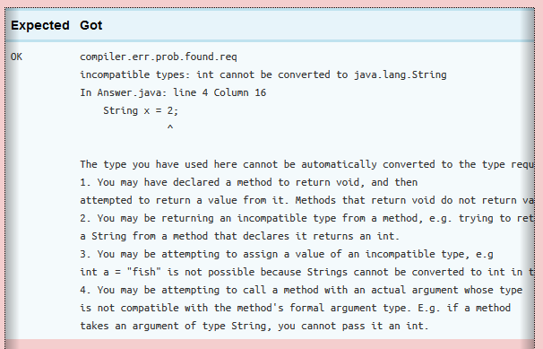
Compilation check example
Notes:
But BlueJ has a feature to provide help on errors. I obtained permission to reuse a file containing extended help on error messages so that the kind of help the student gets in the BlueJ plugin can also be reproduced in Coderunner.
This is integrated into Coderunner as a unit test with the expected output ‘Compiled OK’. If this output is not seen, then an error occurred, and my code retrieves a suitable set of error help messages to display to the student.
Only the first compilation error is displayed.
Here the file name Answer.java is used instead of __Tester.java__. This is hopefully more intuitively associated with the student’s answer. This name is used because the strategy I used is to copy the student’s code into a file called Answer.java and compile it separately to the main testing code. The compiler reports the name of the file it attempted to compile in its feedback, which is reproduced on the screen.
There may be many reasons for an error having arisen – here the relevant one is third in the list. The student would have to figure this out, but I hope that the help would assist in this. In fact, the first line of the error message covers all of the subsequent numbered situations in which the error might arise.
Further work could be done on organising the error help according to how common the error is, so that the most common kinds of errors are listed first.
The initial line of output “compiler.err.prob.found.req” is the message used to determine the help to be provided, but need not be shown here. It was left in for debugging purposes at this stage.

Slide 13
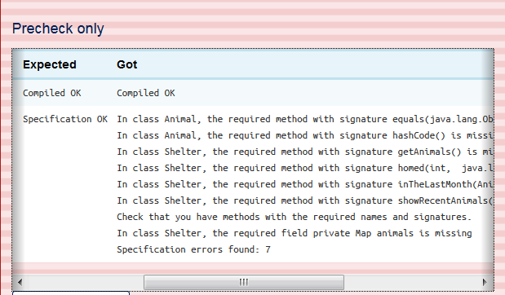
Example “Precheck” in Coderunner
Discrepancy in expected output for Specification Check
Notes:
Here you can see a Specification checking report on missing features in the student’s answer. This is again implemented using a unit test. The expected output is ‘Specification OK’, and if this is not detected, then the alternative output is displayed. This has been simplified for display on the VLE.
This was implemented as a Precheck in Coderunner, which carries no penalty. So students were allowed to run the Precheck before running the check, which is the part of the question that is actualy marked. It provides a way to see that required features have been provided. This means that the student’s code should run under Check, whereas if the specification is incorrect, the student’s code will not compile under Check, so no tests can be run anyway.
Here 7 features are missing from the student’s answer – in fact all the features requested in the question are missing from the answer in this case.

Slide 14
Results
Some results from the survey

Slide 15
So far…
8 tutors completing a survey reported that they used the tool
  Maybe 10 used it
20 tutors responded to the survey (12 of whom did not use the tool)
6 interviews with tool users were conducted
Compilation help was deployed on one formative Coderunner quiz on Moodle (500 attempts; 102 submitted)
Compilation help + Specification checking was deployed on another formative Coderunner quiz (200 attempts so far; 35 submitted)

Slide 16
Why was it not used by some?
Insufficient time. I had three TMA deadlines in the period 7-14 December and I had to focus on getting the marking done not the optional extras.
Little time to go and look for it, time to find how to use it and I thought it was something the module team was using, not for a tutor.
I was busy in other areas. I downloaded it and tried it out but didn't feel I needed it for TMA1
Didn't really want to spend any significant time in familiarising myself with a tool when the TMA was sufficiently simply to mark.
I can usually find errors by eye.
Its purpose has not been explained to me. At this level I can anyway spot coding errors without it.
Did not know about it.
Despite reading the tutor forums and viewing the marking guidelines I did not discover this tool until after marking TMA 01
Wasn't aware of its existence
Notes:
Main themes:
no time (underlined)
Didn’t feel it was needed (purple)
Didn’t know (italics)

Slide 17
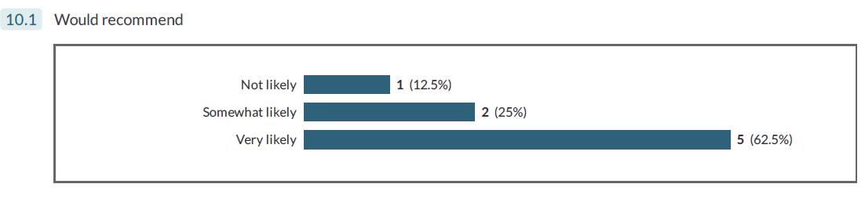
Feedback
1/8 tutors would not be likely to recommend the tool to other tutors
  Reported reason: it slowed down marking
Most tutors very positive about the tool, particularly those interviewed.
Notes:
Time is a particular worry for many tutors, but some consider the extra time in using a tool to be worth it, if it helps them find issues they might otherwise have missed. My feeling is the time investment is minimal and possibly marking could be speeded up by using the tool, once initial unfamiliarity is overcome and any user-interface issues are overcome. One tutor reported that this was so – speed was increased by using the tool.

Slide 18
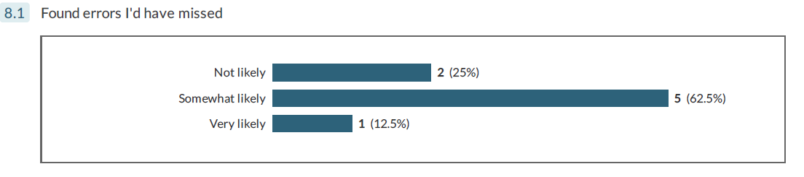
Does the tool help find errors? Survey results
Ideally I’d have done a test where tutors record the errors they observed and compare that with the tool’s output
Notes:
My experience is everyone gets it wrong, frequently, i.e. misses errors that students make.
I’ve seen this at marking coordination, and through monitoring, too often to believe anything else.

Slide 19
What interviewees said
There were errors I hadn’t spotted, which was embarrassing
That’s what computers are useful for as far as I’m concerned.
I would have liked to say to you that I’d spotted all those errors anyway, but I would be lying.
When I initially looked at the code I couldn’t see why [the tool flagged an error], but then when I looked a little closer you found there was an issue
If you’d asked me previously do you ever miss things I’d have gone ‘of course not’
Notes:
Interviewees recognised that the tool found issues that they hadn’t noticed.
In general this was considered valuable by those who used the tool.

Slide 20
Different attitudes to tools and marking
Theme | Negative | Positive
1 Time available to engage with the tool | No time to use, or slows me down | Worth investing the time
2 Quality of marking | No need for complete accuracy; could detract | Accuracy matters; improves feedback
3 Attitude towards tools | Over-reliance on tools is an issue | Tools help us do our job better
4 Focus of teaching | There are other things to be providing feedback on | Correct specification (also) matters
5 Need for a tool | The task is too simple to warrant use of a tool | Even with simple tasks, we make mistakes that tools can find
Notes:
Over-reliance on tools is expressed both with respect to tutors (might stop paying attention) and students (might think all is well when it’s not, basically the same issue).
In some cases tutors are also concerned about over-loading students, particularly if they are already struggling. This seems to me to be a reason to deploy the tool in a context like coderunner, where the module team deal with the overhead of having to configure the tool.
Regarding ‘other things matter’, the idea has never been that specification checking would dominate or prevent checking against other kinds of correctness… So I think there’s some misunderstanding about how such a tool would be used in general.

Slide 21
Tutors Comparing utility to students and tutors (percentages)
Percentages of 20 tutors reporting a tool would be Extremely, Very or Moderately useful to themselves and to students
Tool use to tutors when marking | Extremely | V+E | M+V+E
Unit tests | 26 | 58 | 79
Style checking | 22 | 39 | 72
Compilation error help | 20 | 40 | 70
Specification checking help | 17 | 33 | 72
Tool use to students | Extremely | V+E | M+V+E
Unit tests | 27 | 73 | 89
Specification checking help | 21 | 47 | 69
Style checking | 20 | 45 | 65
Compilation error help | 16 | 37 | 53
Notes:
Based on 20 survey results. 12 of the 20 didn’t actually use the tool. 60% of respondents didn’t use the tool.
Reporting percentages answering Extremely, Very or Moderately useful
Specification Checking help was rated as more useful to students than tutors.
Doubtful all the tutors thought this through.
I think more tutors would find the tool useful if they tried it and understood its relationship to unit testing. Possibly also tutors are familiar with the term ‘unit testing’, and not familiar with the idea I’m putting forward here of ‘specification testing’. It’s generally acknowledged that ‘unit testing is good’.

Slide 22
Do some tutors like or dislike tools?
Cross-tabulation of scores awarded to utility of Specification Checking tool for use by tutors versus use by students showed
Association measure Somers’ d = 0.625, Statistically significant (p < 0.001).
Tutors tended to rate Specification Checking highly for both themselves and students, or for neither.
Correlation measure Spearman’s rho between ratings of different tools was positive and statistically significant, except for Compilation Help.
Most significant correlation was between specification checking and unit testing (0.801) at the 0.01 significance level.
There are no significant correlations between ratings of other resources (e.g. module text) and tools.
Tutors tended to rate Tools highly for both themselves and students, or for neither.

Slide 23
Conclusions and future work
Where to from here?

Slide 24
What did the tool spot?
Capitalisation errors, e.g. Boolean versus boolean (wrapper types)
Inappropriate use of static
Misspelled method names and variable names
Incorrect access modifiers (e.g. public instead of private)
So what?
Quite possibly the student’s code ‘works’ in some sense but
  It doesn’t meet the specification
  It may fail unit tests that rely on correct specification
  The specification check can pick up issues that unit tests miss
    in CodeRunner picked up failure to override equals()
    Unit testing could have picked this up, but our unit tests missed it.
In question authoring, the process of producing a specification helped identify several issues with English specifications of questions

Slide 25
What next?
I intend to rewrite the code from scratch using a different approach
  Will help fix a couple of technical issues
Redeploy in Coderunner, and make more extensive use of it there
Add style checking for tutors, and for students in Coderunner
Create a standalone version of the tool in anticipation of M250 rewrite
Use by tutors is optional.
Write more of this up…
Notes:
There is an issue around generic types in the specification checking
It is desirable to check parameter names, which is easier in Java 8
M250 uses Java 7 at the moment

Slide 26
THANK YOU
Notes:
“It’s much better for [students] to find their own mistakes than for us to find them. Both for saving time but more importantly for their learning. You remember things that you find yourself much better than things that people point out”

