Slide 1

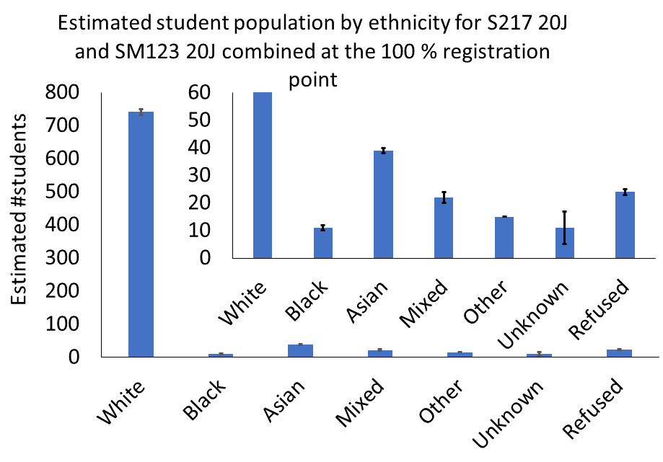
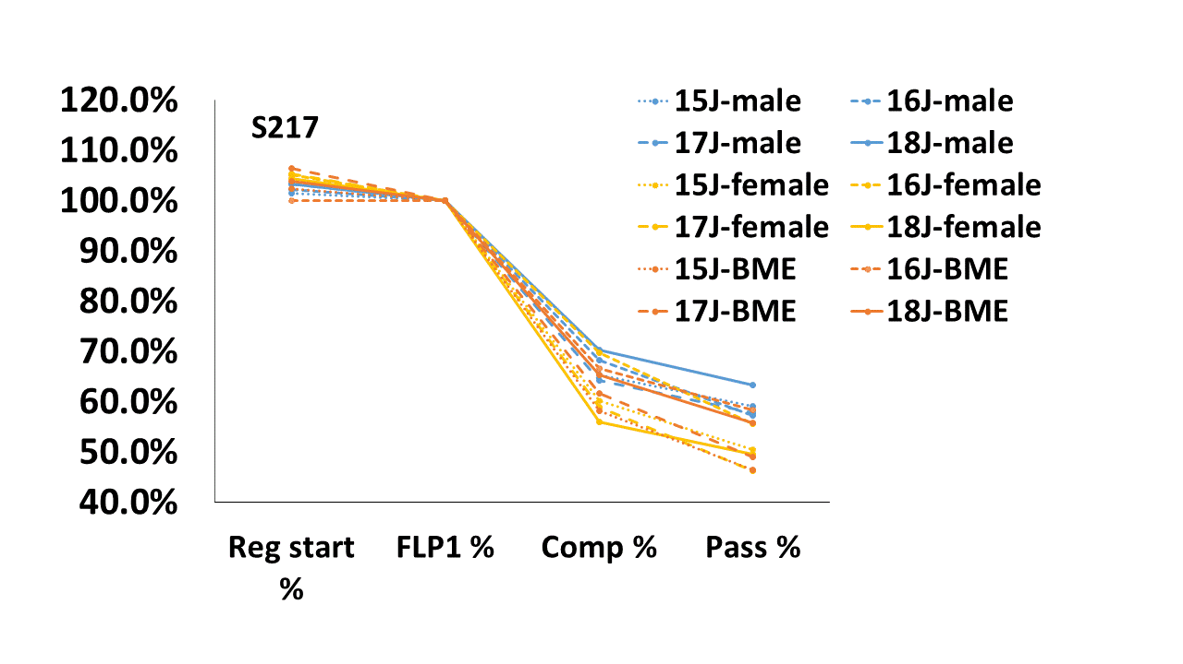

Investigating the impact of ethnicity on student experience in stage 1 and 2 Physical Sciences (PS)-oriented modules
Annika Lohstroh, Laura Alexander
PS has a low proportion of students with minority ethnic background, and are less
likely to complete modules. Literature suggests socio-economic factors only partially contribute to this gap.
Are differences in student experience contributing to the gap?
The project will study the experience of early stage PS (initially represented by SM123 and S217) students with minority ethnic background and contrast it to that of white students with similar profile in terms of socio economic background, prior study, study intensity, gender, age (and more?). Surveys and in depth interviews will be used for the purpose.
Survey design & target cohort will informed by
Literature review
Data analysis of module population and progression
Consultation with module team chairs
Feedback from previous module students
Personal Learning Advisers (if possible)
Survey findings shall inform subsequent in depth interviews
The aim is to identify possible changes to module design and delivery that can improve the student experience, retention and progression for PS students.
What Headings can be Arial 18 point bold (style = Heading 1) or
Headings can be Arial 16 point bold (style = Heading 2)
Text should be no smaller than Arial 14 point (style = Normal) ideally – absolute minimum of Arial 12 point.
You can use this space for content, either using the text, and using columns if you would like OR
Use the drawing tools to set content out how you wish.

