Slide 1


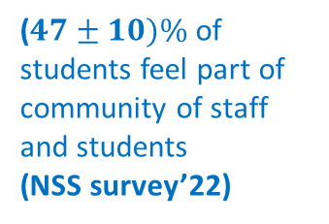
Building a sense of community in a core 2nd level Physics module(S217) and investigating qualitatively its effect on retention.
Anne-Katrin Klehe
30-40% of students have withdrawn,
~ ½ of them before Christmas
Have passed level1
75% excitement of learning
Level 2
Actionplan
Offer weekly 45min tutor group meetings until Christmas to
Build a sense of belonging
Weekly reminder emails of the meetings
Solicit student opinion about perceived difficulties – student voices to be heard
Measure progression through the module by questionairs
Check Early Alert indicators for passive withdrawals
Intended outcome:
record in diary entries the qualitative effects of these meetings
gain direct information on things students struggle with as well as those things that work well
determine actionable reasons behind student withdrawal
(very potential: effect on retention in my tutor groups)
S217
?
($47±10)\%$of students feel part of community of staff and students
(NSS survey’22)

