Slide 1

Progression from distance learning to postgraduate research: motivations and barriers
eSTEeM seminar series
Alice Fraser-McDonald, Sally Jordan, David Sharp & Teresa Sides
23rd September 2026

Slide 2
Outline
Project introduction
Rates of progression
Demographic data analysis
    Motivations for pursuing PGR
    Barriers to progression to PGR
    Project outcomes and next steps

Slide 3
Project introduction
Aim: Investigate the progression of OU students from undergraduate and taught postgraduate courses to postgraduate research (PGR) and the reasons for pursuing or not pursuing this pathway.
Background and rationale
Low proportion of OU Postgraduate Research students (PGRs) who have previously completed a taught qualification with the OU.
Improve understanding of current situation – is there a pathway?
Widening access to postgraduate research by understanding barriers.

Slide 4

Rates of progression (quantitative)
Objective: Evaluate the current rate of progression from undergraduate and taught postgraduate courses to postgraduate research at the OU (full-time and part-time).
Obtained data from across STEM Faculty to find out how many current PGRs have previously completed taught courses with the OU.
Findings for each School (7 within STEM Faculty) and mode of study (part-time and full-time).
11% of full-time and 40% of part-time PGRs had completed taught qualifications with the OU.

Slide 5
Percentage of PGRs with OU taught qualifications

Slide 6
Demographic data analysis
No significant variation by gender or ethnicity.
Strong correlation between having studied at least one OU taught course and being a part-time PGR student, rather than full-time.
PGR students with previous OU study significantly older than those without.
Students who declared a disability were more likely to have previously studied an OU taught course.

Slide 7




Student experiences – taught qualifications
Objectives:
Conduct student surveys and follow-up interviews to obtain information about student decisions relating to the pipeline to postgraduate research.
Conduct thematic analysis to identify the common themes and topics in responses to surveys and interviews about progression to postgraduate research.
Surveyed and interviewed students studying/completed OU taught courses
  Awareness of PGR
  Whether they considered/would consider PGR
  How well taught qualification prepared them for PGR
  Barriers in transitioning from taught study to PGR

Slide 8
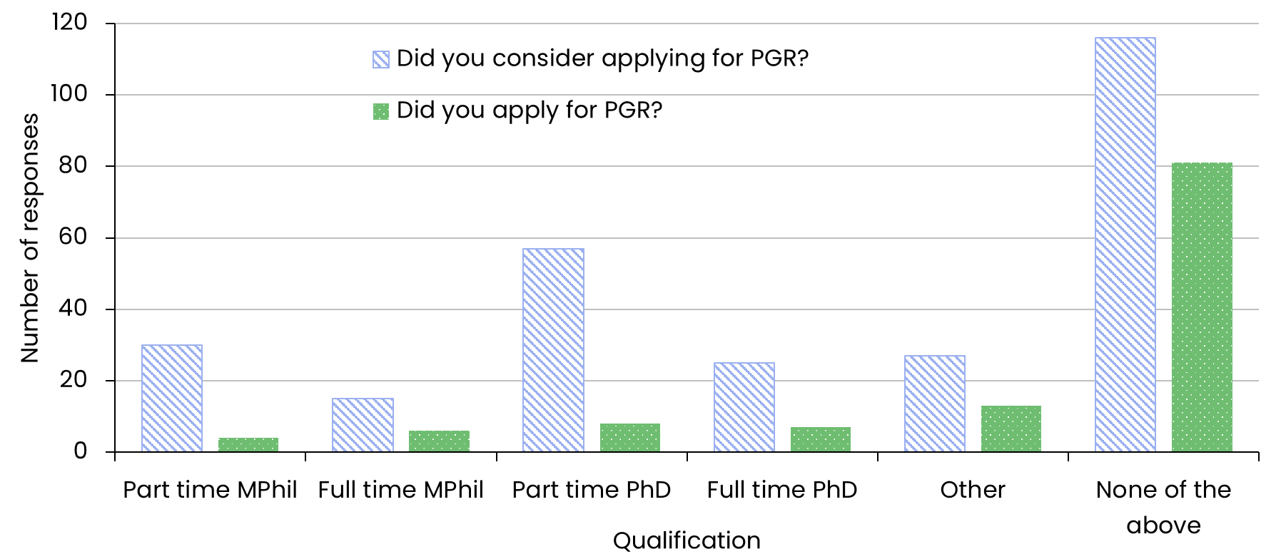
Motivations for pursuing PGR
Comparison of students who considered applying for PGR at any university with students who did apply (graduates only).

Slide 9



Barriers to progression to PGR
Main themes from survey of OU graduates and students on final modules:
Cost and/or funding
Cost - both in terms of finance and time taken away from other work
Possibility of conducting this whilst trying to support a family financially.

Slide 10

Barriers to progression to PGR
Main themes from survey of OU graduates and students on final modules:
Time and/or other commitments and study mode
Being able to fit in around full-time employment
Available time around work commitments
There should be more robust part-time options

Slide 11

Barriers to progression to PGR
Main themes from survey of OU graduates and students on final modules:
Location
The main barrier for me was location, as it is necessary to be close enough to a university to study for a PhD.
the main barrier to this is the requirement for study at Milton Keynes based on what I have read…

Slide 12


Barriers to progression to PGR
Main themes from survey of OU graduates and students on final modules:
Confidence and support
I don’t think I am good enough to undertake a research qualification. How do you even know?!
No contact was ever made about the options and how I could do this

Slide 13

Barriers to progression to PGR
Main themes from survey of OU graduates and students on final modules:
Lack of practical experience
The biggest barrier for me is that I do not have enough real life lab experience.
Limited or no face to face opportunities to enhance the distance online learning

Slide 14

Barriers to progression to PGR
Main themes from survey of OU graduates and students on final modules:
Health/Mental health
Worries about my mental health.
…my own health challenges that have been somewhat exacerbated by transitioning to a brick university.

Slide 15
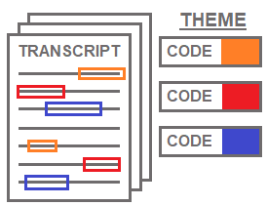
Student experiences – current PGRs
Objectives:
Conduct student surveys and follow-up interviews to obtain information about student decisions relating to the pipeline to postgraduate research.
Conduct thematic analysis to identify the common themes and topics in responses to surveys and interviews about progression to postgraduate research.
Interviewed current OU PGRs who hold previous OU qualifications
  Experiences of PGR
  How well taught qualification prepared them for PGR
  Barriers in transitioning from taught study to PGR

Slide 16


PGR experiences
Factors affecting PhD decision:
Mental health & disability
Neuro-diversity and general mental health needs to be supported more.
Practical experience
Support network
There was no one who would allow me to do my job and to do a PhD at the same time.
Location
Work commitments
I was just looking at like. Universities that were close to where I live
Prior study (continuity)
I've done the undergrad there. I felt like part of the OU family

Slide 17

PGR experiences
Preparation for PGR qualification:
Previous study
The final module that I did that I felt like that was probably the best primer for what postgraduate research would be like.
Application & registration
Project module
Some of the sessions like how to get the best out of a PhD … could have been offered maybe before we started.
Information & awareness
Preparatory materials
I think PGRs need to have more exposure with the undergraduate community.

Slide 18

PGR experiences
Support for PGRs:
Social networks
There is a huge number of people in this area in academia and doing PhDs with mental health issues.
Mental health
There is a general lack of understanding about how neuro-diversity affects students differently.
Mentoring
I quite like doing sports or activities outside like walking or that kind of stuff. I think it would be nice if we had more of those kinds of societies.”
I think if you'd been offered a buddy to be paired up with a couple of months before you started … might have eased the transition a bit more.”

Slide 19
Project outcomes and next steps
Understanding of current pipeline to PGR for OU students on taught courses, including reasons for students’ decisions and possible barriers
Recommendations:
  Develop networking or mentoring schemes
  Introductory courses/sessions to outline what PGR involves
  Investigate funding sources for part-time PGR opportunities.

Slide 20
Thank you
alice.fraser-mcdonald@open.ac.uk

