Slide 1
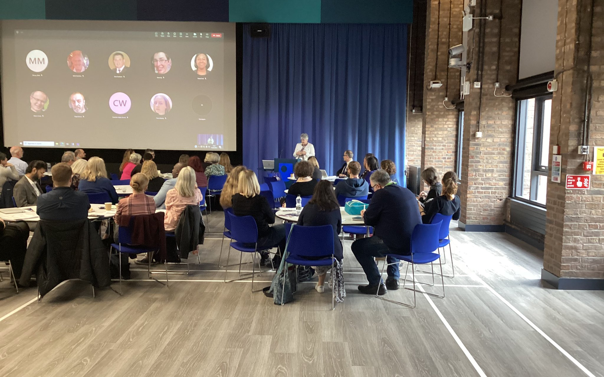

Intro Slide Title 1
eSTEeM Pre-bidding Workshop
Daphne Chang and Fiona Aiken
eSTEeM Directors
Monday 7th September, 10.30-12.00
esteem@open.ac.uk www.open.ac.uk/esteem
Call for projects July 2026
Please note: This session may be recorded
Notes:
Daphne slides 1-11

Slide 2
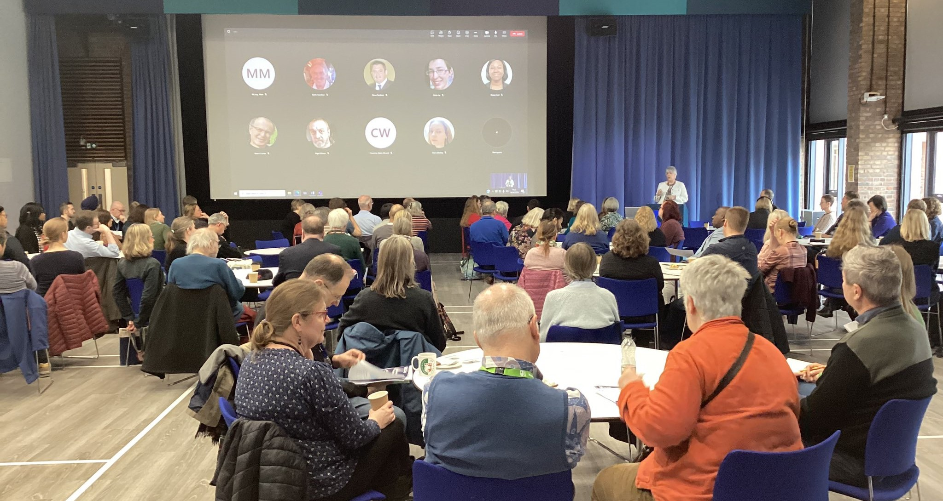
Slide Title 9
Overview
Defining scholarship
About eSTEeM
Proposal and project workflow
27th call for projects
Key information
Things to consider
Timeline and planning
Sources of support

Slide 3
Slide Title 9
Defining scholarship
Defining scholarship as the Scholarship of Teaching and Learning (SoTL)
  “systematic and ethically reasoned investigation of aspects of teaching and student learning by applying disciplinary knowledge, resulting in reflections and outcomes that are publicly shared for peer-review and for others to build upon” (SoTL in STEM BOC – Minocha and Butler, 2021)
SoTL is important in three ways
  For students allowing us to evaluate our teaching to improve the quality of student learning
  For academic disciplines and institutions ensuring we base future development on robust evidence enabling our teaching and learning to be recognised externally for its excellence and impact
  For practitioners allowing staff to develop their professional practice in the field of teaching and learning

Slide 4

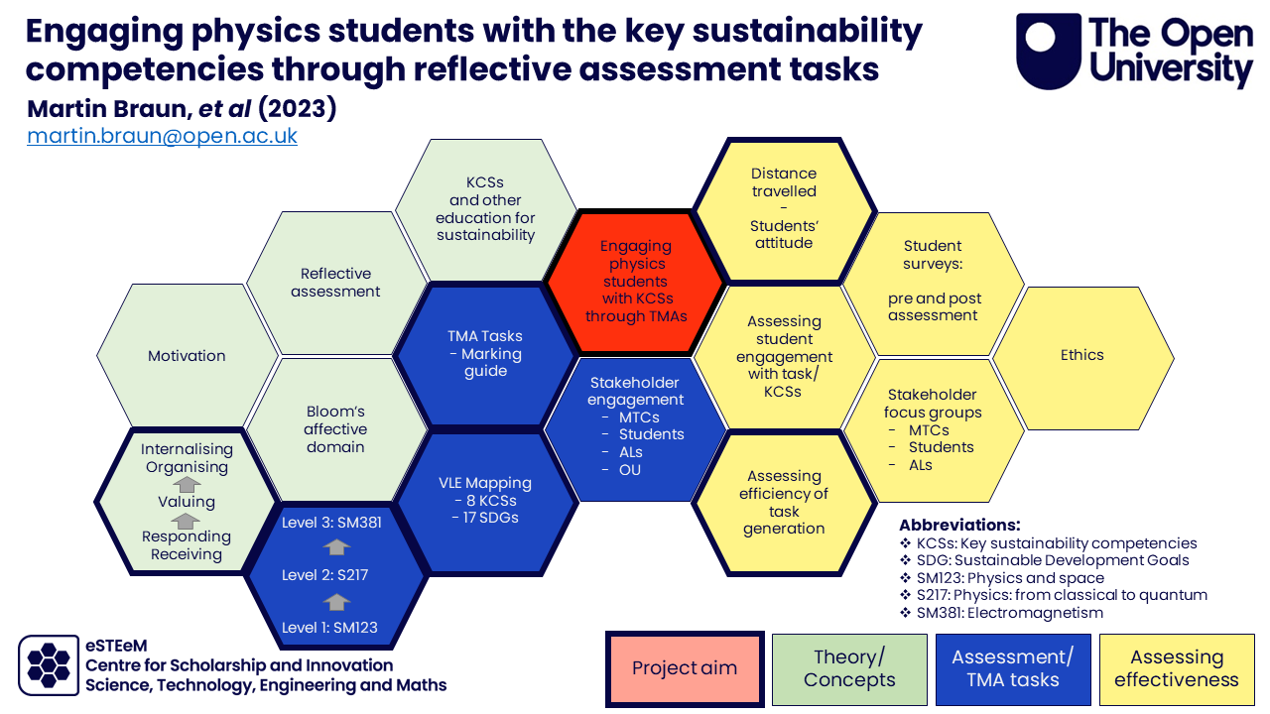
Slide Title 9
About eSTEeM
The STEM Centre for Scholarship and Innovation (Dec 2010)
Scholarship to enhance learning and teaching practice and strategy
Over 250 projects supported since 2011
Over 40 currently in progress
Individuals, groups and cross-disciplinary project teams
Professional development and support for project team – Applaud (Advance HE Fellowship)
External influence in HE STEM environment

Slide 5
Slide Title 9
From ideas to projects
Project idea – discuss with School Scholarship Lead/eSTEeM Directors
Project proposal form completed, endorsed by Scholarship Lead, approval required from Line Manager (ALs) and HoS
Proposal submitted by advertised deadline
eSTEeM Coordination Group meeting to evaluate proposals – accept, revise or decline
Project proposers informed of decision
Where necessary, plans revised. Final sign-off by eSTEeM Directors

Slide 6
Slide Title 9
Progress and completion
Ethics review, SRPP/SSPP approval, Data Protection compliance
Induction workshop
- project begins
Mentoring, ongoing project management and support
Ongoing staff development events
Short reports and interim IETT once a year
Ongoing dissemination - eSTEeM Annual Conference, internal and external events
Final report, outputs and publications uploaded to eSTEeM website/ Scholarship Exchange/ ORO and update IETT

Slide 7
Slide Title 9
26th call for projects - context
Artificial Intelligence (AI) is likely to play a key role in revolutionising many areas of our lives. The use of Generative Artificial Intelligence (GenAI) in HE has proven to be a highly contested area. The OU has responded by generating resources, interest groups and policies (for example, Digital, Data and AI hub, Generative AI in learning, teaching and assessment at the OU and Critical AI Literacy Skills).
For this project call, eSTEeM would like to invite practitioners to investigate the role of GenAI in helping us to understand/interrogate the strategic priority areas concerned.

Slide 8
Slide Title 9
26th call for projects – priority areas
Equitable student experience and outcomes: Projects related to Access, Participation and Success (APS) which investigate issues around tuition, assessment, retention and awarding gaps for students from specific minoritised or marginalised groups. Particularly interested in projects related to those students identified as high priority in the OU’s Access, Participation Plan: Black students, students with mental health challenges and students with the highest level of deprivation. For example, how GenAI could enhance or hinder these students’ outcomes and experience with the OU. Accessibility with respect to disabled and neurodivergent students’ experiences of GenAI tools would also be of interest.
Continuation and completion: Projects that investigate the role of GenAI in enhancing or hindering student continuation, completion and sense of community/belonging. Projects examining risks, limitations or unintended consequences are equally welcome.

Slide 9
Slide Title 9
26th call for projects cont’d
Curriculum design and assessment: Projects that investigate how GenAI can be deployed to deliver innovations in sustainable curriculum design and assessment as well as the limitations of doing so.
Staff and student community, wellbeing and support: Projects that foster a supportive and inclusive environment for both staff and students. Particularly interested in initiatives that address mental health and wellbeing, enhancing a sense of belonging and strengthening community connections across diverse student and staff populations and ways in which GenAI can be used to achieve these goals.

Slide 10
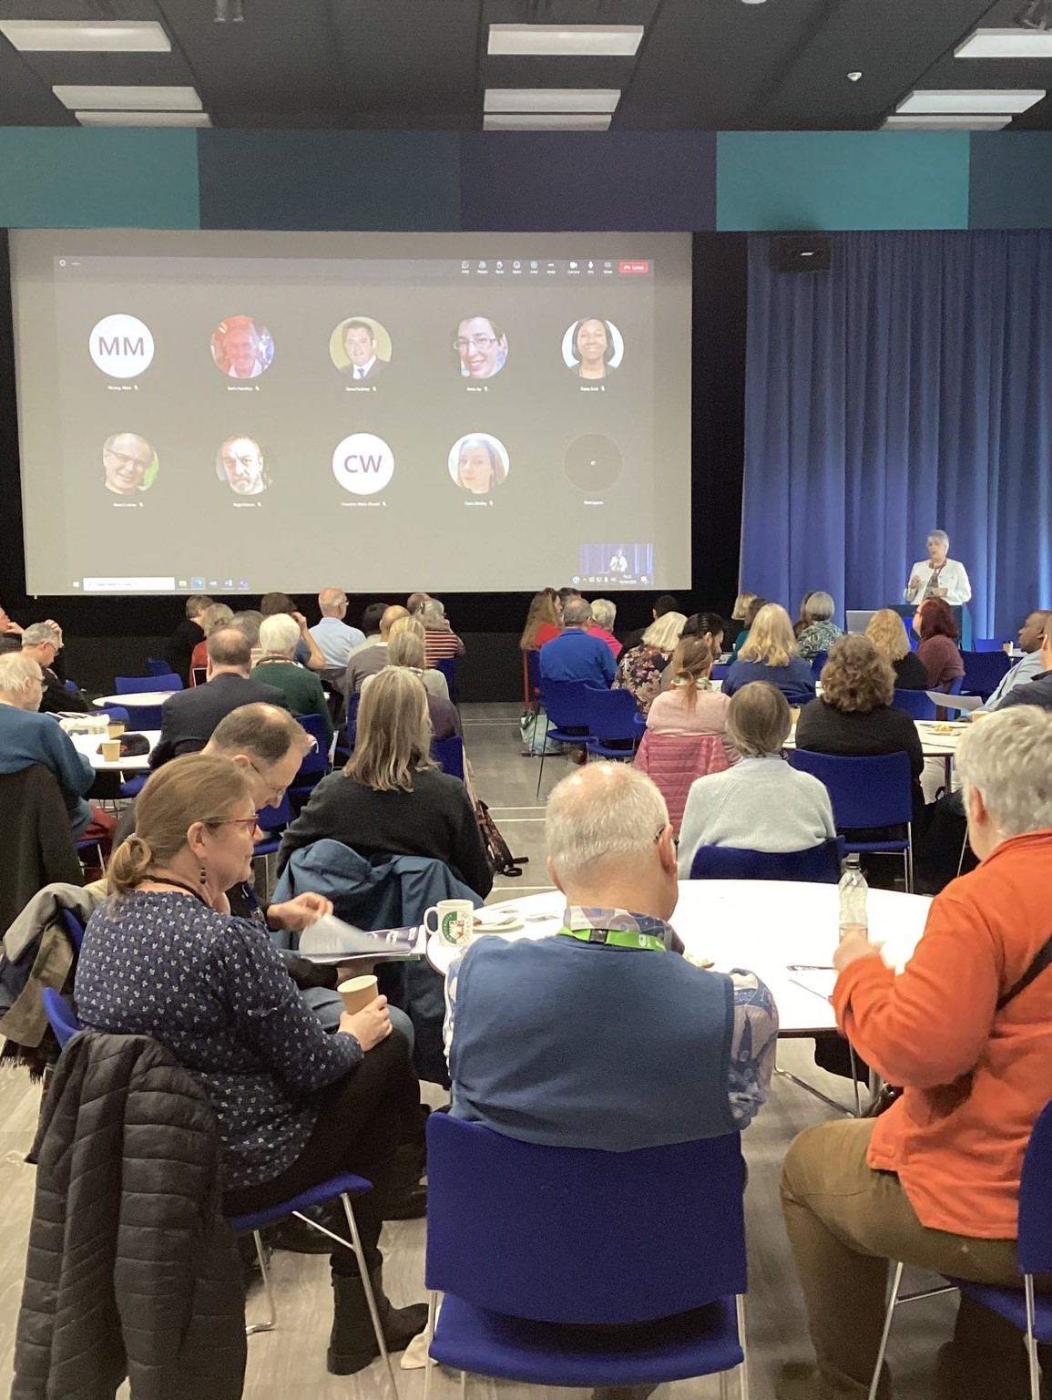
Slide Title 9
Key information
eSTEeM projects normally run to completion within 12-18 months with each team member expected to commit a minimum of 10 days.
Endorsement required from your School Scholarship Lead. If based outside a school, contact eSTEeM Director. You should have contacted your relevant Scholarship Lead by now as recommended date was 4th September.
Central and regional staff require approval of time allocation from your HoS. If based outside a school, line manager approval is required. ALs require approval of time from Line Manager and approval of proposal from HoS.
ALs must be able to fulfil this role within the maximum working allowance of 1.3 FTE (may use spare FTE capacity or an ADC may be raised in exceptional circumstances).

Slide 11
Slide Title 9
Key information cont’d
All eSTEeM funded project teams are required to submit yearly short reports and a final project report within two months of completion.
We particularly encourage projects that involve students as collaborators/co-investigators on the project (and not just as participants in a study) and draw upon the experience of Student Support Hub/Educational Advisers, learning designers and professional services staff. Please contact eSTEeM if you need help in this area..
Scholarship skills development and project mentoring will be provided by eSTEeM.

Slide 12

Slide Title 9
Things to consider in your proposal
Is the project consistent with the aims of eSTEeM?
Which theme(s) does it address?
Have you considered the literature?
Are you aware of related projects? (check eSTEeM website and Scholarship Exchange)
Explain how your project builds on the prior work?
Notes:
Fiona slides 12-17

Slide 13
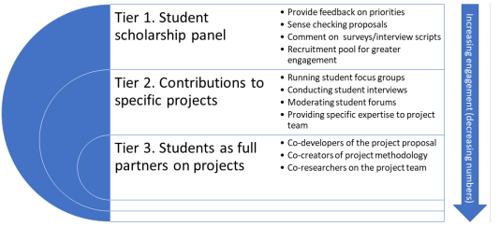

Slide Title 9
Things to consider in your proposal cont’d
Would your project benefit from student involvement at any stage (other than as participant in your research)?
Do you have any specific development needs to enable you to undertake this project? How will you address this?
Will the project produce significant deliverables/outputs within a reasonable timeframe and what might these be?
Is there an evaluation and an internal dissemination plan, including dissemination to students?

Slide 14
Slide Title 9
Selection criteria
Funding for projects is limited; the eSTEeM Coordination Group will be considering all projects based on the following criteria:
How closely the project addresses one or more of the priority areas.
The range, scope and clarity of the project.
How it builds upon previous projects from across STEM/the university and other research.
The breadth and diversity of project team and others involved with the project, e.g. involvement of students as partners.
The potential for impact of the project as based on the criteria within the Impact Evaluation Tracking Tool (IETT).
The number of ongoing and/or unfinished projects by members of the project team.

Slide 15
Slide Title 9
Selection criteria cont’d
The expected maximum amount of funding for each project will be £4,000 for the total duration of the project.
Funding for external dissemination to UK or international conferences may be requested up to a maximum of £2,000. However, please note that any requests must be made to the eSTEeM Management Team before the submission of an abstract to a conference and is dependent on the remaining budget within eSTEeM for that academic year

Slide 16
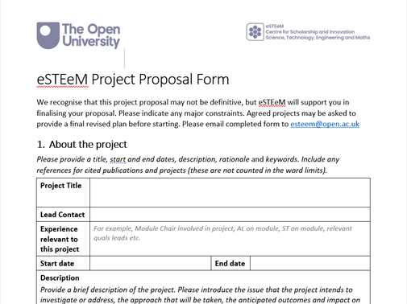
Slide Title 9
Checking your proposal
Is there a clear and realistic project plan with actions, responsibilities and timescales?
Will the project impact favourably on student experience and/or faculty effectiveness?
Is there a realistic workload allocation for staff?
eSTEeM project proposal form
eSTEeM project plan supplementary information

Slide 17
Slide Title 9
eSTEeM contacts
School Scholarship Leads
  C&C: Soraya Kouadri Mostéfaoui
  E&I: Alice Fraser-McDonald
  EEES: Servel Miller
  LHCS: Sarah Daniell
  M&S: Cathy Smith/Sally Crighton
  SPS: Jonathan Nylk
Management Team
  Director: Daphne Chang
  Deputy Director: Fiona Aiken
  Senior Manager: Diane Ford

Slide 18
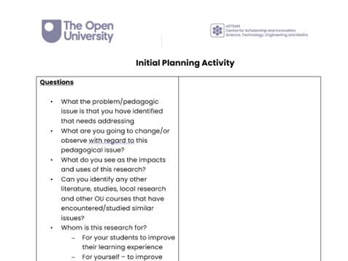
Slide Title 9
Timeline and planning
Timeline
  Deadline for project proposals
  17.00 Friday 9th October 2026
  Proposals scrutinised by the eSTEeM Coordination Group in Nov
  Informed of decision Nov/Dec
  Attend induction meeting in Dec/Jan
Post session planning activity
  Review the questions in the Initial Planning Activity
  Use this as the basis for discussion with your scholarship lead.
Project planning activity
Notes:
Daphne

Slide 19
Slide Title 31

