Slide 1
Guiding students in the use of GenAI
Emma Steele, Carol Calvert, Alison Bromley and Ruth Neal
eSTEeM conference
30 April 2026

Slide 2
Guiding students in the use of GenAI
Why guide students in using GenAI?
Student insights on using GenAI for study
How students are supported in using GenAI on Category 2 module M248 – a few highlights
Notes:
M248 is a category 2 module – allowing use of generative AI on formative TMAs

Slide 3

Why guide students in using GenAI?
94% of students said they use generative AI to help with assessed work (89% in 2025).
OU students may be more conservative. An international study found that 74% of M248 students used GenAI in their statistical studies.
68% of students believe AI skills are essential, but fewer than half (48%) feel their teaching staff are helping them to develop these skills for their future careers.
HEPI student Generative AI Survey 2026
Third annual survey of just over 1,000 full time UK undergraduates
Notes:
Emma - introduction
Why should we guide students in using GenAI?
This third HEPI / Kortext Student Generative AI Survey, based on responses from 1,054 full-time undergraduates in
the UK, shows that AI use among students is now near universal.
Some 95% of students report using
AI in at least one way and 94% say they use generative AI to help with assessed work. Almost all students are therefore engaging with AI as
part of their studies.
Carol did some work surveying students as part of an international study looking at students learning of statistics: students from M248, DD309, and MU123 participated alongside peers from six UK and three Australian universities.
OU students may be more conservative. An international study found that 74% of M248 students used GenAI in their statistical studies This is reasonably close to, but lower than, the HEPI survey figure of 88%, perhaps suggesting slightly lower usage amongst M248 students
A substantial majority (68%) of students believe generative AI skills are essential to thrive. This indicates that students perceive AI tools as a
necessary skillset for their future careers and lives. However, there is a clear gap between the perceived importance of AI and the support
students feel they receive in developing these skills. Only 48% felt as though their teaching staff were helping them to develop these
skills for their future career. This 20 percentage point gap highlights a current mismatch between the perceived importance of AI tools and the
delivery of these skills.
M248 journey
Our journey in exploring student use of GenAI has been and still is an ongoing journey. Three years ago, we made the decision for M248 to be category 2 – GenAI may be used – in the TMAs (since 23J).
(the module also an exam that is category 1).
In this talk, I’m going to look at:
How we transitioned M248 to Category 2 continuous assessment and what that looked like in practice. We realised early on that students were already experimenting with GenAI and decided to take a proactive approach to help them use it critically and constructively. This has required the module team to support students directly and in close partnership with Associate Lecturers, who are central to supporting students
As part of this work, we have also redesigned some of the continuous assessment so that is is now more robust to over-reliance on Gen AI by students.

Slide 4
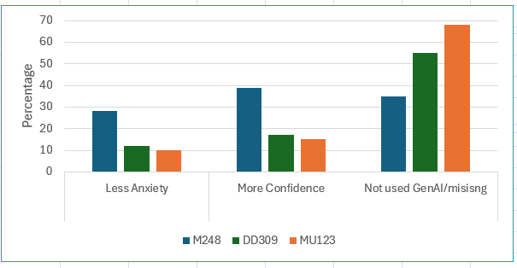
Potential benefits of GenAI use
Just a couple of positives to consider
Reduced anxiety and more confidence
Results from survey investigating students' perceptions and awareness of using Generative AI tools to support their learning of statistics.
Scholarship exchange:Item - Student and Associate lecturer views on Gen AI - The Open University Scholarship Exchange - Figshare
Notes:
In work led by Carol, three OU modules took part in an international Survey (three Aus universities and 6 UK universities) in Investigating students' perceptions and awareness of using Generative AI tools to support their learning of statistics.
In the OU this survey ran in 2025 across 3 modules M248, DD309 and MU123.
On the right, M248 has the lowest proportion of students who haven’t used GenAI – perhaps unsurprising as for three years on M248, we have been encouraging and supporting students in using AI in their studies.
On the left, students are reporting that using GenAI is reducing their anxiety and increasing their confidence. And this is a finding across the universities in this survey – not just in the OU modules.
Students were asked how, it at all, using GenAI had altered their anxiety about statistical tasks and their confidence in tackling them.
(Q29.How has using GenAI impacted on any anxiety you have about learning statistics?
Response options Q29: Feel much more anxious; A little more anxious; No change; A little less anxious; A lot less anxious; Not used GenAi
Q30 How has GenAI impacted on your confidence with learning statistics?
Response options Q30: Feel much less confident; A little less confident; No change; A little more confident; A lot more confident; Not used GenAi)
Across all three modules around a third said they had not used GenAI but a relatively high number of DD309 and MU123 students did not answer this pair of questions. M248 students, who were allowed to use GenAi in their assessments, however reported reduced anxiety and increased confidence.

Slide 5
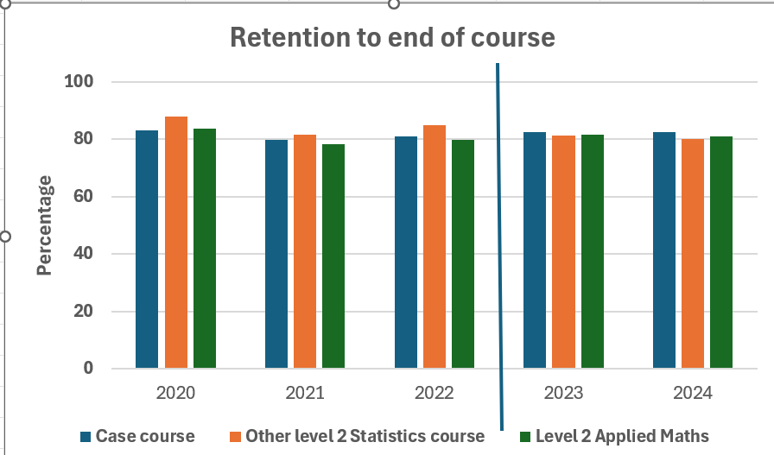
Potential benefits of GenAI use
Just a couple of positives to consider
Increased retention
Notes:
We might argue that if students are less anxious and more confident – does this follow through to retention.
This figures shows retention for three level 2 30 credit modules in maths and stats.
2023 is when M248 first allowed the use of GenAI.
It is a very slight increase in retention. Pre-2023 M248 had the lower retention – and unsurprising as it is a service module in many areas.
But retention has crept up, and we feel this may be down to a positive and proactive approach to GenAI in study.
Retention – the student has not withdrawn

Slide 6
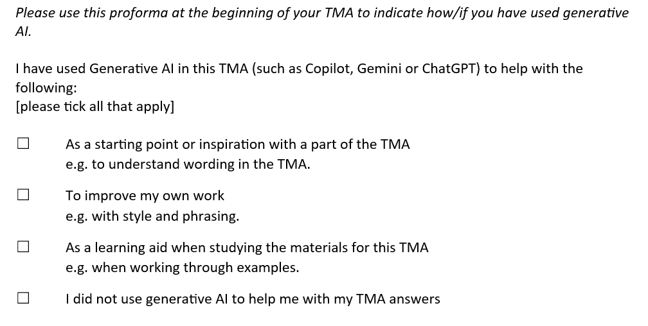
How many students are using GenAI in assessment?
M248 (Analysing Data) is Category 2 (permits the use of GenAI) for the formative TMAs
All students need to complete the following proforma with every TMA
Notes:
I want to talk about students using GenAI on a Level 2 statistics module, M248.
On M248, GenAI use has been permitted since 23J. M248 has a diverse student population – including students from other faculties and subjects where the module is used for service teaching. These students have a weaker mathematics background. So, we really saw the potential for Generative AI to help these students in their study and on the module.
The aim wasn’t simply to ‘allow’ AI, but to encourage students to think critically about how they used it—whether they chose to use it at all, and how they could check and understand the output it generated.
One of our key challenges was encouraging students to acknowledge use of GenAI.
To make things easier for both students and tutors, the module team introduced a simple acknowledgement form - the proforma - for students to submit with every TMA. Instead of including their whole conversation, students just tick a few boxes to indicate whether and how they used GenAI.
This small change has had several benefits: it gives ALs a straightforward, non‑confrontational way to ask for acknowledgement; it reduces anxiety for students; and it opens up a much more transparent dialogue about responsible GenAI use.

Slide 7
Use of GenAI in assessment on M248
The proforma gives information on how many students acknowledge use of GenAI in their TMAs
In 24J TMA01, about 25% of students acknowledged some use of GenAI
Most recently: in 25J TMA04, 50% of students acknowledged some use of GenAI
48% are using it as a learning aid
25% as a starting point
27% to improve their own work
Notes:
The acknowledgement form provides detail on how many and which students are using GenAI in their studies.
For example, at the start of the 2024 academic year, about 25% of M248 students acknowledged some use of AI. This figure has continued to rise and at the current time (March 2026), the proportion of M248 students acknowledging some GenAI use is 50%.
So we can see clearly how widespread GenAI use is becoming amongst our students. It is also evident that students on the Economics or Data Science qualification route are more likely to use AI, compared to students on Maths and Stats routes. For example, in February 2026, 56% of Economics and 54% of Data Science students acknowledged the use of AI, compared with 34% of Maths-Stats students.
This provides evidence that different students may have different needs, and that GenAI study support might be more helpful to some students, depending on their qualification route.

Slide 8
How are students using GenAI to enhance their learning?
“I use ChatGPT a lot. Actually, I didn't think I would. I was very surprised. I use it as a memory extension. I love a lot of the work that I'm doing and mention topics to it that I want to revise. I use it when I'm doing practise quizzes - sometimes the explanations aren't quite enough if I've got a question wrong, so I use it to break the thinking down.”
Mentor
Study Buddy
Side kick
… but there is a risk is that GenAI becomes a nuisance or distraction
M248 student participating in a focus group exploring attitudes to GenAI in learning
Notes:
Focus group with 5 M140 or M248 students, structured around positive use of GenAI in learning
and
Key concerns: AI hallucinations, checking the correctness of output, over-reliance, academic integrity, ethical concerns
One student described using (paid for) GenAI in study extensively.
Other students had more limited experience in GenAI.
This slide highlights some of the different roles GenAI can play in study and learning.
It might be all of these things in one study session!
Positive: a mentor, a study buddy, a sidekick
Mentor: Giver to younger or less experienced person help and advice over a period of time, especially at work or school
The buddy system is a procedure in which, the "buddies", operate together as a single unit
A sidekick: works with someone who is more important than they are
Nuisance: There is a slim boundary between a student enhancing their learning and outsourcing their own thinking. That’s when GenAI can become a nuisance or a distraction. Students need to be the ruler and make sure they are in charge of the AI in an effective way.
Ongoing student-led eSTEeM project: we are supporting two students to design and produce resources that demonstrate how GenAI can be used as a study support tool.

Slide 9
How are students using GenAI to enhance their learning?
Feedback from one maths student who attended the focus group.
Personalised study planning. Uses (paid for) ChatGPT as a memory extension and retrieves these logs before exams.
Step‑by‑step explanations for deeper understanding. When practice quiz feedback is insufficient, asks GenAI for alternative explanations.
Identifying and correcting errors. The student completes maths problems independently, then uses GenAI to check for mistakes (e.g., missing minus sign).
Study habits and wellbeing. Student sets rules so GenAI prompts them to take breaks when tired (example indicators are spelling errors or swearing).
Maintaining their own clear boundaries on its use. For example, the student reported that they do not use GenAI for calculations—finding it unreliable. Practises without GenAI before assessments.
Notes:
A focus group was run with 5 students who had successfully completed either M140 or M248 in 24J.
Structured around Positive use of GenAI for learning
and
Key concerns: AI hallucinations, checking the correctness of output, over-reliance, academic integrity, ethical concerns
Note: summary produced with assistance from Copilot on an anonymised transcript.
1. As a “memory extension” to support revision planning StudentD actively asks ChatGPT to remember topics and key points they have encountered during their study period. As exams approach, they use this stored log to retrieve important revision items without having to track everything manually.
2. For personalised study plans and focus areas They ask GenAI to help design study plans—e.g., “what should I focus on in the last week before the exam?”—based on the history the tool has stored about their progress and needs.
3. As a step‑by‑step explainer when practice quiz feedback is insufficient When they get a quiz question wrong and the OU explanation isn’t enough, StudentD uses GenAI to:
break down the reasoning
go through steps more slowly
clarify misunderstandings
This is used as a learning aid, not to generate solutions for TMA work.
4. To diagnose errors in their own mathematical reasoning They complete maths problems themselves, then use GenAI to help identify where an error occurred (e.g., a missing minus sign). They emphasise that they remain the author and do the maths themselves, using GenAI only to highlight mistakes.
5. To support understanding of external tools (e.g., PSPP) They use GenAI to learn how to operate statistical software for a side project. This widens their practical skill set beyond the module materials.
6. As a metacognitive / wellbeing aid StudentD sets behavioural prompts such as:
If they start making spelling errors
Or start swearing
…GenAI reminds them to take a break. This helps them manage fatigue and sustain productive study habits.
7. For practical problem-solving (e.g., using a new calculator) When they struggled with a new calculator, GenAI helped them learn its functions—reducing frustration and saving time.
8. Not used for maths calculations They explicitly avoid using GenAI for performing calculations because they find it unreliable for numeric accuracy.
9. Used with awareness of exam integrity StudentD ensures they practise without GenAI before assessments. They want to prove to themselves that they can do the maths independently, and do not want to become reliant on AI for processes they can’t use in exams.

Slide 10
How do we support students in effective GenAI use on M248?
Written guidance “How might Generative AI be helpful to me on M248?’ with module-specific examples of responsible use
Supporting students in tutorials – tutorial resources for ALs to use, including critical evaluation of GenAI output
TMA questions involving critical evaluation of GenAI output
Notes:
On this slide, I want to talk about how we guide students in using GenAI responsibly and effectively.
GUIDANCE:
It is important to note that students can choose to use GenAI on M248, but they don’t have to. It is Category 2. Some students prefer learning from the module materials and in our guidance, we emphasise that they don’t need to use GenAI. However, using GenAI may offer benefits, such as a way to personalise learning and improve critical evaluation skills.
Our written guidance has evolved over time. – both to align with University policy and to better support students. The module team produced written guidance for students on responsible and effective GenAI use. One of the most important things for me has updating and refining the guidance each year as I’ve watched how students actually use GenAI tools in practice—and as the tools themselves have continued to evolve. When we first produced guidance in 2023, it contained quite a heavy emphasis on academic conduct warnings. This was in line with University policy at the time. Although our intention was to promote positive use, that framing didn’t really convey the supportive, developmental message we wanted students to take away. Additionally University policy has adapted, with more emphasis on permitting GenAI use and guiding students in using it effectively.
So from 2024 onward, we changed both the tone and the title. The document became ‘Why might Generative AI be helpful to me on M248?’ It shifted the emphasis toward specific, constructive examples of responsible GenAI use that are directly relevant to the module— like checking understanding or working step‑by‑step through a problem.”
We’ve also begun a set of tutorial resources which include module-specific examples of how GenAI output can be checked and evaluated. This is a challenge for students and we need to ensure that they are aware that GenAI is not always correct!
At the start of the 2025 academic year, the tutorial resources were used by 14 ALs on M248 (just over half the ALs). ALs reported that the example generated active discussions on which graphs were part of M248. They also fed back suggestions on how the example could be improved, which I will use to refine the resources.
To support further both students and ALs with this, we also introduced new assessment questions in the first two formative TMAs, where students are required to evaluate GenAI output in terms of identifying errors and commenting on the communication style.
The example shown here…
This allows ALs to directly comment on a student’s evaluation of GenAI output in their correspondence tuition

Slide 11
Questions and discussion
How can we encourage students to use AI to enhance their learning, rather than outsource their thinking?
Are there any types of AI use that students on your module could be actively encouraged to explore?
Notes:
Time for questions…
I leave you with a couple of prompts to consider:
Ai is here and it’s here to stay. With that in mind, How can we encourage students to use AI to enhance their learning, rather than outsource their thinking?
And….

Slide 12
Thank you

