Slide 1

Unequal Outcomes: Investigating the LGBTQ+ Awarding Gap in STEM Distance Learning Higher Education
Neal, W., Zuza, E., Gauld, K., McPherson, E., Hutton, C. and Elhaggagi E.
Earth, Environment and Ecosystem Sciences
30th April 2026
Notes:
Hi everyone, thanks for coming to our talk on our Esteem scholarship and learning research. We are going to discuss the rationale of our project with a bit of background and then talk about what our findings are and what it means in the context of higher education.

Slide 2


Surprise rodent
Notes:
You can remove the flag if you want but……… you shouldn’t!!

Slide 3

LGBTQ+ project phase overview
Looking into awarding gaps
Focus on LGBTQ+ students with an intersectional perspective
Two phases to the project:
Phase 1: Quantitative model
Phase 2: Qualitative model
Notes:
So, our project is about awarding gaps, particularly with LGBTQ+ students but also from an intersectional perspective.
This project has two phases, a quantitative model and a qualitative model. Phase 1, which is the quantitative model, is complete and that is the main topic we are discussing.

Slide 4

Academic awarding gaps
What’s an academic awarding gap and why does it matter?
Differences in achievement between socio-economic groups
Minority communities potentially badly affected
Notes:
So, what is an academic awarding gap and why does it matter?
Academic awarding gaps describe differences in achievement between different socio-economic groups (here we used the final degree classification to indicate academic achievement).
This matters because the presence of academic awarding gaps means that some groups are, on average, achieving worse academic outcomes than others due to their minority status.
Minority communities are thought to be highly affected by academic awarding gaps, due to the stresses and disadvantages they are faced with on a regular basis. Amongst other factors, disability, ethnicity, and being LGBTQ+ may all affect academic achievement.

Slide 5

Disadvantages affecting LGBTQ+ people
Research shows that mental health, poverty, familial support all contributes to academic achievement.
Queer people are likely to have mental illness, be financially unstable and have weaker familial connections.
Notes:
Queer students are highly likely to face additional challenges in society, due to their identity.
Research shows that mental health, poverty, and familial support all contribute to academic achievement.
Queer people are more likely to have mental illnesses, be financially unstable, and have weaker familial connections.

Slide 6

Intersectionality
Oppressions combine, creating a lived experience greater than the sum of its parts.
Groups that oppress LGBTQ+ people also oppress other groups.
Many LGBTQ+ people belong to other minority groups.
Intersectionality likely compounds disadvantages.
Notes:
Intersectionality, a term originally coined when discussing the lived experiences of black women (who faced greater marginalisations than could be described by combining racism and misogyny), is now used in a much wider context.
Intersectionality is a social theory that addresses how different oppressions experienced by an individual, or group of individuals, combine in a complex way, often creating a lived experience greater than the sum of its parts.
As a minority group, LGBTQ+ people can share oppressors, and therefore commonality, with other minority groups. Many queer people also belong to other minority groups, for example, being disabled. Therefore, intersectionality is a critical factor in this area, and those with intersectional experiences likely experience the aforementioned disadvantages at an elevated level.

Slide 7
Methods and data
10-year period including 12,283 students across 42 degrees
Index of Multiple Deprivation Quartile Score
Sexuality
Characteristics
Gender Identity
Disability Status
Ethnicity
Declaration of Mental Health Problems
Notes:
In addition to looking at LGBTQ+ declaration, we also explored how this might interact with other intersectional traits, which included the following characteristics: sexuality, gender identity, Index of Multiple Deprivation Quartile (IMDq) score, disability status, declaration of mental health problems (independent of disability) and ethnicity. Our data covered a 10-year period and included 12,283 students across 42 degrees.

Slide 8

Pilot study: Environmental degrees
Initial Project Idea: See if this gap existed in environmental science and environmental studies modules.
Use HESA data to fit a statistical model by looking at grades of pass between LGBTQ+ and non-LGBTQ+ students.
…but! Not enough data to work with, so expanded to all of STEM.
Notes:
Our initial project idea was to see if this gap existed in environmental science and environmental studies modules. Our plan was to use the university HESA data to fit a statistical model by looking at awarded degree classifications between LGBTQ+ and non-LGBTQ+ students.
However, despite there being 700 students that completed their degree in the timeframe we chose, there were not enough identifying as LGBTQ+ to make any statistical sense.
So, we had to expand this to all of STEM. This sounded like a big task at first, but it was essential to fulfil the quantitative part of this project.

Slide 9

Expanding to STEM
Expanded across STEM degrees at the Open University.
Proportions:
318 reported themselves LGBT
7,220 (63%) didn’t declare a sexual orientation
Data were down sampled to match the number of LGBTQ+ students
A proportional odds logistic regression (POLR) model was fitted.
Notes:
After expanding this to STEM and 42 degrees we had a pool of 12,283 students that had completed their degree in the past 10 years.
Of these students, 318 were LGBT, and a massive 7,220 (63%) didn’t declare any sexual orientation at all. After randomly down sampling the data to match the number of Queer students, we were able to fit a proportional odds logistic regression model. We chose this test because the degree classification has a meaningful order to it.

Slide 10
Model findings
POLR model with LGBTQ+ status and IMD.Q score with an interaction effect, showing independent significant odds, but no interaction.
Predictor | Coefficient (β) | Std. Error | Odds Ratio (exp(β)) | 95% CI for OR | t value | Result
LGBTQ+ Group | -0.7877 | 0.3428 | 0.455 | 0.285 - 0.726 | -2.298 | Significant
Deprivation | -0.17 | 0.0719 | 0.844 | 0.740 - 0.962 | -2.364 | Significant
LGBTQ+ Group * Deprivation | 0.1537 | 0.1035 | 1.166 | 0.851 - 1.602 | 1.486 | Not significant
Notes:
We found LGBTQ+ students have a 55% lower chance of getting a good degree classification than their non-LGBTQ+ peers, independent of intersecting traits.
This contrasts with the descriptive data that may imply otherwise for some subgroups, and suggests the aggregate impact of intersecting disadvantages likely suppresses academic outcomes across the LGBTQ+ cohort.

Slide 11
Model findings in context
LGBTQ+ students are significantly less likely to achieve a higher degree classification compared to non-LGBTQ+ students with about 50% lower odds.
This means that if a non-LGBTQ+ student has a 70% chance of getting a good degree, an LGBTQ+ student would have about a 50% chance.
LGBTQ+ students always start with lower odds, so they are disadvantages from the outset.
More deprived students have a significantly larger odds ratio (~80% lower odds), meaning starting from an even lower point than LGBTQ+ students.
There is no interaction between deprivation and being LGBTQ+ however, likely being deprivation causes lower odds for everyone, no matter their sexuality.
Notes:
In context, these model findings mean that:
LGBTQ+ students are significantly less likely to achieve a higher degree classification compared to non-LGBTQ+ students, with about 50% lower odds.
This means that if a non-LGBTQ+ student has a 70% chance of getting a good degree, an equivalent LGBTQ+ student would have about a 50% chance.
This also means that LGBTQ+ students always start with lower odds, so they are disadvantaged from the outset.
More deprived students have a significantly lower odds ratio, meaning they start from an even lower point than LGBTQ+ students.
However, there is no interaction between deprivation and being LGBTQ+, likely because deprivation causes lower odds for everyone, no matter their sexuality.

Slide 12

Within-community differences
Gay men received higher degree classifications than other LGBTQ+ subgroups.
Why? Not sure! Maybe:
Social support from LGBTQ+ community (Frost, Meyer and Schwartz, 2016)​.
Improved societal attitudes (Clements and Field, 2014).
Notes:
Gay men received higher degree classifications than other LGBTQ+ subgroups. It is unclear why that is, but it is probably because:
Gay men experience a community with effective support networks. Gay men tend to rely more on the LGBTQ+ community for social support than friends or family, reducing the disadvantage a lack of support network causes (Frost, Meyer and Schwartz, 2016).
It might also be because gay men have experienced improved (and improving) societal attitudes in the UK over the past several decades (Clements and Field, 2014), despite recent rollbacks in LGBTQ+ rights in the UK (United Nations, 2023).
These factors may go some way to explain why gay men have better academic outcomes than other Queer sub-groups.

Slide 13
LGBTQ+ students are more likely to be disabled
Results for Chi-squared and Fisher’s exact tests for associations between the LGBTQ+ group and other characteristics.
Test | Chi-squared Statistic (X²) | Degrees of Freedom | p-value
LGBTQ+ ~ Mental Health | 47.03 | 1 | > 0.001
(Chi-squared)
LGBTQ+ ~ Disability | 53 | 1 | > 0.001
(Chi-squared)
LGBTQ+ ~ IMD.Q | 6.03 | 4 | 0.196
(Chi-squared)
LGBTQ+ ~ Ethnicity | - | - | 0.439
(Fisher's Exact Test)
Notes:
Our analysis also revealed LGBTQ+ students are more likely to report having a disability or a mental health condition, highlighting this group’s additional support needs.

Slide 14

Why are LGBTQ+ students more likely to be disabled?
Chronic stress (Juster, Vencill and Johnson, 2017).
More restricted access to healthcare (esp. trans/NB) (Whitehead, 2017)
The community can be more accepting (Kempapidis et al., 2023), leading to a culture of openness, possibly increasing the rate of disclosure.
Mental health conditions and the psychological burden faced by students navigating intersecting or less socially recognised identities (Su et al., 2016; Scandurra et al., 2019)
Image: Disability pride flag by Ann Magill (CC0)
Notes:
So why are LGBTQ+ students more likely to be disabled?
There are a few factors that might explain this.
Firstly, the chronic stress of being part of a minority community can cause, or exacerbate health problems affecting disabilities (Juster, Vencill, and Johnson, 2017).
Secondly, LGBTQ+ people (especially those who are NB or transgender) may also have more restricted access to healthcare (Whitehead, 2017)​.
Also, the LGBTQ+ community tends to be more accepting of disabilities than the norm (Kempapidis et al., 2023), leading to a culture of openness, possibly increasing the rate of disclosure of disability status in students.
Finally, mental health conditions can also be affected by being LGBTQ+, potentially due to the psychological burden faced by students navigating intersecting or less socially recognised identities ​(Su et al., 2016; Scandurra et al., 2019)​

Slide 15

Reflection
Think about your own teaching practices…
  Do you consider sexuality and identity?
  Whether you do or do not, how might these results affect your future teaching practices?
  Can you think of three changes you could make to help bridge this gap?
Notes:
*Addressing the audience*
So, think about your own teaching practices. Do you consider sexuality and identity? *pause* Whether you do or not, how might these results affect your future teaching practices? *pause* Finally, can you think of 3 changes that you can make to help bridge this gap?

Slide 16

Under reporting of LGBTQ+ identities
Significant underreporting of LGBTQ+ identities in student data; a major challenge
Only 318 students identified as either bisexual, gay man, or gay woman
Approximately 465 students identify as LGB, with another 86 students falling into other non-heterosexual identities
Potential distrust (​Macbrayne et al. 2025)​
Notes:
Furthermore, we observed significant under-reporting of LGBTQ+ identities in student data, presenting a major challenge for both research and institutional policy making.
Within our data, only 318 students identified as either bisexual, gay man, or gay woman.
Based on data from the Office for National Statistics (2025), for a data set of this size, approximately 465 students should identify as LGB, with another 86 students falling into other non-heterosexual identities.
This clearly isn’t reflected here, and non-heterosexual identities appear to be under-reported or under-represented in STEM degrees at the Open University.
Oter minorities have been shown to be distrustful of universities intentions when asking about identities (Macbrayne et al 2025), and it is possible that something similar is happening here.

Slide 17
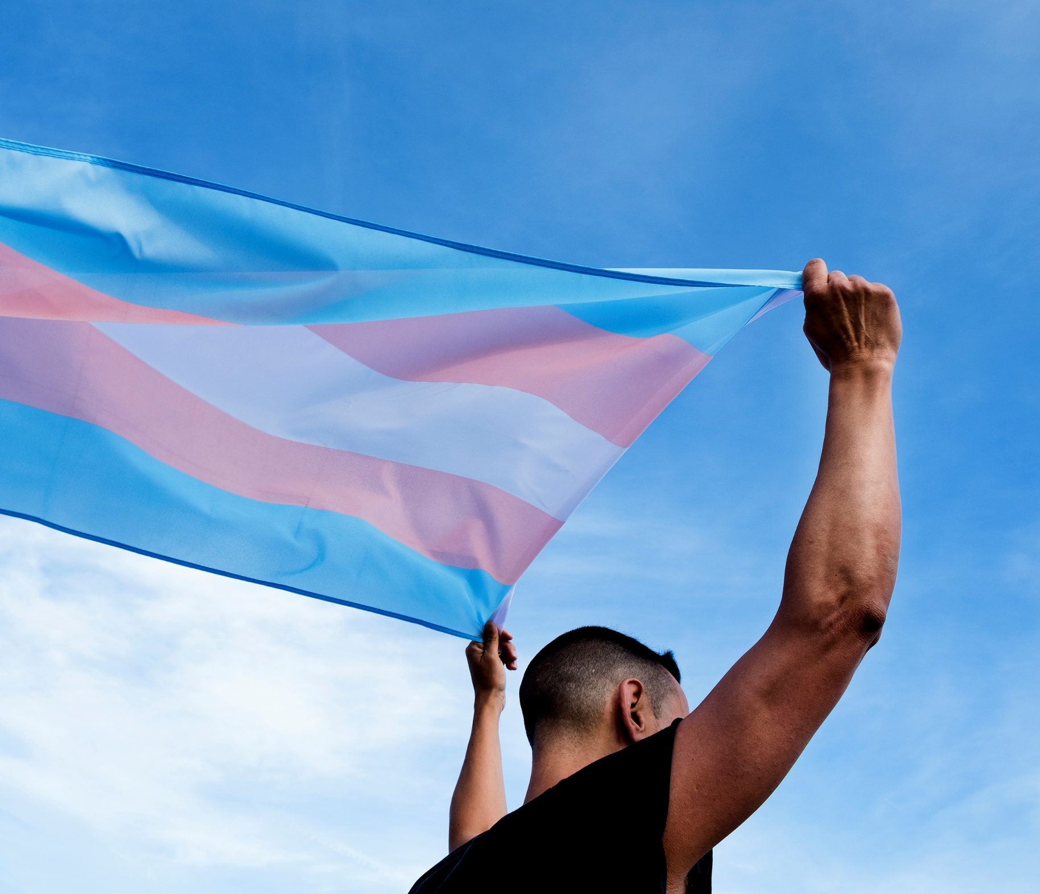
Not enough choices
The OU/HESA offers a poor range of options. “Gay man”, “Gay woman” and “Bisexual” do not reflect modern expression of sexuality or gender identity.
Many sexualities and genders are not represented, and there is no indicator of transitioning.
Only 3 trans students were identified within the data.
The data do not reflect the diversity of LGBTQ+ student experiences, and we suggest that HEIs collect more specific data on their LGBTQ+ students.
Notes:
Compounding this however is a lack of choices and options when declaring sexuality and gender through the HESA systems. Students have a limited range of choices when declaring their identity, and do not have the ability to add their own options. The options presented to students are limited, with sexuality presented as heterosexual, gay woman, gay man, bisexual, and other, and gender more limited still, as it is limited to the binary and a nebulous ‘other’, with no indication of transitioning or differences from assigned gender at birth, or non-binary genders. As it stands, only 3 trans students were identified within the data, assuming we inferred them correctly.
The data therefore doesn’t reflect the diversity of Queer student experiences, and we suggest that HEIs collect more specific data on their LGBTQ+ students.

Slide 18

No conclusion on race
Ethnic diversity within the LGBTQ+ sample is limited and dominated by white people.
May reflect:
Broader systematic barriers ​(Gutman and Younas, 2024)​
And/or LGBTQ+ disclosure rates among ethnic minorities ​(Garvey et al., 2019)​
Notes:
The ethnic diversity within the LGBTQ+ data is very limited, and our data is dominated by white people. This means we haven’t been able to form conclusions on race. This may reflect broader systematic barriers (Gutman and Younas, 2024), and/or LGBTQ+ disclosure rates among ethnic minorities (Garvey et al 2019).
The relative academic success of the small number of Asian and Black students in higher classifications is interesting, but insufficient to override the broader trend of White over-representation in the LGBTQ+ sample.

Slide 19

Conclusions of Phase 1
LGBTQ+ students face multiple challenges that negatively affect academic outcomes, with those in STEM at higher risk of receiving lower degree classifications compared to cisgender heterosexual peers.
Differences between subgroup success and overall trends show that disparities probably stem from systemic barriers.
Limited data and outdated interpretation of LGBTQ+ identities, especially on transgender students, hinder understanding and action.
Low reporting rates must be addressed.
Image: Educate for Action
Notes:
Educational risks and disparities: LGBTQ+ students face multiple challenges that negatively affect academic outcomes, with those in STEM at higher risk of receiving lower degree classifications compared to cisgender heterosexual peers.
Structural, not individual, issues: Differences between subgroup success and overall trends show that disparities probably stem from systemic barriers, requiring institutional accountability rather than relying on individual resilience.
Data gaps: Limited data, especially on transgender students, hinder understanding and action. More accurate, detailed data on degree awarding and student identity are essential, with clear communication about their purpose to build trust and support minority success.

Slide 20
Phase 2
  Planned second phase
  Engaging with students directly to discuss the effect identity, representation, and experiences have upon their academic outcomes and learning experience
  Focus on the student perspective
Notes:
So, where next?
Phase 2 of this research is planned and will incorporate a qualitative component. Students will be engaged with directly, to discuss their opinions on how their identity, experiences, and representation, have affected their academic outcomes and learning experiences. The focus will strongly be on the student perspective, and we hope it will enhance our understanding of the Phase 1 results.

Slide 21

Reflection
    How have qualitative, student-centred approaches been used in your research?
    Have you discussed identity in this manner?
    What methods do you think might work well in future scholarship?
Notes:
*Addressing audience*
So, how have qualitative, student-centred approaches been used in your research? *pause* Have you discussed identity in this manner? *pause* What methods do you think might work well in future scholarship?

Slide 22
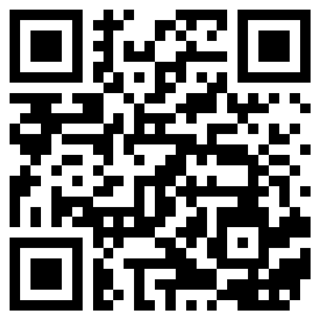
Thank you for listening!
Any questions?
kat.gauld@open.ac.uk

Slide 23
Thank you for listening!
Any questions?

Slide 24
References
Clements, B. and Field, C.D. (2014) ‘Public Opinion toward Homosexuality and Gay Rights in Great Britain’, Public Opinion Quarterly, 78(2), pp. 523–547. Available at: https://doi.org/10.1093/POQ/NFU018.
Frost, D.M., Meyer, I.H. and Schwartz, S. (2016) ‘Social support networks among diverse sexual minority populations’, American Journal of Orthopsychiatry, 86(1), pp. 91–102. Available at: https://doi.org/10.1037/ORT0000117.
Garvey, J.C., Mobley, S.D., Summerville, K.S. and Moore, G.T. (2019) ‘Queer and Trans* Students of Color: Navigating Identity Disclosure and College Contexts’, The Journal of Higher Education, 90(1), pp. 150–178. Available at: https://doi.org/10.1080/00221546.2018.1449081.
Gutman, L.M. and Younas, F. (2024) ‘Understanding the awarding gap through the lived experiences of minority ethnic students: An intersectional approach’, British Educational Research Journal, 51(2), pp. 990–1008. Available at: https://doi.org/10.1002/BERJ.4108.
Juster, R.P., Vencill, J.A. and Johnson, P.J. (2017) ‘Impact of Stress and Strain on Current LGBT Health Disparities’, Trauma, Resilience, and Health Promotion in LGBT Patients: What Every Healthcare Provider Should Know, pp. 35–48. Available at: https://doi.org/10.1007/978-3-319-54509-7_4.
Notes:
See script to add

Slide 25
References (continued)
Kempapidis, T., Heinze, N., Green, A.K. and Gomes, R.S.M. (2023) ‘Queer and Disabled: Exploring the Experiences of People Who Identify as LGBT and Live with Disabilities’, Disabilities 2024, Vol. 4, Pages 41-63, 4(1), pp. 41–63. Available at: https://doi.org/10.3390/DISABILITIES4010004.
Macbrayne, L., Bellamy, J., Richards, A. and McPherson, E. (2025) ‘Black student experience on an introductory STEM module: Closing the awarding gap by listening to our Black students’. Available at: https://doi.org/10.21954/OU.RO.00102266.
Scandurra, C., Mezza, F., Maldonato, N.M., Bottone, M., Bochicchio, V., Valerio, P. and Vitelli, R. (2019) ‘Health of non-binary and genderqueer people: A systematic review’, Frontiers in Psychology, 10, p. 464643. Available at: https://doi.org/10.3389/FPSYG.2019.01453/.
Su, D., Irwin, J.A., Fisher, C., Ramos, A., Kelley, M., Mendoza, D.A.R. and Coleman, J.D. (2016) ‘Mental Health Disparities Within the LGBT Population: A Comparison Between Transgender and Nontransgender Individuals’, https://home.liebertpub.com/trgh, 1(1), pp. 12–20. Available at: https://doi.org/10.1089/TRGH.2015.0001.
Whitehead, B. (2017) ‘Inequalities in Access to Health Care for Transgender Patients’, Links to Health and Social Care, 2(1), pp. 63–76. Available at: https://doi.org/10.24377/.
Notes:
See script to add

