Slide 1


Postcode inequity -closing the awarding gap for STEM students in deprived UK postcodes
Louise MacBrayne, School of Life, Health & Chemical Sciences
Jennie Bellamy, School of Environment, Earth & Ecosystem Sciences
Isabella Henman, School of Life, Health & Chemical Sciences
Kate Gibson, School of Physical Sciences

Slide 2
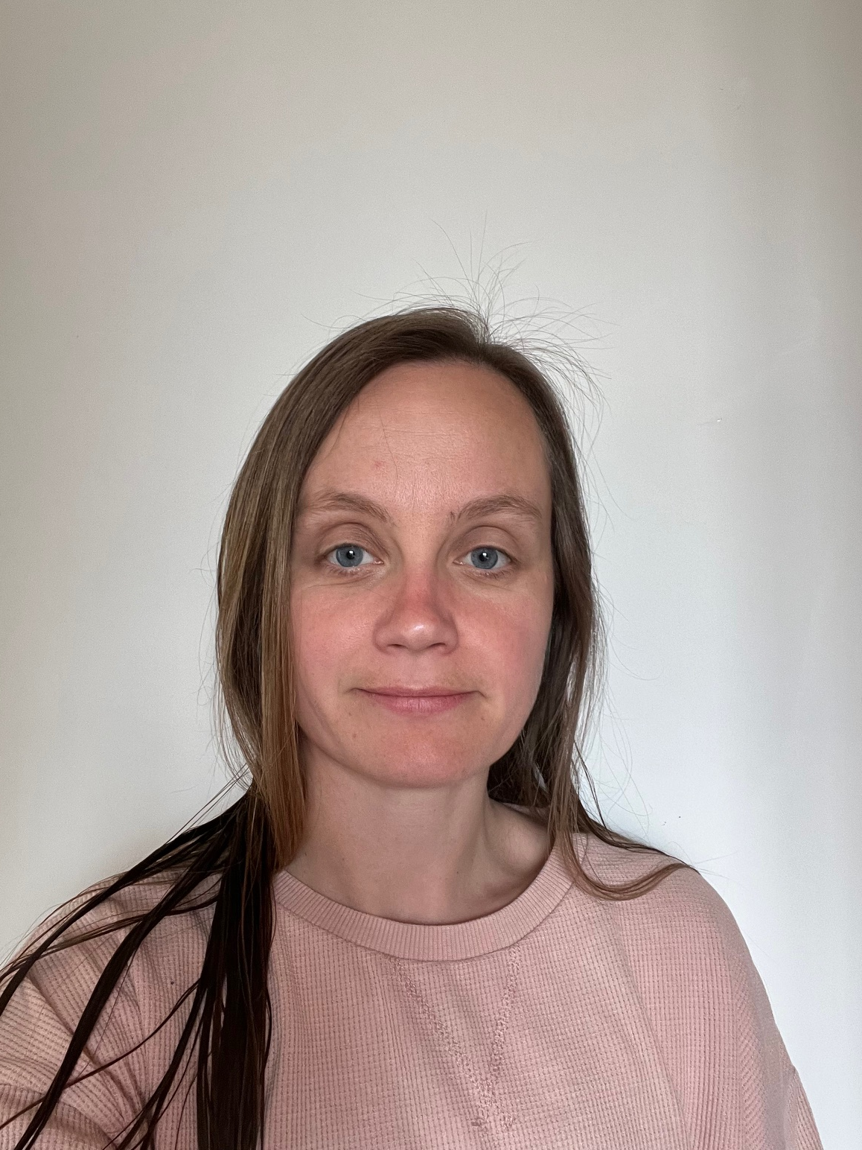


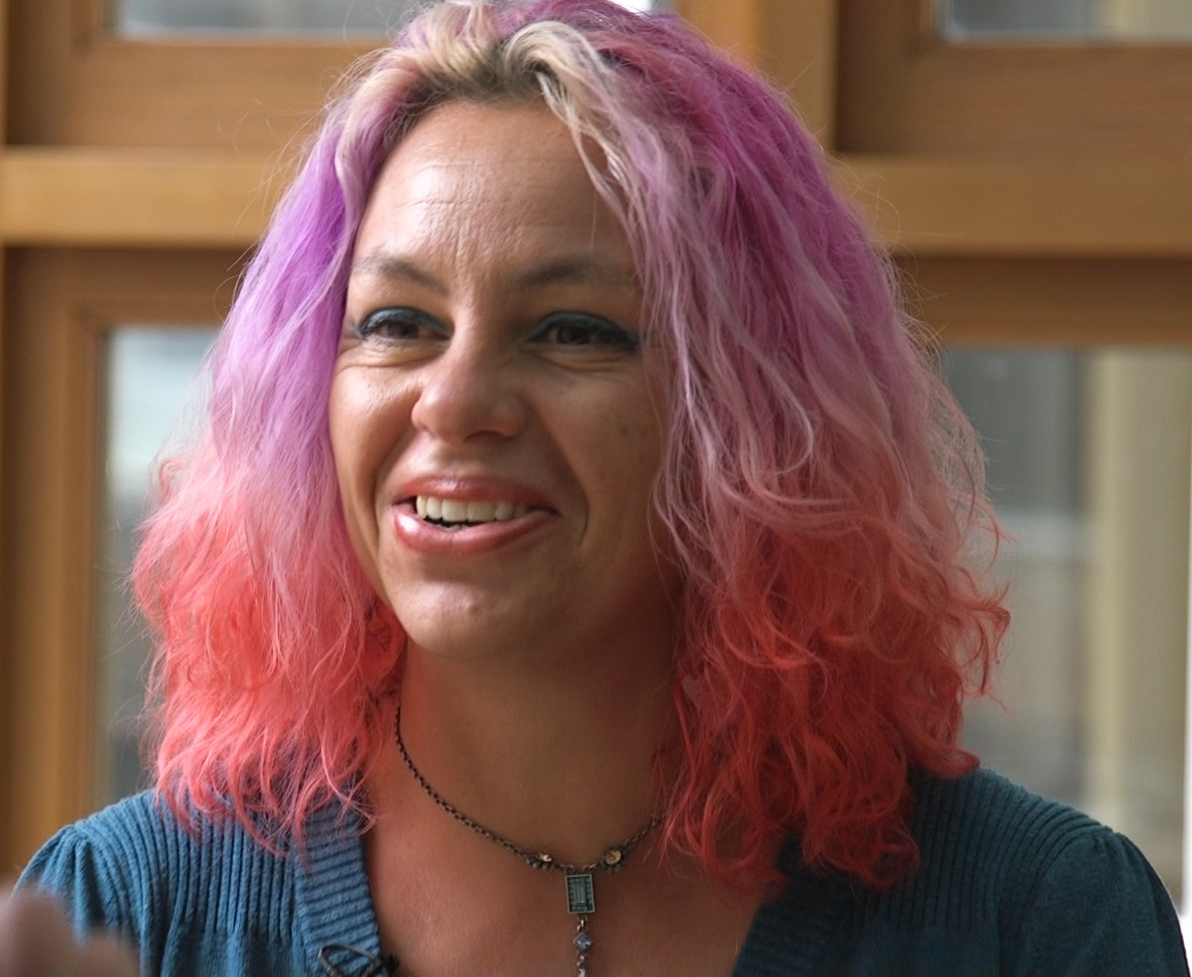
Project Background: Project Team
Louise MacBrayne : Project co-lead
Jennie Bellamy: Project co-lead
Isabella Henman: Student interview facilitator
Kate Gibson: Project team member
Louise
Jennie
Isabella
Kate

Slide 3
Project Background: STEM Gateway Awarding Gaps
The STEM faculty has identified the awarding gap between IMDQ1 and IMDQ5 (most and least deprived) UK postcodes as a priority under Access Participation and Success (APS) criteria.
We have identified that Gateway STEM modules have pass rate and completion awarding gaps between about 10% and over 25% depending on module and presentation (see below)
The gateway modules we looked at are in the following STEM disciplines: science, environment, design, engineering, health.

Slide 4
Research Questions
1
What are the needs of STEM gateway students in IMDQ1 postcodes and possible barriers to their study?
2
What could be influencing the experience and outcomes for STEM gateway students in IMDQ1 postcodes?

Slide 5
Research Methodology
JISC survey sent to c. 6000 students
c.3000 IMDQ1 and c. 3000 IMDQ5 students surveyed across six gateway STEM modules. Students had studied the modules between 2019 and 2023
One-to-one interviews
Online semi-structured interviews with students who indicated in the survey they were willing to be contacted
Intersectional study
To investigate whether STEM IMDQ1 students face a double disadvantage:
IMD status and Ethnicity
IMD status and disability
IMD status and declaration of mental health challenges
IMD status and parents in Higher Education (‘first in family’)
IMD status and carer status

Slide 6
Survey and Interview Topics
1
Study rate/intensity
2
Time available for study
3
Support from family and friends whilst studying
4
Other commitments during study (employment, caring etc)
5
Additional costs of study and awareness of the student assistance fund
6
Mode of online study (e.g., laptop, PC, tablet, phone)
7
Study space and environment (including geographical location)

Slide 7
JISC survey of c. 9000 students
Findings from c. 300 survey responses
Other commitments – caring and employment
IMDQ1 students were more likely to be working full-time than those in IMDQ5
IMDQ1 students were more likely to have caring responsibilities than those in IMDQ5
Graph showing proportions of survey respondents with work and caring responsibilities

Slide 8
Over to you…
Thematic analysis and Discussion (8 – 10 min)
Around the room you will find a very small subsection of anonymised quotes from IMD Q1 and IMD Q5 students
What themes can you identify?
How do these resonate with your own modules and qualifications?
Do these findings surprise you?

Slide 9
Focus Groups & Semi structured interviews
Themes
Self-confidence linked to belonging/alienation
Finance, resources and space
Motivations for study and inspirations
Neighbourhood and community
Family support and ethos
“[face-to-face tutorials] gave me a little bit more confidence. I also realised that I was not the only one struggling”
(IMDQ1)
“wasn't a lot of room in the house and I was living with my parents’ ”
(IMDQ1)
“I just thought, well, [living in a deprived area] is temporary. I need to get on with it. I need to get this degree” (IMDQ1)
“I felt like the stupidest person in the [online] room”
(IMDQ1)
“it doesn't lose me credibility to say, actually, I haven't a clue”
(IMDQ5)
“My [rented] room was like a shoebox”
(IMDQ5)
“I wanted something better”
(IMDQ1)
“‘I managed to sort of source all the little gizmos we needed for the experiments, had great fun with that, kept Amazon busy”
(IMDQ5)
“one time at the end of a tutorial I asked [the tutor] if I could just have a chat” (IMDQ5)

Slide 10
Focus Groups & Semi structured interviews
Themes
Self-confidence linked to belonging/alienation
Finance, resources and space
Motivations for study and inspirations
Neighbourhood and community
Family support and ethos
“I don’t tell many people, my neighbours don’t know I’m at uni, they’d rip into me” (IMDQ1)
“my husband’s generally very supportive” (IMDQ5)
“Nobody that I knew in the street had ever gone to university” (IMDQ1)
“[ex-spouse] will not help me out with the kids when I’m busy with my uni work, it’s deliberate” (IMDQ1)
“We’d badger each other ‘have you done your TMA?’ ” (IMDQ5)
“Continuous smell of cannabis” (IMDQ1)
“Some nights you hadn't slept at all because they were fighting and shouting and breaking glasses and bottles.” (IMDQ1)
“I am the first person in my family to have a degree” (IMDQ1)

Slide 11
Wider Recommendations
The project makes the following recommendations:
IMDQ1 flag on student records – i) to encourage ALs to be more flexible with extensions, and ii) to allow easier discretionary postponement – because we know IMDQ1 students are more likely to be working full time and more likely to have caring responsibilities.
Promote SCONUL access (use of other university libraries by OU students as quiet place to study) to all to help those without desk/space/quiet at home.
Consider alternatives to adding additional costs during study – e.g. Avoid assessed home experiments and projects which require items to be purchased.
Increase the visibility of university staff, especially academic staff, from non-traditional and working-class backgrounds and encourage those staff to be open about their lived experiences.
Promote and raise awareness among students and tutors of the student assistance fund.
“Teach to the margins of the classroom”

Slide 12
Acknowledgements
eSTEeM Centre for STEM Scholarship and Innovation: for project funding
Jonathan Evans: eSTEeM project officer for assistance with data gathering

Slide 13
Any Questions?

