Slide 1
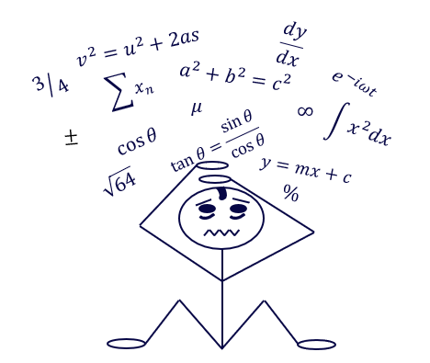

Identifying and supporting maths anxiety
Nicola McIntyre, Susan Pawley and Becca Whitehead,
eSTEeM Presentation
April 2026

Slide 2

What is maths anxiety? Emotional responses to maths
Describe maths anxiety
Studying subjects that include maths can evoke a range of emotions. For some it’s a thrilling challenge – they find it exciting and rewarding to solve problems and see progress. But for others the experience can be quite different. They may start to panic when they study maths, with the heightened anxiety leading to mental or physical symptoms. These responses can create a cycle, where the negative feelings about maths can inhibit the ability to study maths, which increases the negative feelings.

Slide 3
Prevalence of Maths Anxiety: Maths anxiety in first year undergraduates at the Open University (survey results 2022)
Describe maths anxiety

Slide 4
What makes you anxious?
Describe maths anxiety
Word cloud – Think of a situation that makes you anxious
My first word cloud - Mentimeter

Slide 5
The consequences of maths anxiety?
Explore symptoms of maths anxiety
Avoidance
You might find you are avoiding
situations or questions with maths in them
Procrastination
You might find you don’t leave enough time to tackle the maths in your assignment
Physical symptoms
Anxiety can affect your physical and mental health

Slide 6
How does your anxiety make you feel?
Explore symptoms of maths anxiety
Describe (in as few words as possible) your physical and mental symptoms when thinking about/engaging in the activity which makes you anxious
My first word cloud - Mentimeter

Slide 7

Getting ready to study maths
Act to reduce your anxiety
Strategies to help students prepare to study maths will be individual. They will include cognitive and behaviour approaches and the strategies adopted will depend on personal preference. It is likely that students will need to try different strategies making a note of which ones work with the goal of creating a toolbox of strategies to draw upon if the feel anxiety levels rising.
Image by Peter Middleton from Pixabay

Slide 8







Cognitive and behavioural approaches
Act to reduce your anxiety
Cognitive reframing
  Drop the belief that you're bad at maths
Externalise it
Talk to someone, journalling, expressive writing, creativity
Visualise
  Think about how you will feel when you've completed some maths
Look after yourself
Relaxation & rest, mini rewards, exercise, remove distractions
Create a growth mindset
  Believe you have the ability to learn
Be proactive
Action plan, SMART goals, 'Eat the frog’, Pomodoro technique
Have realistic expectations
  You don't need to be perfect

Slide 9
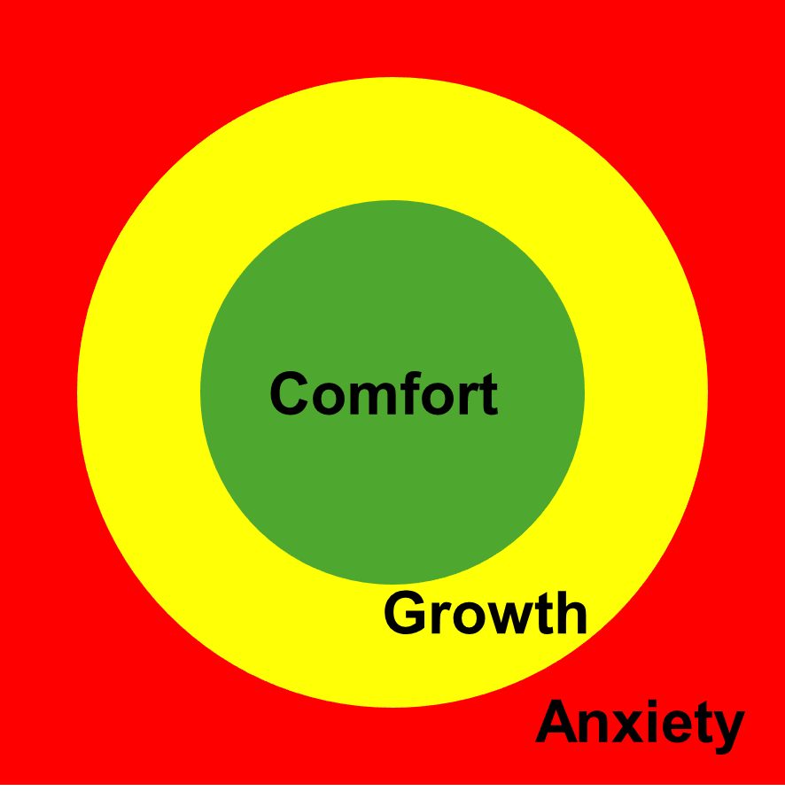
Measuring anxiety levels
Learn to study with anxiety
The growth zone model (revised model of Vygotsky’s ‘zone of proximal development’)
Comfort Zone (Green inner circle)
In the Comfort zone people work confidently and have low levels of anxiety. They are happy with what they are studying and everything makes sense.
Growth Zone (Yellow middle circle)
In the Growth zone people are studying productively, learning something new, or practicing something complicated, they may be feeling slightly anxious, however the levels are manageable.
Anxiety Zone (Outer red area)
In the Anxiety zone people will have ceased the ability to study productively. Anxiety does not always have a physical manifestation, however if they are struggling to study and nothing is going in, it is likely they are in the anxiety zone.
Johnston-Wilder et al. (2013)

Slide 10
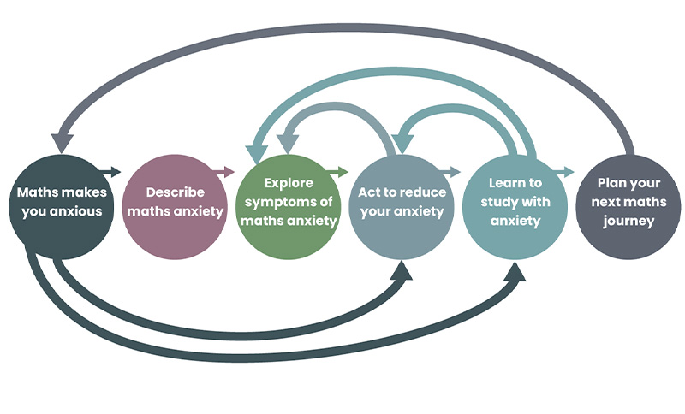
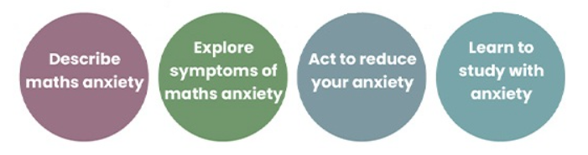
Openlearn Free Online Course (upcoming)
DEAL process

Slide 11
Openlearn Free Online Course (upcoming)
Maths Anxiety Pathway (MAP)
Notes:
From a body of work in progress (due to be published in a set of free online resources (soon )- looking at the DEAL process - student focused, but will also offer advice for educators.
Also some background from surveys and interviews with students at the Open University 21/22.

Slide 12
Thanks for listening
Any questions ?

