Slide 1


Intro Slide Title 1
Investigating and supporting skills development needs for students transitioning between stages 1 and 2, and 2 and 3 in Environmental and Earth Sciences
Iris Verhagen, Fiona Aiken and Chris Hutton
School of Environment, Earth and Ecosystem Sciences
Photo by Unseen Studio on Unsplash
30 April 2026

Slide 2
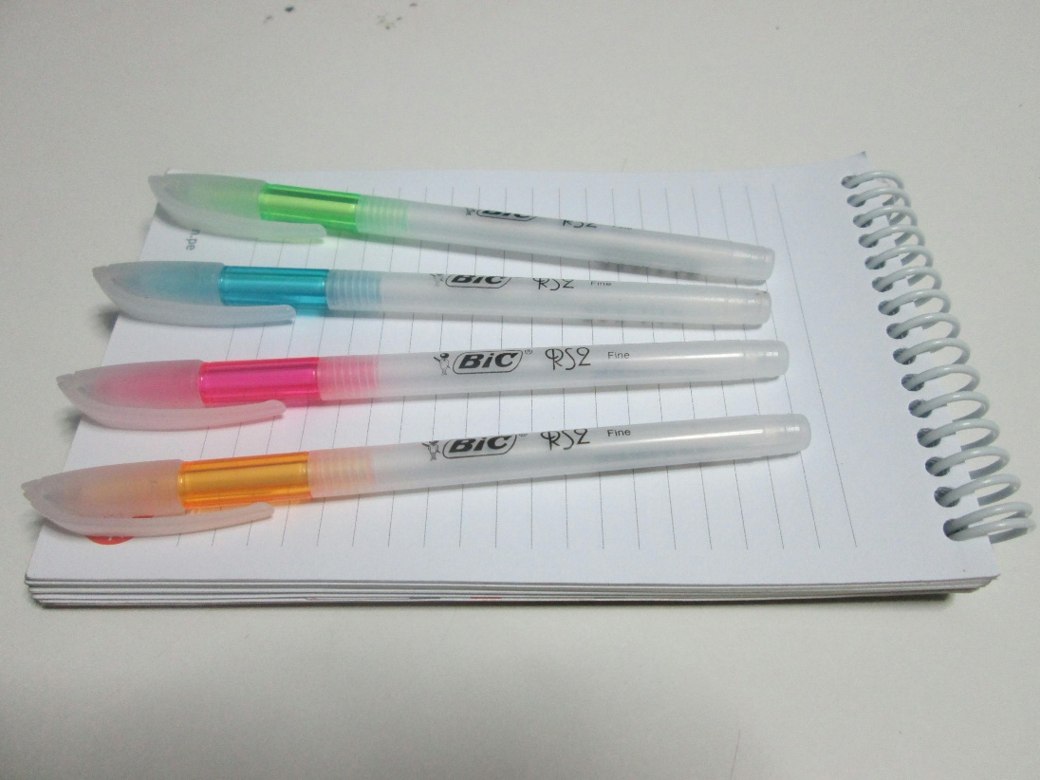

Slide Title 9
Contents
Introduction
Why skills development?
Challenges
Objectives
Summary of previous projects and the literature
Methods
Where are we now?
Interim results
Findings so far
Next steps
References
Photo by Cristian Loayza

Slide 3
Slide Title 9
Introduction
Why focus on skills development?
Multiple sources of evidence
Student feedback
Student assessment
Tutor feedback
Module Team observations
Increasing focus on skills and autonomy with progression through stages
Students’ skills needs are dynamic
Vary by cohort / module / assessment strategy
Shifts in sector and employer demands
Skills are transferable (knowledge less so)

Slide 4
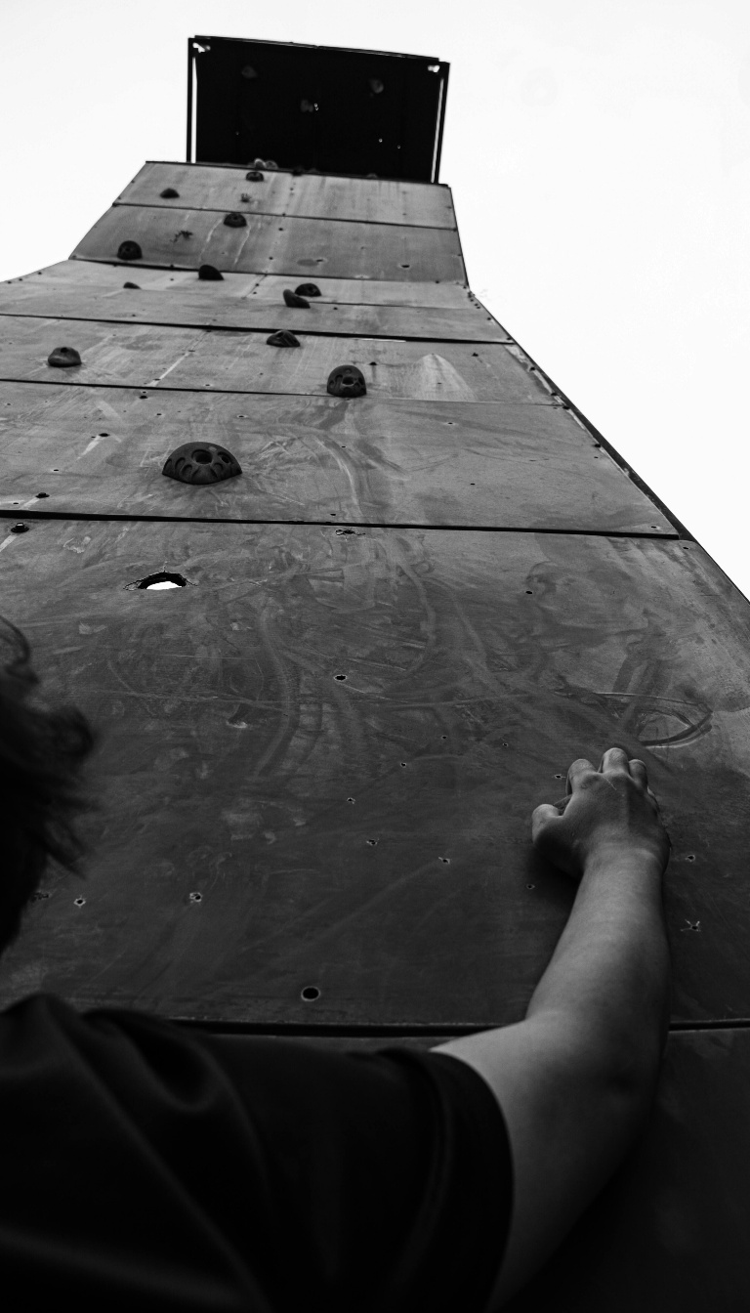
Slide Title 9
Introduction
Challenges in skills development
Open access / entry – varied starting points
Skills are less tangible than knowledge
May appear less important
Students’ self-evaluations vary
Students may be resistant to advice
Promoting engagement is difficult
Reflection and PDP are often unpopular
Improving awareness and forming bridges between present and past / future study is valuable for progression.
Photo by AHMAD IRFANDI

Slide 5

Slide Title 9
Introduction
Discussion point:
Which specific skills do students in your discipline area struggle with?
Our chosen focus skills (in Earth and Environment)
Basic maths
Data handling and analysis
Foundation subjects (e.g. basic chemistry…)
Field and practical skills
Study skills (e.g. time management)
Photo by RDNE Stock project

Slide 6
Slide Title 9
Introduction: Aims and Objectives
1. Identify the main challenges students face in their transferable skills when starting stage 2 or stage 3. [Phase 1]
[To be followed by Phase 2…]
2. Identify and trial an intervention for one of the skills gaps identified.
3. Evaluate the efficacy of the intervention.
4. Share the findings internally and externally.

Slide 7
Slide Title 9
Background
Previous projects covering aspects of skills development
These projects covered incorporating employability skills into modules through practical work.
Haresnape, Janet (2022). Practical skills progression and employability in the Life Sciences pathway at the Open University. eSTEeM Final Report. The Open University Scholarship Exchange. Report. https://hdl.handle.net/10779/ou.se.24353509.v2
Cayless, Alan; Nock, Arabella; Bradbury, Stella; McJury, Mark (2024). Learning Logs in SXPS288 – Employability skills for remote experiments. eSTEeM Final Report. The Open University Scholarship Exchange. Report. https://doi.org/10.21954/ou.se.25976902.v1
A project in FBL by Saroli et al investigated skills development across a qualification.
Saroli, Alessandro (2024). Investigating student engagement with module activities and tasks aimed at facilitating skills development, as part of the OU’s BA (Honours) Business and Management (Q91) and assessing associations between student engagement and performance. The Open University Scholarship Exchange. Report. https://doi.org/10.21954/ou.se.25836184.v1

Slide 8
Slide Title 9
What does the literature say?
Since the academic year 2003-2004 UK universities must align with QAA national framework (QAA,2001)
It has a requirement for the incorporation of appropriate transferable skills
Dakin and Main (2002) propose that transferable skills such as communication, teamwork and research skills can be developed through study skills support and peer mentoring.
More specifically for Environmental Science, Kneale, (2011) identifies a range of areas where students need guidance to develop their skills e.g. in reflection and in grasping threshold concepts.
Kneale (2011) also identifies numeracy and report writing as areas where students need additional guidance.

Slide 9

Slide Title 9
Methods
For phase 1…
Literature review
Focus groups
Associate Lecturers
Student Support Hub and Guidance Services
Student survey
For phase 2
To be decided based on findings of phase 1, resulting interventions and time scales
Photo by Diva Plavalaguna

Slide 10

Slide Title 9
Where are we now?
AL focus group completed and analysed
To come:
Student Support Hub and Guidance services focus group
Student survey
Photo by Tara Winstead

Slide 11
Slide Title 9
Results from AL focus group
Slide 1/3
Skills identified
Maths skills
Needs better support in module materials (tutors vary in experience)
Students only realise their gaps as they study the module (little time to practice)
Need to set consistent examples in all teaching materials with good techniques
Statistics
Need reinforcement at stage 2 to help students anticipate stage 3
Stats not really required in Earth science as they are in Env science
Differences in how different Schools teach stats – inconsistent
Independent project work
Noticeable gap for students arriving at capstone module (insufficient prep)

Slide 12
Slide Title 9
Results from AL focus group
Slide 2/3
Skills (cont’d)
Academic skills – use of library and referencing
Students still struggle with academic writing and general knowledge / background at stage 2 if they don’t start stage 1 with a higher level of these skills
Lacking at start of stage 3
Need to learn searching databases within the library too (e.g. Web of Science)
Gen AI skills
noticeable from 2 to 3
Students identifying this themselves and unsure what to do
Skills gap between students using it and not
We have to improve how we teach it
Tutors need training in it too
Basic chemistry

Slide 13
Slide Title 9
Results from AL focus group
Slide 3/3
Further key points
Step changes between stages, but 1 to 2 most noticeable
Lower TMA01 mark – reassurance needed
Higher drop-out at 1 to 2
The 1 to 2 jump helps students anticipate the 2 to 3 jump
Students often forget skills taught earlier
Particularly when skimming through materials when busy with full-time study
Need basic skills to work in teams effectively
Possibly reason for not participating in S226 virtual field school
Good to have links between tutorials if a sequence (not possible with cluster)
Very few Qs about progression
Often from very motivated students moving from 2 to 3 (e.g. volunteering)
Generally professional skills focussed (e.g. work experience)
Inconsistencies across modules (e.g. format of an essay) cause problems in skills development

Slide 14

Slide Title 9
Next steps
Student Support Hub & guidance services focus group
Thematic analysis
Student survey
HREC, SRPP and DP permissions
JISC online survey tool
Timed for July results week for 26J
Photo by eberhard grossgasteiger

Slide 15
Slide Title 9
References
Cayless, Alan; Nock, Arabella; Bradbury, Stella; McJury, Mark (2024). Learning Logs in SXPS288 – Employability skills for remote experiments. eSTEeM Final Report. The Open University Scholarship Exchange. Report. https://doi.org/10.21954/ou.se.25976902.v1
Durkin, K. and Main, A. (2002) ‘Discipline-Based Study Skills Support for First-Year Undergraduate Students’, Active learning in higher education, 3(1), pp. 24–39. Available at: https://doi.org/10.1177/1469787402003001003.
Haresnape, Janet (2022). Practical skills progression and employability in the Life Sciences pathway at the Open University. eSTEeM Final Report. The Open University Scholarship Exchange. Report. https://hdl.handle.net/10779/ou.se.24353509.v2
Kneale, P. (2011). Study Skills for Geography, Earth and Environmental Science Students (3rd ed.). Routledge. https://doi.org/10.4324/9780203772928
QUALITY ASSURANCE AGENCY (2001) Guidelines for Preparing Programme Specification: Academic Standards – Communication, Media, Film and Cultural Studies.Gloucester: QAA.

Slide 16

Slide Title 9
Thank you
Questions welcome!
Fiona.Aiken@open.ac.uk
Iris.Verhagen@open.ac.uk
Christopher.Hutton@open.ac.uk
Photo by Ann H

Slide 17
Slide Title 30
Thank you

Slide 18
Slide Title 31

