Slide 1
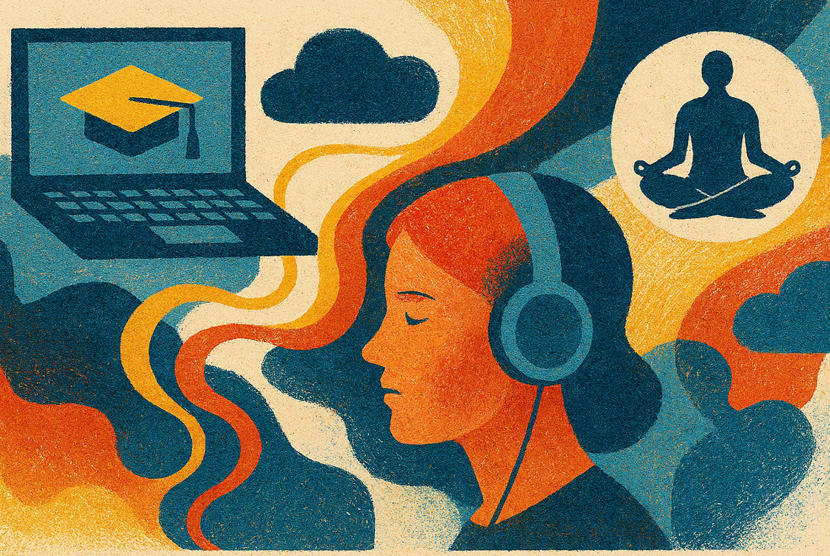

Understanding students’ emotion regulation when learning online
Slide 1
Jake Hilliard, Karen Kear and Helen Donelan
15th eSTEeM Annual Conference
30 April 2026

Slide 2



Hello!
Slide 2
Jake Hilliard
(Learning Designer in Learner and Discovery Services)
Karen Kear
(Professor of Online Education in the School of Computing and Communications)
Helen Donelan
(Senior Lecturer in the School of Computing and Communications)

Slide 3
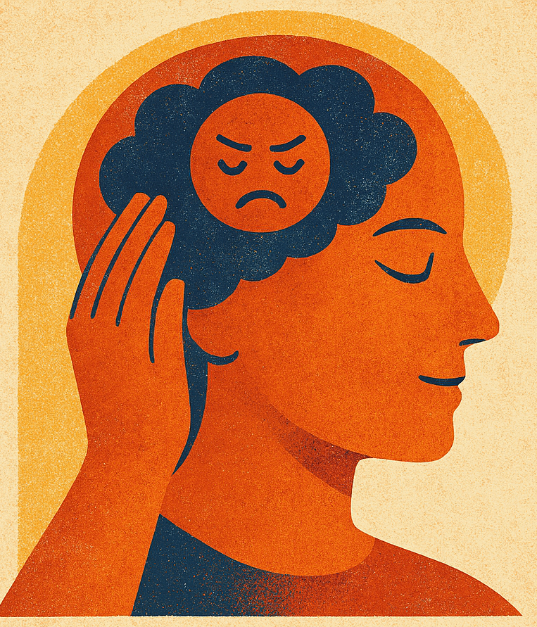
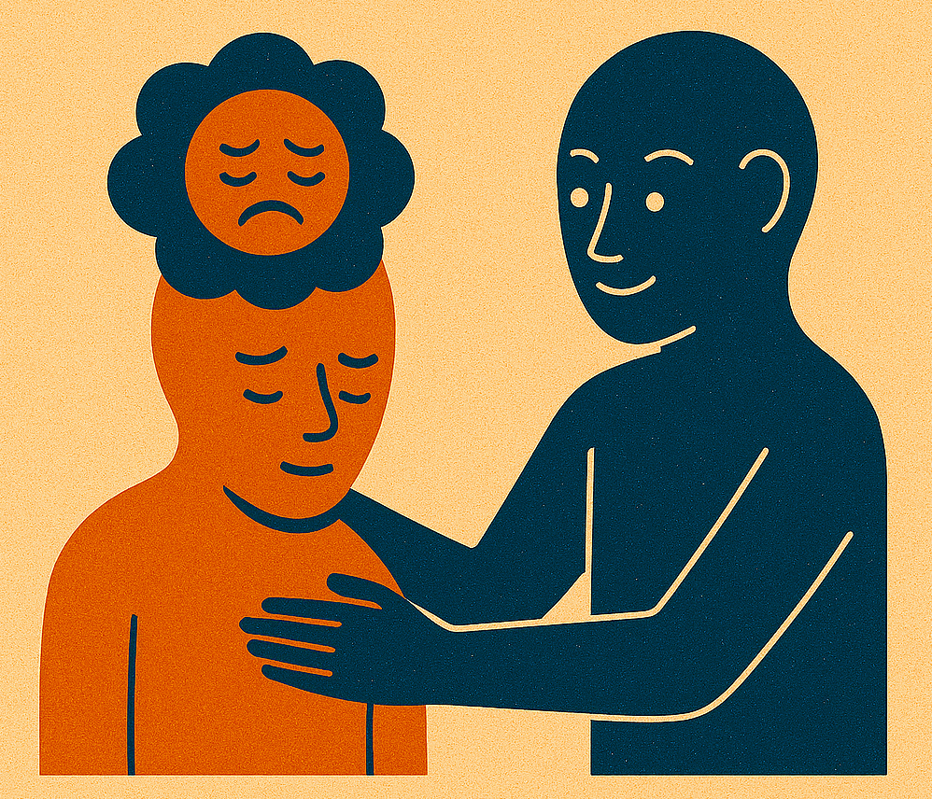
Emotion regulation
Slide 3
Emotion regulation refers to thoughts and behaviours performed to alter the identity, intensity, and/or expression of emotions (Gross, 1998).
Strategies
Motives
Intrinsic (self-) regulation
Extrinsic (other-) regulation
Implicit
Explicit

Slide 4
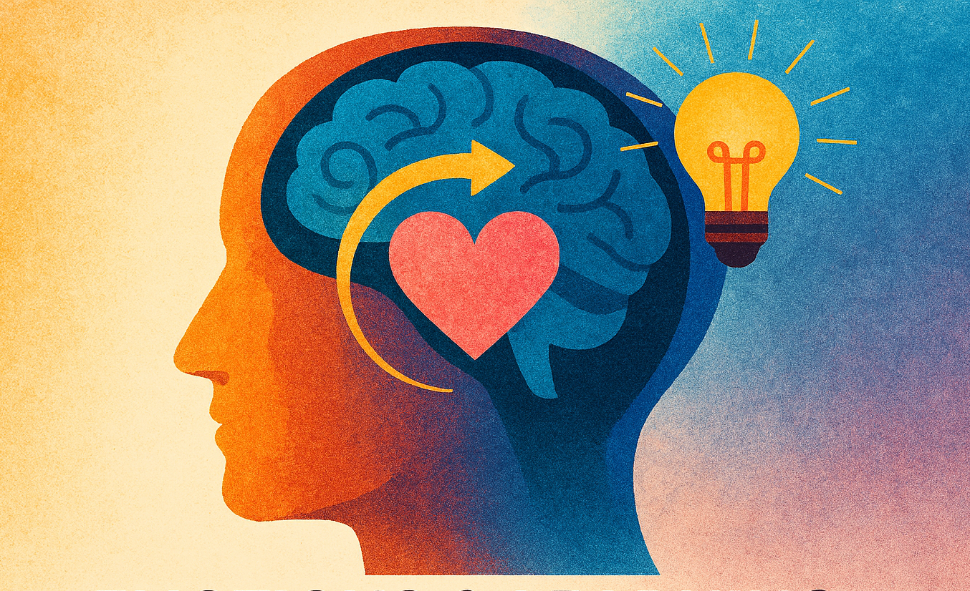
Reason for the project
Slide 4
Currently very little is known about how and why students regulate they own and other students' emotions in online higher education.
Students’ emotional experiences and the regulation of their own and others’ emotions are often overlooked in education.
This is despite research showing emotions and emotion regulation play a crucial part in students’ learning experiences.
Digital learning environments present unique challenges and opportunities for the regulation of emotions.

Slide 5
What we’re trying to find out
Slide 4
How and why do students regulate their own emotions, and those of other students, when learning online?
In what ways does the online learning environment influence these processes?
How are digital tools used to support students’ emotional regulation in online settings?
What can be done to better support students’ emotion regulation in online learning environments?

Slide 6
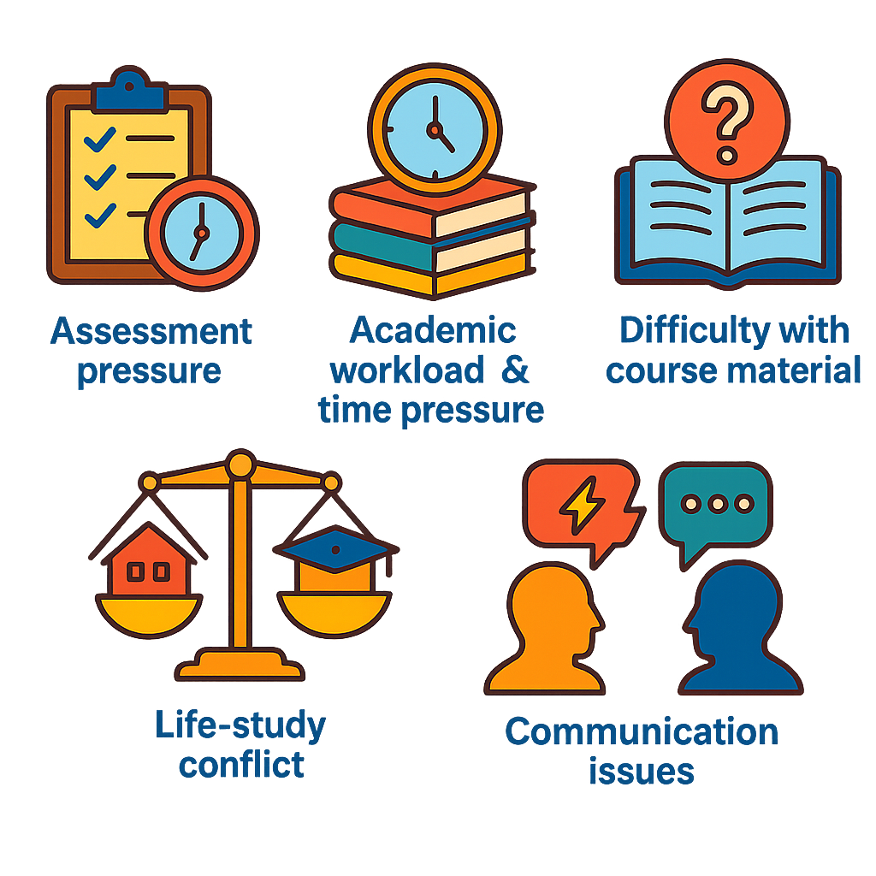
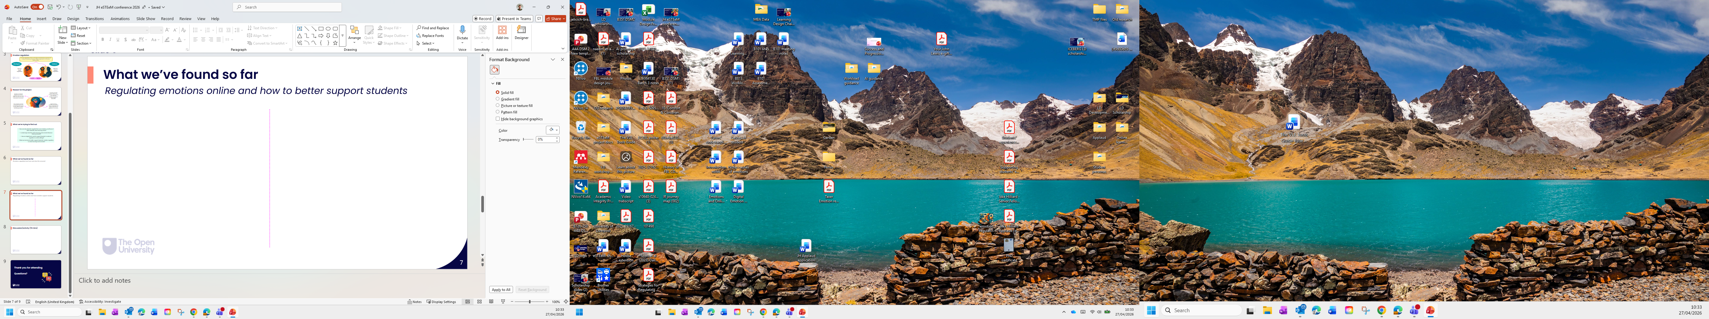
What we’ve found so far
Slide 5
Emotions targeted for regulated
Students primarily described regulating unpleasant emotions when learning online.
Frustration
Caused by …
Disappointment
Anger
Anxiety
Boredom
Assessment pressure
Difficult course material
Confusion
Overwhelm
Academic workload and time pressure
Life-study conflict

Slide 7
What we’ve found so far
Slide 5
How and why emotions were regulated
Students reported employing a range of strategies to manage their emotions, primarily aimed at maintaining or improving task performance.
Physiological calming
Task‑focused behaviours
Cognitive reappraisal and self-talk
Social and external support seeking
Strategic disengagement, pausing, and distraction
Maladaptive/ high‑cost regulation strategies
The primary motive for regulation was to enhance task performance. However, regulation was also employed to feel better and to maintain social relationships.

Slide 8
What we’ve found so far
Slide 5
Regulating emotions online
Online learning presents both affordances and challenges for emotional regulation.
Affordances
Challenges
Being able to learn at your own pace reduces unpleasant emotions
Less social pressure makes learning feel emotionally safer
Feeling isolated makes emotional difficulties harder to cope with
Taking breaks and stepping away is easier online
Delayed support can intensify and prolong unpleasant emotions
It can be difficult to feel seen, heard, or understood by tutors
Not constantly comparing yourself to others lowers unpleasant feelings
Studying in private makes it easier to manage strong emotions
Asynchronous communication feels lower‑risk for sharing ideas and feelings
The loss of non‑verbal and emotional cues makes it harder to know how others are feeling online
Building supportive relationships is harder online

Slide 9
What we’ve found so far
Slide 5
Regulating emotions online and use of digital tools
Students use a diverse variety of digital technologies to help manage their emotions when learning online.
Video and audio
Tools for diversion and distraction
Online communication tools
Tools for supporting productivity
Tools for supporting wellbeing

Slide 10
Discussion activity Supporting students’ emotion regulation
Slide 5
Thinking about an online course or activity you know well (as an author, tutor, support staff member, student, etc):
Where do students seem to experience the biggest emotional challenges?
What could be done through design, teaching, or support to better help students manage these emotions? This could be one small change.
In‑person: discuss with someone near you
Online: share your thoughts in the chat
We’ll then come back together for a whole group discussion.

Slide 11

Thank you for attending
Questions?

