Slide 1
Intro Slide Title 3
The crucial role that scholarship of teaching and learning plays in Fellowship of the Higher Education Academy (HEA) applications
Janet Haresnape PFHEA, Former Senior Lecturer and Staff Tutor, now Honorary Associate and AL, School of Life, Health and Chemical Sciences (LHCS)
Sarah Daniell SFHEA, Senior Lecturer, Staff Tutor, Scholarship Lead, LHCS.
Carina Bossu SFHEA, Senior Lecturer (Academic Professional Development), Institute of Educational Technology (IET), former Applaud academic lead
April 2026

Slide 2

About this workshop
Understand the elements of a Fellowship application (Dimensions and Descriptors)
How to evidence the scholarship of teaching and learning in a Fellowship application?
Which category is the best fit for my practice at the moment?
Examples
Group activities

Slide 3

Introductions
Icebreaker activity
Do you have a HEA Fellowship?
Are you involved in a Scholarship project at the moment?
Are you planning to apply for a Fellowship?
FHEA? SFHEA? or PFHEA?

Slide 4
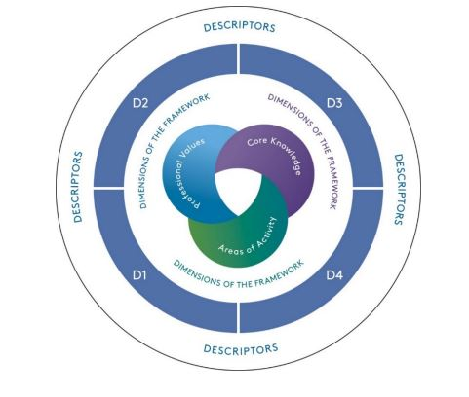
The Professional Standards Framework (PSF) 2023
Consists of Descriptors and Dimensions
Advance HE operates the fellowship scheme and aligns its fellowships to the PSF 2023 Descriptors as follows:
Descriptor 1 (D1) aligns to Associate Fellow
Descriptor 2 (D2) aligns to Fellow
Descriptor 3 (D3) aligns to Senior Fellow
Descriptor 4 (D4) aligns to Principal Fellow

Slide 5
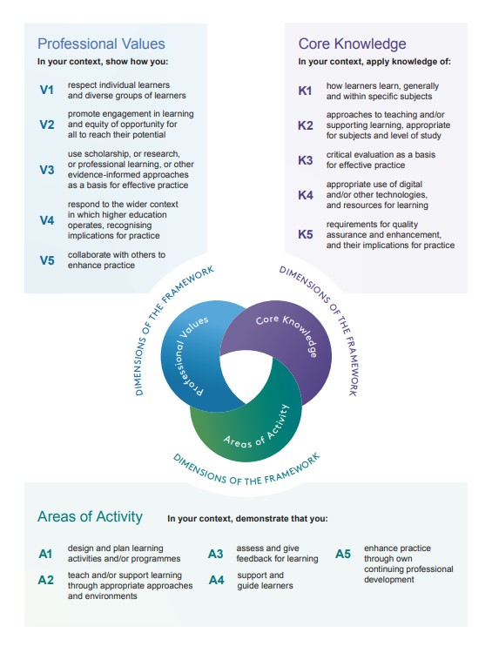
Dimensions of the Professional Standards Framework
2023

Slide 6
Dimensions of the Professional Standards Framework
2023
Showing the role of scholarship

Slide 7
Descriptors of the 2023 PSF
D1. Associate Fellow - suitable for individuals whose practice enables them to evidence some Dimensions.
D2. Fellow - suitable for individuals whose practice with learners has breadth and depth, enabling them to evidence all Dimensions.
D3. Senior Fellow - suitable for individuals whose comprehensive understanding and effective practice provides a basis from which they lead or influence those who teach and/or support high-quality learning.
D4. Principal Fellow - suitable for highly experienced individuals whose practice involves a sustained record of effectiveness in strategic leadership of high-quality learning, with extensive impact beyond your own Faculty/Institution.

Slide 8

Evidencing scholarship of teaching and learning in a Fellowship application
There are three main basic ways to get Scholarship recognised in a Fellowship application:
Use it to underpin/inform your teaching/support learning practice
        Use relevant readings and existing work and/or your own scholarship papers
      Influence/help others to engage with it
        Formal and informal ways to engage colleagues to use scholarship in their practice – for improvement
Engage with scholarship projects
        Undertake scholarship yourself

Slide 9
Evidencing scholarship of teaching and learning in a Fellowship application
V3: In your CONTEXT, show how you use scholarship, or research, or professional learning, or other evidence-informed approaches as a basis for effective practice.
Demonstrating V3 is about explaining about why you do what you do, in the way that you do it, and the sources of information, data, and evidence you use when making decisions about your learning and teaching practice. The key issue is to demonstrate that the approaches you adopt in your teaching and/or support for learning are not a matter of chance, but that your practice is evidence-based.
The actual sources of that evidence that you point to can be varied, and will differ according to your context of work, your role, and the type of teaching and/or support of learning that you are involved in.
Importantly, you should indicate how your learners responded to the activities, approaches or adaptations you introduced. Showing evidence of any positive impact on their engagement, learning and/or achievement will help demonstrate that your use of the evidence-based approaches has helped make your practice effective / has resulted in effective practice.

Slide 10
Activities that could count
Project leader or take a leadership role in some of the project activities.
Involved in the designing, planning, execution and implementation of the scholarship project.
Was the project informed by some existing scholarship of learning and teaching?
Collaboration with a range of stakeholders.
Your influence on others, for example, provide formal or informal guidance to other colleagues involved in the project.
Your professional learning from this experience.
Project evaluation to collect feedback from the stakeholders involved in the project and then implemented some of their suggestions (or not, why).
The project involved a diverse cohort of students/participants and careful measures were taken for them to be included and their needs addressed.
Project impact on module, programme, school, Faculty, etc

Slide 11

Gathering evidence
Start early – so that evidence don’t get lost or forgotten (mini activity)
Be familiar with the PSF and the Descriptor – it can help you to focus on what is missing or which dimension you would need further evidence, for example.
Understand your role within the project – as they tend to involve a range of stakeholders, but the Applaud application is about your individual contribution.
Keep a reflective journal about your professional learning during the time of the project and beyond.
Notes:
Ask participants to create a folder for their future fellowship application. Ask them to outline at least one evidence.

Slide 12

Other considerations
Engagement with only one scholarship project will not provide enough evidence for a FHEA, SFHEA, PFHEA case – but it is a wonderful start!
Use examples of practice (or projects) that have already happened, not what you are planning to do, so that there is enough time for you to demonstrate your expertise, impact and influence.
Examples of practice should not be older than 3 years for AFHEA and FHEA, and 5 years for SFHEA and PFHEA.

Slide 13
Slide Title 11
Am I ready to apply? Which category would best suit my practice?
Please complete the Advance HE
Fellowship Category Tool

Slide 14
Example from a Fellowship (FHEA) Submission
I make deliberate use of interactive tools such as drawing functions and polls to check comprehension, encourage active participation, and adjust the pace of the session accordingly.
This approach aligns with evidence showing that active learning and formative assessment improve student outcomes and confidence (Freeman et al., 2014).
Students have commented that these features increase their confidence in applying concepts to unfamiliar contexts, which suggests that the approach fosters both engagement and deeper learning
Freeman et al. (2014). Active learning increases student performance in science, engineering, and mathematics. Proceedings of the National Academy of Sciences, 111(23), 8410–8415. https://doi.org/10.1073/pnas.1319030111
Provides evidence of use of scholarship/ evidence-based approaches, as a basis for effective practice

Slide 15
Example from a Senior Fellowship (SFHEA) Submission
eSTEeM Scholarship Project on Marking Grids
The scholarship project I led provided clear evidence that the use of module grids as part of correspondence tuition was popular with and beneficial to students – it gave them a clearer indication of where they needed to improve.
As a consequence, the module team implemented the use of module grids as part of their assessment strategy.
The positive influence this had on students has been disseminated to AL colleagues, and similar marking grids are now being used not only on this module but also on at least six other modules within my School, and some in other parts of STEM.
Hence my scholarship work has influenced the practise of several other module teams.
Presentations on this project given at STEM Horizons conference in 2022, at eSTEeM conferences in 2022 and 2023 and at Advance HE Advance HE Teaching and Learning Conference in 2023, as well as at the Board of Studies for my School.
Provides evidence of leading or influencing those who teach and/or support high-quality learning.

Slide 16
Example from a Principal Fellowship (PFHEA) Submission
In my role as external examiner at another UK University for BSc (Hons) Biology and Biomedical Science degrees, I discovered that attempts were being made to offer randomly assigned questions to different students to reduce risk of collusion for the newly-introduced online exams – e.g. some were assigned an essay-style and others a calculation-style question.
I am very aware, through wide experience of trying to produce alternative questions of equal difficulty for computer marked assignments, of the pitfalls of using different variants of assessment questions for different students, for example men and women may have different strengths and perform more or less well on certain types of question (Jordan et al, 2012). I identified that these pitfalls had not been sufficiently well addressed.
As a result, measures were introduced throughout this University to ensure that alternative question versions used for exams are more equivalent.
Hence I influenced the assessment strategy throughout an entire UK university.
Jordan et al. (2012). Same but different, but is it fair? An analysis of the use of variants of interactive computer-marked questions. International Journal of eAssessment, 2(1), 1-12.
Provides evidence of strategic leadership of high-quality learning with impact beyond the OU

Slide 17
Group work:
Consider your own examples – what level (F, SF, PF) might they be appropriate for?
Notes:
We have some examples which participants can discuss if they prefer (next few slides)

Slide 18
Example for discussion – what level (F, SF, PF) might they be appropriate for? What might be missing?
As an AL, I mark tutor-marked assignments (TMAs) using module-specific criteria.
I provide detailed comments and constructive individual feedback linked to the module learning outcomes, designed to help students identify and close gaps in knowledge, and build confidence.
This is not simply correction, but correspondence tuition, for example by identifying recurring mistakes and offering proactive guidance in recommending targeted topics for review.
I also provide formative feedback through emails and tutorials, particularly ahead of exam periods, offering guidance on conceptual understanding and problem-solving strategies (Nicol & Macfarlane-Dick, 2006).
By using detailed rubrics aligned with module learning outcomes, I ensure that feedback is both transparent and actionable and will also aid students to understand assessment criteria.
Nicol, D. J., & Macfarlane-Dick, D. (2006). Formative assessment and self-regulated learning: A model and seven principles of good feedback practice. Studies in Higher Education, 31(2), 199–218.
Notes:
This one was from a Fellowship application

Slide 19
Example for discussion – what level (F, SF, PF) might they be appropriate for? What might be missing?
I identified the learning outcomes and the assessment strategy early in the module design lifecycle, thus ensuring constructive alignment between learning outcomes, module materials (learning activities) and assessment (Biggs 2003).
Biggs, J (2003). Aligning teaching for constructing learning. Higher Education Academy, 1(4), pp.1-4.
Notes:
This one was from a Senior Fellowship application

Slide 20
Example for discussion – what level (F, SF, PF) might they be appropriate for? What might be missing?
I undertook an eSTEeM project on the impact of TMA checklists – a low-cost intervention, providing targeted support to those with additional needs, whilst also benefiting all students. They aim to help students overcome setbacks e.g. assessment-related anxiety (Putwain et al, 2023), which has significant consequences for student attainment, confidence and retention. (Cavanaugh et al, 2012).
….. This strategy drew inspiration from “Fit to submit” checklists trialled at the University of Derby (Wilson, 2015), which had narrowed attainment gaps and improved timely submissions.
Introduction of the checklists led to improved TMA submission rates and scores; moreover they were of particular benefit to students with mental health challenges and/or neurodivergence.
….. Building on the positive results so far, the use of checklists has been extended to more student cohorts. I am currently exploring integration of the findings within the work of the Quality Enhancement and Innovation Team in IET, indicating potential cross-departmental collaborations and impact.
Cavanaugh et al (2012) “Using a generalized checklist to improve student assignment submission times in an online course,” Journal of asynchronous learning networks JALN, 16(4).
Putwain et al (2023). Academic Buoyancy: Overcoming Test Anxiety and Setbacks. J Intell. 11(3):42.
Wilson, H (2015) University of Derby Fit to Submit: Assignment Checklist. Available at https://uodpress.files.wordpress.com/2015/05/press-fit-to-submit-assignment-checklist-png.png
Notes:
This one was from a Senior Fellowship application – note this replaces the original example which was on ‘sense of belonging’.

Slide 21
Example for discussion – what level (F, SF, PF) might they be appropriate for? What might be missing?
For a ‘good’ tutorial, most of my effort goes into preparation of the session – to ensure that during the tutorial time, the students will be most active.
I use my understanding of ‘deep learning’ (summarised by HEA 2011) and Meyer and Land’s ‘threshold concepts’ (Meyer and Land 2003) to decide the focus for tutorials. Following this, mindful of Biggs’ theory of constructive alignment (Biggs, 2003), I develop aligned learning outcomes for the tutorial.
Presenting my tutorial approach with colleagues at a STEM-ByALs-ForALs’ workshop stimulated a lively discussion around the value of defining learning outcomes for teaching activities, with some tutors agreeing there was value in sharing defined learning outcomes for tutorials with students in future.
Biggs , J. (2003).Aligning teaching for constructive learning- Advance HE https://www.advance-he.ac.uk/knowledge-hub/aligning-teaching-constructing-learning
Meyer J.H.F & Land R (2003) Threshold concepts and troublesome knowledge: linkages to ways of thinking and practising within the discipline Occasional Report (4) ETL Project, University of Edinburgh [online], available at: http://www.etl.tla.ed.ac.uk/docs/ETLreport4.pdf,
Notes:
This one was from a Senior Fellowship application

Slide 22
Example for discussion – what level (F, SF, PF) might they be appropriate for? What might be missing?
My setting up of a highly successful online AL-led staff development programme – called ByALs-ForALs - for Science ALs in 2015 was a strategic change, leading to a novel way for ALs to co-create regular development opportunities and resources.
It resulted in ALs feeling more valued and proved invaluable for those working in isolation. Since many STEM modules at the OU are now all online, the opportunity for ALs to share concerns and develop a sense of community was particularly appreciated.
Moreover, many ALs reported incorporating advice and suggestions made by other ALs during these workshops into their subsequent teaching demonstrating the lasting impact of the programme throughout the STEM Faculty (Haresnape, Aiken and Wynne, 2020).
Influenced by the STEM-ByALs-ForALs programme, similar programmes of online AL-led workshops have been established elsewhere in the OU. For example, in the School of Education, Childhood, Youth and Sports (Faculty of WELS), this approach was adopted in 2018.
Haresnape, J., Aiken, F. and Wynn, C. (2020) Sharing good practice and encouraging community cohesion online: a programme of tutor-led online events for Open University tutors, Open Learning: The Journal of Open, Distance and e-Learning, 37(1) pp. 30–52
Notes:
This one was from a Principal Fellowship application

Slide 23
Example for discussion – what level (F, SF, PF) might they be appropriate for? What might be missing?
Enabling students to complete the practical elements of their modules became particularly challenging during the Covid pandemic.
A successful assessment strategy developed during the pandemic involved provision of photographic and video resources (initially developed for disabled students) for students unable to work in the field or with access to only a limited area for collecting data. This enabled students with little or no access to outside space to complete the practical elements despite Covid restrictions, giving all students the opportunity to meet the learning outcomes of their modules during the pandemic (Haresnape et al, 2021).
I shared examples of particularly innovative projects which students had developed during the pandemic at an eSTEeM conference, and a colleague from the School of Physical Sciences who heard my presentation then incorporated these examples into a talk “Lessons for assessment in a post-COVID world”, at a University of Kent Digitally Enhanced Education webinar attended by around 75 people from across the HE sector.
Haresnape, J.M., Taylor, V. and Gauci, H. (2021). A successful assessment strategy even in times of Covid-19. Presented at 2nd Annual STEM Teaching Conference, held online, March 2021.
Notes:
This one was from a Principal Fellowship application

Slide 24

Please share ideas from what you’ve discussed…
Do you have an example from your own work you could use towards an HEA application?
Did you look at any of the examples on your table?

Slide 25
Slide Title 30
Thank you – any questions?

Slide 26
Slide Title 31

