Slide 1

Intro Slide Title 1
OU Sustainathon
Employability Skills through Sustainable Design Challenges
Vera Hale, Emma Dewberry & Georgine Hawkins
STEM - Engineering & Innovation & Career and Employability Services
April 2026
Notes:
Image link – Earth-Day_498255619-LAGG.png (800×398)
Group of people holding plant in hands together | Free Photo

Slide 2
Today’s Workshop
Introduction (10 min)
OU Sustainathon Showcase (30 min)
Your Sustainathon - Ways of enhancing sustainable employability skills in your curriculum or alongside it (20 min)
How might we create authentic, scalable, discipline-relevant, sustainable opportunities for our students?
Focus on employability skills
Notes:
Why are we here?
Explore how to embed sustainable employability into curricula
Share and co-create practical approaches
Learn through doing, not just listening

Slide 3


The OU Sustainathon
Week‑long online enrichment event (June post EMA)
Work on a real sustainability challenge (2026 - NT & WLWA)
Teams of students from different disciplines (within STEM)
Focus on employability skills

Slide 4
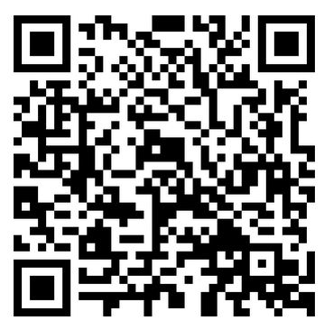
Employability Skills Focus through Design
Teamwork and collaboration
Creative and critical thinking
Problem‑solving
Communication and presenting
Managing time and uncertainty
Based on OpenLearn Create Employability by Design
https://www.open.edu/openlearncreate/course/view.php?id=4763

Slide 5

Purpose of OU Sustainathon
Develop key sustainable employability skills
Work on real briefs from national organisations
Build confidence in teamwork & problem‑solving
Experience they can add to their CV
Organisation get a variety of fresh perspectives on real challenges faced in their organisation
Notes:
Created to connect students with real-world sustainability challenges
Partnerships with charities and organisations (this year’s partners are also part of our EEES industrial board
Students work collaboratively to solve live problems
What participants gained:
Practical experience
Employability skills
Confidence in tackling real issues

Slide 6
OU Sustainathon Approach
Work over a week with a workload of about 8-12 hours (Wednesday until Tuesday)
Work in small, interdisciplinary teams (max 6 students)
Respond to a live sustainability brief (Theme 2026 – Waste)
Define, Brainstorm challenge, and Refine ideas (Design Thinking Approaches)
Share outcomes at the end of the event (Small Presentation)

Slide 7
Activity – Micro Sustainathon
At tables / in breakout rooms:
Review English Heritage Challenge 2025 (5min)
Define the problem (5min)
Brainstorm/ Identify Challenges and areas of Opportunities (5min)
Refine to 3 possible solutions -> Steps, sequence or related actions (5min)

Slide 8
Open University Sustainathon 2025
Katie Wooldridge
Sustainability Learning Lead
Grieg Davies
Environmental Management Lead
18th June 2025

Slide 9
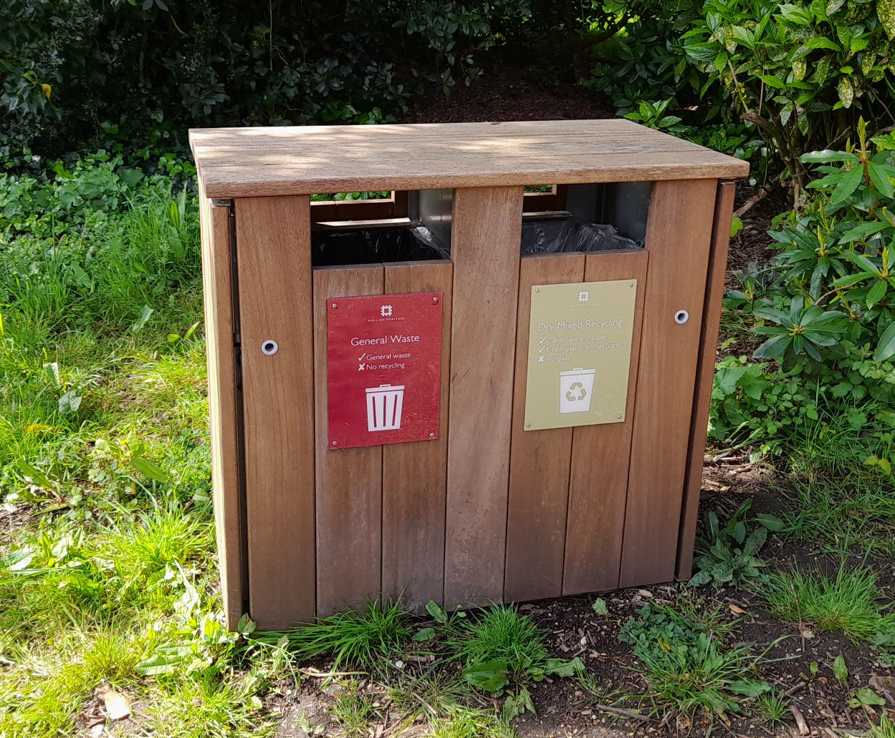
Background
Climate Action Plan 2022-25 70% recycling target (on 2022/23 baseline) and zero waste to landfill.
Currently recycling 54% of our waste and sending 13% to landfill – missing our targets.
We have targets to reduce waste across EH
Notes:
Challenges
We have targets to reduce our waste overall (655 tonnes by half), including reducing general waste, increasing the % of recycling, reducing landfill.
Need to consider actions of staff vs visitors, what influence we have
Mix of visitors mix of generations, with different ideas, understanding, experience, attitudes to waste
Dilemma, provide bins or not
Waste costs money, carbon and the environment

Slide 10
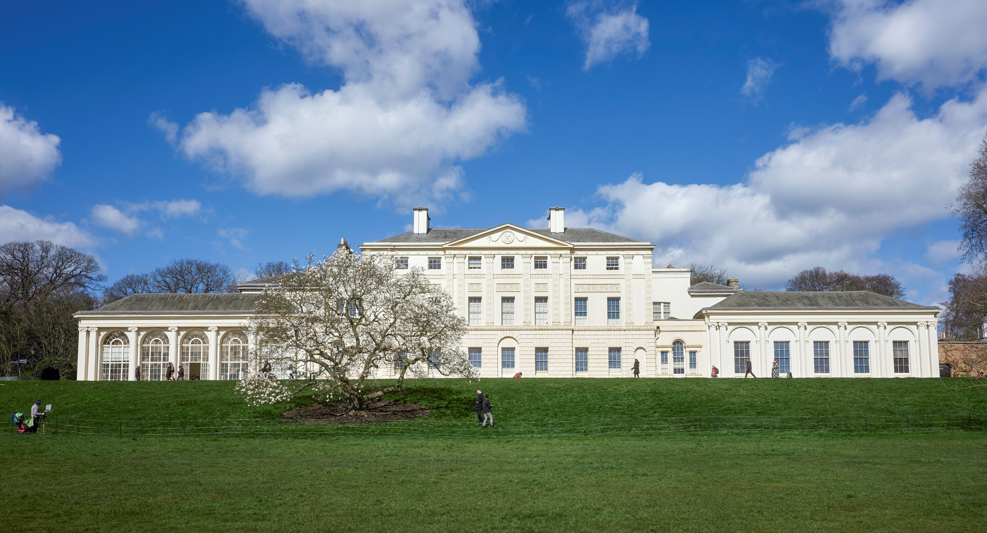
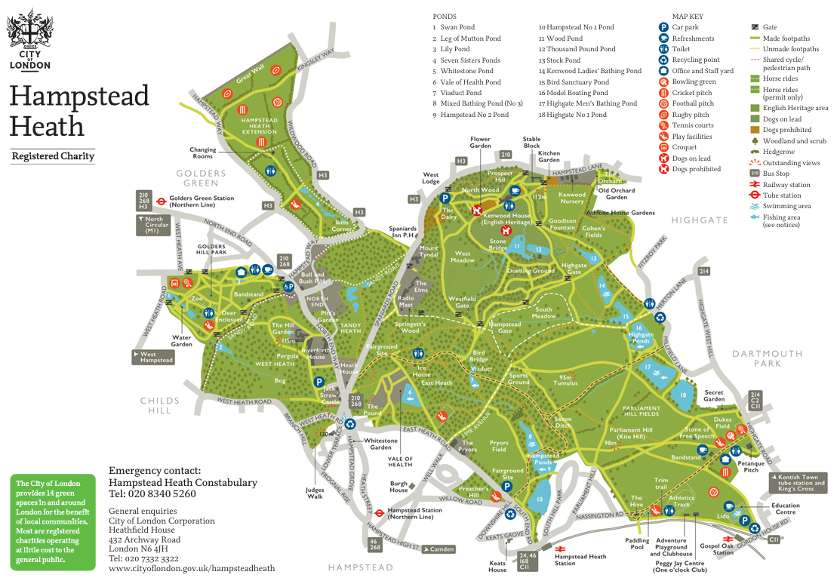
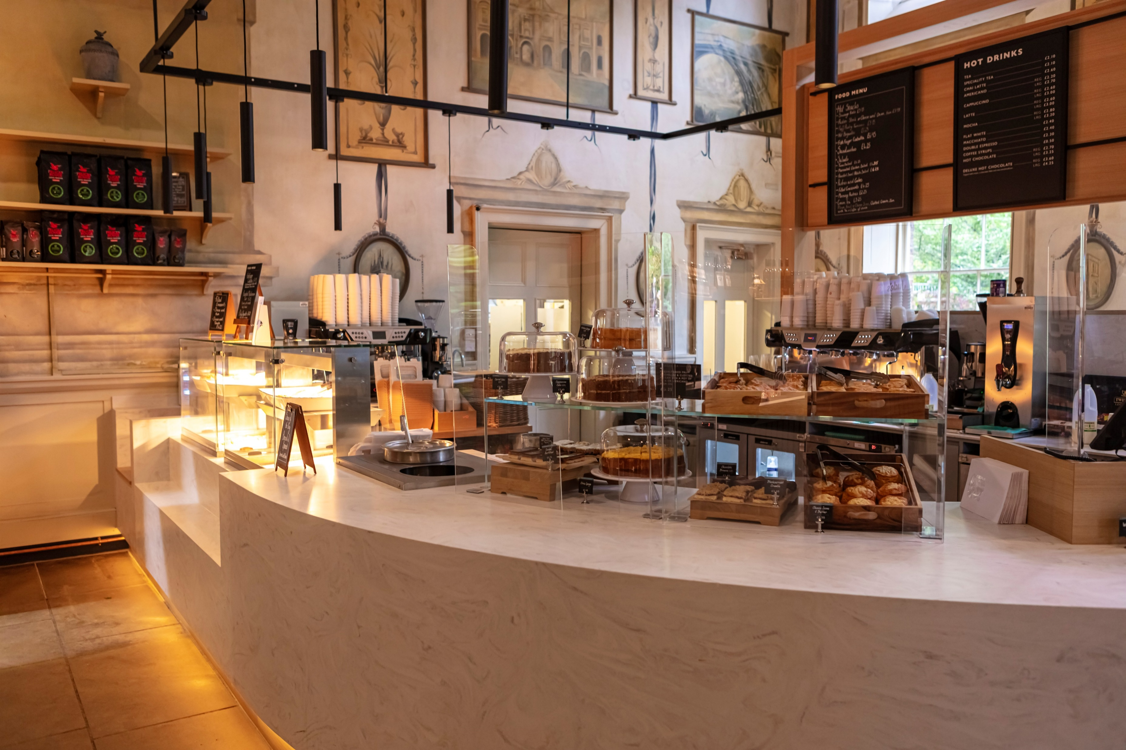
The challenge at Kenwood

Slide 11
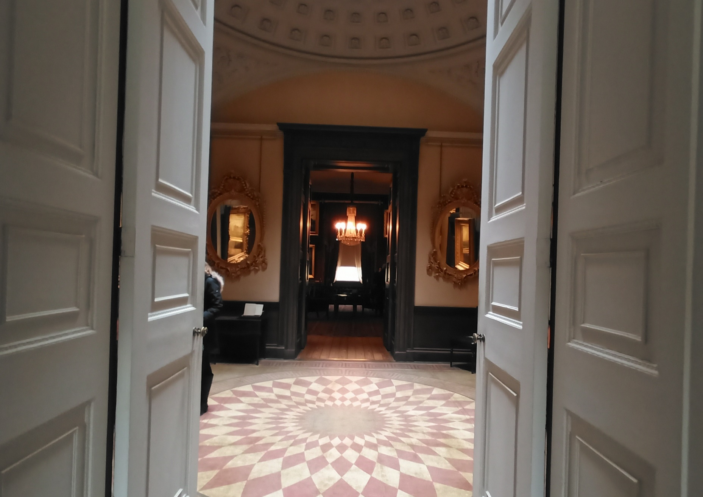
The challenge at Kenwood
Kenwood produces the most waste per year
135 tonnes (70% GW, 30% DMR), 20% of total EH waste
Large successful café/restaurant
Grounds has unrestricted public access
Local dog walkers
Affluent neighbourhood
We need a solution

Slide 12
Define
Brain
Storm
Refine
Activity – Micro Sustainathon
At tables / in breakout rooms:
Define the problem (5min)
Brainstorm/ Identify Challenges and areas of Opportunities (5min)
Refine to 3 possible solutions -> Steps, sequence or related actions (5min)

Slide 13


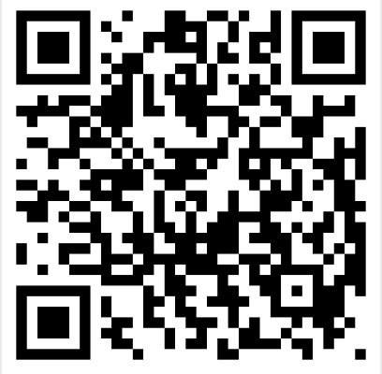
Student Projects

Slide 14
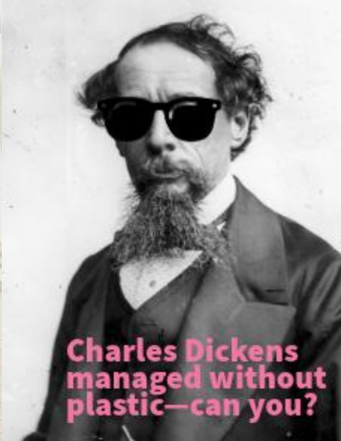
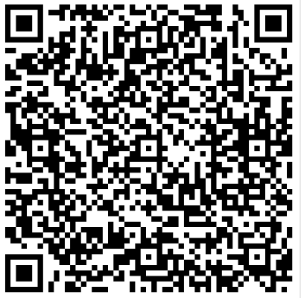
Slide Title 16
What We’ve Learned
Collaboration is key
Real-world context drives engagement
Small interventions can have big impact

Slide 15
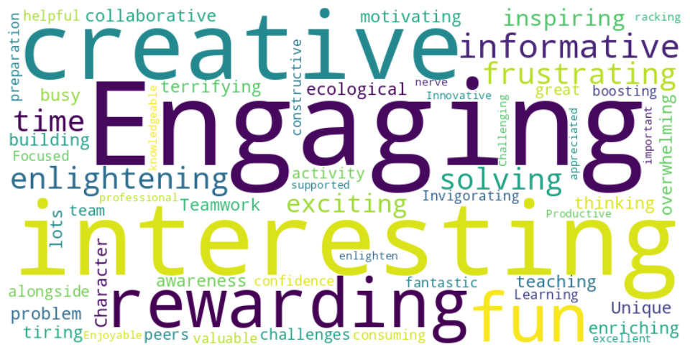
Student Feedback

Slide 16
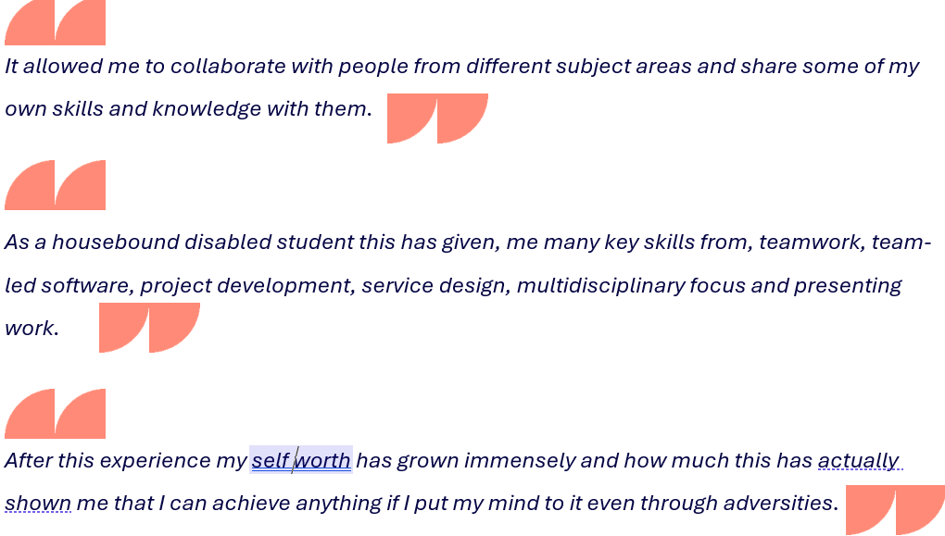
Slide Title 16

Slide 17
Your Sustainathon – Breakout Activity
Embedding sustainability in assessment
Partnering with external organisations
Designing short, high-impact activities
Supporting articulation of employability skills (RSA or other Frameworks)
Overcoming online/distance barriers
How might we create authentic, scalable, discipline-relevant, sustainable opportunities for our students?

Slide 18
Breakout Task (15 min)
In your groups with your selected theme
Identify opportunities (5 min)
Identify constraints (5 min)
Propose one practical idea (5 min)

Slide 19
Breakout Reflections
Connecting Back to OU Sustainathon
Which ideas align with the model?
Which can extend it?
Where can you see new opportunities emerging?

Slide 20
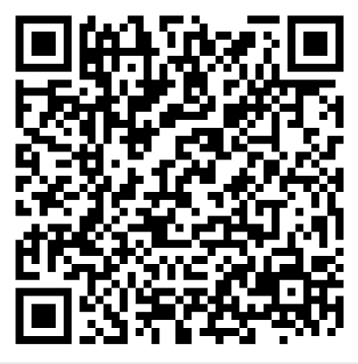
OU Sustainathon Model take-away
Collaborative problem framing
Real-world relevance
Creativity within constraints
Student-centred design
Sustainability as a lived practice
Launch of next OU Sustainathon is on Opportunity Hub
https://opportunityhub.open.ac.uk/students/events/Detail/4917979

Slide 21
Slide Title 30
Thank you

Slide 22
Slide Title 31

