Slide 1

How does it feel to support students with extensions:
The AL experience
eSTEeM Conference 2026
Emma Champion, Rosie Boltryk
With contributions from Anne-Marie Gallen
School of Engineering and Innovation
29th April 2026

Slide 2
Agenda and Aims
Aim of session: to explore ALs’ experiences of managing extensions and the impact extensions have on their workload and personal time.
Agenda:
Introductions
Workshop Part A: Granting extensions
Workshop Part B: Impacts of extensions on ALs

Slide 3
The Project
Project Aim:
Investigate the experiences around extensions for students and ALs on T192 and T194.
Methodology:
Surveyed students and ALs on T192 in 24D and T194 in 23J

Slide 4
Part A: Granting extensions
Activity 1: Scenarios
For discussion:
What would you do as AL in this situation?
What is common practice in this situation?
What else might influence your decision, and in what way?
What does the policy say should happen?
Scenario 1: Received email the day before cut-off “I have not managed to get my TMA01 completed. Would it be possible for me to have an extension so I could get it finished to an acceptable standard?”
Scenario 2: Received email the day before cut-off of the final TMA “I’m so sorry to ask, but would it be possible to have an extension on this TMA? I’ve been really struggling with work being so busy at the moment.”

Slide 5
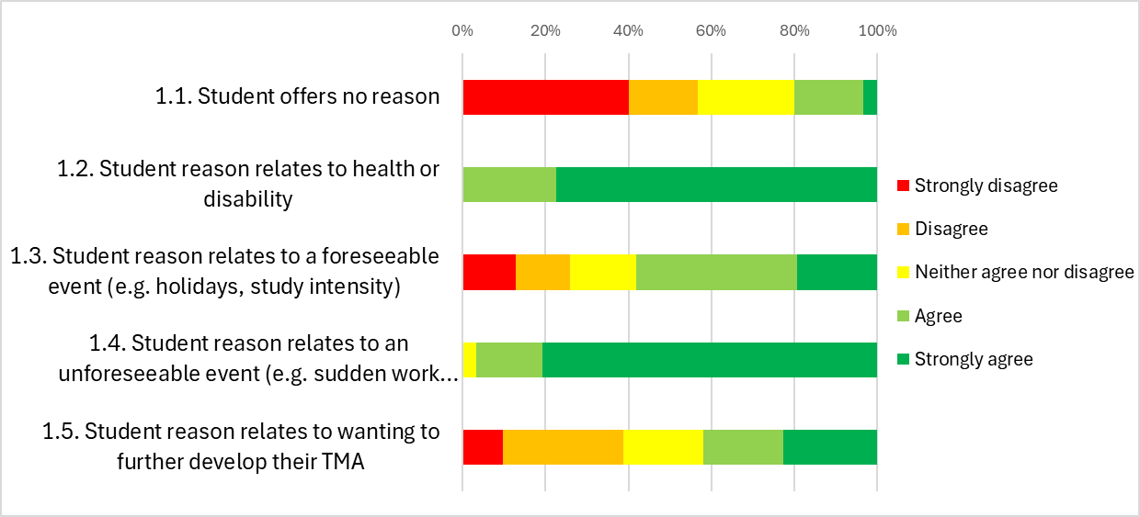
AL survey results:
Reasons for granting extensions
Q1) ALs asked how much they agreed with the following statements:
I am willing to grant extensions where the student offers the following reasons:
Results suggests a more consistent approach to extensions when the reason relates to:
health or disability
an un-foreseeable event
Results suggests a more variable approach to extensions when the reason relates to:
further developing their TMA
a foreseeable event
or when the student gives no reason

Slide 6
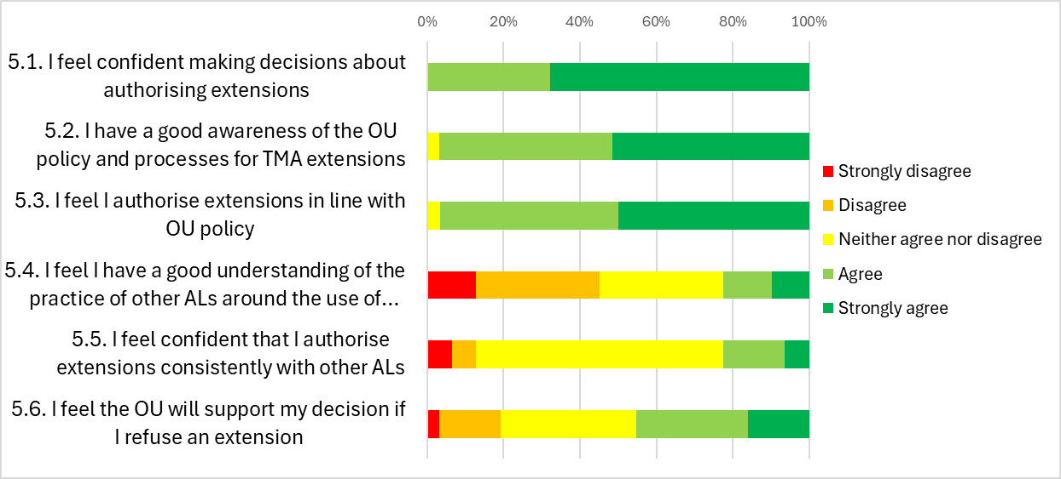
AL survey results:
Confidence in policy and practice
Q5) ALs asked how much they agreed with the following statements:
Results suggests ALs feel confident about:
making decisions about extensions
awareness of policy and processes
setting extensions in line with policy
Results suggests ALs are less confident that they:
understand the practice of other ALs
grant extensions consistently with other ALs
will be supported for refusing an extension

Slide 7
Activity 2
In your tables, discuss these results.
Why are there differences?
Note your thoughts on a Post-it, or in the online chat.
Results suggests a more consistent approach to extensions when the reason relates to: health or disability an un-foreseeable event | Results suggests ALs feel confident about: making decisions about extensions awareness of policy and processes setting extensions in line with policy
Results suggests a more variable approach to extensions when the reason relates to: further developing their TMA a foreseeable event or when the student gives no reason | Results suggests ALs are less confident that they: understand the practice of other ALs grant extensions consistently with other ALs will be supported for refusing an extension

Slide 8
Part B: Impacts of extensions on ALs
As well as policy and practice, this eSTEeM project is also looking at
the impact on ALs of working with extensions
Can you think of examples when the management of extensions significantly impacts :​
An AL's workload or personal time?​
An AL emotionally?

Slide 9
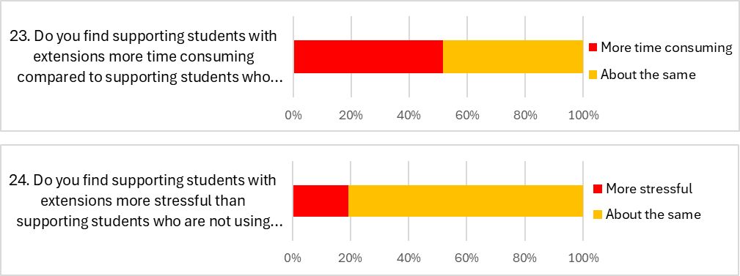
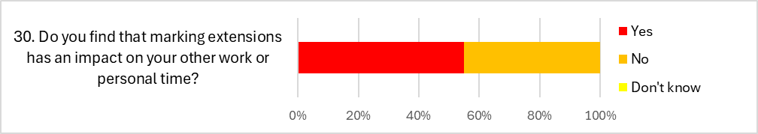
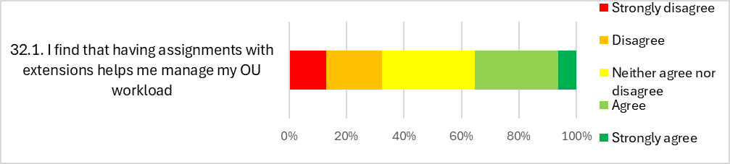
AL survey results:
The impact on ALs
Q23, 24, 30, 32) ALs asked: Do you find [working with extensions]…
23. Do you find supporting students with extensions more time consuming compared to supporting student who are not using extensions?
…time consuming?
52% said more time consuming
48% said about the same
24. Do you find supporting students with extensions more stressful than supporting students who are not using extensions?
…stressful?
19% said more stressful
81% said about the same
…impacts your other work or personal time?
55% said Yes
45% said No
30. Do you find that marking extensions has an impact on your other work or personal time?
…helps you manage my OU workload?
Quite a variation!
32.1. I find that having assignments with extensions helps me manage my OU workload

Slide 10

AL survey results:
Planning my workload is impossible because I cannot plan when the work will come in. In the 3 months of May, June & July, I granted 29 extensions across my modules. This made it very difficult to plan my time or take a break.
The impact on ALs cont.
Free text responses…
One month I had a big batch of marking coming in - at one point we'd planned to take a holiday, I'd kept a week clear, but I had so many extensions that were coming in … that I just said we have to cancel all these plans.
Granting extensions spreads the marking workload beyond the two-week grace period. This is advantageous for me but may not be for other ALs.
With overlapping B, D and J presentations I find organising holidays that do not conflict with marking periods tricky. Extensions narrow the holiday period window further.

Slide 11
Activity 3
In your groups, discuss the following:
Are these impacts visible (to STs)? ​
To what extent do ALs share these impacts? ​
When should ALs share these impacts, or ask for help?
Do you find [working with extensions]…
…time consuming? 52% said more time consuming 48% said about the same | …impacts your other work or personal time? 55% said Yes 45% said No
…stressful? 19% said more stressful 81% said about the same | …helps you manage my OU workload? Quite a variation!

Slide 12
In summary
Final task!
On a Post-it, please share one idea…
What can we do to make things better?
We have discussed:
The consistencies and inconsistencies in the granting of extensions.
The level of confidence ALs have in working with the policy and along side others.
The impact on ALs when working with extensions.

Slide 13
Thank you for participating!
Questions

Slide 14
eSTEeM: How does it feel to have an extension?
Objectives of the session
To empathise with our students
To provide an overview of the project
To explore how we improve our students’ experiences

Slide 15
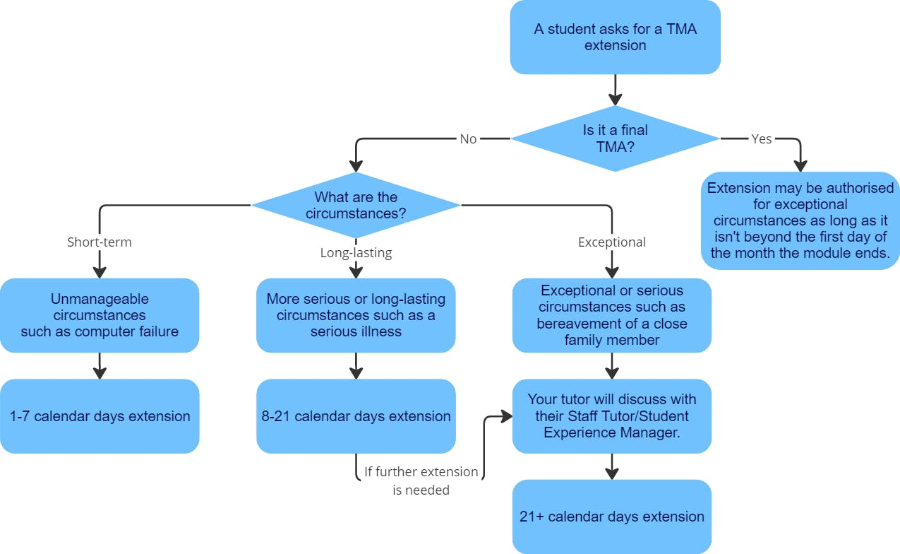
Activity 1 – Reaching out
Student Help Centre Flow Chart
Asking for an extension to your assignment deadline | Help Centre

Slide 16
Activity 1 – Reaching out
Scenario 1
Scenario 2
You’re studying your first module with the OU. You work fulltime and have a family and you have really struggled to keep up with the work. You are now about three weeks behind. Your TMA deadline is in 3 days and you’ve only just looked at the TMA and realised you won’t be able to get it submitted on time. You’ve looked at the guidance on the Student Help Centre.
You have decided to contact your tutor.
You have enjoyed your level 1 study with the OU, but you are privately finding the maths content on your current module incredibly challenging. This is affecting your engagement with the module – procrastination has set in and you are about two weeks behind. You have a TMA cut-off in a couple of days and are feeling very anxious.
You have decided to contact your tutor.
Pick one of the scenarios and try to empathise with the student.
Your task is to draft an email to your tutor (3 mins).
Share your observations and reflections in undertaking this task.

Slide 17
The Project
Project Aim:
Investigate the experiences around extensions for students and ALs on T192 and T194.
Objective:
1. Investigate the link between the use of extensions, the experience of students on the module, and retention.

Slide 18
Background
Previous scholarship has shown:
Students with extensions are more likely to withdraw or achieve lower grades.
Extensions are used by a higher proportion of students within EDIA groups.
Use of extensions on T192, T193 and T194 (from 18J to 21J)
Percentage of assignments with an extension
T192: 9%
T193: 19%
T194: 20%

Slide 19
Activity 2 – The extension journey
Try to empathise with our students.
What thoughts and feelings do you think emerged?
Before asking for an extension
Once it is granted
Working towards TMA submission
Catching-up

Slide 20
Methodology
Examples of survey questions
Tell us how much you agree with the following statements. [Likert scale]
I felt confident asking for an extension
I found asking for an extension stressful
I felt able to be open with my tutor about my reason for needing an extension
Etc.
When catching up, I might use the following activities: [Likert scale]
Attending live online tutorials
Talking to my tutor
Talking to the Student Support Team
Etc.
Students have been asked about their experiences via student surveys and interviews
 | T192 24D | T194 23J
Survey - Phase 1 | 42 (8%) | 25 (7%)
Survey – Phase 2 | 33 (10%) | 30 (9%)
Interview | 2 | 4
We are also undertaking:
Quantitative data analysis of who are using extensions and their outcomes
Qualitative and quantitative data from AL surveys about managing extensions

Slide 21
Some quotes from our students... (1)
Before asking for an extension
2. Once it is granted
Personal/domestic issues causing extra stress.
It allowed me time and breathing space to get back on top of things.
Family emergency
Workloads - major engineering breakdown at work.
Having the extension did take pressure off…
Death of an immediate family member
Without the extension I would have done worse in the assignment …not fully understand the module and it would have been highly stressful.
I felt like it was a failure, not a failure, but it was a let down for myself.

Slide 22
Some quotes from our students... (2)
3. Working towards TMA submission
4. Catching up
I think I surprised myself, after I actually took the extension and just got on with it
I kept thinking I could so easily just walk away at this point.
TMA02...it was a catastophe
I simply gave up...
And so by the end of the TMA, I often would have like a little reprieve.
I did kind of feel like, oh, maybe I'm bit of a failure. Maybe this isn't right for me.
…you've got to kind of have a bit of resilience and just try and persevere…

Slide 23
Activity 3 – Moving forward
Whatever your role, consider your own experience of working with extensions.
Share what is happening in your own area or modules related to extension requests and improving the experience of students who use or would benefit from extensions.
What else could be done to improve the experience for our students?

Slide 24
Thank you for participating!
Questions

